Slide 1
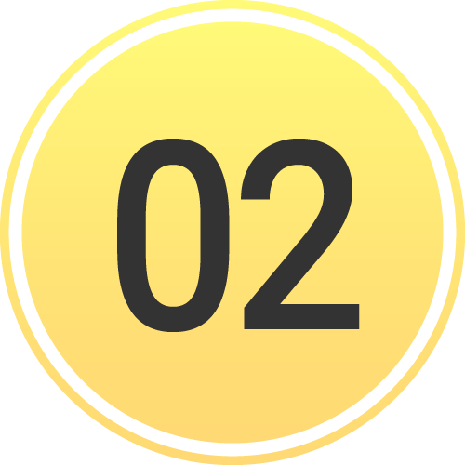
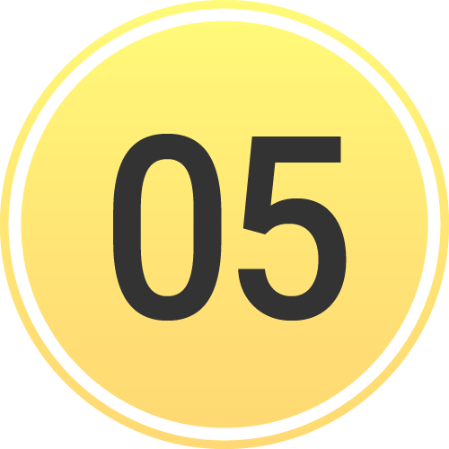
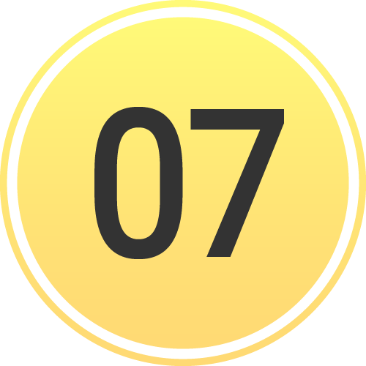
INCIDENTS | Participate & Join Incident
Patients Screen
This is what you will use daily
View your patients under My Patients
Incidents Screen
This screen groups patient channels under one Incident
Offers additional Incident functionality and workflows
To open, tap the Navigation Menu, then tap Incidents
Identify and Work within Correct Incident
Participating shows Incidents you have joined
Tap incident to open
Join an Incident shows other Incidents in your area
Nearby Incidents
Tap Join to join an Incident
Notes:
Let’s discuss the difference between the Patients screen and the Incidents screen, and help you identify and work within the correct incident.
For everyday routine cases, you’ll use the Patients screen. This screen defaults to the My Patients view, which shows you all the patient channels you are participating in. The Incidents screen, on the other hand, groups patient channels by incident.
To see active incidents in your area, tap the navigation menu in the upper left-hand corner, then tap Incidents. This opens the Incidents screen. Here, you can access all incidents you are participating in, and view or join nearby incidents in your region.
It is important to identify and work within the correct incident. The screen defaults to the list of incidents you’re participating in. If you find the incident you are working on, simply tap on it to open. If you don’t see the appropriate incident, tap “Join an Incident.” This will list all nearby incidents. When you find the correct incident, tap “Join.”

Slide 2
INCIDENTS | Participate & Join Incident
Patients Screen
This is what you will use daily
View your patients under My Patients
Notes:
For everyday routine cases, you’ll use the Patients screen. This screen defaults to the My Patients view, which shows you all the patient channels you are participating in.

Slide 3
INCIDENTS | Participate & Join Incident
Patients Screen
This is what you will use daily
View your patients under My Patients
Incidents Screen
This screen groups patient channels under one Incident
Offers additional Incident functionality and workflows
Notes:
The Incidents screen, on the other hand, groups patient channels by incident, and offers additional functionality and workflows for incidents.

Slide 4
INCIDENTS | Participate & Join Incident
Patients Screen
This is what you will use daily
View your patients under My Patients
Incidents Screen
This screen groups patient channels under one Incident
Offers additional Incident functionality and workflows
To open, tap the Navigation Menu
Notes:
To see active incidents in your area, tap the navigation menu in the upper left-hand corner,

Slide 5
INCIDENTS | Participate & Join Incident
Patients Screen
This is what you will use daily
View your patients under My Patients
Incidents Screen
This screen groups patient channels under one Incident
Offers additional Incident functionality and workflows
To open, tap the Navigation Menu, then tap Incidents
Notes:
Then tap Incidents.

Slide 6
INCIDENTS | Participate & Join Incident
Patients Screen
This is what you will use daily
View your patients under My Patients
Incidents Screen
This screen groups patient channels under one Incident
Offers additional Incident functionality and workflows
To open, tap the Navigation Menu, then tap Incidents
Notes:
This opens the Incidents screen. Here, you can access all incidents you are participating in, and view or join nearby incidents in your region.

Slide 7
INCIDENTS | Participate & Join Incident
Patients Screen
This is what you will use daily
View your patients under My Patients
Incidents Screen
This screen groups patient channels under one Incident
Offers additional Incident functionality and workflows
To open, tap the Navigation Menu, then tap Incidents
Identify and Work within Correct Incident
Notes:
It’s important to identify and work within the correct incident.

Slide 8
INCIDENTS | Participate & Join Incident
Patients Screen
This is what you will use daily
View your patients under My Patients
Incidents Screen
This screen groups patient channels under one Incident
Offers additional Incident functionality and workflows
To open, tap the Navigation Menu, then tap Incidents
Identify and Work within Correct Incident
Participating shows Incidents you have joined
Notes:
The screen defaults to the list of incidents you’re participating in.

Slide 9
INCIDENTS | Participate & Join Incident
Patients Screen
This is what you will use daily
View your patients under My Patients
Incidents Screen
This screen groups patient channels under one Incident
Offers additional Incident functionality and workflows
To open, tap the Navigation Menu, then tap Incidents
Identify and Work within Correct Incident
Participating shows Incidents you have joined
Tap incident to open
Notes:
If you find the incident you are working on, simply tap on it to open.

Slide 10
INCIDENTS | Participate & Join Incident
Patients Screen
This is what you will use daily
View your patients under My Patients
Incidents Screen
This screen groups patient channels under one Incident
Offers additional Incident functionality and workflows
To open, tap the Navigation Menu, then tap Incidents
Identify and Work within Correct Incident
Participating shows Incidents you have joined
Tap incident to open
Join an Incident shows other Incidents in your area
Nearby Incidents
Notes:
If you don’t see the appropriate incident, tap “Join an Incident.” This will list all nearby incidents.

Slide 11
INCIDENTS | Participate & Join Incident
Patients Screen
This is what you will use daily
View your patients under My Patients
Incidents Screen
This screen groups patient channels under one Incident
Offers additional Incident functionality and workflows
To open, tap the Navigation Menu, then tap Incidents
Identify and Work within Correct Incident
Participating shows Incidents you have joined
Tap incident to open
Join an Incident shows other Incidents in your area
Nearby Incidents
Tap Join to join an Incident
Notes:
When you find the correct incident, tap “Join.”

Slide 12
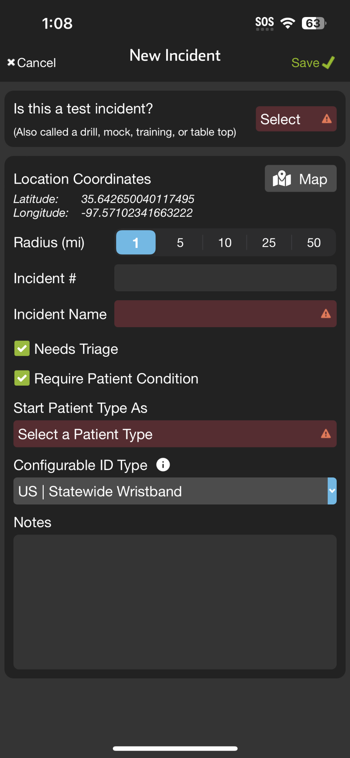
INCIDENTS | Create New Incident
Create New Incident
If not already participating or nearby
Tap + Incident
Select Test vs Real
Set Location
Defaults to current, Tap Map to adjust
Set Radius
Organizations can Join and Add Patients
Name Incident
Set Default Patient Channels
Triage Card / Require Condition
Patient Type
Configurable ID
US | Statewide Wristband or State Specific
All joining organizations “inherit” for interoperability
Save
Notes:
Let’s review how to create a new incident.
First, if you don’t see the appropriate incident in “Participating” or “Join an Incident,” you need to tap “Add Incident.” This will bring up a form that you will need to fill out.
Start by indicating whether this is a real or test incident. Next, set the location of the incident. The location will default to your current position, but you can tap the map to adjust it if necessary.
After setting the location, you will need to define the radius. Organizations within this radius will be able to see the incident, join it, and add patients. However, they will not be able to see the summary screen or any patients they don’t create unless you grant them these privileges. This process is covered in the “Manage Entities” section.
You will then name your incident and set your default patient channels. Selecting “Needs Triage” adds the triage card, and you can choose whether to require patient condition upon channel creation. Next, you will select your default patient type.
Finally, you need to set your Configurable ID type. Most locations will use “US | Statewide Wristband,” but some will have their state or region-specific barcode. Note that all organizations that join the incident will inherit this Configurable ID to ensure interoperability.
Make sure to save this form. After saving, ensure you are working within the incident to simplify your workflows.

Slide 13
INCIDENTS | Create New Incident
Create New Incident
If not already participating or nearby
Tap + Incident
Notes:
First, if you don’t see the appropriate incident in “Participating” or “Join an Incident,” you need to tap “Add Incident.”

Slide 14
INCIDENTS | Create New Incident
Create New Incident
If not already participating or nearby
Tap + Incident
Notes:
This will bring up a form that you will need to fill out.

Slide 15
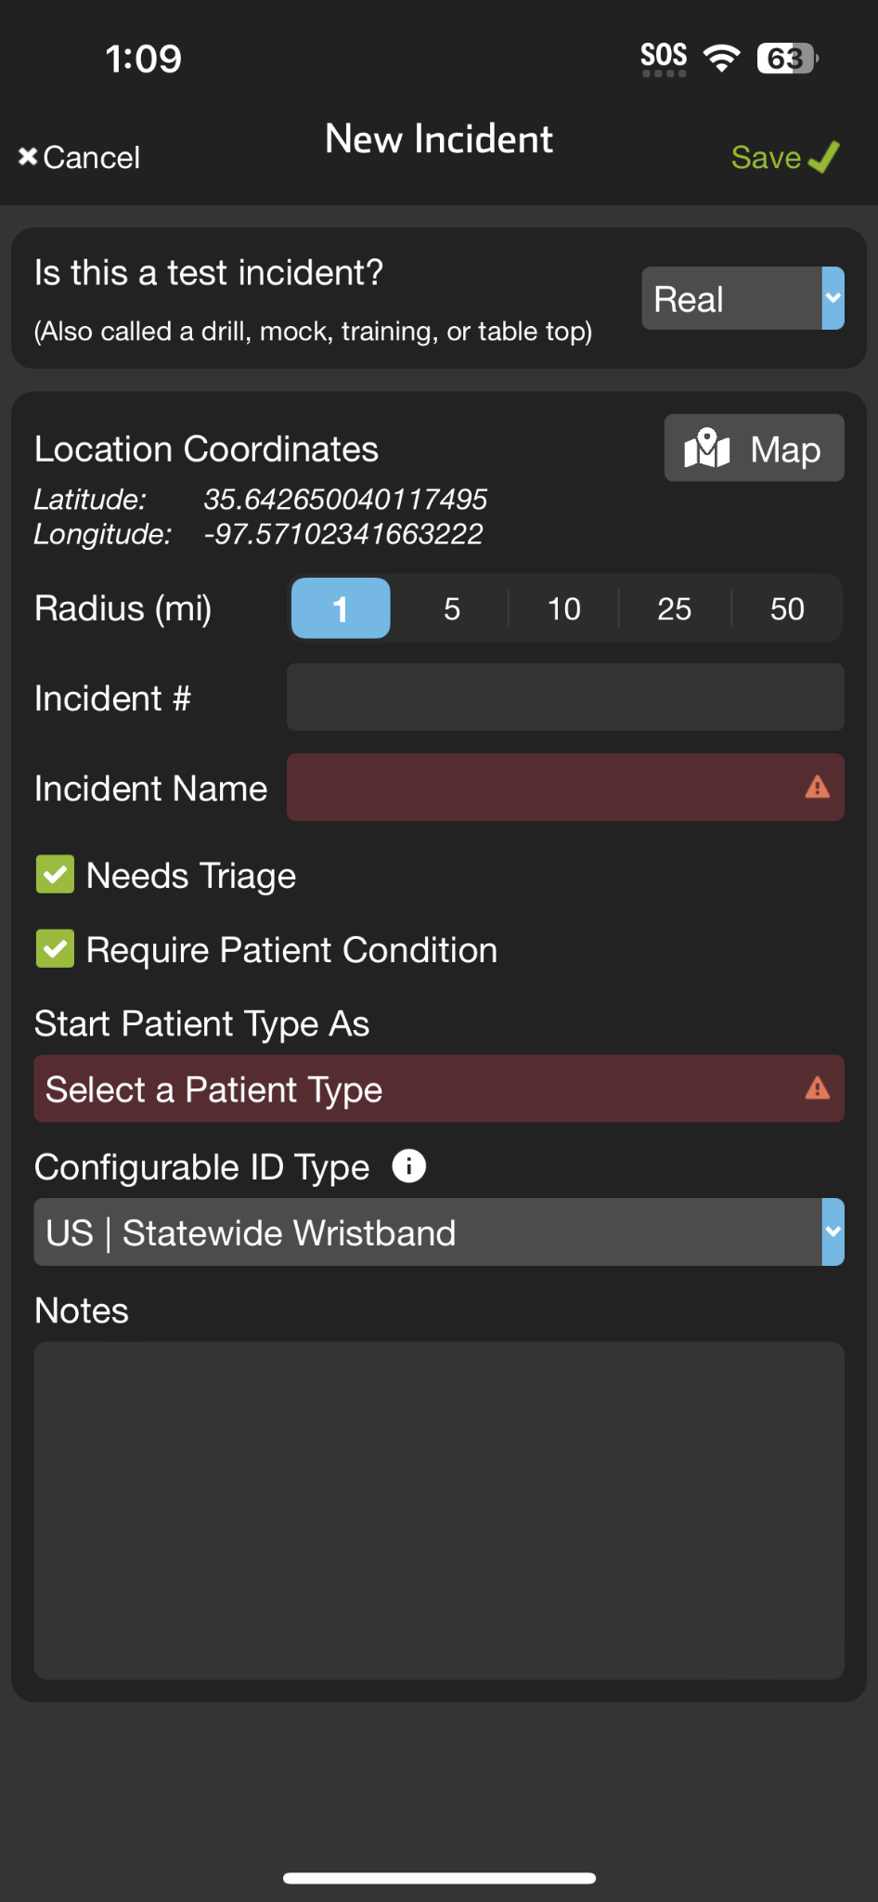
INCIDENTS | Create New Incident
Create New Incident
If not already participating or nearby
Tap + Incident
Select Test vs Real
Notes:
Start by indicating whether this is a real or test incident.

Slide 16
INCIDENTS | Create New Incident
Create New Incident
If not already participating or nearby
Tap + Incident
Select Test vs Real
Set Location
Defaults to current, Tap Map to adjust
Notes:
Next, set the location of the incident. The location will default to your current position, but you can tap the map to adjust it if necessary.

Slide 17
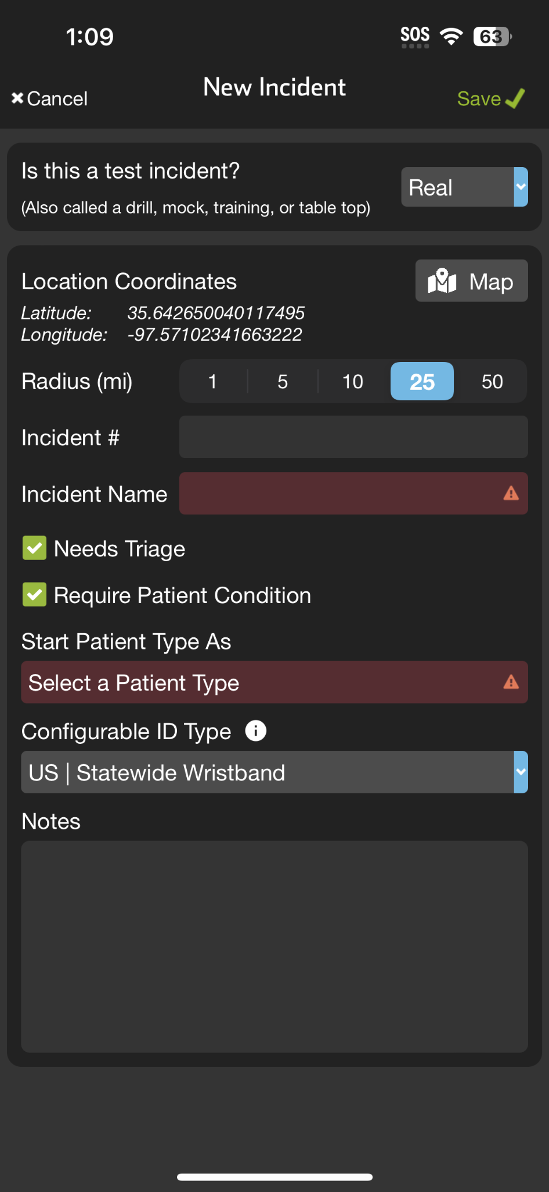
INCIDENTS | Create New Incident
Create New Incident
If not already participating or nearby
Tap + Incident
Select Test vs Real
Set Location
Defaults to current, Tap Map to adjust
Set Radius
Organizations can Join and Add Patients
Notes:
After setting the location, you will need to define the radius. Organizations within this radius will be able to see the incident, join it, and add patients. However, they will not be able to see the summary screen or any patients they don’t create unless you grant them these privileges. This process is covered in the “Manage Entities” section.

Slide 18
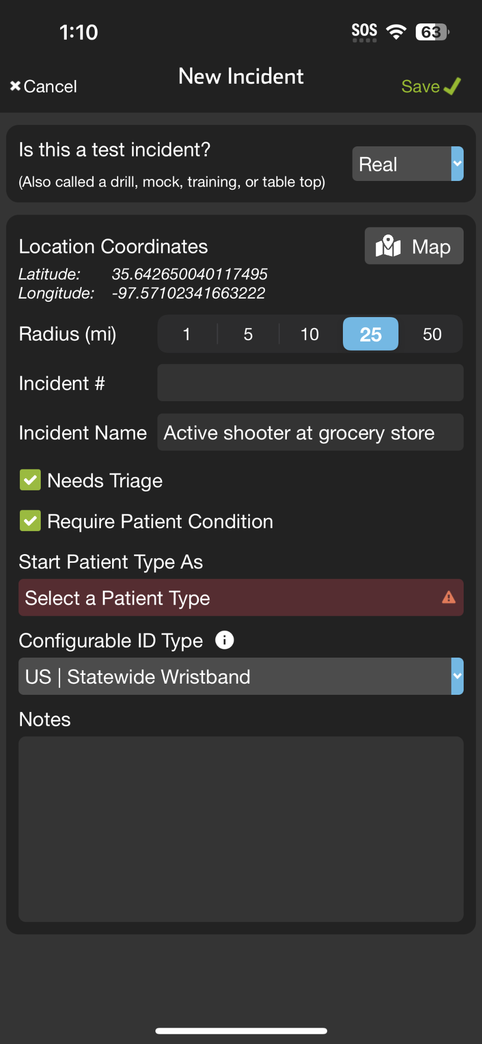
INCIDENTS | Create New Incident
Create New Incident
If not already participating or nearby
Tap + Incident
Select Test vs Real
Set Location
Defaults to current, Tap Map to adjust
Set Radius
Organizations can Join and Add Patients
Name Incident
Notes:
You will then name your incident

Slide 19
INCIDENTS | Create New Incident
Create New Incident
If not already participating or nearby
Tap + Incident
Select Test vs Real
Set Location
Defaults to current, Tap Map to adjust
Set Radius
Organizations can Join and Add Patients
Name Incident
Set Default Patient Channels
Triage Card / Require Condition
Notes:
and set your default patient channels. Selecting “Needs Triage” adds the triage card, and you can choose whether to require patient condition upon channel creation.

Slide 20
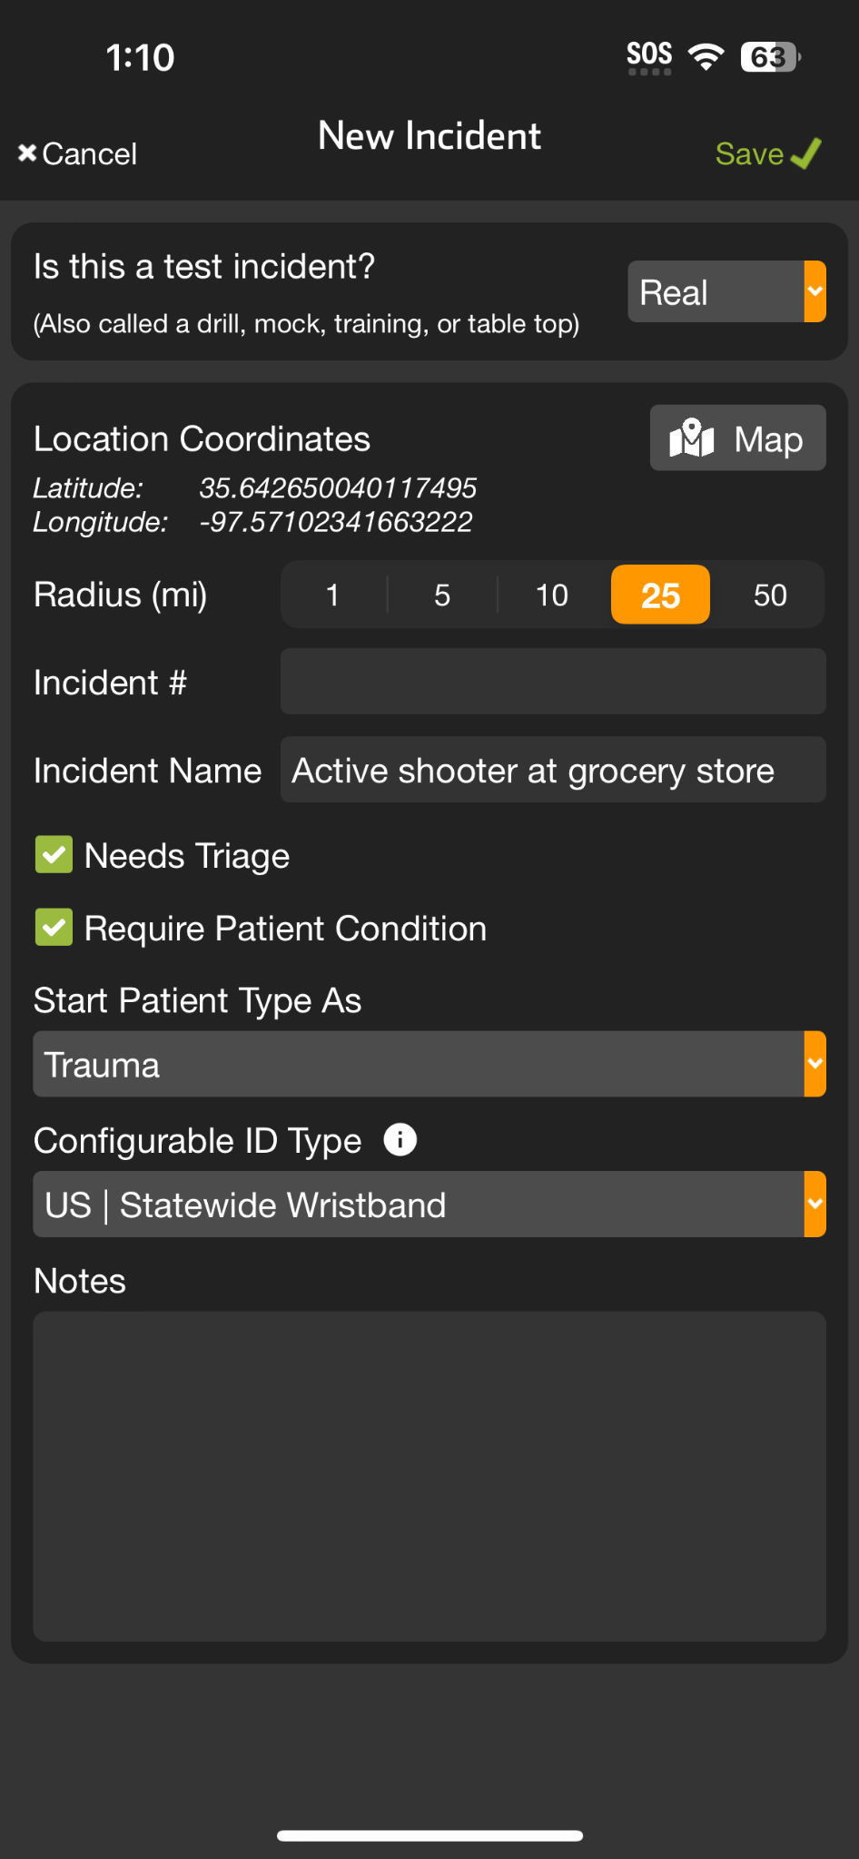
INCIDENTS | Create New Incident
Create New Incident
If not already participating or nearby
Tap + Incident
Select Test vs Real
Set Location
Defaults to current, Tap Map to adjust
Set Radius
Organizations can Join and Add Patients
Name Incident
Set Default Patient Channels
Triage Card / Require Condition
Patient Type
Notes:
Next, you select your default patient type.

Slide 21
INCIDENTS | Create New Incident
Create New Incident
If not already participating or nearby
Tap + Incident
Select Test vs Real
Set Location
Defaults to current, Tap Map to adjust
Set Radius
Organizations can Join and Add Patients
Name Incident
Set Default Patient Channels
Triage Card / Require Condition
Patient Type
Configurable ID
US | Statewide Wristband or State Specific
All joining organizations “inherit” for interoperability
Notes:
Finally, you need to set your Configurable ID type. Most locations will use “US | Statewide Wristband,” but some will have their state or region-specific barcode. Note that all organizations that join the incident will inherit this Configurable ID to ensure interoperability.

Slide 22
INCIDENTS | Create New Incident
Create New Incident
If not already participating or nearby
Tap + Incident
Select Test vs Real
Set Location
Defaults to current, Tap Map to adjust
Set Radius
Organizations can Join and Add Patients
Name Incident
Set Default Patient Channels
Triage Card / Require Condition
Patient Type
Configurable ID
US | Statewide Wristband or State Specific
All joining organizations “inherit” for interoperability
Save
Notes:
Make sure to save this form.

Slide 23
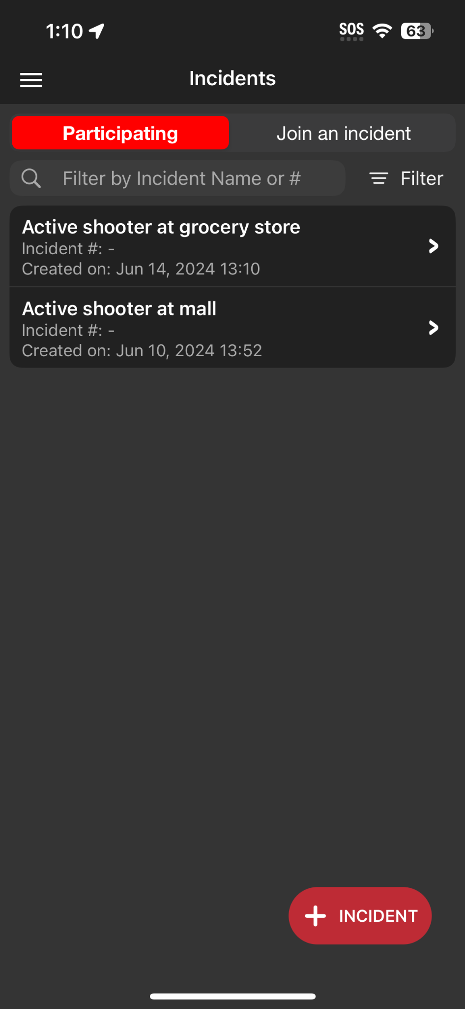
INCIDENTS | Create New Incident
Create New Incident
If not already participating or nearby
Tap + Incident
Select Test vs Real
Set Location
Defaults to current, Tap Map to adjust
Set Radius
Organizations can Join and Add Patients
Name Incident
Set Default Patient Channels
Triage Card / Require Condition
Patient Type
Configurable ID
US | Statewide Wristband or State Specific
All joining organizations “inherit” for interoperability
Save
Notes:
After saving, ensure you are working within the incident to simplify your workflows.

Slide 24
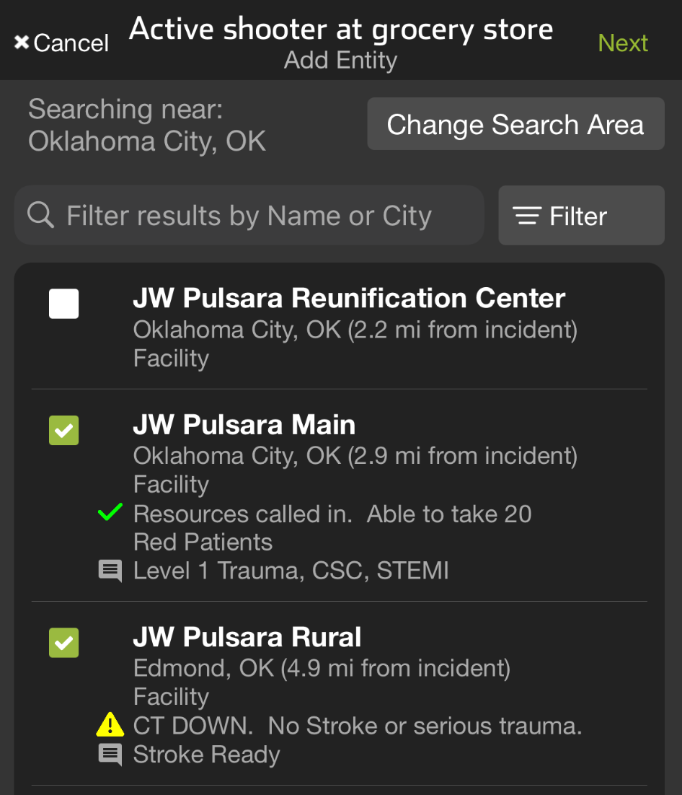
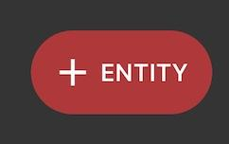
INCIDENTS | Manage Entities
Tap Entities
View Participating Entities
And their privileges
Tap + Entity
Select Entity(s)
Grant / Edit Privileges
View Incident Summary
View All Incident Patients (and Patient Data)
Save
Notes:
Let’s go over how the incident owner can manage entities and grant or edit their privileges.
To begin, go to your main active incident screen and tap Entities. This will show you the participating entities and their current privileges.
If you need to add additional entities, tap Add Entity. Entities are initially listed by geolocation, but you can change the search area, apply filters, or search for entities on the Pulsara Network. Once you have selected the desired entities, tap Next.
At this point, you can grant privileges. You can allow entities to view the incident summary, which contains no patient information, or grant them access to view all incident patients and the data in the patient channels. Examples for this level of access might be an Incident Co-Owner or a Reunification Center.
Make sure to click Save when you are done. As the incident owner, you can always edit or remove these privileges at any time.

Slide 25
INCIDENTS | Manage Entities
Tap Entities
Notes:
To begin, go to your main active incident screen and tap Entities.

Slide 26
INCIDENTS | Manage Entities
Tap Entities
View Participating Entities
And their privileges
Notes:
This will show you the participating entities and their current privileges.

Slide 27
INCIDENTS | Manage Entities
Tap Entities
View Participating Entities
And their privileges
Tap + Entity
Notes:
If you need to add additional entities, tap Add Entity.

Slide 28
INCIDENTS | Manage Entities
Tap Entities
View Participating Entities
And their privileges
Tap + Entity
Select Entity(s)
Notes:
Entities are initially listed by geolocation

Slide 29
INCIDENTS | Manage Entities
Tap Entities
View Participating Entities
And their privileges
Tap + Entity
Select Entity(s)
Notes:
but you can change the search area, apply filters, or search for entities on the Pulsara Network.

Slide 30
INCIDENTS | Manage Entities
Tap Entities
View Participating Entities
And their privileges
Tap + Entity
Select Entity(s)
Notes:
Once you have selected the desired entities

Slide 31
INCIDENTS | Manage Entities
Tap Entities
View Participating Entities
And their privileges
Tap + Entity
Select Entity(s)
Notes:
tap Next…

Slide 32
INCIDENTS | Manage Entities
Tap Entities
View Participating Entities
And their privileges
Tap + Entity
Select Entity(s)
Grant / Edit Privileges
View Incident Summary
View All Incident Patients (and Patient Data)
Notes:
At this point, you can grant privileges. You can allow entities to view the incident summary, which contains no patient information, or grant them access to view all incident patients and the data in the patient channels. Examples for this level of access might be an Incident Co-Owner or a Reunification Center.

Slide 33
INCIDENTS | Manage Entities
Tap Entities
View Participating Entities
And their privileges
Tap + Entity
Select Entity(s)
Grant / Edit Privileges
View Incident Summary
View All Incident Patients (and Patient Data)
Save
Notes:
Make sure to click Save when you are done. As the incident owner, you can always edit or remove these privileges at any time.

Slide 34
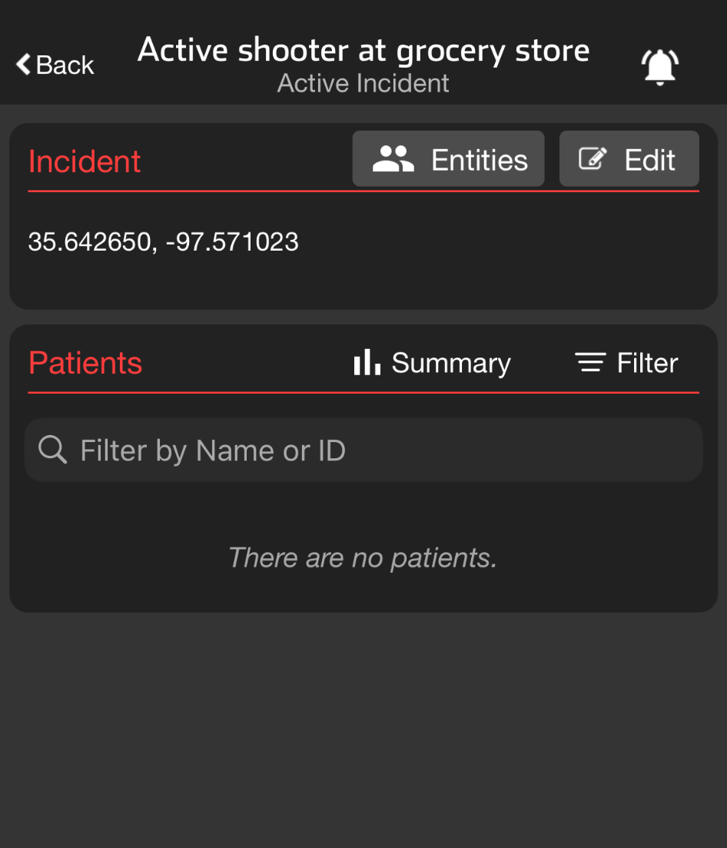
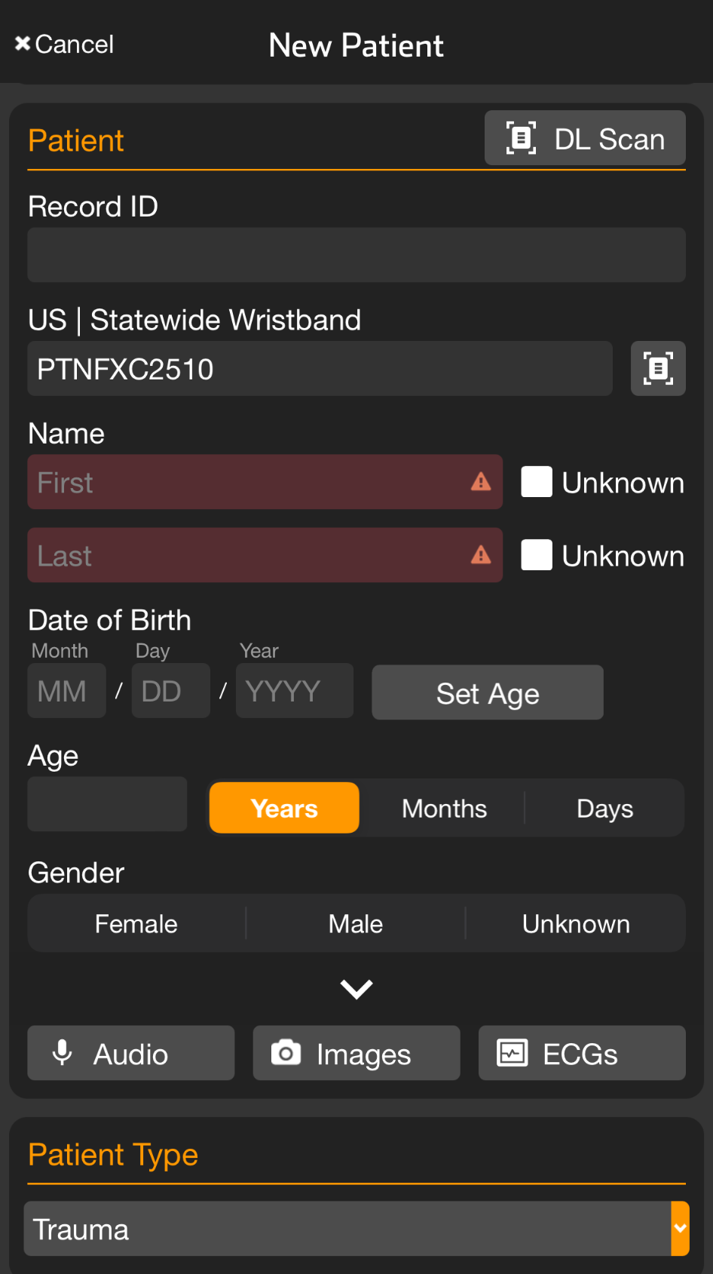
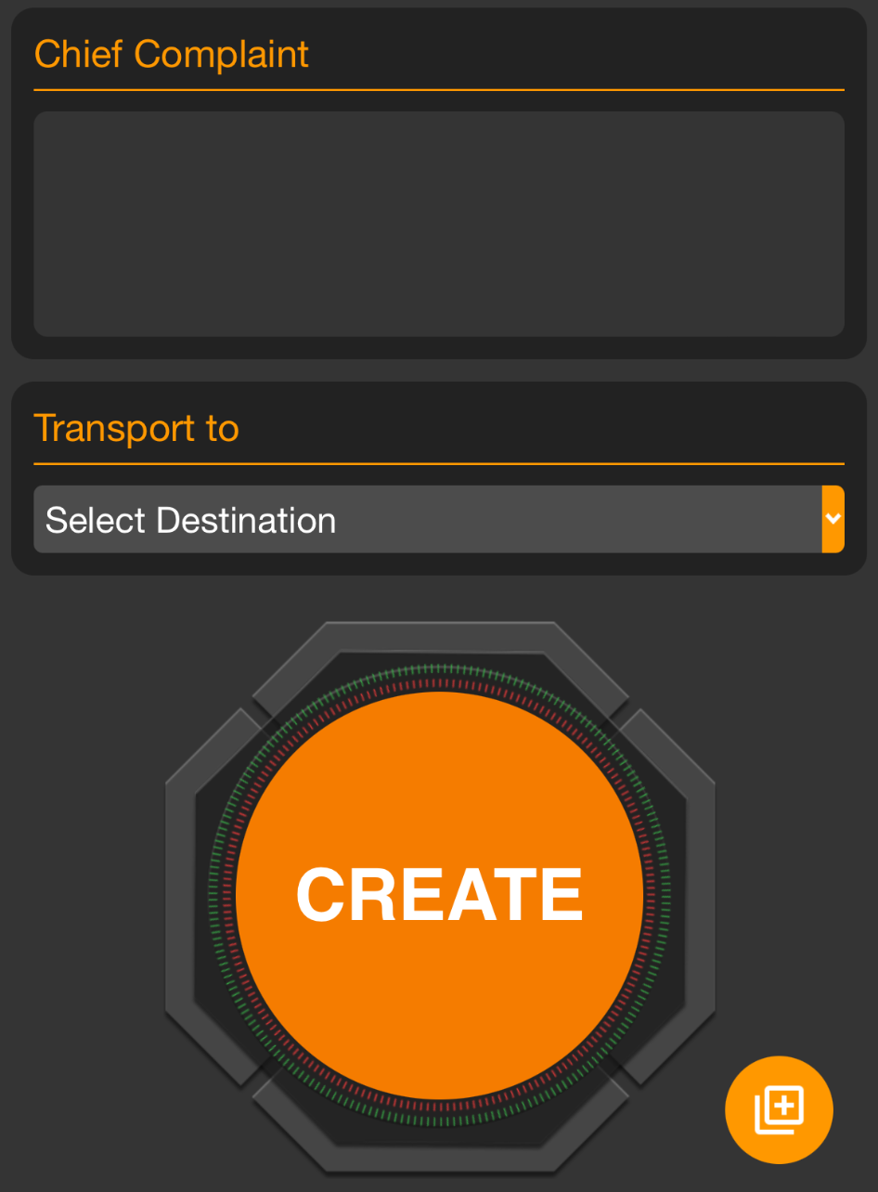
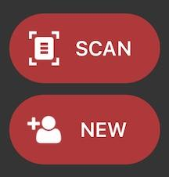
INCIDENTS | Add Patient
Note: All patient information can be added at any time, before or after patient creation.
Apply and Scan Wristband
Scan wristband to add a patient
Adding patients by tapping NEW increases the risk of a duplicate
Set Triage Condition (Color)
Add Patient Demographics
Scan driver’s license (DL), or enter manually
Rapid: Unknown name, estimated Age, Gender
Take Photos (Optional)
Face, injury, DL, belongings, family member, etc.
Chief Complaint (Optional)
Use voice-to-text to describe major injury, vitals, intervention
Create Patient
If you Select Destination prior to hitting Create, you can immediately alert the receiving facility
Quick Add
Scan Wristband
Triage Color
Unknown
Create
Notes:
Let’s talk about how to add patients to an incident.
Begin by applying a wristband to the patient and tapping Scan. Although you can tap New to create a new patient, this increases the risk of creating duplicate patients.
Next, set the patient’s triage condition and enter their demographics. You can enter demographics by scanning their driver’s license or entering the information manually. If the patient’s name is unknown, simply tap Unknown. While not required, it is helpful to enter an estimated age and gender.
If time permits, it is also beneficial to add photos of the patient’s face for identification, any injuries they may have, and other details you might be able to capture with the camera.
Additionally, if you have time, use the voice-to-text feature to quickly summarize the major injuries, vital signs, and important interventions in the chief complaint or narrative field.
To save this patient channel, tap Create. Alternatively, if you are immediately transporting the patient, you can select the destination to alert the receiving facility.
When rapidly triaging multiple patients, you can scan the wristband, set the triage color, tap Unknown for the name, and then tap Create.
In many regions, colored tape is applied to the wristband as a visual indicator on the patient of the triage condition.

Slide 35
INCIDENTS | Add Patient
Note: All patient information can be added at any time, before or after patient creation.
Apply and Scan Wristband
Scan wristband to add a patient
Adding patients by tapping NEW increases the risk of a duplicate
Notes:
Begin by applying a wristband to the patient and tapping Scan. Although you can tap New to create a new patient, this increases the risk of creating duplicate patients.

Slide 36
INCIDENTS | Add Patient
Note: All patient information can be added at any time, before or after patient creation.
Apply and Scan Wristband
Scan wristband to add a patient
Adding patients by tapping NEW increases the risk of a duplicate
Set Triage Condition (Color)
Notes:
Next, set the patient’s triage condition

Slide 37
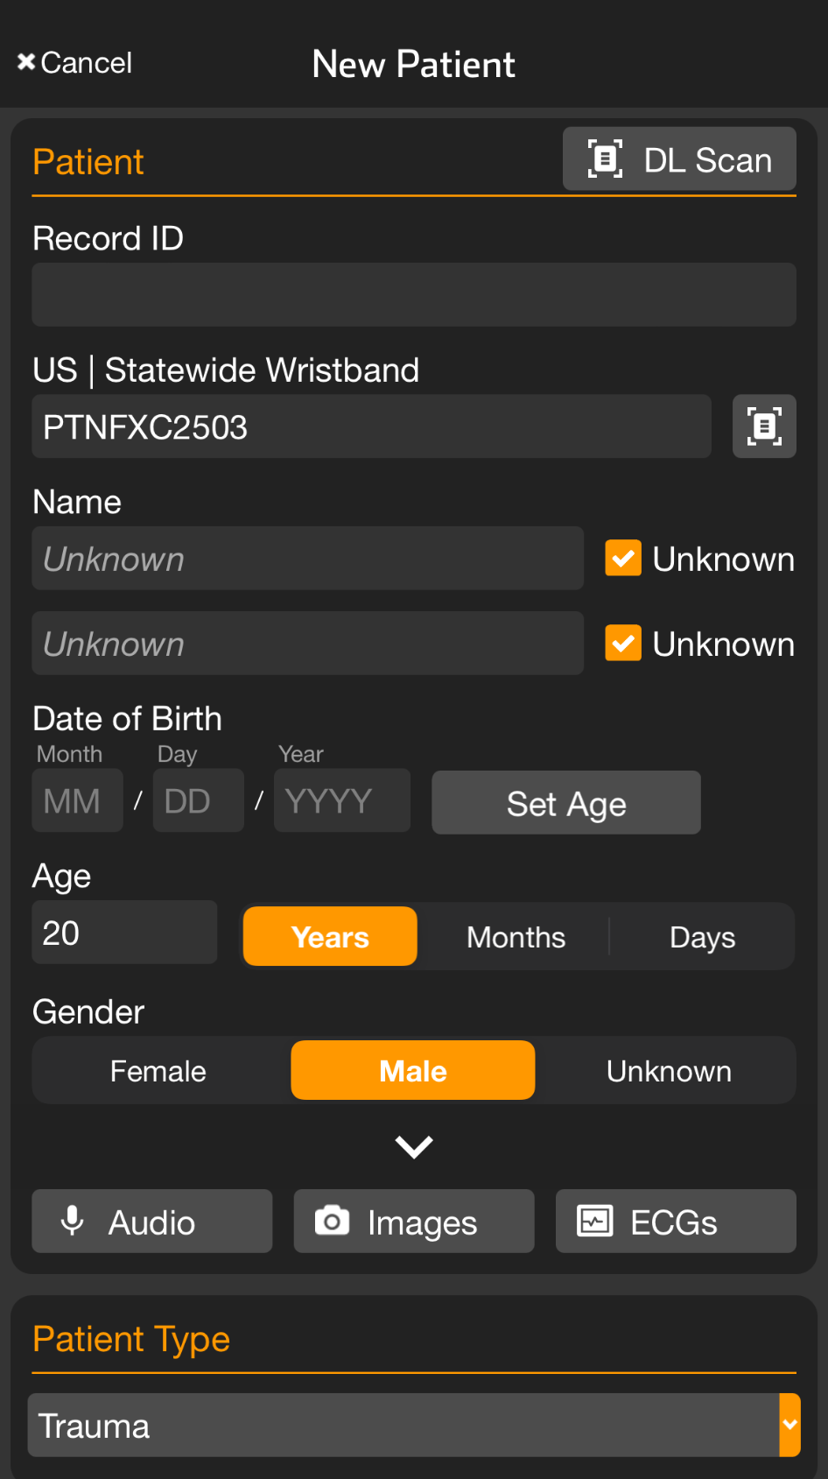
INCIDENTS | Add Patient
Note: All patient information can be added at any time, before or after patient creation.
Apply and Scan Wristband
Scan wristband to add a patient
Adding patients by tapping NEW increases the risk of a duplicate
Set Triage Condition (Color)
Add Patient Demographics
Scan driver’s license (DL), or enter manually
Rapid: Unknown name, estimated Age, Gender
Notes:
and enter their demographics. You can enter demographics by scanning their driver’s license or entering the information manually. If the patient’s name is unknown, simply tap Unknown. While not required, it is helpful to enter an estimated age and gender.

Slide 38
INCIDENTS | Add Patient
Note: All patient information can be added at any time, before or after patient creation.
Apply and Scan Wristband
Scan wristband to add a patient
Adding patients by tapping NEW increases the risk of a duplicate
Set Triage Condition (Color)
Add Patient Demographics
Scan driver’s license (DL), or enter manually
Rapid: Unknown name, estimated Age, Gender
Take Photos (Optional)
Face, injury, DL, belongings, family member, etc.
Notes:
If time permits, it is also beneficial to add photos of the patient’s face for identification, any injuries they may have, and other details you might be able to capture with the camera.

Slide 39
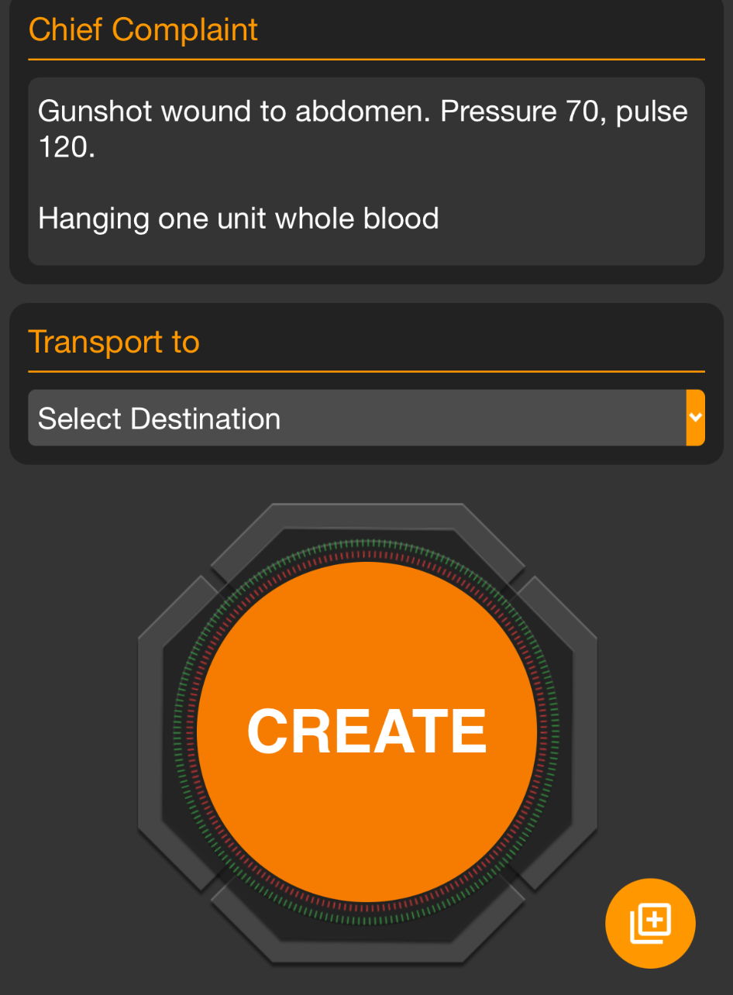
INCIDENTS | Add Patient
Note: All patient information can be added at any time, before or after patient creation.
Apply and Scan Wristband
Scan wristband to add a patient
Adding patients by tapping NEW increases the risk of a duplicate
Set Triage Condition (Color)
Add Patient Demographics
Scan driver’s license (DL), or enter manually
Rapid: Unknown name, estimated Age, Gender
Take Photos (Optional)
Face, injury, DL, belongings, family member, etc.
Chief Complaint (Optional)
Use voice-to-text to describe major injury, vitals, intervention
Notes:
Additionally, if you have time, use the voice-to-text feature to quickly summarize the major injuries, vital signs, and important interventions in the chief complaint or narrative field.

Slide 40
INCIDENTS | Add Patient
Note: All patient information can be added at any time, before or after patient creation.
Apply and Scan Wristband
Scan wristband to add a patient
Adding patients by tapping NEW increases the risk of a duplicate
Set Triage Condition (Color)
Add Patient Demographics
Scan driver’s license (DL), or enter manually
Rapid: Unknown name, estimated Age, Gender
Take Photos (Optional)
Face, injury, DL, belongings, family member, etc.
Chief Complaint (Optional)
Use voice-to-text to describe major injury, vitals, intervention
Create Patient
If you Select Destination prior to hitting Create, you can immediately alert the receiving facility
Notes:
To save this patient channel, tap Create.

Slide 41
INCIDENTS | Add Patient
Note: All patient information can be added at any time, before or after patient creation.
Apply and Scan Wristband
Scan wristband to add a patient
Adding patients by tapping NEW increases the risk of a duplicate
Set Triage Condition (Color)
Add Patient Demographics
Scan driver’s license (DL), or enter manually
Rapid: Unknown name, estimated Age, Gender
Take Photos (Optional)
Face, injury, DL, belongings, family member, etc.
Chief Complaint (Optional)
Use voice-to-text to describe major injury, vitals, intervention
Create Patient
If you Select Destination prior to hitting Create, you can immediately alert the receiving facility
Notes:
Alternatively, if you are immediately transporting the patient, you can select the destination to alert the receiving facility.

Slide 42
INCIDENTS | Add Patient
Note: All patient information can be added at any time, before or after patient creation.
Apply and Scan Wristband
Scan wristband to add a patient
Adding patients by tapping NEW increases the risk of a duplicate
Set Triage Condition (Color)
Add Patient Demographics
Scan driver’s license (DL), or enter manually
Rapid: Unknown name, estimated Age, Gender
Take Photos (Optional)
Face, injury, DL, belongings, family member, etc.
Chief Complaint (Optional)
Use voice-to-text to describe major injury, vitals, intervention
Create Patient
If you Select Destination prior to hitting Create, you can immediately alert the receiving facility
Quick Add
Scan Wristband
Triage Color
Unknown
Create
Notes:
When rapidly triaging multiple patients, you can scan the wristband, set the triage color, tap Unknown for the name, and then tap Create. In many regions, colored tape is applied to the wristband as a visual indicator on the patient of the triage condition.

Slide 43
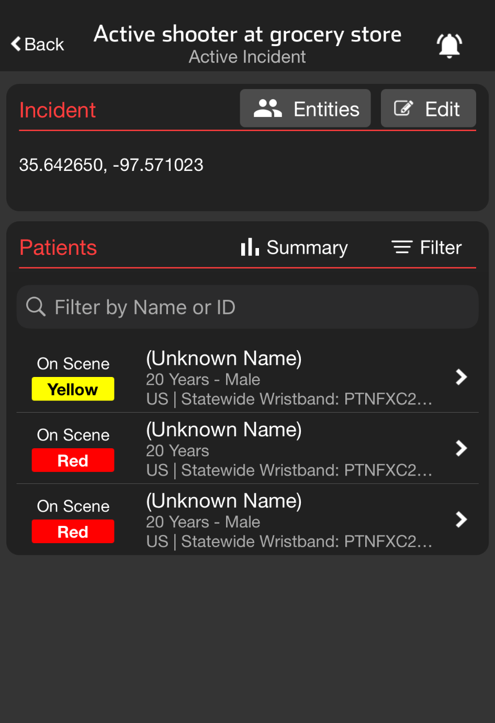
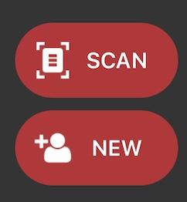
INCIDENTS | Transport
Set Transport Destination
Scan Wristband
If recognized, patient channel will open
If not recognized, you will be prompted to Create
Transport Destination
Destination already set
Displays assigned receiving facility
Able to Change Destination if appropriate
Set Transport Destination
Transport
Select Destination
Select Hospital
Alert
Destination already set
Notes:
Let’s discuss how to transport patients during an incident.
The quickest way to open a patient channel is by scanning the wristband. If the wristband is recognized, the correct patient channel will open.
If a destination has already been set, the request card will display the assigned receiving facility. Remember, you can always change the destination if needed.
If a destination has not been selected, follow your usual workflow by tapping Transport on the request card. You will then be prompted to select a destination. Facilities are listed by location, but you can also search by reviewing your linked facilities, changing the search area for long transports, or searching by the facility’s name or city.
Once you have identified the desired facility, simply tap it and then hit Alert. The hospital will be notified about the inbound patient, and the patient will move to En Route on the Summary Board.

Slide 44
INCIDENTS | Transport
Scan Wristband
If recognized, patient channel will open
If not recognized, you will be prompted to Create
Notes:
The quickest way to open a patient channel is by scanning the wristband. If the wristband is recognized, the correct patient channel will open.

Slide 45
INCIDENTS | Transport
Scan Wristband
If recognized, patient channel will open
If not recognized, you will be prompted to Create
Transport Destination
Destination already set
Destination already set
Notes:
If a destination has already been set,

Slide 46
INCIDENTS | Transport
Scan Wristband
If recognized, patient channel will open
If not recognized, you will be prompted to Create
Transport Destination
Destination already set
Displays assigned receiving facility
Destination already set
Notes:
the request card will display the assigned receiving facility.

Slide 47
INCIDENTS | Transport
Scan Wristband
If recognized, patient channel will open
If not recognized, you will be prompted to Create
Transport Destination
Destination already set
Displays assigned receiving facility
Able to Change Destination if appropriate
Destination already set
Notes:
Remember, you can always change the destination if needed.

Slide 48
INCIDENTS | Transport
Set Transport Destination
Scan Wristband
If recognized, patient channel will open
If not recognized, you will be prompted to Create
Transport Destination
Destination already set
Displays assigned receiving facility
Able to Change Destination if appropriate
Set Transport Destination
Destination already set
Notes:
If a destination has not been selected,

Slide 49
INCIDENTS | Transport
Set Transport Destination
Scan Wristband
If recognized, patient channel will open
If not recognized, you will be prompted to Create
Transport Destination
Destination already set
Displays assigned receiving facility
Able to Change Destination if appropriate
Set Transport Destination
Transport
Destination already set
Notes:
follow your usual workflow by tapping Transport on the request card.

Slide 50
INCIDENTS | Transport
Set Transport Destination
Scan Wristband
If recognized, patient channel will open
If not recognized, you will be prompted to Create
Transport Destination
Destination already set
Displays assigned receiving facility
Able to Change Destination if appropriate
Set Transport Destination
Transport
Select Destination
Destination already set
Notes:
You will then be prompted to select a destination.

Slide 51
INCIDENTS | Transport
Set Transport Destination
Scan Wristband
If recognized, patient channel will open
If not recognized, you will be prompted to Create
Transport Destination
Destination already set
Displays assigned receiving facility
Able to Change Destination if appropriate
Set Transport Destination
Transport
Select Destination
Destination already set
Notes:
Facilities are listed by location

Slide 52
INCIDENTS | Transport
Set Transport Destination
Scan Wristband
If recognized, patient channel will open
If not recognized, you will be prompted to Create
Transport Destination
Destination already set
Displays assigned receiving facility
Able to Change Destination if appropriate
Set Transport Destination
Transport
Select Destination
Destination already set
Notes:
but you can also search by reviewing your linked facilities

Slide 53
INCIDENTS | Transport
Set Transport Destination
Scan Wristband
If recognized, patient channel will open
If not recognized, you will be prompted to Create
Transport Destination
Destination already set
Displays assigned receiving facility
Able to Change Destination if appropriate
Set Transport Destination
Transport
Select Destination
Destination already set
Notes:
changing the search area for long transports,

Slide 54
INCIDENTS | Transport
Set Transport Destination
Scan Wristband
If recognized, patient channel will open
If not recognized, you will be prompted to Create
Transport Destination
Destination already set
Displays assigned receiving facility
Able to Change Destination if appropriate
Set Transport Destination
Transport
Select Destination
Destination already set
Notes:
or searching by the facility’s name or city.

Slide 55
INCIDENTS | Transport
Set Transport Destination
Scan Wristband
If recognized, patient channel will open
If not recognized, you will be prompted to Create
Transport Destination
Destination already set
Displays assigned receiving facility
Able to Change Destination if appropriate
Set Transport Destination
Transport
Select Destination
Select Hospital
Destination already set
Notes:
Once you have identified the desired facility, simply tap it

Slide 56
INCIDENTS | Transport
Set Transport Destination
Scan Wristband
If recognized, patient channel will open
If not recognized, you will be prompted to Create
Transport Destination
Destination already set
Displays assigned receiving facility
Able to Change Destination if appropriate
Set Transport Destination
Transport
Select Destination
Select Hospital
Alert
Destination already set
Notes:
then hit Alert. The hospital will be notified about the inbound patient, and the patient will move to En Route on the Summary Board.

Slide 57
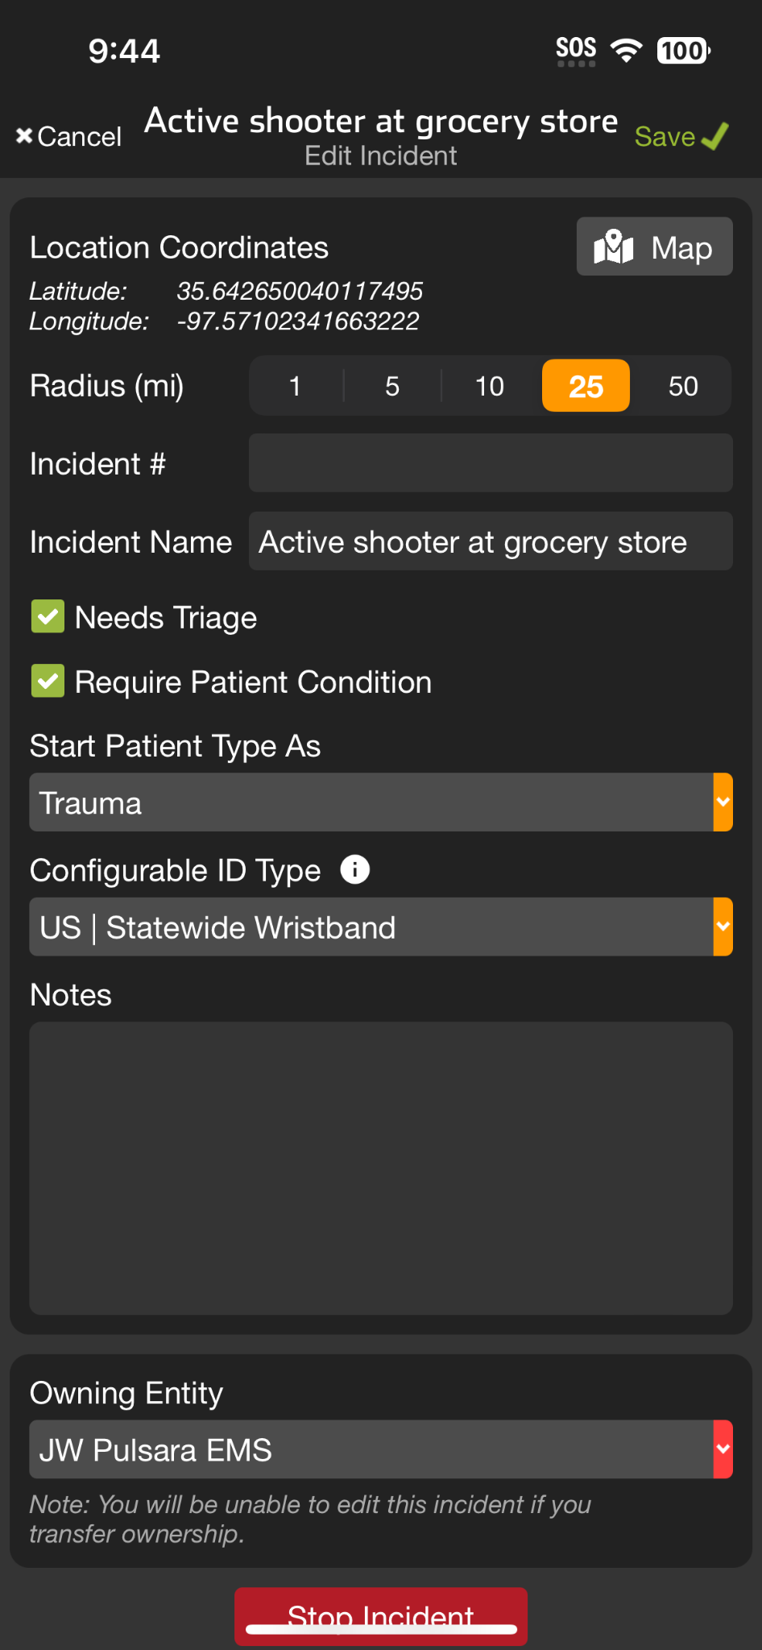
INCIDENTS | Incident Owner Privileges
Manage Entities
Others in region can See, Join, and Add Patients
Only able to see their patients unless granted additional privileges by Incident Owner
Separate tutorial will review in detail
Edit Incident
Edit details
Change Owning Entity
Stop Incident
Notes:
Let’s go over incident owner privileges.
As an incident owner, you have the ability to add and grant additional privileges to other entities in the region. While these entities can see, join, and add patients to an incident, they can only view their own patients unless you grant them further access. For more details on managing entities, refer to the Manage Entities Tutorial.
Additionally, the incident owner has the authority to edit the incident. This includes editing the details of the incident, changing the owning entity, and stopping the incident when appropriate.

Slide 58
INCIDENTS | Incident Owner Privileges
Manage Entities
Others in region can See, Join, and Add Patients
Only able to see their patients unless granted additional privileges by Incident Owner
Separate tutorial will review in detail
Notes:
As an incident owner, you have the ability to add and grant additional privileges to other entities in the region. While these entities can see, join, and add patients to an incident, they can only view their own patients unless you grant them further access. For more details on managing entities, refer to the Manage Entities Tutorial.

Slide 59
INCIDENTS | Incident Owner Privileges
Manage Entities
Others in region can See, Join, and Add Patients
Only able to see their patients unless granted additional privileges by Incident Owner
Separate tutorial will review in detail
Edit Incident
Notes:
Additionally, the incident owner has the authority to edit the incident.

Slide 60
INCIDENTS | Incident Owner Privileges
Manage Entities
Others in region can See, Join, and Add Patients
Only able to see their patients unless granted additional privileges by Incident Owner
Separate tutorial will review in detail
Edit Incident
Edit details
Notes:
This includes editing the details of the incident,

Slide 61
INCIDENTS | Incident Owner Privileges
Manage Entities
Others in region can See, Join, and Add Patients
Only able to see their patients unless granted additional privileges by Incident Owner
Separate tutorial will review in detail
Edit Incident
Edit details
Change Owning Entity
Notes:
changing the owning entity,

Slide 62
INCIDENTS | Incident Owner Privileges
Manage Entities
Others in region can See, Join, and Add Patients
Only able to see their patients unless granted additional privileges by Incident Owner
Separate tutorial will review in detail
Edit Incident
Edit details
Change Owning Entity
Stop Incident
Notes:
and stopping the incident when appropriate.

