Slide 1
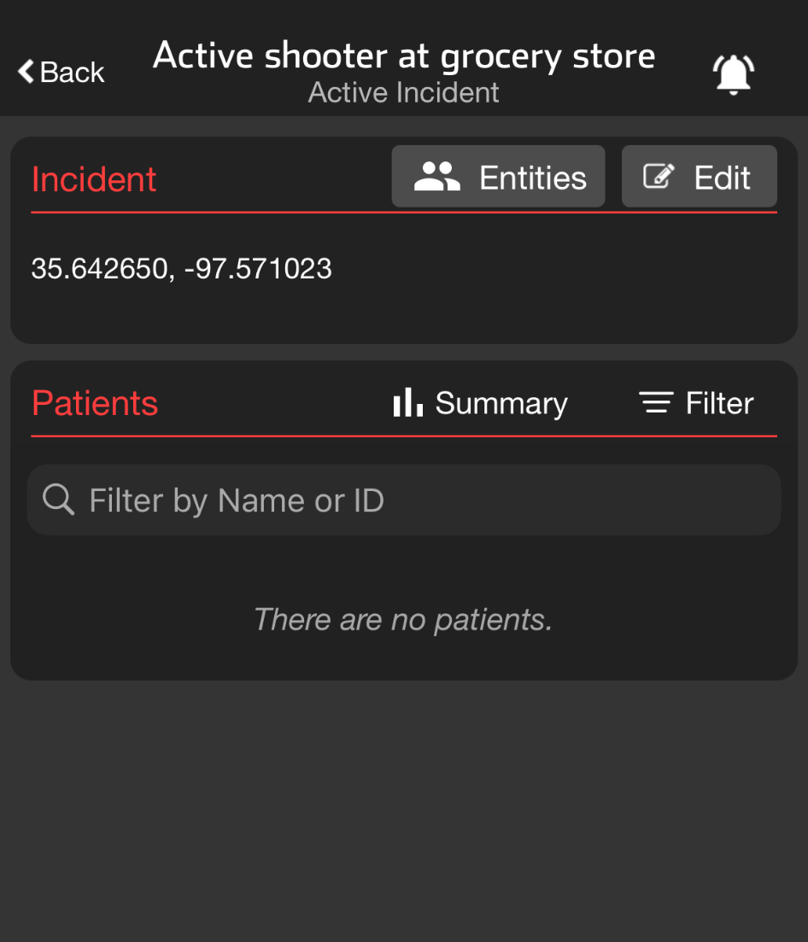
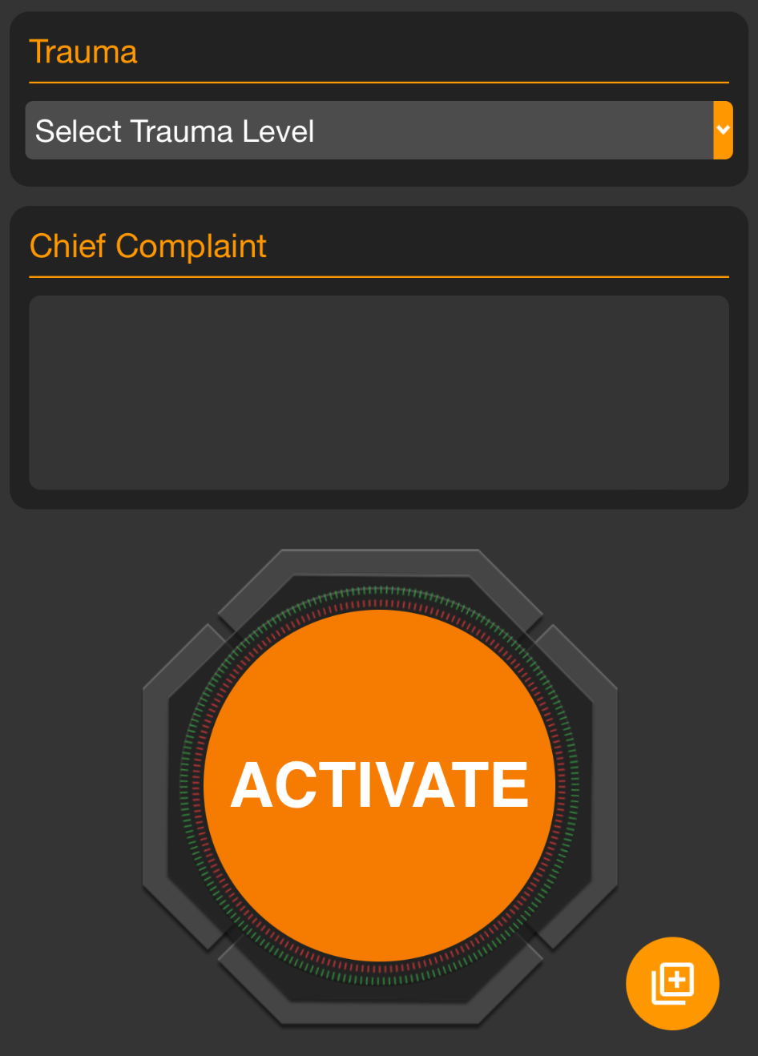
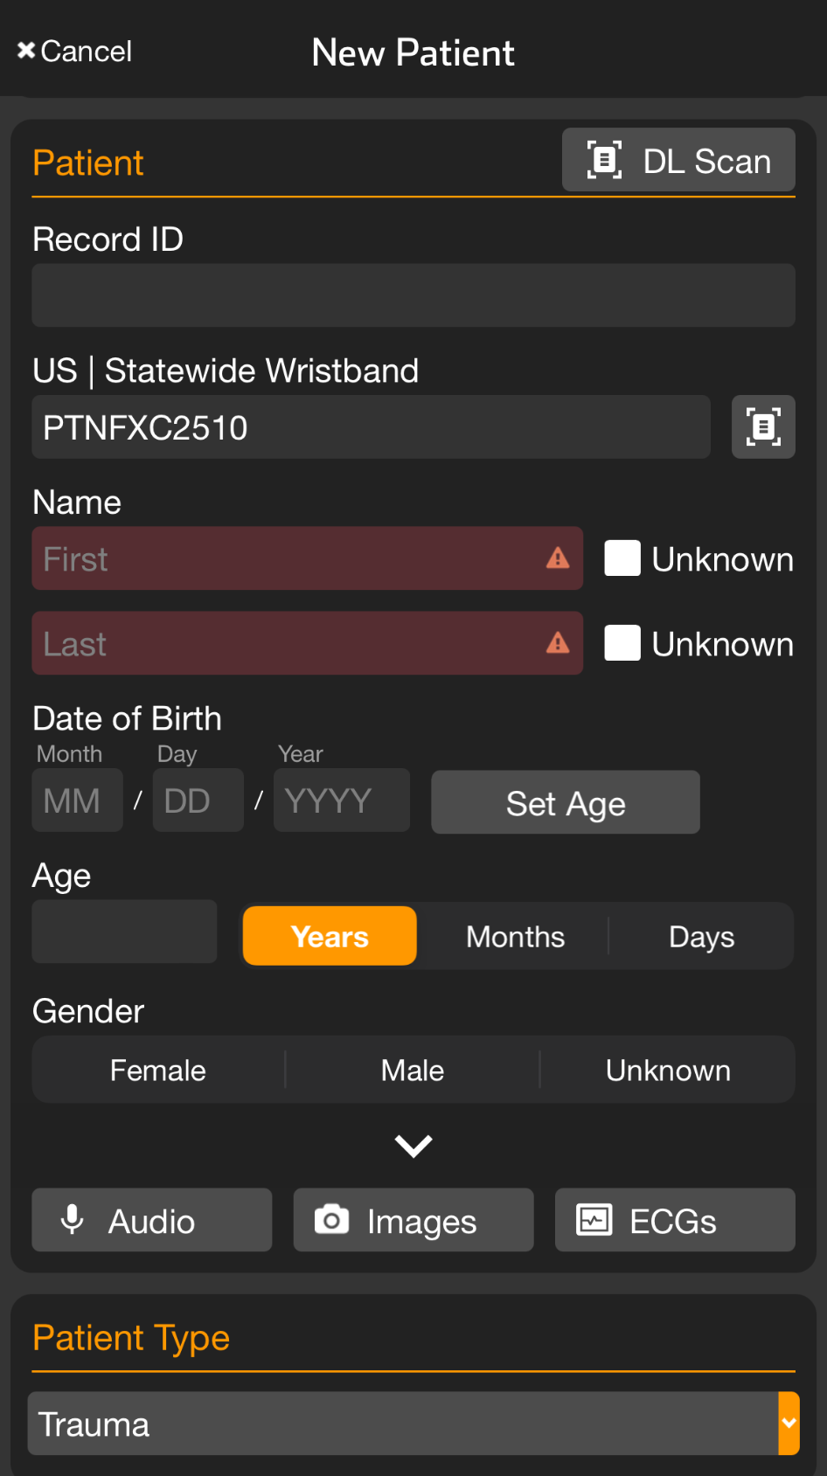
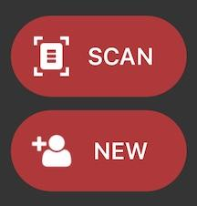
INCIDENTS | Add Patient to Incident - Mobile
Apply and Scan Wristband
Scan wristband to add a patient
Adding patients by tapping NEW increases the risk of a duplicate
Patient is automatically added to incident in Incident View
Set Method of Arrival
Set Triage Condition (Color)
Add Patient Demographics
Scan driver’s license (DL), or enter manually
Rapid: Unknown name, estimated Age, Gender
Activate Patient
Triage Section not visible?
You are in Patient View (all patients)
Tap Add, then Triage / Incident
Select Incident and Condition
Optional
Take Photos
Face, Injury…
Chief Complaint
Voice-to-text
Trauma Level
Notes:
Let’s dive into how to add patients to an incident.
From a regional perspective, it’s crucial to add patients as soon as possible. Doing so allows participating entities to monitor the burden on each facility in near real-time, which can significantly impact load balancing. The process is quick. You can add a patient in seconds with just a few details, and you can always go back to update the information later as the incident deescalates or as you begin working on reunification.
To add patients quickly, ensure you’re in the correct incident within Incident View. If you’re unsure how to navigate to the correct incident, refer to our lesson on this topic. Let’s get started.
First, apply a wristband to the patient and tap Scan. Although you have the option to tap New to create a new patient, doing so increases the risk of creating duplicates. The wristband also serves as a visual cue that the patient has already been entered into Pulsara.
Next, set the patient’s method of arrival, triage condition, and enter their demographics. You can quickly input demographic details by scanning their driver’s license or entering the information manually. If the patient’s name is unknown, simply tap Unknown. While not required, entering an estimated age and gender can be helpful.
At this point, you can tap Activate to create the channel, which assigns the patient to the incident and adds them to your facility in the summary view. It’s that simple.
If time allows, consider adding photos of the patient’s face for identification, documenting any visible injuries, and capturing other pertinent details using the camera. Additionally, if you have time, use the voice-to-text feature to quickly summarize major injuries or other important details in the chief complaint or narrative field.
If this is a Trauma Patient, you will be prompted to select the Trauma Level. Remember, to prevent overalerting in a chaotic incident environment you can always silence alerting for the incident by tapping the bell icon on main Incident view.
If you don’t see the Triage Incident card, you’re in Patient View, which shows all patients in your facility, not just those associated with the incident. To add the patient to the incident, tap the universal add button in the lower right corner and select Triage Incident. You can then assign the patient to the correct incident and select their condition. This step can be done at any time, so if you forget to add a patient to the incident or they get assigned to the wrong one, it’s easy to correct.

Slide 2
INCIDENTS | Add Patient to Incident - Mobile
Incident View
Incident Name
Notes:
To add patients quickly, ensure you’re in the correct incident within Incident View. If you’re unsure how to navigate to the correct incident, refer to our lesson on this topic.

Slide 3
INCIDENTS | Add Patient to Incident - Mobile
Apply and Scan Wristband
Scan wristband to add a patient
Adding patients by tapping NEW increases the risk of a duplicate
Patient is automatically added to incident in Incident View
Notes:
Let’s get started.
First, apply a wristband to the patient and tap Scan. Although you have the option to tap New to create a new patient, doing so increases the risk of creating duplicates. The wristband also serves as a visual cue that the patient has already been entered into Pulsara.

Slide 4
INCIDENTS | Add Patient to Incident - Mobile
Apply and Scan Wristband
Scan wristband to add a patient
Adding patients by tapping NEW increases the risk of a duplicate
Patient is automatically added to incident in Incident View
Set Method of Arrival
Notes:
Next, set the patient’s method of arrival

Slide 5
INCIDENTS | Add Patient to Incident - Mobile
Apply and Scan Wristband
Scan wristband to add a patient
Adding patients by tapping NEW increases the risk of a duplicate
Patient is automatically added to incident in Incident View
Set Method of Arrival
Set Triage Condition (Color)
Notes:
triage condition,

Slide 6
INCIDENTS | Add Patient to Incident - Mobile
Apply and Scan Wristband
Scan wristband to add a patient
Adding patients by tapping NEW increases the risk of a duplicate
Patient is automatically added to incident in Incident View
Set Method of Arrival
Set Triage Condition (Color)
Add Patient Demographics
Scan driver’s license (DL), or enter manually
Rapid: Unknown name, estimated Age, Gender
Notes:
and enter their demographics. You can quickly input demographic details by scanning their driver’s license

Slide 7
INCIDENTS | Add Patient to Incident - Mobile
Apply and Scan Wristband
Scan wristband to add a patient
Adding patients by tapping NEW increases the risk of a duplicate
Patient is automatically added to incident in Incident View
Set Method of Arrival
Set Triage Condition (Color)
Add Patient Demographics
Scan driver’s license (DL), or enter manually
Rapid: Unknown name, estimated Age, Gender
Notes:
or entering the information manually. If the patient’s name is unknown, simply tap Unknown. While not required, entering an estimated age and gender can be helpful.

Slide 8
INCIDENTS | Add Patient to Incident - Mobile
Apply and Scan Wristband
Scan wristband to add a patient
Adding patients by tapping NEW increases the risk of a duplicate
Patient is automatically added to incident in Incident View
Set Method of Arrival
Set Triage Condition (Color)
Add Patient Demographics
Scan driver’s license (DL), or enter manually
Rapid: Unknown name, estimated Age, Gender
Activate Patient
Notes:
At this point, you can tap Activate to create the channel, which assigns the patient to the incident and adds them to your facility in the summary view. It’s that simple.

Slide 9
INCIDENTS | Add Patient to Incident - Mobile
Apply and Scan Wristband
Scan wristband to add a patient
Adding patients by tapping NEW increases the risk of a duplicate
Patient is automatically added to incident in Incident View
Set Method of Arrival
Set Triage Condition (Color)
Add Patient Demographics
Scan driver’s license (DL), or enter manually
Rapid: Unknown name, estimated Age, Gender
Activate Patient
Optional
Take Photos
Face, Injury…
Notes:
If time allows, consider adding photos of the patient’s face for identification, documenting any visible injuries, and capturing other pertinent details using the camera.

Slide 10
INCIDENTS | Add Patient to Incident - Mobile
Apply and Scan Wristband
Scan wristband to add a patient
Adding patients by tapping NEW increases the risk of a duplicate
Patient is automatically added to incident in Incident View
Set Method of Arrival
Set Triage Condition (Color)
Add Patient Demographics
Scan driver’s license (DL), or enter manually
Rapid: Unknown name, estimated Age, Gender
Activate Patient
Optional
Take Photos
Face, Injury…
Chief Complaint
Voice-to-text
Notes:
Additionally, if you have time, use the voice-to-text feature to quickly summarize major injuries or other important details in the chief complaint or narrative field.

Slide 11
INCIDENTS | Add Patient to Incident - Mobile
Apply and Scan Wristband
Scan wristband to add a patient
Adding patients by tapping NEW increases the risk of a duplicate
Patient is automatically added to incident in Incident View
Set Method of Arrival
Set Triage Condition (Color)
Add Patient Demographics
Scan driver’s license (DL), or enter manually
Rapid: Unknown name, estimated Age, Gender
Activate Patient
Optional
Take Photos
Face, Injury…
Chief Complaint
Voice-to-text
Trauma Level
Notes:
If this is a Trauma Patient, you will be prompted to select the Trauma Level.

Slide 12
INCIDENTS | Add Patient to Incident - Mobile
Apply and Scan Wristband
Scan wristband to add a patient
Adding patients by tapping NEW increases the risk of a duplicate
Patient is automatically added to incident in Incident View
Set Method of Arrival
Set Triage Condition (Color)
Add Patient Demographics
Scan driver’s license (DL), or enter manually
Rapid: Unknown name, estimated Age, Gender
Activate Patient
Optional
Take Photos
Face, Injury…
Chief Complaint
Voice-to-text
Trauma Level
Notes:
Remember, to prevent overalerting in a chaotic incident environment you can always silence alerting for the incident by tapping the bell icon on main Incident view.

Slide 13
INCIDENTS | Add Patient to Incident - Mobile
Apply and Scan Wristband
Scan wristband to add a patient
Adding patients by tapping NEW increases the risk of a duplicate
Patient is automatically added to incident in Incident View
Set Method of Arrival
Set Triage Condition (Color)
Add Patient Demographics
Scan driver’s license (DL), or enter manually
Rapid: Unknown name, estimated Age, Gender
Activate Patient
Triage Section not visible?
You are in Patient View (all patients)
Optional
Take Photos
Face, Injury…
Chief Complaint
Voice-to-text
Trauma Level
Notes:
If you don’t see the Triage Incident card, you’re in Patient View, which shows all patients in your facility, not just those associated with the incident.

Slide 14
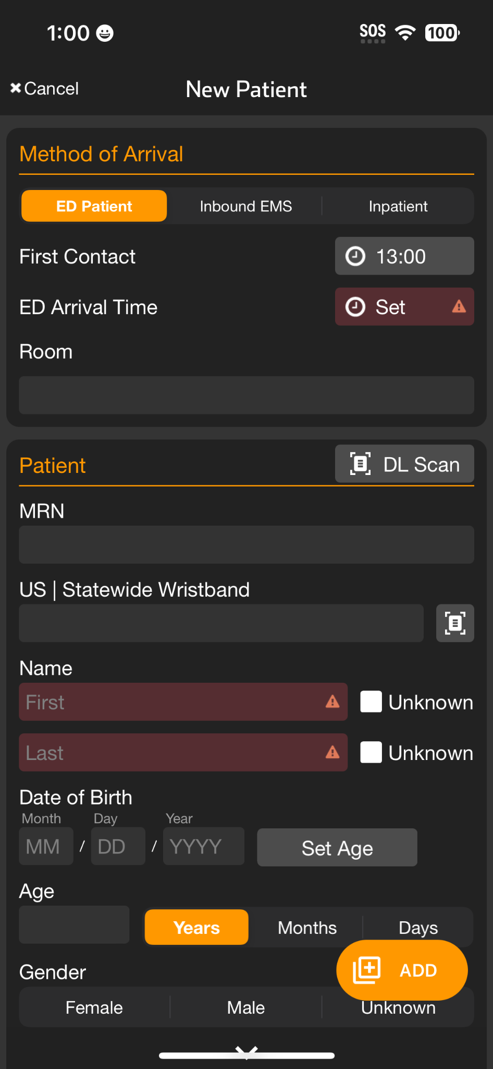
INCIDENTS | Add Patient to Incident - Mobile
Apply and Scan Wristband
Scan wristband to add a patient
Adding patients by tapping NEW increases the risk of a duplicate
Patient is automatically added to incident in Incident View
Set Method of Arrival
Set Triage Condition (Color)
Add Patient Demographics
Scan driver’s license (DL), or enter manually
Rapid: Unknown name, estimated Age, Gender
Activate Patient
Triage Section not visible?
You are in Patient View (all patients)
Tap Add,
Optional
Take Photos
Face, Injury…
Chief Complaint
Voice-to-text
Trauma Level
Notes:
To add the patient to the incident, tap the universal add button in the lower right corner

Slide 15
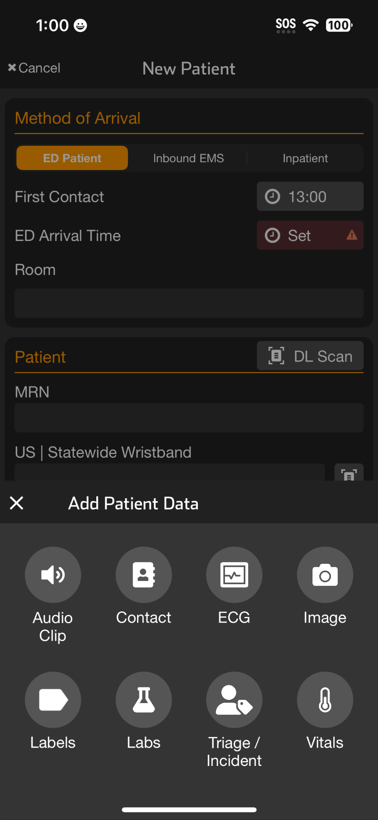
INCIDENTS | Add Patient to Incident - Mobile
Apply and Scan Wristband
Scan wristband to add a patient
Adding patients by tapping NEW increases the risk of a duplicate
Patient is automatically added to incident in Incident View
Set Method of Arrival
Set Triage Condition (Color)
Add Patient Demographics
Scan driver’s license (DL), or enter manually
Rapid: Unknown name, estimated Age, Gender
Activate Patient
Triage Section not visible?
You are in Patient View (all patients)
Tap Add, then Triage / Incident
Optional
Take Photos
Face, Injury…
Chief Complaint
Voice-to-text
Trauma Level
Notes:
and select Triage Incident.

Slide 16
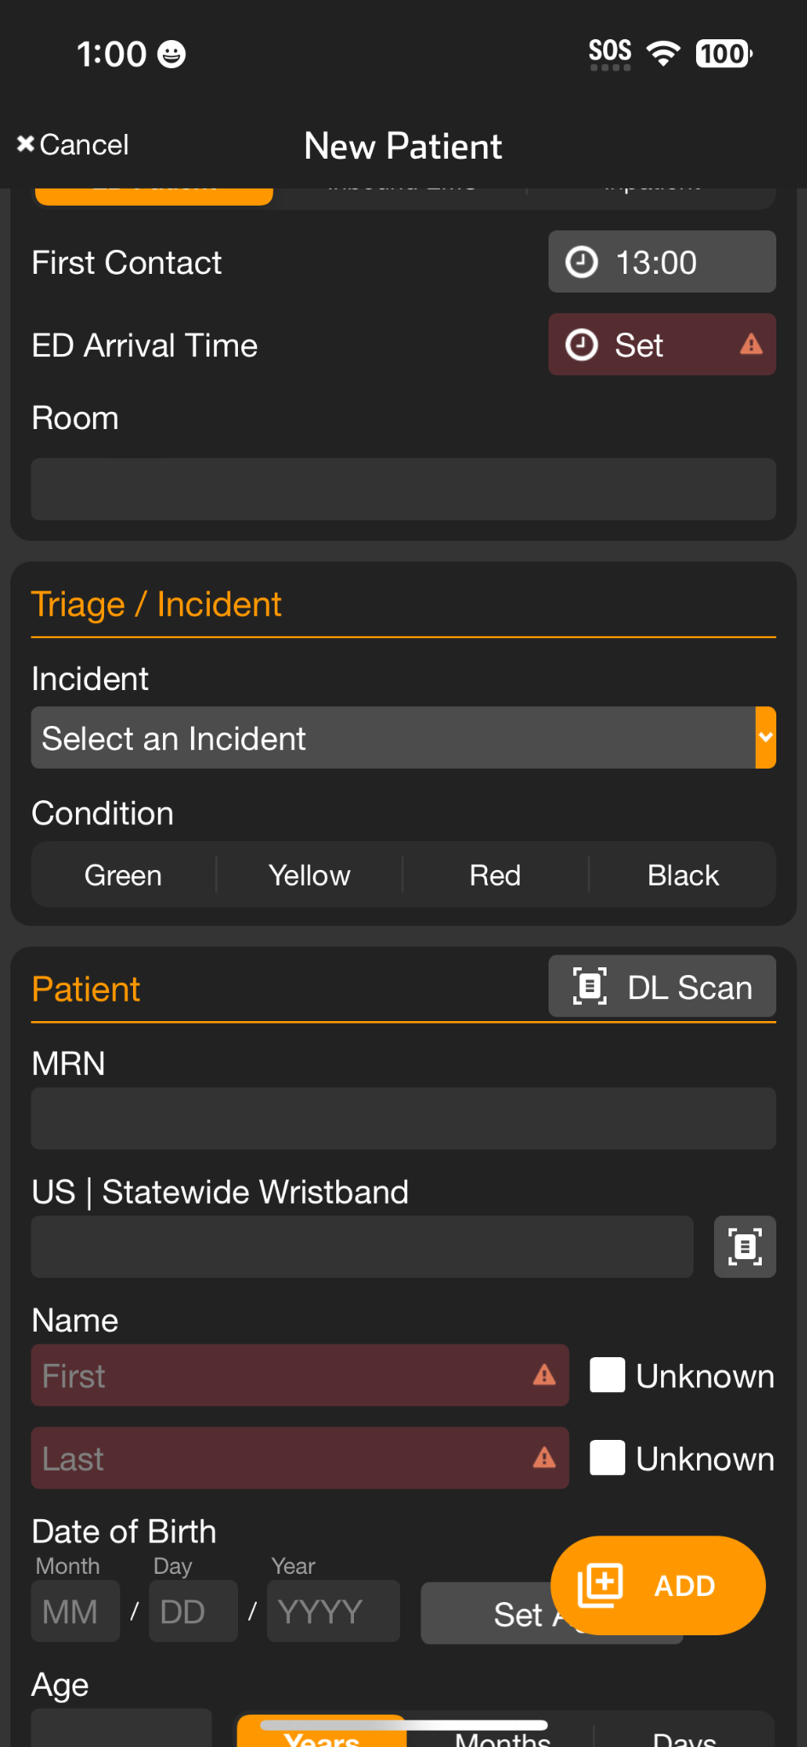
INCIDENTS | Add Patient to Incident - Mobile
Apply and Scan Wristband
Scan wristband to add a patient
Adding patients by tapping NEW increases the risk of a duplicate
Patient is automatically added to incident in Incident View
Set Method of Arrival
Set Triage Condition (Color)
Add Patient Demographics
Scan driver’s license (DL), or enter manually
Rapid: Unknown name, estimated Age, Gender
Activate Patient
Triage Section not visible?
You are in Patient View (all patients)
Tap Add, then Triage / Incident
Select Incident and Condition
Optional
Take Photos
Face, Injury…
Chief Complaint
Voice-to-text
Trauma Level
Notes:
You can then assign the patient to the correct incident and select their condition. This step can be done at any time, so if you forget to add a patient to the incident or they get assigned to the wrong one, it’s easy to correct.

