Slide 1
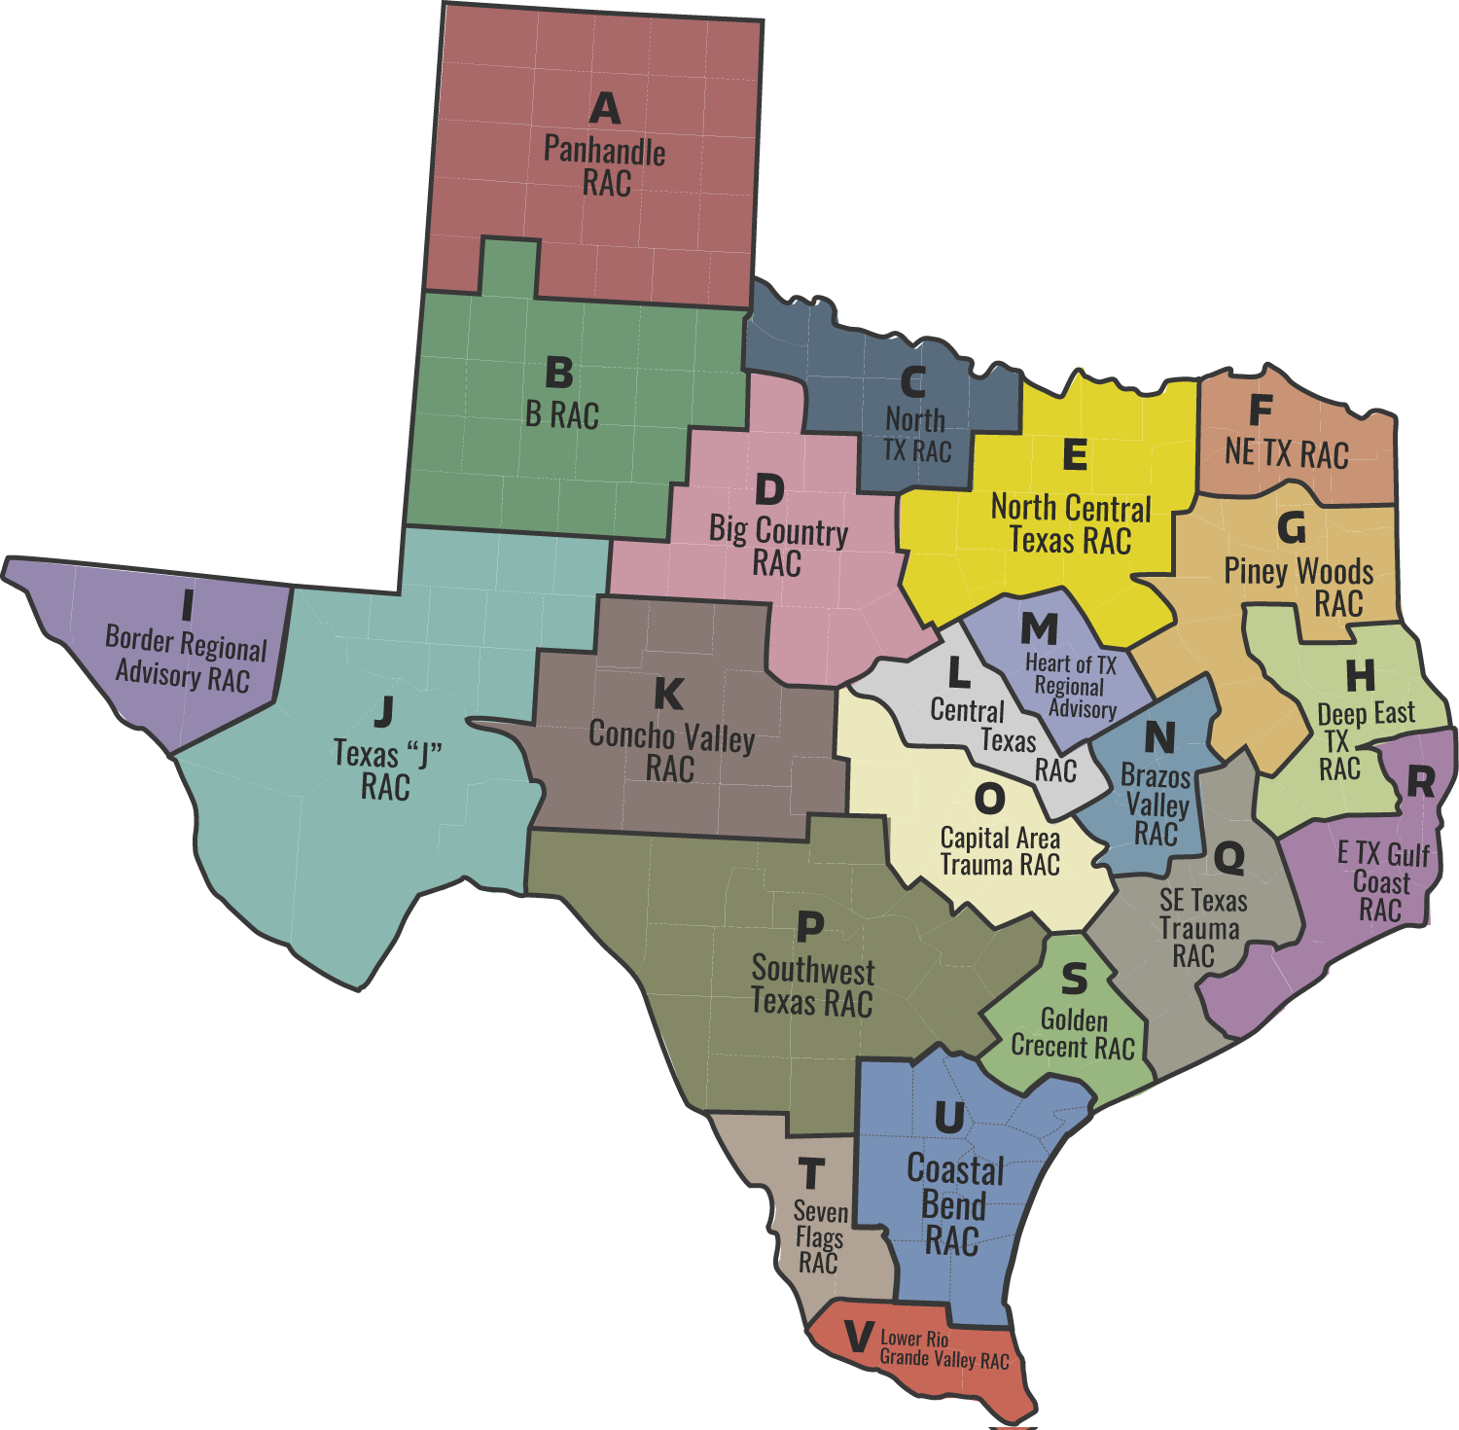
MED OPS
Notes:
Welcome to the Texas State Resource page! This presentation will guide you through the website, your go-to resource for learning about Pulsara, signing up, and implementing Pulsara MED OPS. As many of you know Pulsara has been legislatively funded for years through DSHS general revenue budget. Texas EMTF, TDEM, Hospitals, EMS and others can take advantage of this Statewide Pulsara MED OPS offering.

Slide 2
EXTENSIONS
INFRASTRUCTURE
Hospital Functionality by Package
BUNDLE OPTIONS
All hospital bundles include either Pulsara ONE or Pulsara MED OPS Infrastructure Package. Hospitals can upgrade to Pulsara UNITED which includes all hospital functionality OR they can add Pulsara TRANSFER OPS and/or Pulsara SELECT to meet their needs.
Pulsara ONE
Pulsara MED OPS
Pulsara TRANSFER OPS
Pulsara SELECT
Pulsara UNITED
v
OR
v
AND/OR
OR
Multimedia Prehospital Report (ECG, Video, PSR…)
ALL
ALL
ALL
ALL
ALL
ALL
ALL
ALL
Send Consult/Transfer Request
ALL
ALL
ALL
ALL
ALL
ALL
ALL
ALL
State | Regional: Incidents, Events, Evac, ESF8 & other Initiatives
ALL
ALL
ALL
ALL
Receive Consult/Transfer Request
ALL
ALL
ALL
1-2
ALL
ALL
ALL
Add Physician Consultants for Consult & Transfer Request
ALL
ALL
1-2
1-2
ALL
ALL
Add Physician Consultants All Methods of Arrival (EMS, ED, Inpatient, Transfer)
1-2
1-2
ALL
ALL
Add Downstream Teams (STEMI, Stroke, Trauma…) All Methods of Arrival (EMS, ED, Inpatient Transfer)
1-2
1-2
ALL
ALL
Always Free to Everyone
Free to Hospitals in MED OPS Regions
Adds
Consultants
Adds 1-2
Patient Types
Includes ALL Extensions
Notes:
Most regions in Texas have already implemented Pulsara, with varying levels of maturity across the state. Its core functionality, used daily, is designed to modernize EMS-to-ED prehospital notifications.
Pulsara MED OPS upgrade unlocks advanced incident management capabilities, enhancing response to Mass Casualty Incidents, Mass Evacuations, and Mass Gatherings. Additionally, EMS agencies have upgraded functionality while hospitals now have access to enhanced inter-facility features, enabling seamless consults and transfer requests between facilities.
New organizations and regions typically begin with basic EMS-to-ED and incident management functionality. However, many regions are now leveraging this network for broader regional initiatives, such as C4 programs, fall prevention efforts, load balancing strategies, behavioral health coordination, and other complex multi-organization operations. Pulsara also scales to support multi-region incidents, including large-scale patient movements and 911 augmentation during hurricane evacuations.
While Pulsara offers additional optional paid packages, this resource focuses on our infrastructure packages.
If you’re interested in learning more, feel free to request a demo or ask a Pulsara Team Member any questions.
It’s important to note that our team members do not work on commission or have sales quotas—our priority is building a strong, connected network that supports your needs.

Slide 3
Discovery | Socialization
EMS
Daily Use
Watch or Download and Review EMS Executive Summary (5 min)
Watch Daily Use – EMS to ED Demo (6 min)
Pulsara ONE - Hospitals
Daily Use
Watch or Download and Review Hospital Executive Summary (4 min)
Watch Daily Use – EMS to ED Demo (6 min)
Incidents
EMS & Hospitals
Watch or Download and Review Incident Executive Summary (5 min)
Watch Incident Demo (7 min)
Notes:
We offer separate tracks for EMS and Hospitals, allowing you to quickly grasp the problem, solution, value, and next steps for implementing Pulsara in just 10 minutes—all while seeing the platform in action. If Incident functionality is relevant to your role, an additional 13-minute session provides deeper insight.
While MED OPS regions offer a wide range of capabilities, new organizations typically start by focusing on core functionality, including EMS-to-ED communication and Incident Management

Slide 4
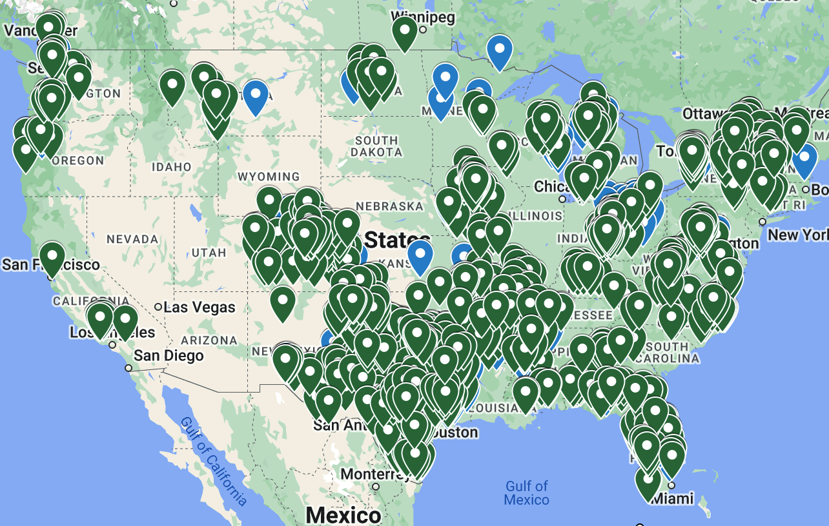
Who is on the Network?
Interactive Map
See Who has Signed Up
Does not represent Implementation or Live Status
It does not represent organizations that have verbally committed and are working through the sign-up process
Regional Projects
Located at the bottom of the page and accessible via top navigation
Displays implementation status of active projects
Showcases regional projects and workflows
Highlights other initiatives (Pulsara MED OPS regions)
It CAN be Done!
Proven success – 1000+ organizations in Texas already connected
Functionality seamlessly extends across state lines
Notes:
Finding out who is on the network is simple using the interactive map.
If your region is actively implementing Pulsara, visit the Regional Project section to track each organization’s progress. This section also provides details on region-specific workflows and projects.
If you are just now getting started, with over a thousand organizations in Texas alone, you have plenty of neighbors who have successfully implement and would be happy to assist with lessons learned.

Slide 5
Sign Up | Procurement
Who to Engage
EMS: Leadership
Hospital: ED and Executive Sponsor
Use this Resource Page to assist with socialization
Sign Up Now
Sign up to join the queue with no commitment to a timeline or completing onboarding.
Pulsara will collaborate with you and your region to coordinate training and implementation timelines
Additional Resources
Assets to help you navigate your internal IT / Compliance / Security process
Business Associate Agreement (BAA)
Implementation Overview
Notes:
Engaging Emergency Department leadership is key to a successful rollout. We also recommend securing an executive sponsor, as they will want to understand the regional impact and scope of the project. They can also help navigate your organization’s IT adoption process.
The most important step? Sign up as soon as possible. This ensures you’re in the queue, allowing us to coordinate your region effectively for a smooth implementation and avoid any false starts.
You’ll also find resources to guide you through internal IT and Legal Procurement processes, along with a clear roadmap of what to expect during implementation.

Slide 6
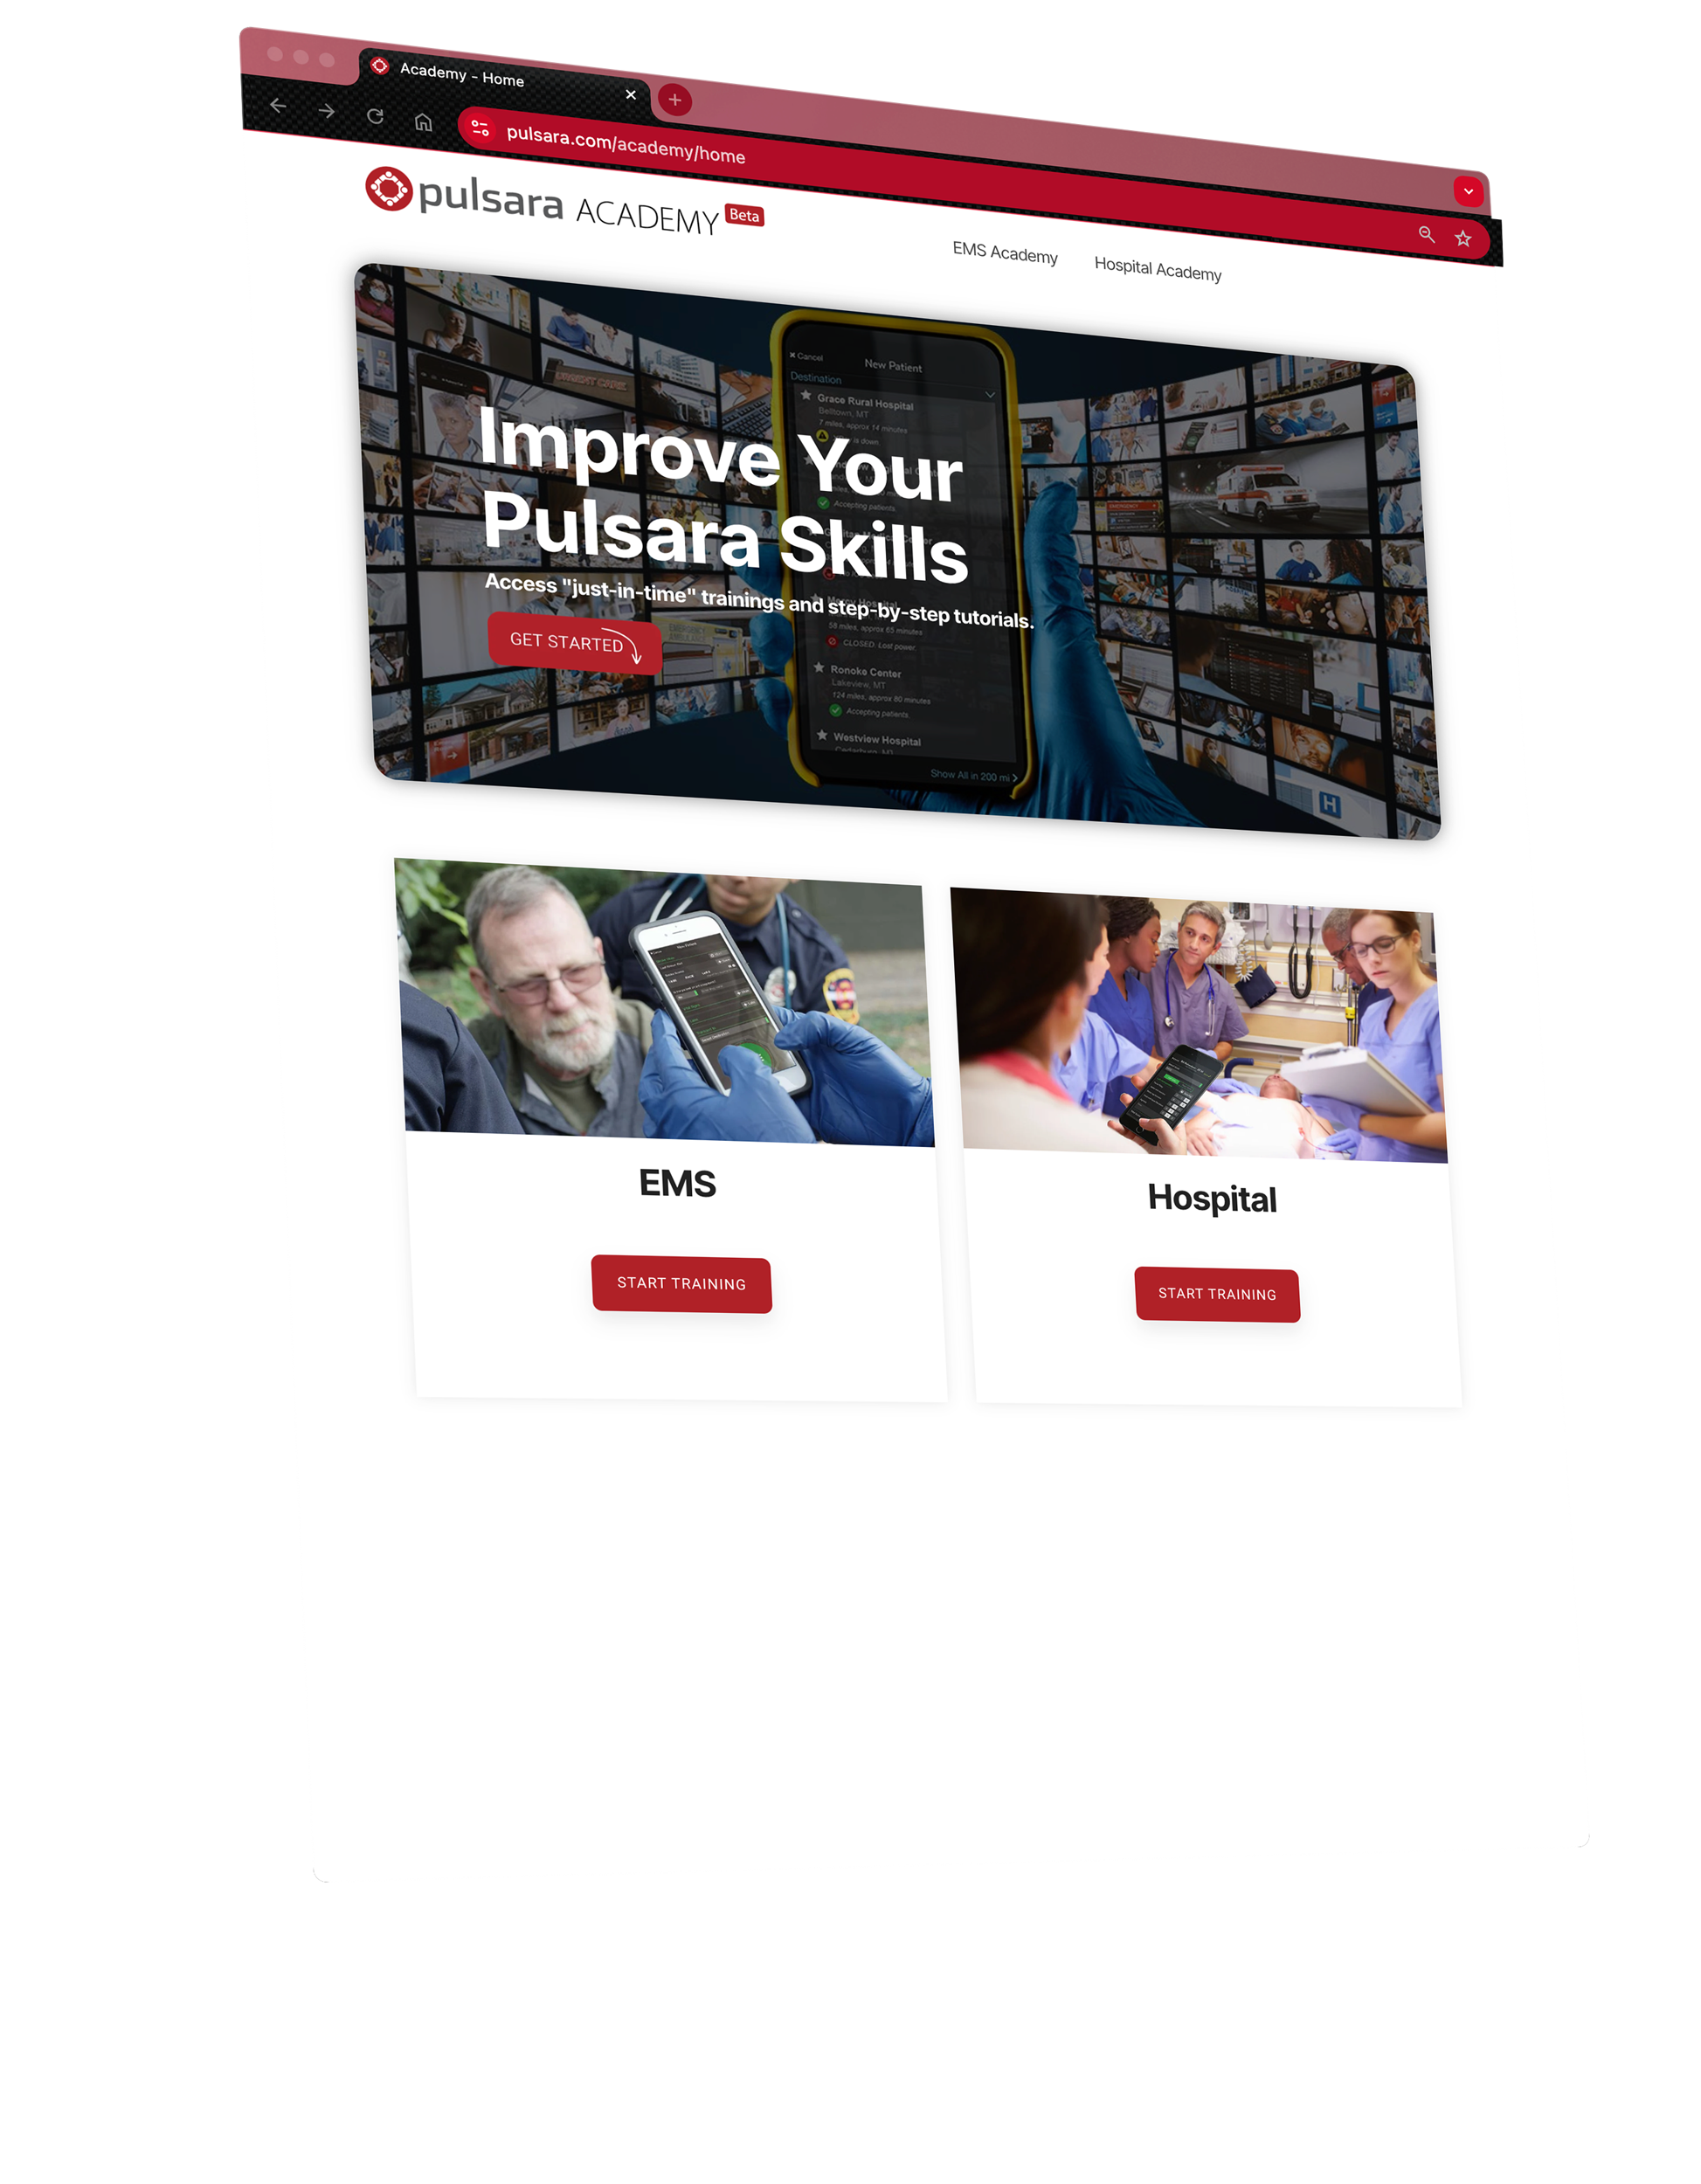
Pulsara Academy / Training
Content
Socialization
Pulsara Basics (conceptual)
How To
Demos
Just-In-Time Training Assets
Consume as Needed
Videos
Printable / PDF
PowerPoint
Options
Download & Customize
Link to your LMS
Onboarding & Ongoing Training
Notes:
To support both initial and ongoing training, we provide a variety of resources, including short videos, slide presentations, and printable Just-In-Time training materials, ensuring easy access to the information you need.

