Slide 1


SCALE
SYSTEMS OF CARE THAT
Using the same Patient Movement Platform daily that can scale easily for local, regional, or national stress events or emergencies.
© 2025 Pulsara – Confidential and Proprietary
Notes:
Readiness is a proactive, continuous process that allows communities to respond swiftly and effectively when an incident occurs. Therefore, using the same patient movement system daily that can scale to meet the demands of large scale all hazards stress events is a critical component of preparedness.

Slide 2


Integrated System of Care
Replace EMS to ED Report
ECG Attachment
Telehealth
MIH | CP | TIP
C4 programs
Medical Direction | Consult
Behavioral Health
Rural Health
Time Sensitive Emergencies
Integrated System of Care
Event Management
Alternate Destinations
Inter-facility Transfer
Incident Management
  MCI
  Evacuation
  Event
Patient Movement (Tracking)
Reunification
Alternate Care Sites
Load Balancing
Medical Direction
Telehealth
  ACS
  MIH | CP
1. Replace EMS to ED Report
© 2025 Pulsara – Confidential and Proprietary
Notes:
Pulsara’s MED OPS infrastructure package supports flexible interactions for a variety of initiatives, but the cornerstone of a region’s integrated system of care lies in the daily use of Pulsara for the EMS-to-ED prehospital report.
The phrase “fight like you train” captures this approach perfectly. By using Pulsara daily, communities build the muscle memory needed for seamless communication and coordination, ensuring effective transitions of care during high-stress, large-scale incidents and patient movement events.

Slide 3
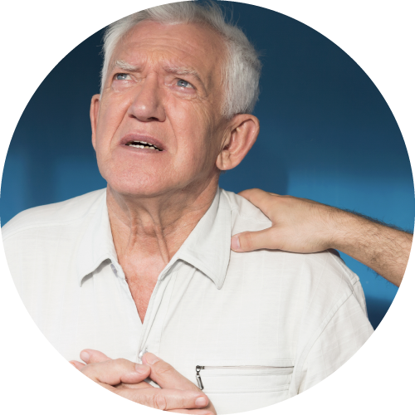

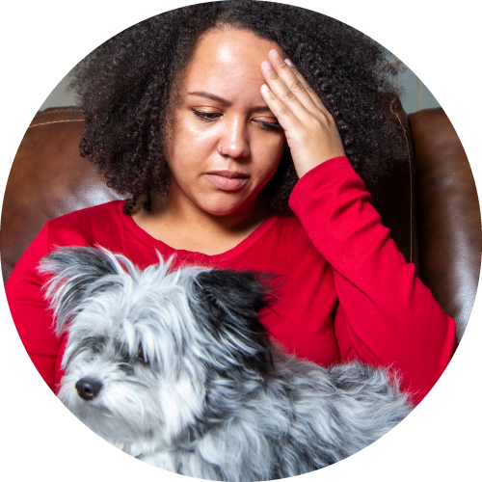
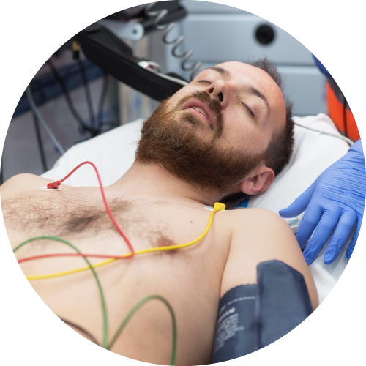
INCIDENT
FIRE 1
FF 1
EMT 2
EMS 1
Medic 1
EMT 1
HOSP 1
EDMD
Registration
Trauma Surgeon
…
Medic 7
Medic 2
ED Charge
Radiology
Pharmacy
PATIENT MOVEMENT EVENT
EMS 1
Medic 1
EMT 1
HOSP 3
EDMD
…
Medic 2
ED Charge
PATIENT MOVEMENT EVENT
EMS 7
Medic 5
HOSP 2
EDMD
Supervisor
…
Medic 6
ED Charge
PATIENT MOVEMENT EVENT
Notes:
During an incident with multiple patients, each patient has a dedicated communication and logistics channel creating situational awareness for the team providing care for that individual patient.
Within a standardized Incident Command System, Command and participating organizations also need situational awareness around the broader incident.

Slide 4
INCIDENT
FIRE 1
FF 1
EMT 2
EMS 1
Medic 1
EMT 1
HOSP 1
EDMD
Registration
Trauma Surgeon
…
Medic 7
Medic 2
ED Charge
Radiology
Pharmacy
PATIENT MOVEMENT EVENT
EMS 1
Medic 1
EMT 1
HOSP 3
EDMD
…
Medic 2
ED Charge
PATIENT MOVEMENT EVENT
EMS 7
Medic 5
HOSP 2
EDMD
Supervisor
…
Medic 6
ED Charge
PATIENT MOVEMENT EVENT
Notes:
Therefore, Incident Command is able to create an incident around this group of patient channels.

Slide 5


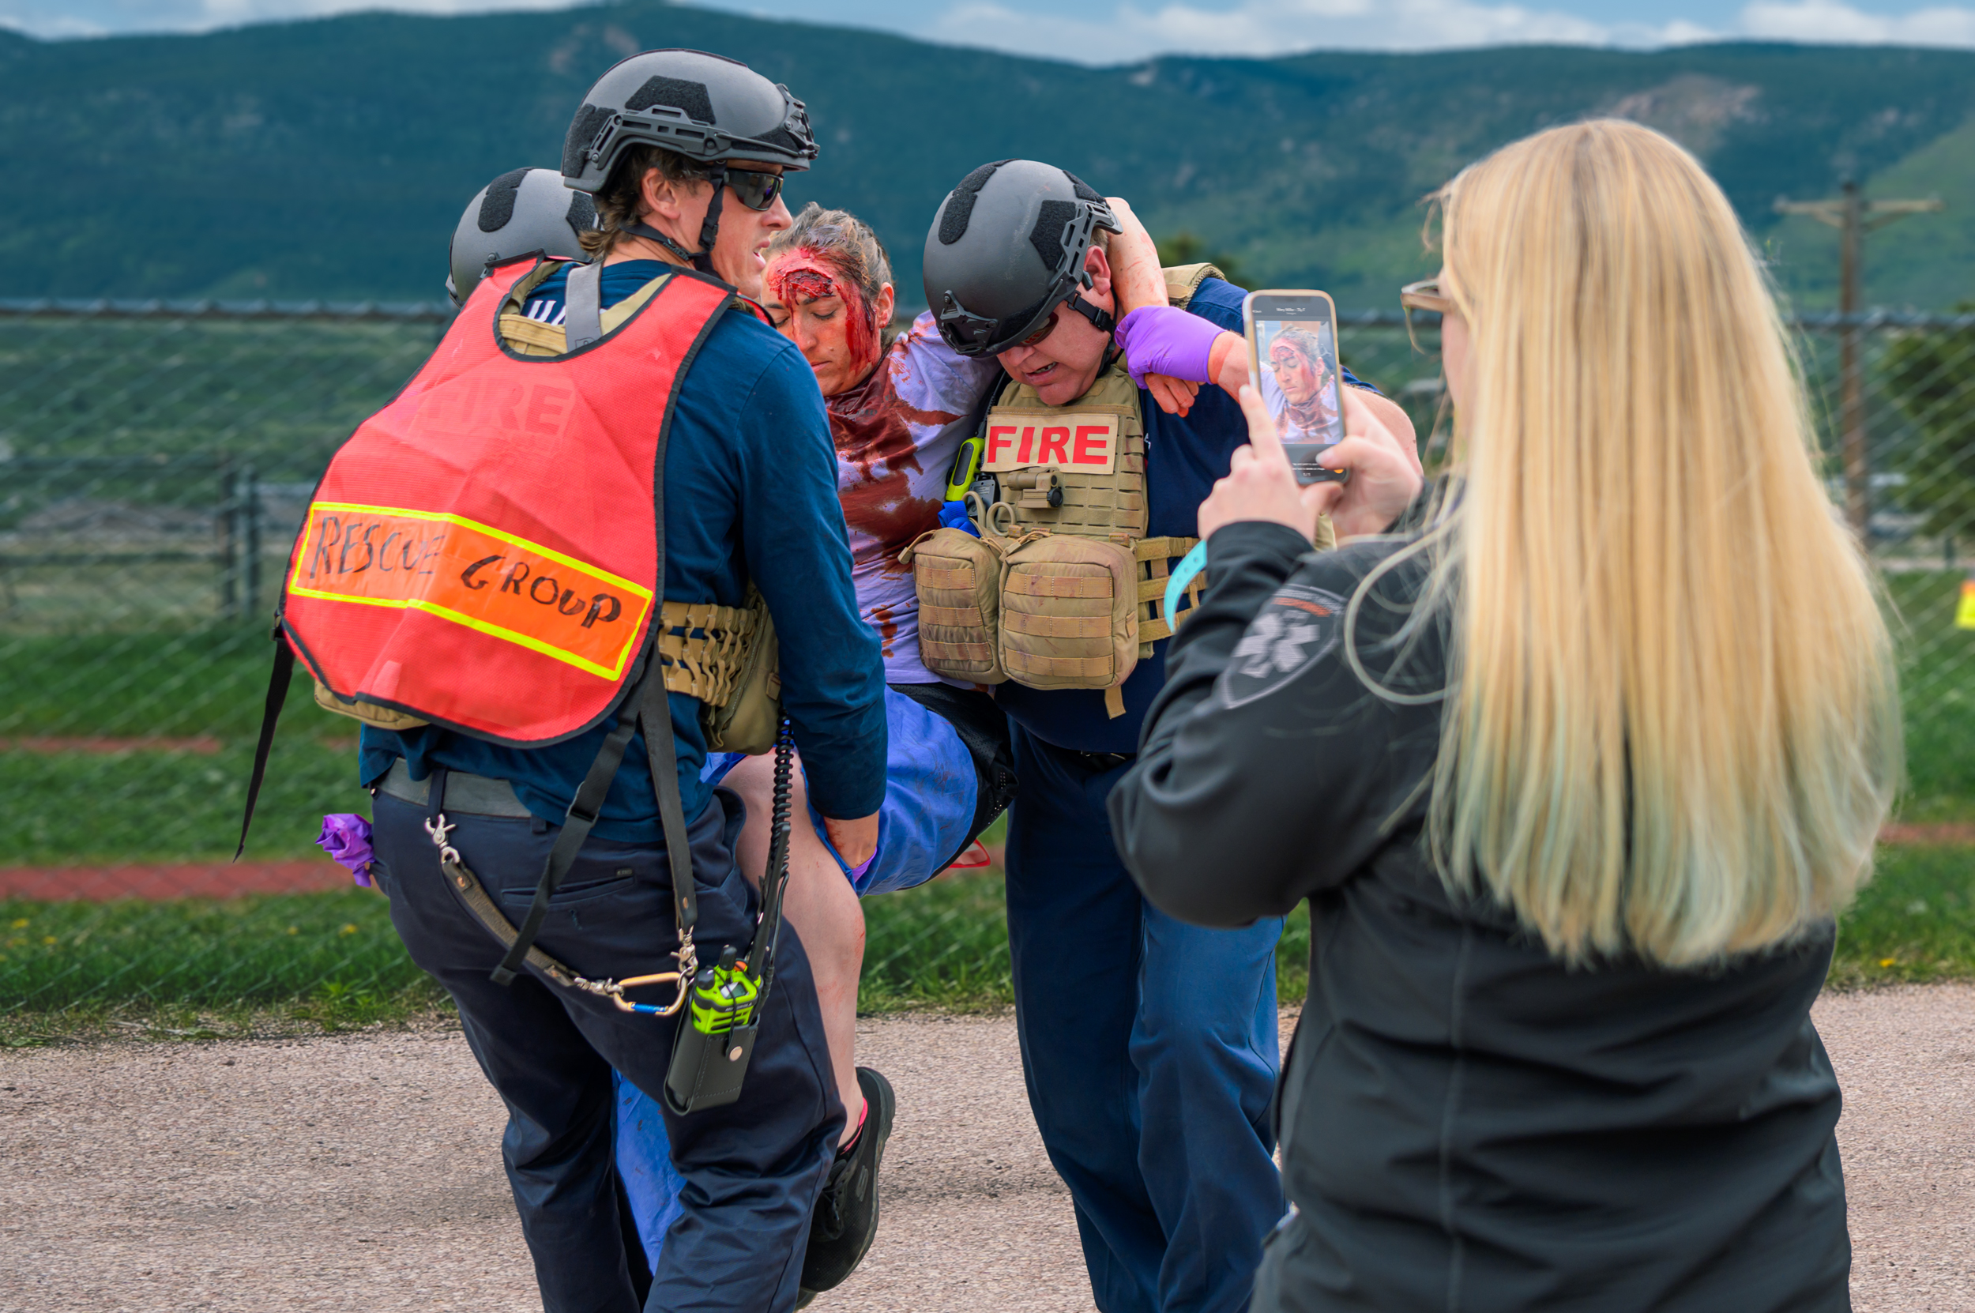
INCIDENT
FIRE 1
FF 1
EMT 2
EMS 1
Medic 1
EMT 1
HOSP 1
EDMD
Registration
Trauma Surgeon
…
Medic 7
Medic 2
ED Charge
Radiology
Pharmacy
PATIENT MOVEMENT EVENT
EMS 1
Medic 1
EMT 1
HOSP 3
EDMD
…
Medic 2
ED Charge
PATIENT MOVEMENT EVENT
EMS 7
Medic 5
HOSP 2
EDMD
Supervisor
…
Medic 6
ED Charge
PATIENT MOVEMENT EVENT
EMS 2
Medic 1
Medic 8
HOSP 1
EDMD
Registration
EMS 3
Medic 1
HOSP 7
Registration
Trauma Surgeon
…
Medic 4
ED Charge
Radiology
EMT 1
Radiology
Pharmacy
PATIENT MOVEMENT EVENT
HOSP 1
EDMD
Registration
…
ED Charge
PATIENT MOVEMENT EVENT
JOIN
Add Patients
Participate
Notes:
Outside organizations can join the incident, add patients, and participate. Unless granted additional privileges by Incident Command, they are only able to see the patients where they are participating in their care.

Slide 6
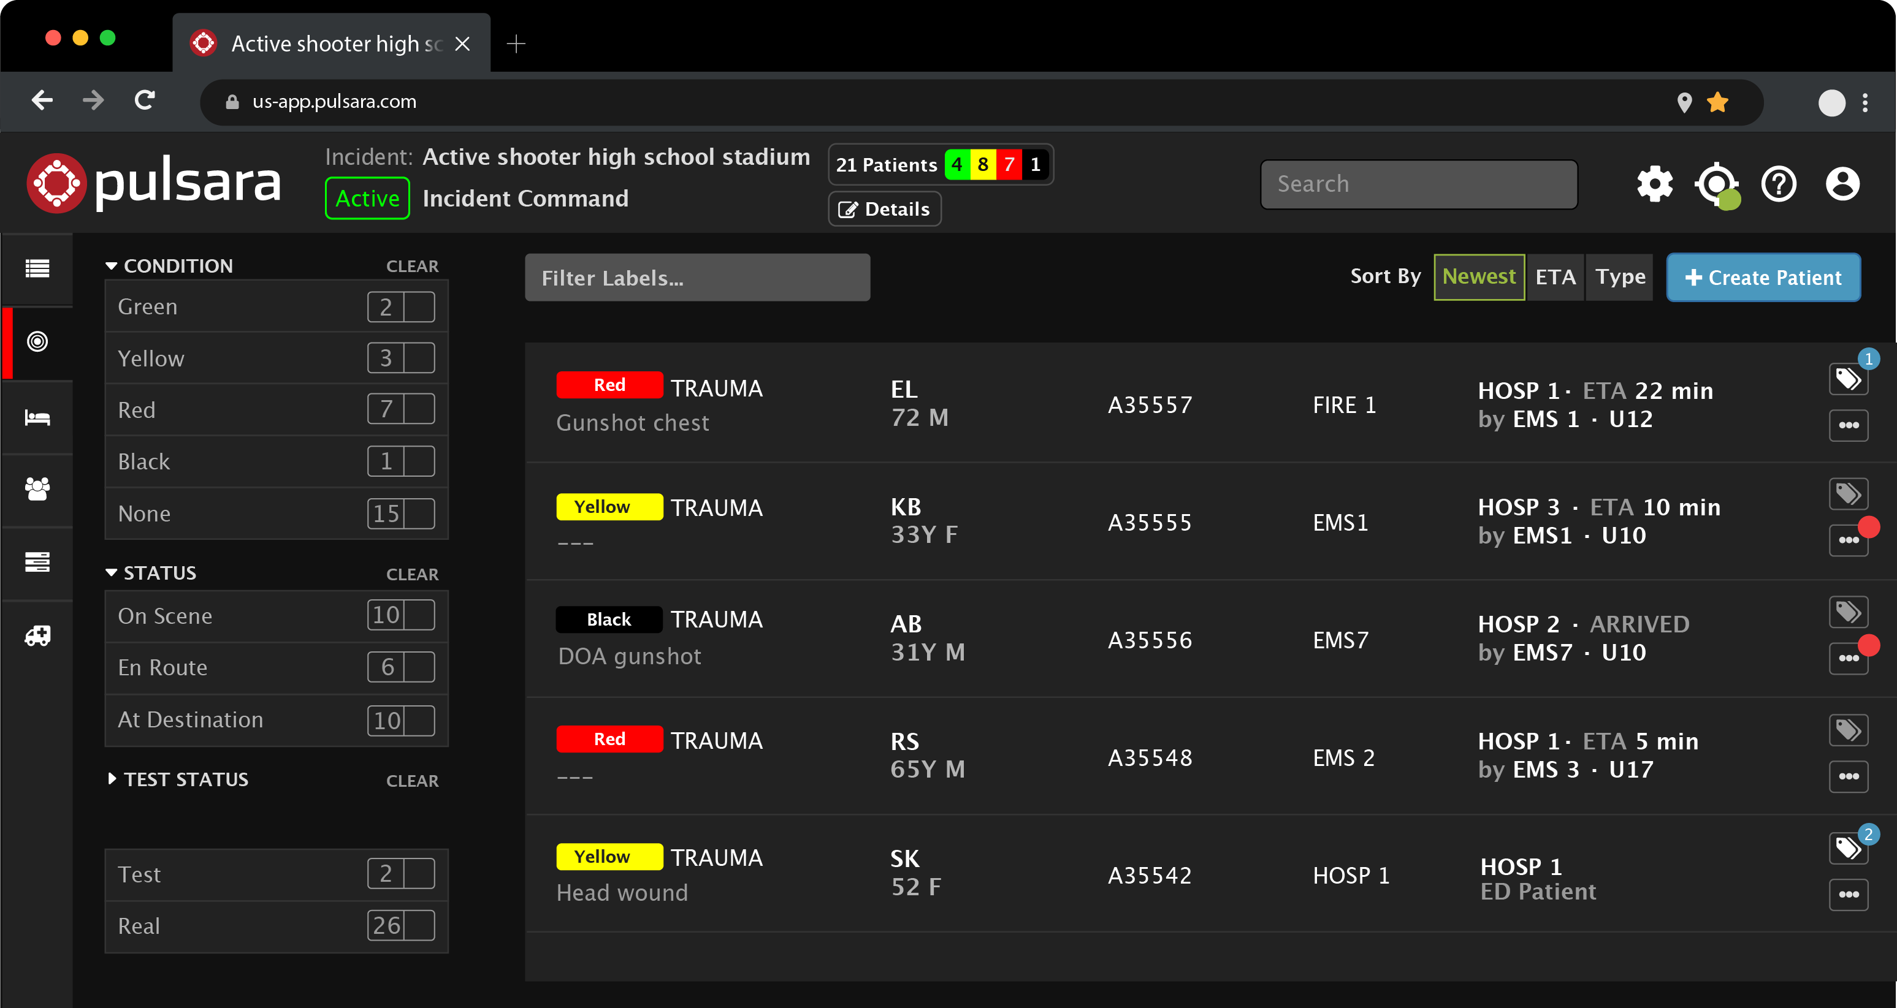
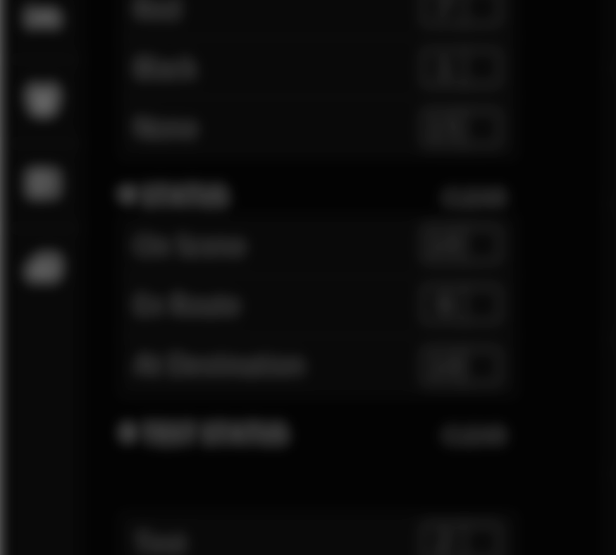
INCIDENT
FIRE 1
FF1
EMT 2
EMS 1
Medic 1
EMT 1
HOSP 1
EDMD
Registration
Trauma Surgeon
…
PATIENT MOVEMENT EVENT
Medic 7
Medic 2
ED Charge
Radiology
Pharmacy
EMS 1
Medic 1
EMT 1
HOSP 3
EDMD
…
PATIENT MOVEMENT EVENT
Medic 2
ED Charge
EMS 7
Medic 5
HOSP 2
EDMD
Supervisor
…
PATIENT MOVEMENT EVENT
Medic 6
ED Charge
EMS 2
Medic 1
MEDIC 8
HOSP 1
EDMD
Registration
EMS 3
Medic 1
HOSP 7
Registration
Trauma Surgeon
…
Medic 4
ED Charge
Radiology
EMT 1
Radiology
Pharmacy
PATIENT MOVEMENT EVENT
HOSP 1
EDMD
Registration
…
PATIENT MOVEMENT EVENT
ED Charge
JOIN
Add Patients
Participate
Notes:
However, Incident Command can see all patients who are associated with the incident.

Slide 7
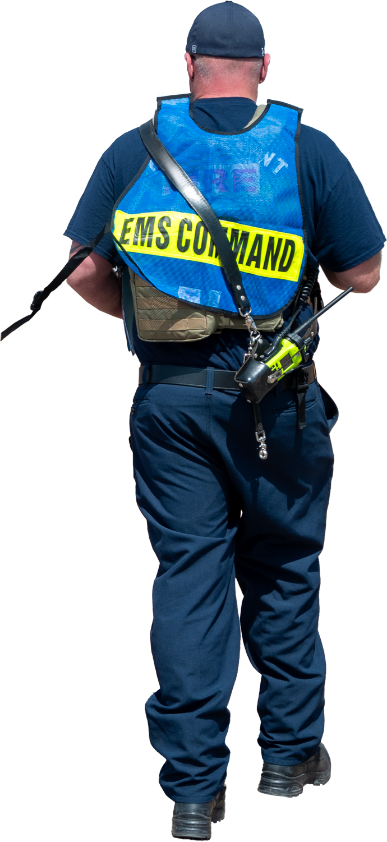
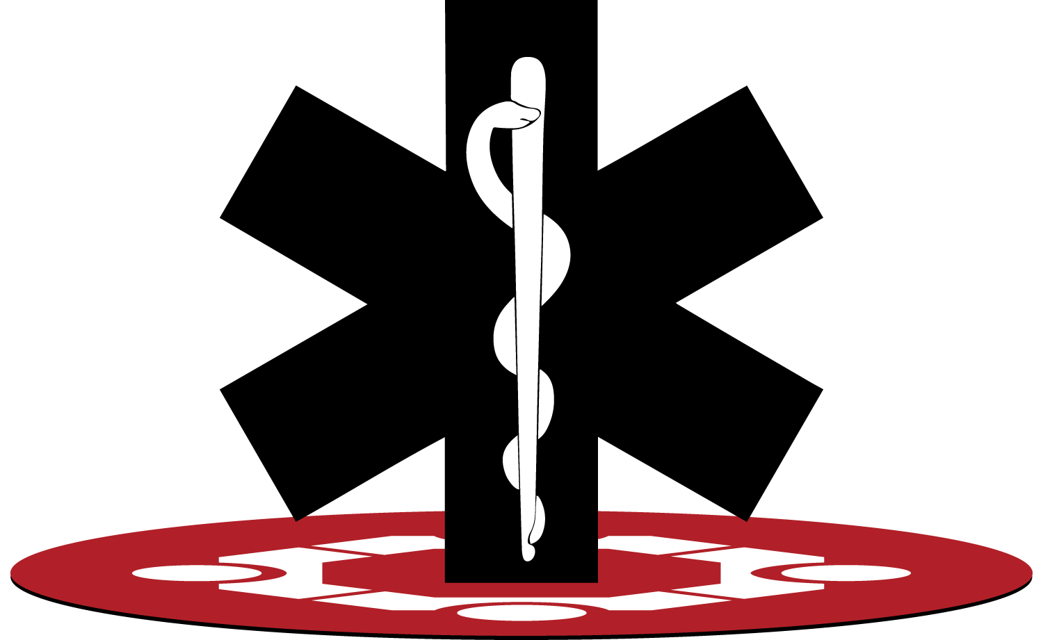
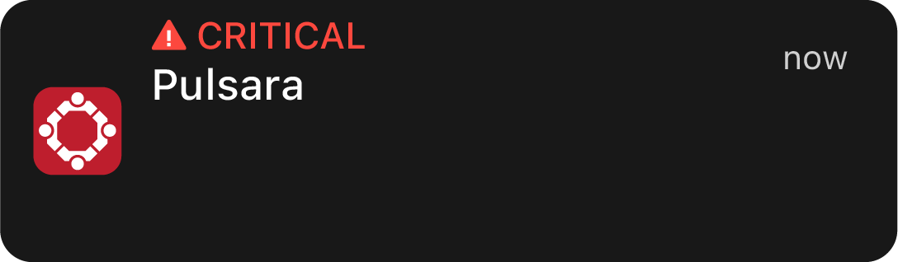






INCIDENT
Grace Memorial added to
INCIDENT: Active shooter at club
Grace Memorial added to
INCIDENT: Active shooter at club
Unit 1
Unit 2
Unit 3…
Grace Memorial added to
INCIDENT: Active shooter at club
ED • Radiology • Lab • Respiratory • Trauma Surgeon Ortho • CT Surgery • Pediatrics • Critical Care …
Grace Memorial added to
INCIDENT: Active shooter at club
Engine 1
Engine 2
Engine 3…
ED • Radiology • Lab • Respiratory • Trauma Surgeon Ortho • CT Surgery • Pediatrics • Critical Care …
Unit 1
Unit 2
Unit 3…
Grace Memorial added to
INCIDENT: Active shooter at club
Unit 1
Unit 2
Unit 3…
Engine 1
Engine 2
Engine 3…
ED • Radiology • Lab • Respiratory • Trauma Surgeon Ortho • CT Surgery • Pediatrics • Critical Care …
Grace Memorial added to
INCIDENT: Active shooter at club
Grace Memorial added to
INCIDENT: Active shooter at club
ED • Radiology • Lab • Respiratory • Trauma Surgeon Ortho • CT Surgery • Pediatrics • Critical Care …
Unit 1
Unit 2
Unit 3…
Engine 1
Engine 2
Engine 3…
JOIN
Add Patients
Participate
INVITE
Alerting
Notes:
Command as the ability to Invite organizations like hospitals and EMS agencies to participate in the incident, and these organizations can choose who receives these critical notifications.

Slide 8
INCIDENT
FIRE 1
FF1
EMT 2
EMS 1
Medic 1
EMT 1
HOSP 1
EDMD
Registration
Trauma Surgeon
…
PATIENT MOVEMENT EVENT
Medic 7
Medic 2
ED Charge
Radiology
Pharmacy
EMS 1
Medic 1
EMT 1
HOSP 3
EDMD
…
PATIENT MOVEMENT EVENT
Medic 2
ED Charge
EMS 7
Medic 5
HOSP 2
EDMD
Supervisor
…
PATIENT MOVEMENT EVENT
Medic 6
ED Charge
EMS 2
Medic 1
MEDIC 8
HOSP 1
EDMD
Registration
EMS 3
Medic 1
HOSP 7
Registration
Trauma Surgeon
…
Medic 4
ED Charge
Radiology
EMT 1
Radiology
Pharmacy
PATIENT MOVEMENT EVENT
HOSP 1
EDMD
Registration
…
PATIENT MOVEMENT EVENT
ED Charge
JOIN
Add Patients
Participate
INVITE
Alerting
Privileges
  All Details
Notes:
Command can grant privileges to these organizations. They might allow a coordinating entity or a reunification center to see all patients and all patient details,

Slide 9
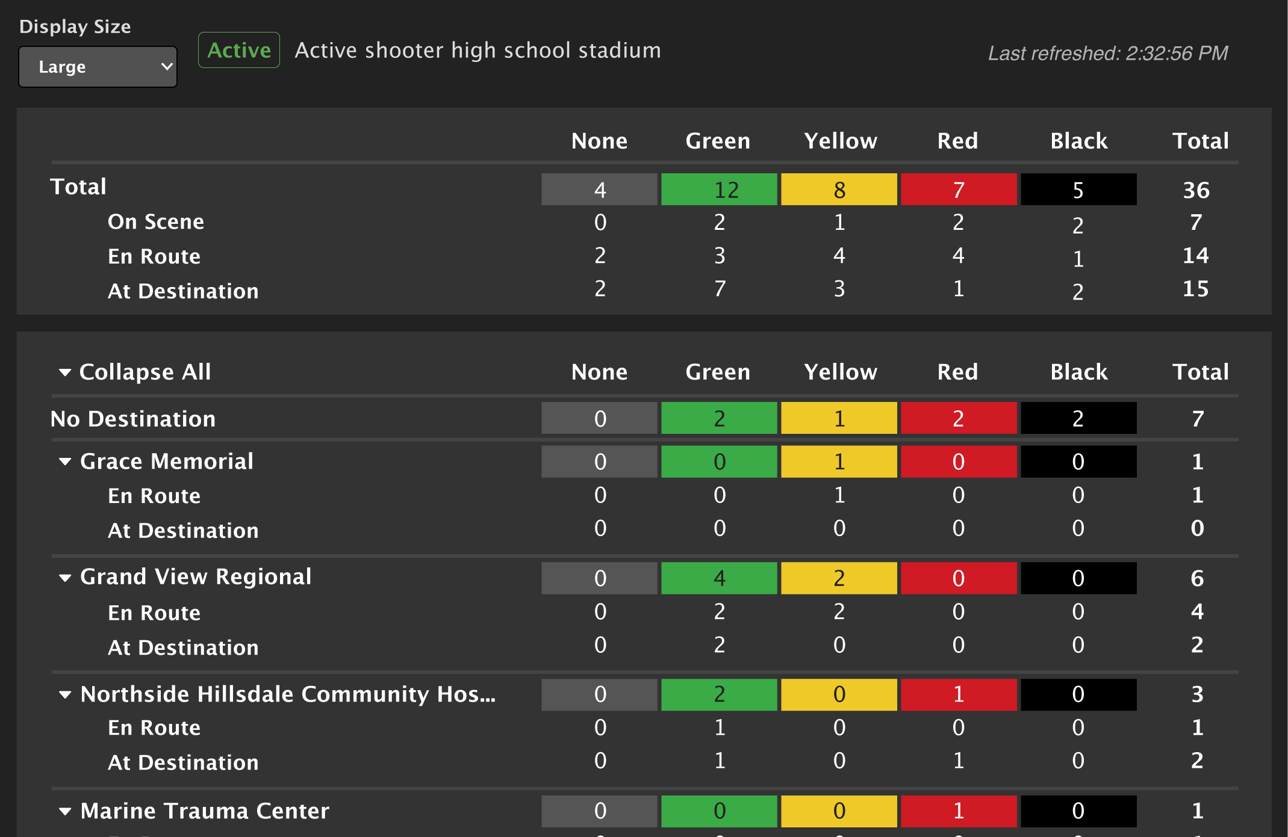
INCIDENT
FIRE 1
FF1
EMT 2
EMS 1
Medic 1
EMT 1
HOSP 1
EDMD
Registration
Trauma Surgeon
…
PATIENT MOVEMENT EVENT
Medic 7
Medic 2
ED Charge
Radiology
Pharmacy
EMS 1
Medic 1
EMT 1
HOSP 3
EDMD
…
PATIENT MOVEMENT EVENT
Medic 2
ED Charge
EMS 7
Medic 5
HOSP 2
EDMD
Supervisor
…
PATIENT MOVEMENT EVENT
Medic 6
ED Charge
EMS 2
Medic 1
MEDIC 8
HOSP 1
EDMD
Registration
EMS 3
Medic 1
HOSP 7
Registration
Trauma Surgeon
…
Medic 4
ED Charge
Radiology
EMT 1
Radiology
Pharmacy
PATIENT MOVEMENT EVENT
HOSP 1
EDMD
Registration
…
PATIENT MOVEMENT EVENT
ED Charge
JOIN
Add Patients
Participate
INVITE
Alerting
Privileges
  All Details
  Summary
Notes:
but most commonly they grant these organizations the ability to see the incident summary.

Slide 10
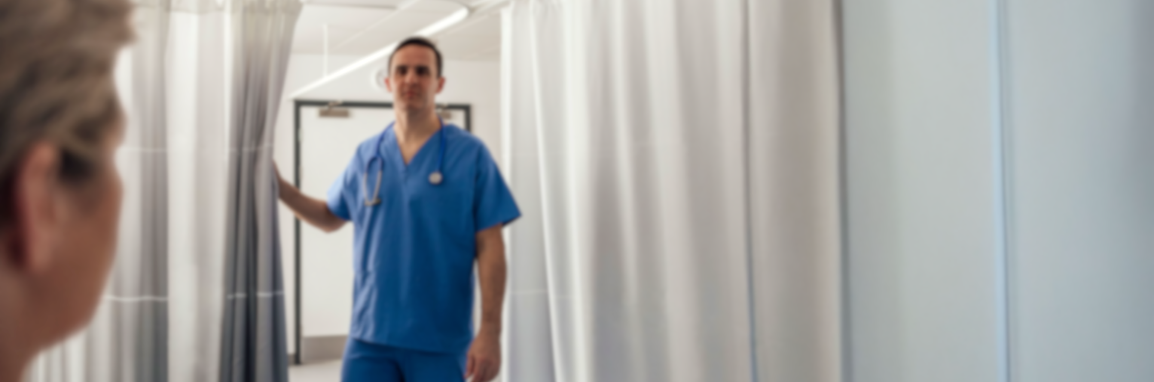
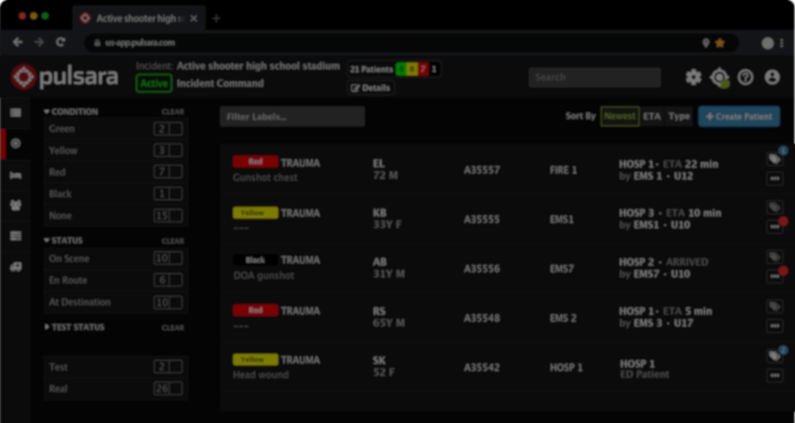
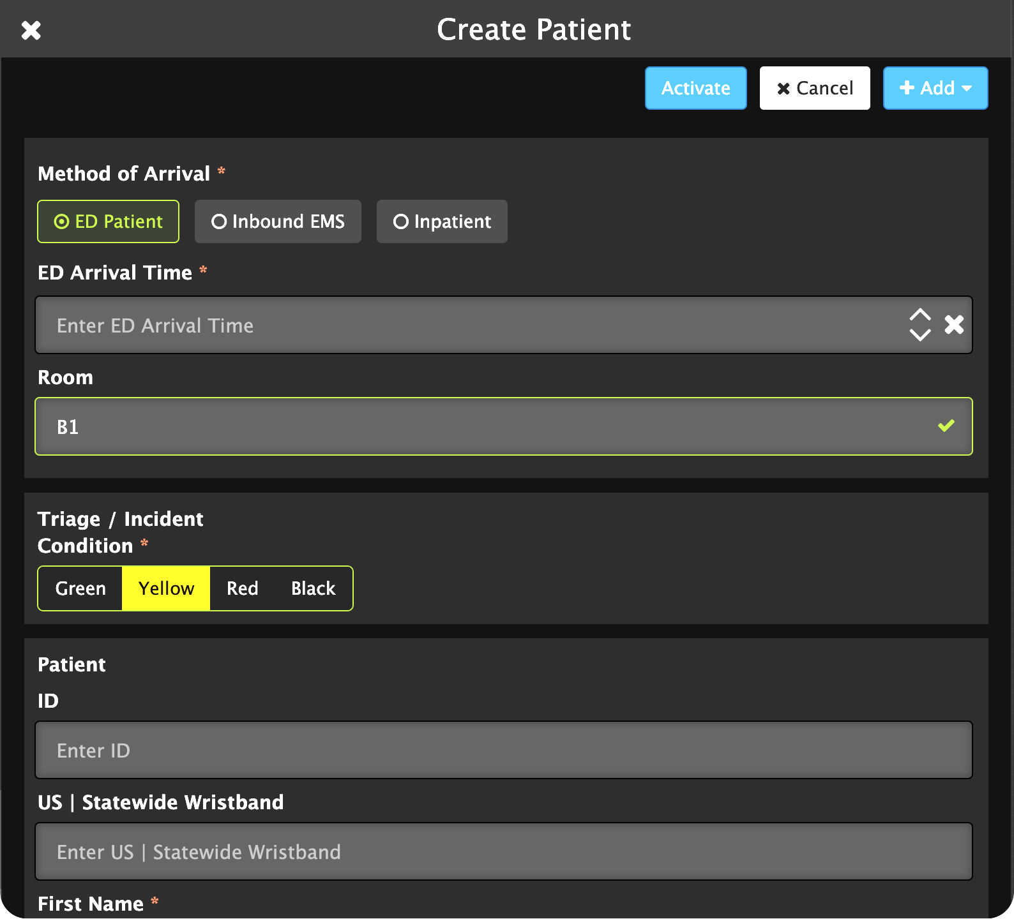
INCIDENT
Unit 1
Unit 2
Unit 3…
ED • Radiology • Lab • Respiratory • Trauma Surgeon Ortho • CT Surgery • Pediatrics • Critical Care …
Engine 1
Engine 2
Engine 3…
ED • Radiology • Lab • Respiratory • Trauma Surgeon Ortho • CT Surgery • Pediatrics • Critical Care …
Unit 1
Unit 2
Unit 3…
Unit 1
Unit 2
Unit 3…
Engine 1
Engine 2
Engine 3…
ED • Radiology • Lab • Respiratory • Trauma Surgeon Ortho • CT Surgery • Pediatrics • Critical Care …
HOSP 1
EDMD
Registration
Unit 1
Unit 2
Unit 3…
ED • Radiology • Lab • Respiratory • Trauma Surgeon Ortho • CT Surgery • Pediatrics • Critical Care …
…
PATIENT MOVEMENT EVENT
ED Charge
Engine 1
Engine 2
Engine 3…
JOIN
Add Patients
Participate
INVITE
Alerting
Privileges
  All Details
  Summary
Participate
Notes:
Hospitals can fully participate in the incident, add patients who self-present to the hospital, and manage inter-facility transfers.

Slide 11
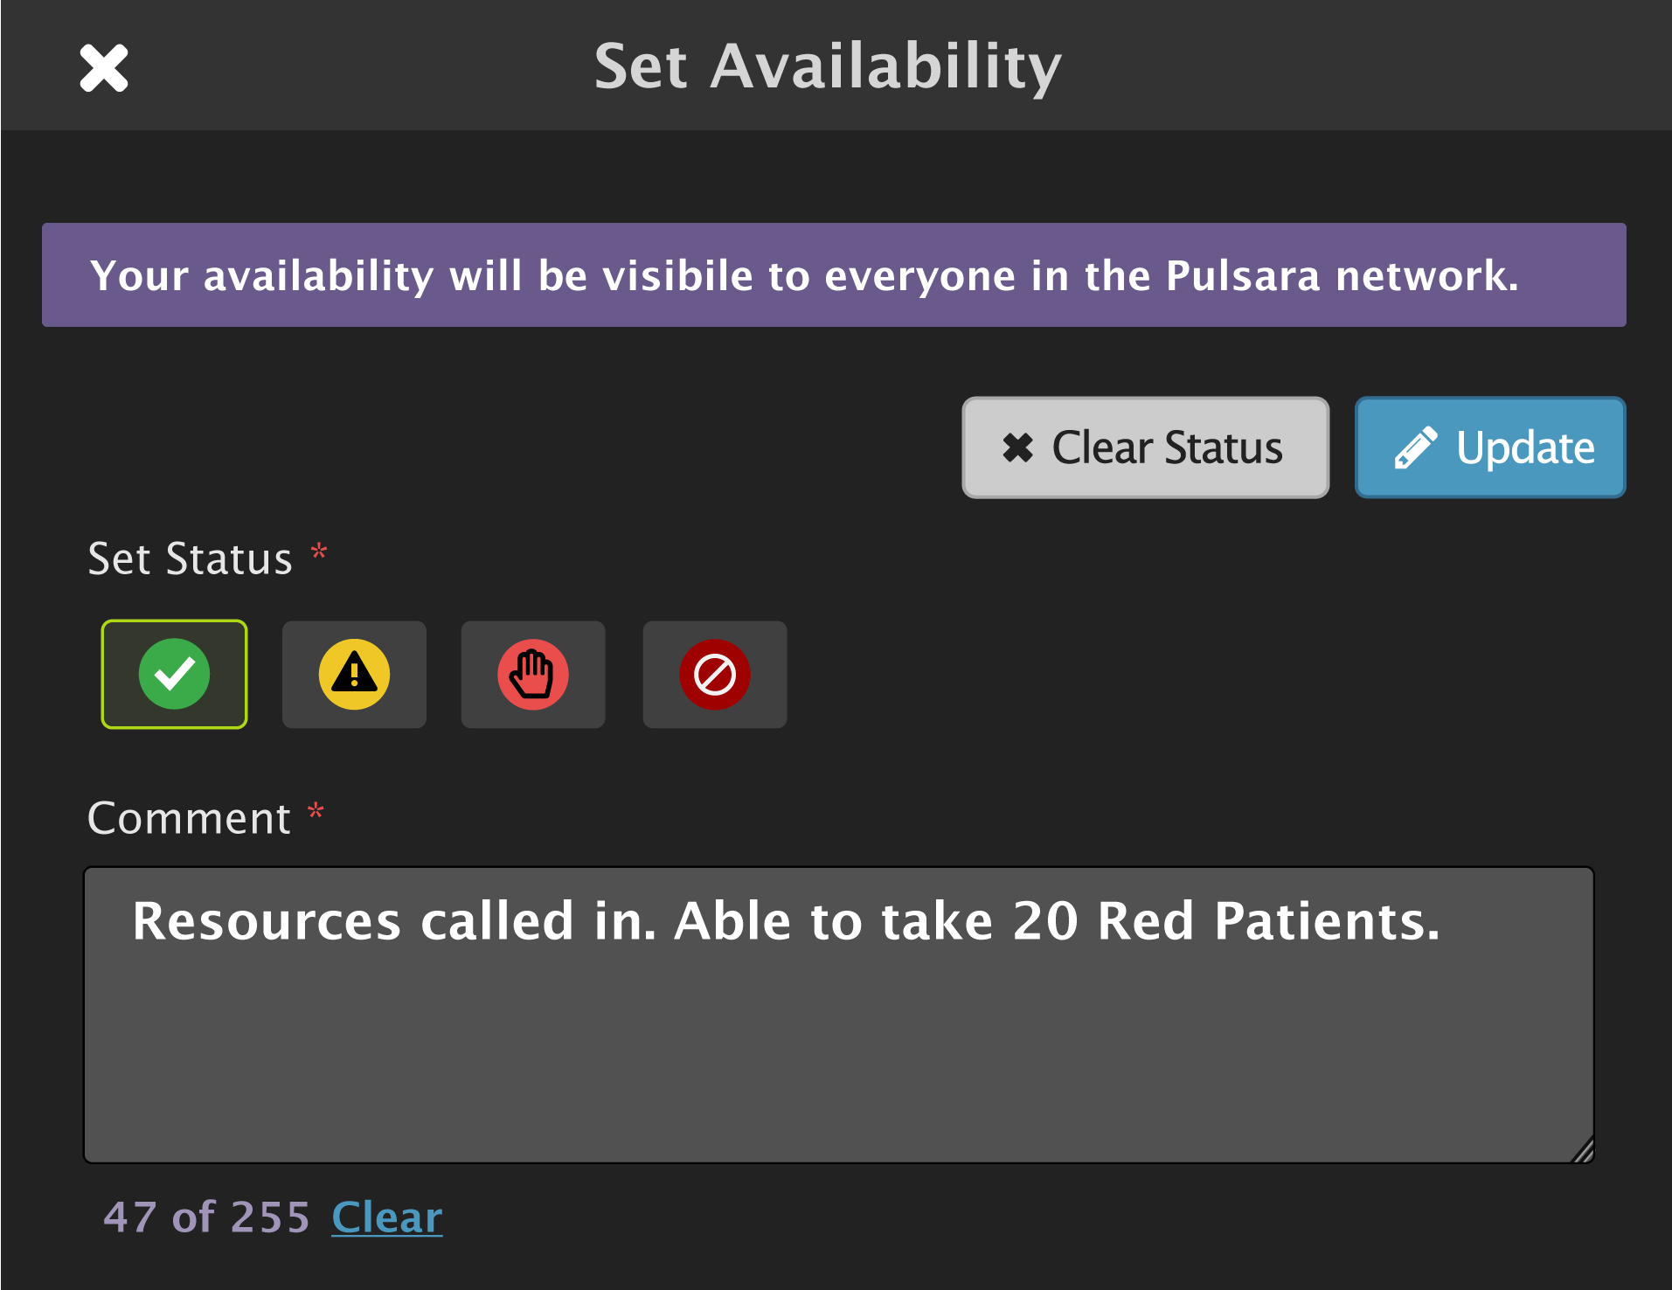
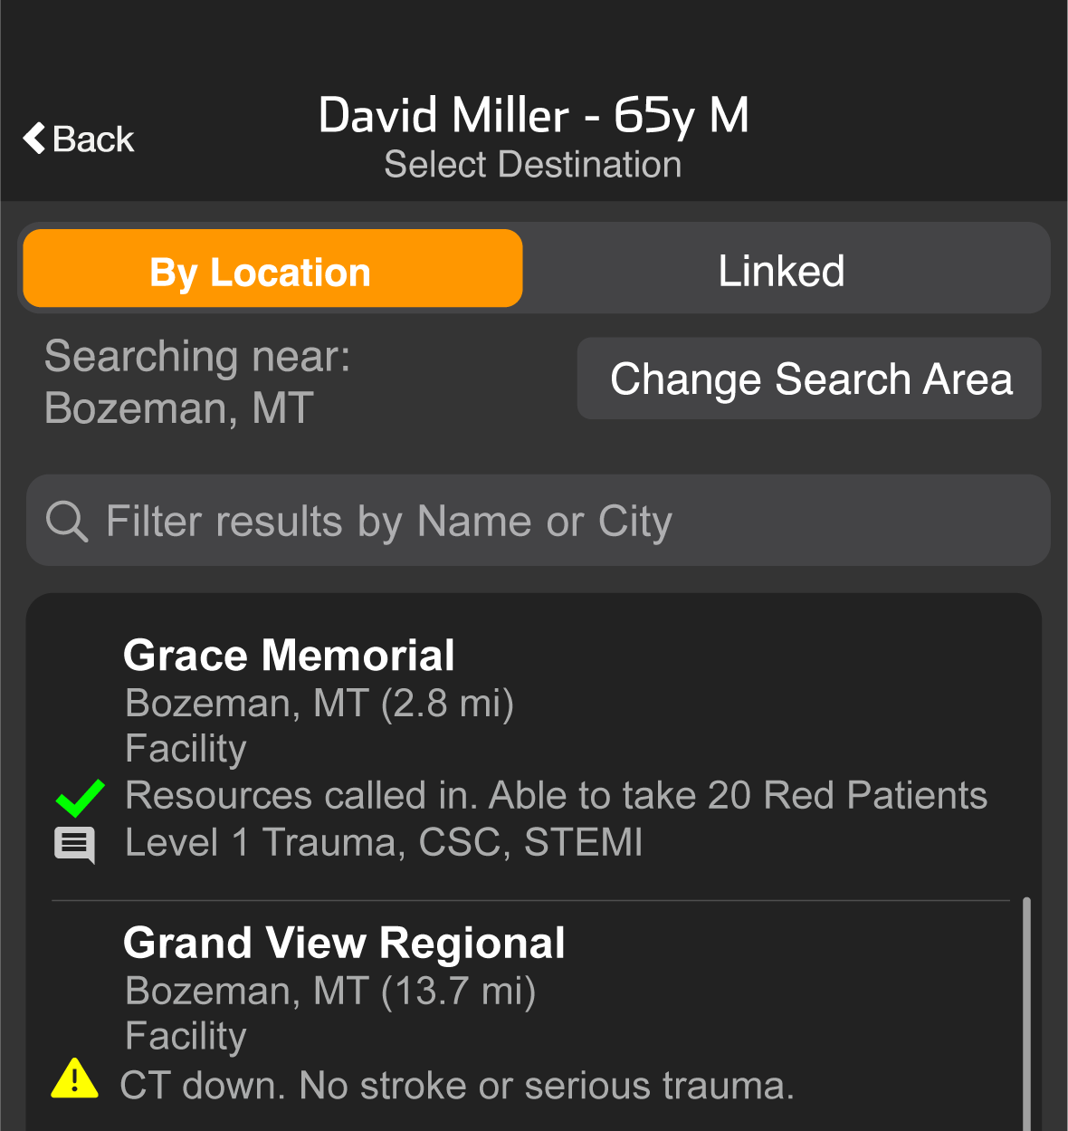
INCIDENT
Hospital
Transport
JOIN
Add Patients
Participate
INVITE
Alerting
Privileges
  All Details
  Summary
Participate
ED Availability
Notes:
In addition, they can update their availability which is presented to the transport officer, transporting EMS agencies, and other hospitals when they are selecting their transport destination.

Slide 12
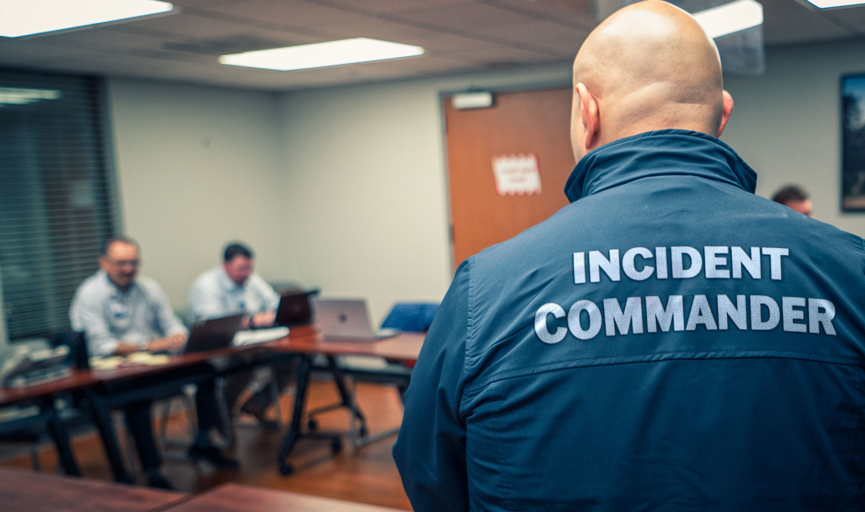
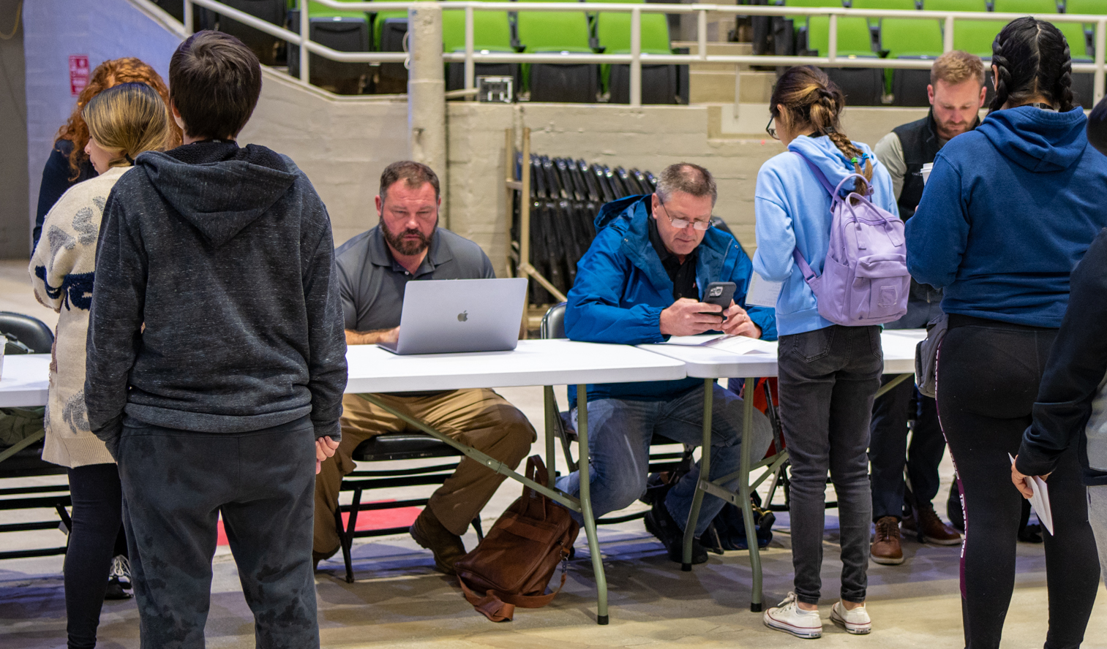
Reunification Workflow
INCIDENT
COMMAND
Add
Hospital(s)
Add Reunification Center(s)
MAIN INCIDENT – Source of Truth for Patient Encounters
REUNIFICATION
CENTER(S)
Key Reunification Features
Photos
  ID, Patient, Family, Belongings, Documents…
Driver License Scan
Contacts
  Pulsara Patient video calls
Template Forms
Labels
Status
Filtering
Search
Communication
  Chat
  Video or Phone Calls
View Summary and all patients for Main Incident
Notes:
To add a virtual or physical Reunification Center, Incident Command invites the Reunification Center and grants access to all patients. Most regions will choose to have a single Reunification Center that can have representatives from multiple organizations, or access is provided via liaisons, but Pulsara can support multiple reunification centers in a region. Initially, individual patient channels may contain few details or identifying information.
As receiving hospitals are added and the patient’s care team expands, more patient-identifying information is added to the individual channels. While clinicians will use patient channels to coordinate care, other hospital staff can assist with workflows aiding patient identification and reunification at the appropriate time.

Slide 13
Reunification Workflow
INCIDENT
COMMAND
Add
Hospital(s)
Add Reunification Center(s)
MAIN INCIDENT – Source of Truth for Patient Encounters
MANIFEST – Source of Truth for Souls on Board, Evacuees, or Missing Persons
REUNIFICATION
CENTER(S)
View Summary and all patients for Main Incident
Upload (or manually enter) Manifest
Notes:
Occasionally, there is a source of truth for potential victims. An example is an airline incident where the airline can upload a manifest and now use this as the source of truth for souls on board to help them reconcile against the main incident for reunification and reconciliation purposes. Similar roster uploads can be used to aid mass evacuations. Some communities will also create a single source of truth for missing persons, which can simplify access to this information and decrease the number of calls from people looking for duplicate missing persons.

Slide 14
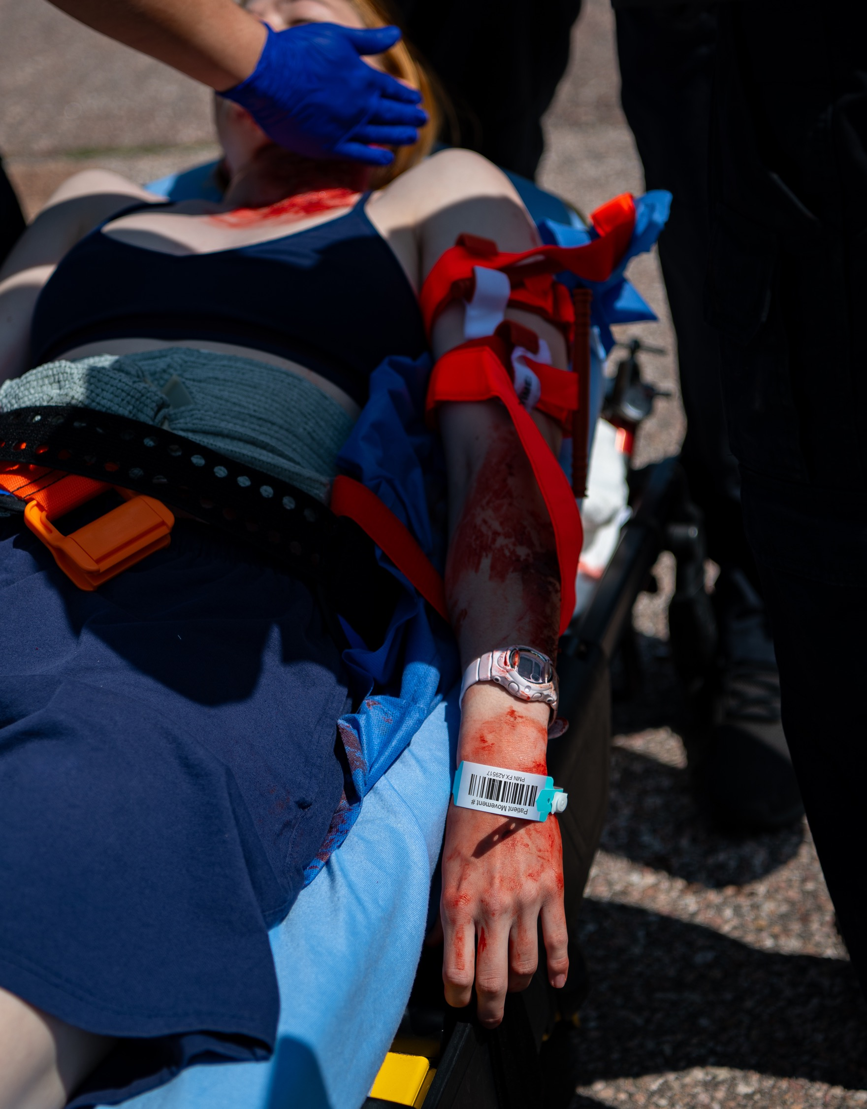
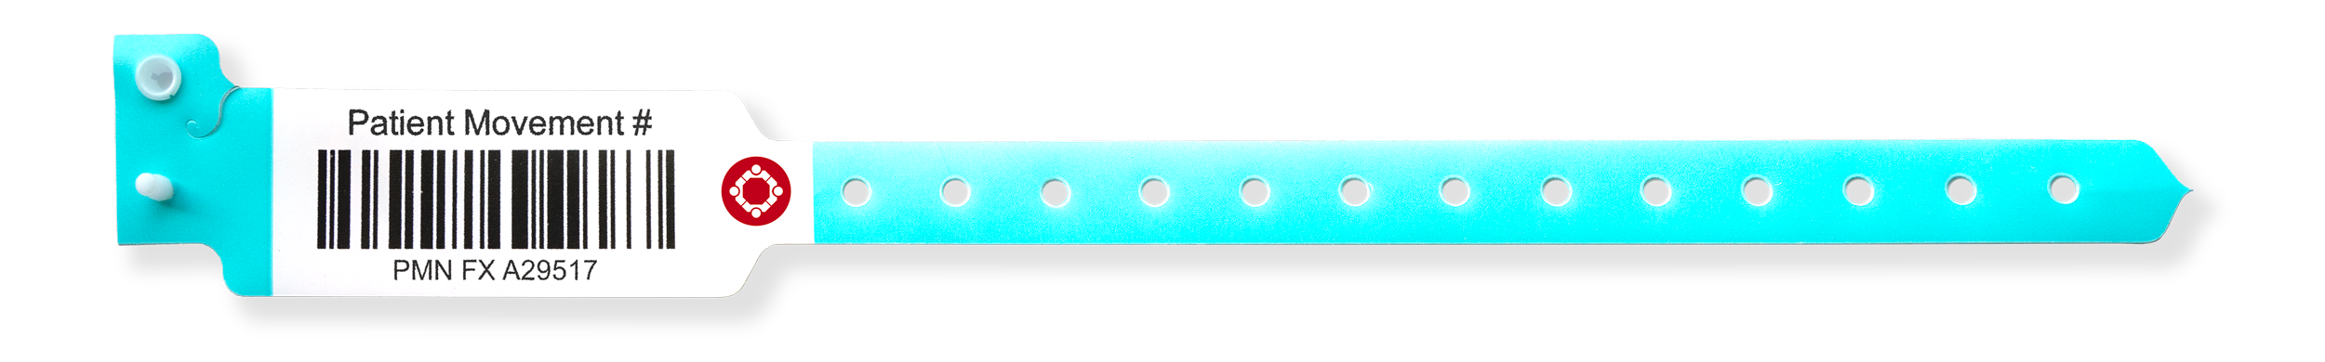
Patient Movement Wristbands
OBJECTIVES
Critical component of robust Patient Movement System
Statewide | National Interoperability
  Daily EMS to ED
  Incidents
Identify, find, move, hand off, and track “John & Jane Doe” patients
DAILY USE BENEFITS
Simplified “Scan and go” patient hand off
Unique ID from First Medical Contact to Definitive Treatment
Build Muscle Memory for Incidents
INCIDENT BENEFITS
Enable real-time situational awareness on the number and severity of patient encounters
Eliminate duplicate patients
Creates self-healing patient movement system in chaotic environments with variable connectivity
Notes:
Patient Movement Wristbands are a critical component of a robust Patient Movement System. Large-scale incidents are chaotic environments, and patient identification and tracking are not at the forefront of front-line providers' priorities.
Using patient movement wristbands on a daily basis helps simplify “scan and go” routine patient handoffs and makes their application automatic when under stress.
Following two simple rules provides organizations with real-time situational awareness on the number and severity of patient encounters, helping identify, find, move, and track “John and Jane Doe” patients and eliminate duplicate patients.

Slide 15
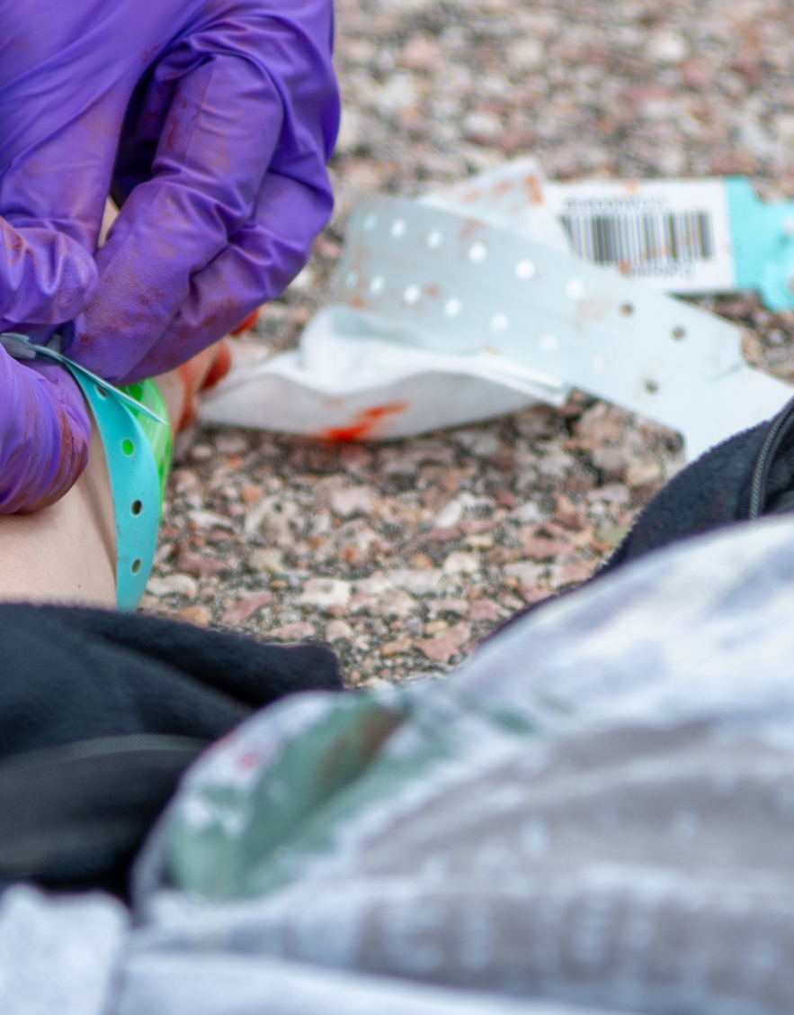
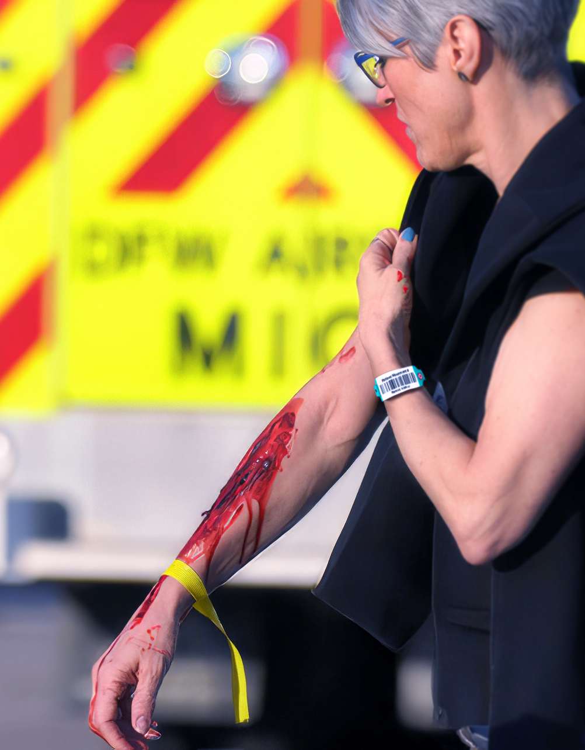
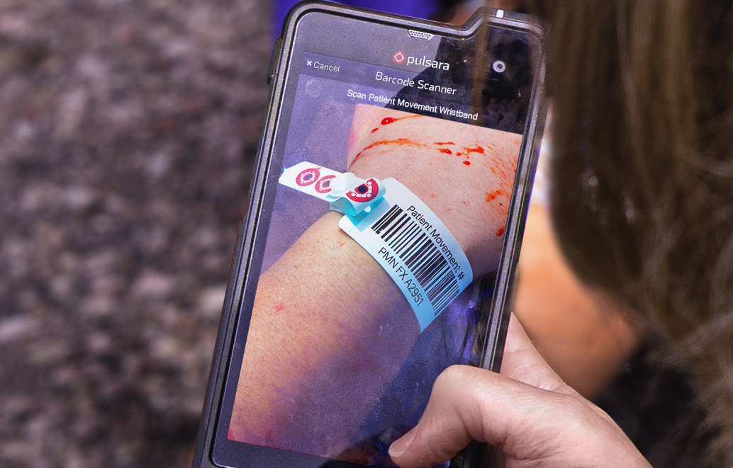
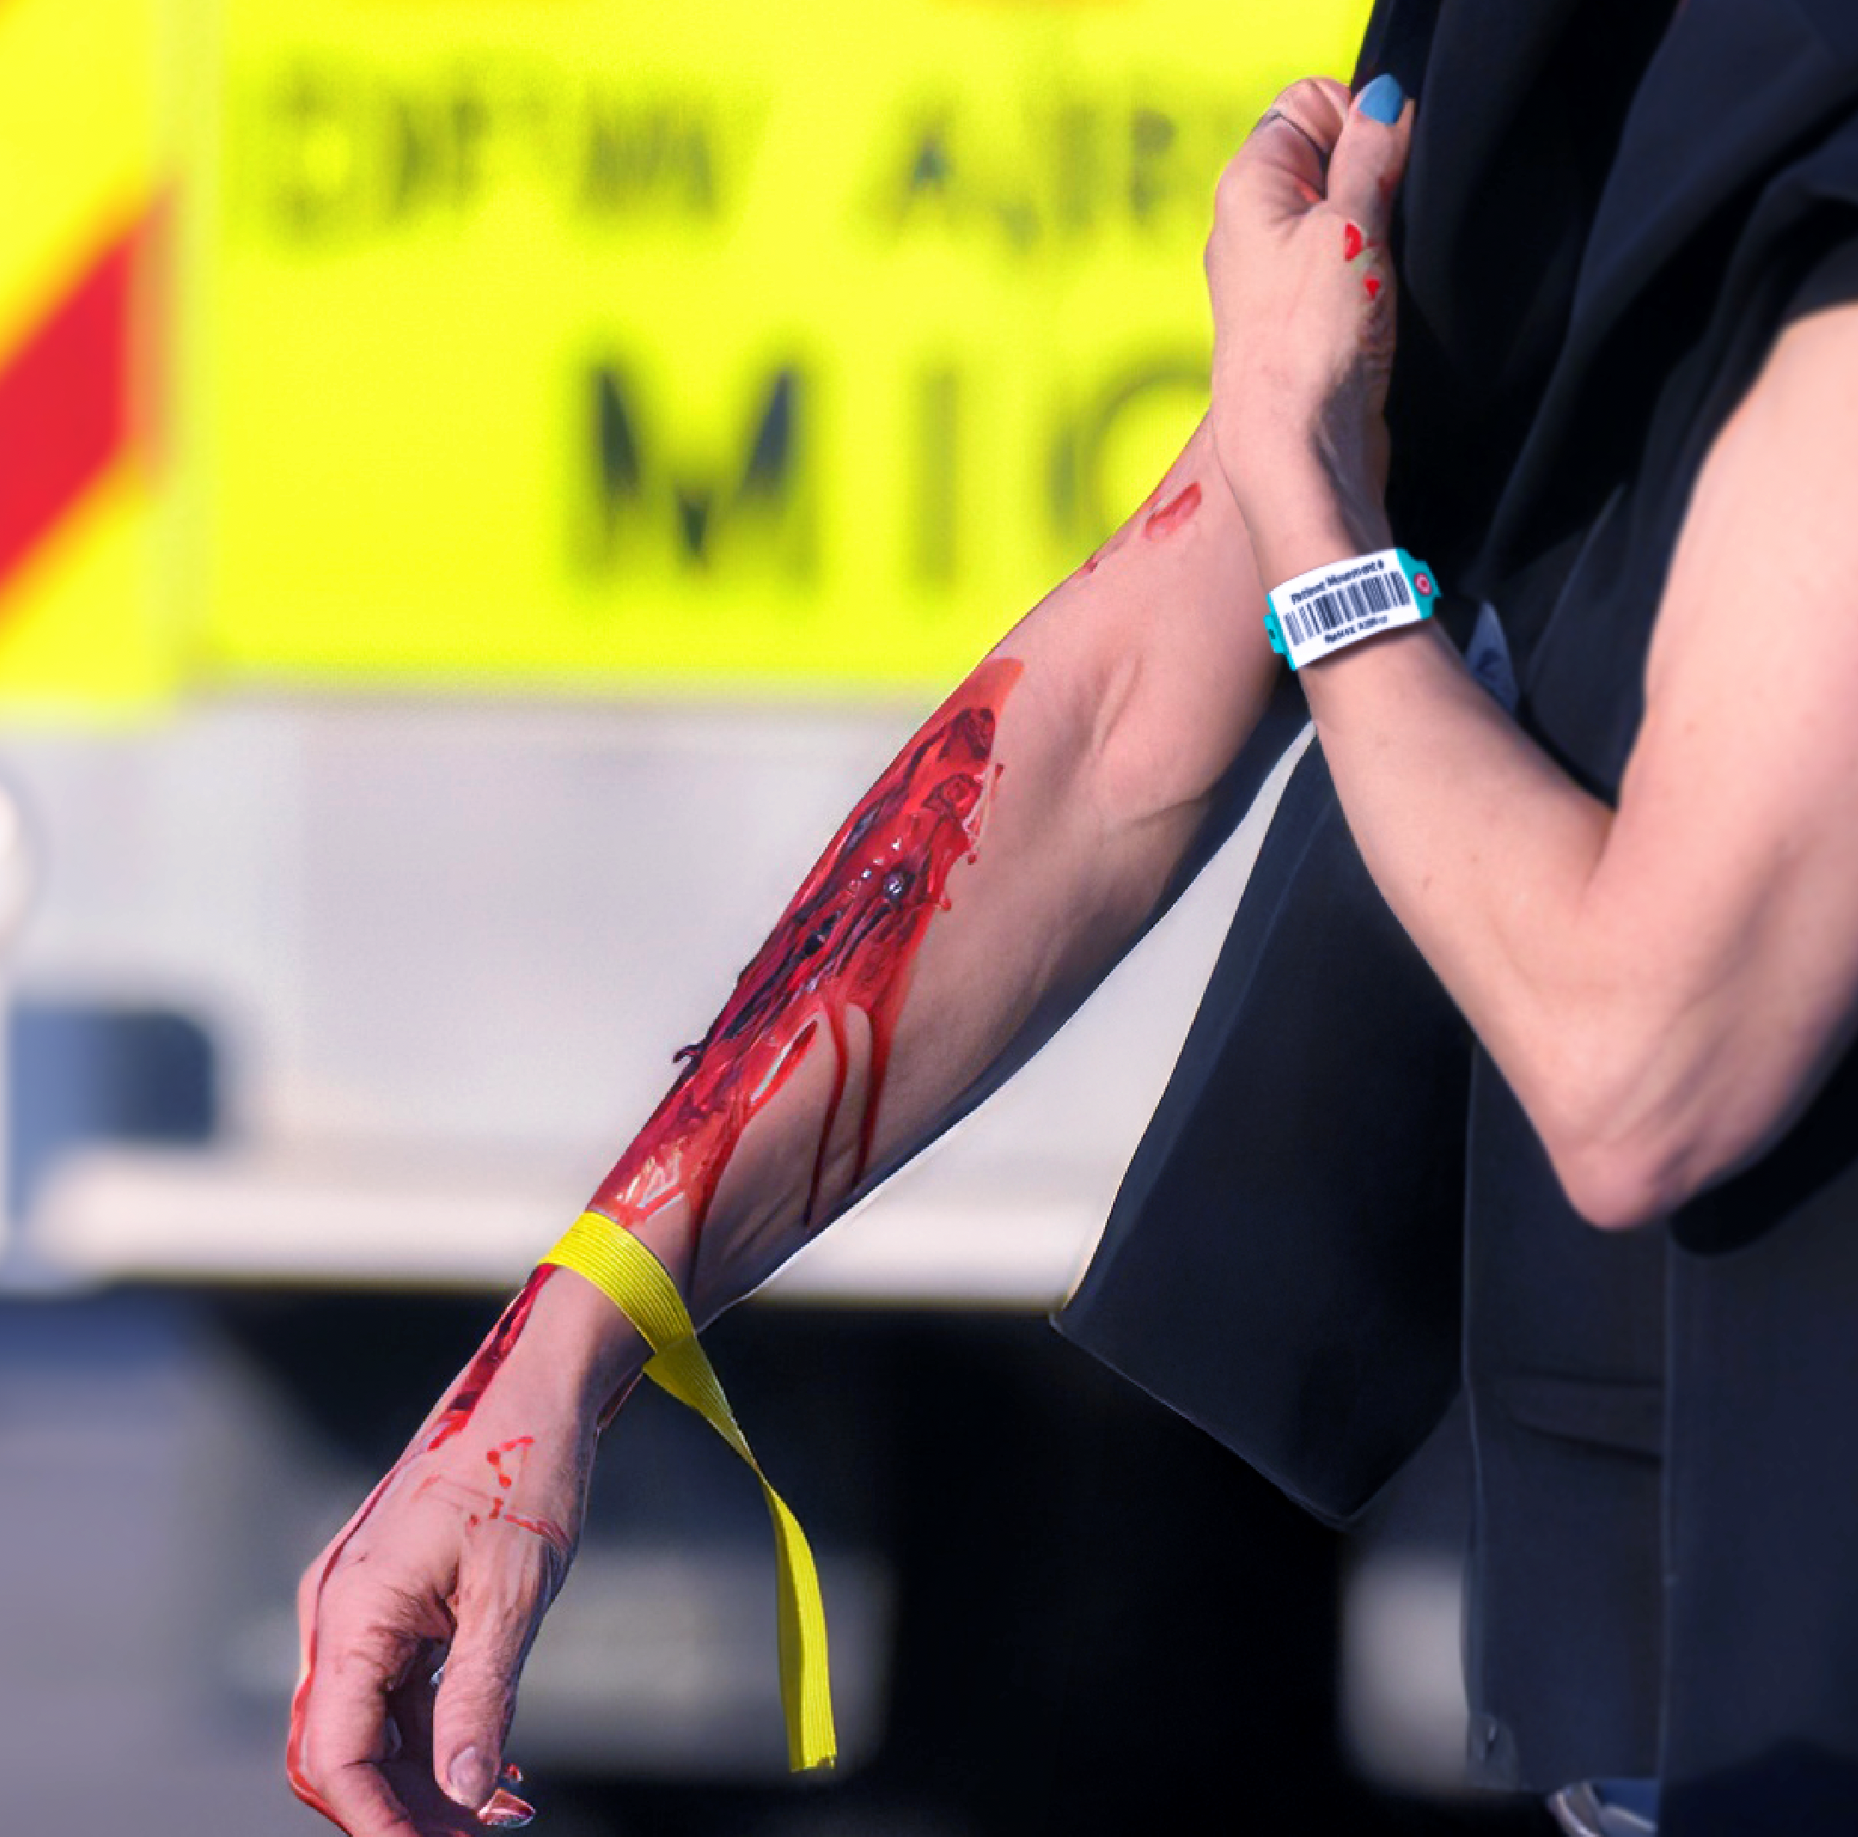
Patient Movement Wristbands
RULE 1: Band Every Patient
See a patient without a band? Add one.
RULE 2: Scan Band
See a band? Scan it.
  Newly added band: Creates new channel
  Existing band: Opens the channel
OPTION: Use colored tape for a visual
indicator of the triage condition.
Notes:
The two simple and intuitive rules of using Patient Movement Wristbands:
Rule 1: If you see a patient without a band, put a band on them. It is preferred to do this immediately at first patient contact. However, it may be most appropriate to do this at a casualty collection point in large-scale chaotic or dangerous environments.
Rule 2: If you see a band, scan it. If the band is in the system, it will open that patient channel and assign you to the patient. If it is new, it will prompt you to create the channel. This creates a self-healing patient movement system in chaotic environments with variable connectivity.
While the patient channel prominently displays the triage condition, some communities like the visual of colored triage tags on patients. They replicate this by applying colored tape to the wristbands.

