Slide 1
SAME PATIENT MOVEMENT SYSTEM
EVERY DAY
EVERY EVENT
Notes:
Pulsara is The communication and logistics platform that unites distributed teams and fragmented technologies during dynamic events.

Slide 2
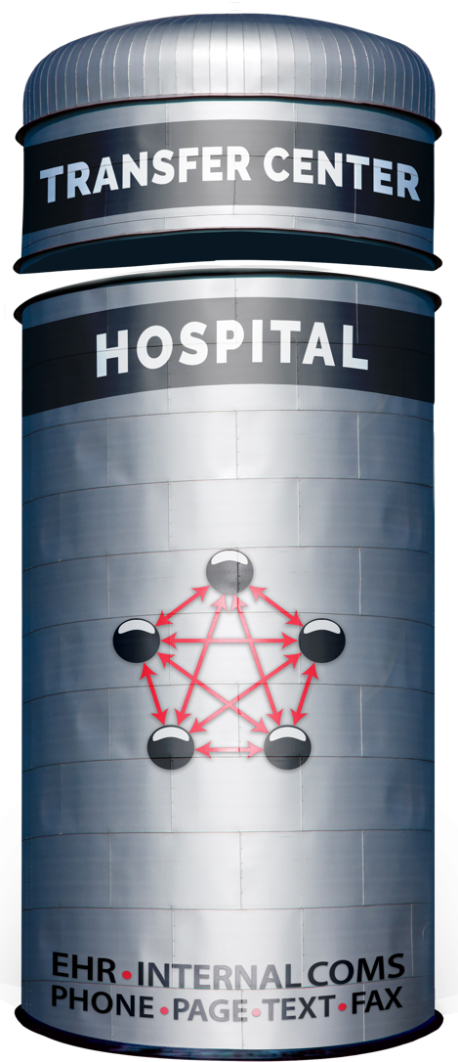


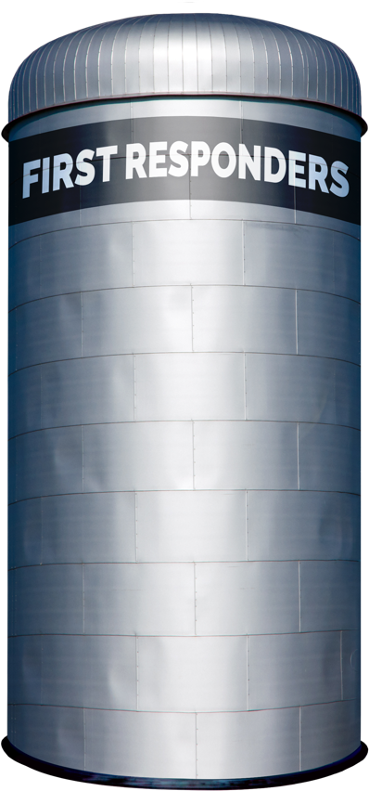
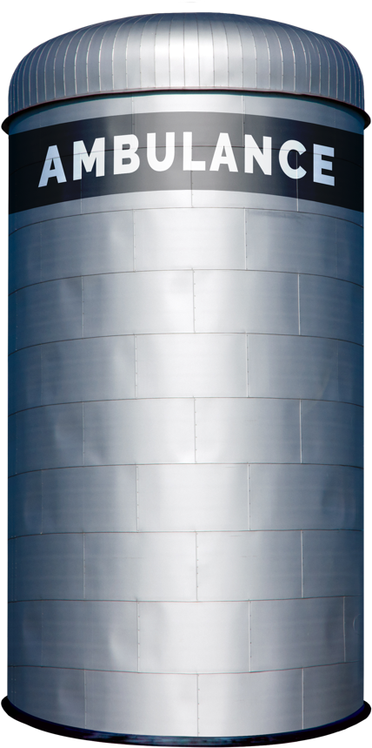

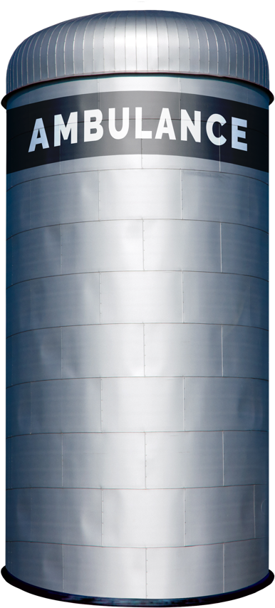


Traditional Patient Movement
Teleconsult
Phone
Secure
Msg
Page
Verbal
Handoff
Electronic
Notifications
Radio
Phone
ECG
ePCR or
Electronic
Notifications
Phone
Bedside
Handoff
Radio
Phone
Bedside
Handoff
Each Red Arrow Represents a Separate Communication Channel
COMMUNICATION CHANNELS: Numerous
Notes:
Traditionally, moving patients across organizations demands coordination through multiple communication channels, including radio reports, phone calls, alerting tools, and secure messaging systems. Often, intermediaries like transfer centers or regional “MedCom” are needed to coordinate these calls and data sources.
In the diagram, the red lines represent these distinct communication channels, each attempting to facilitate care transitions across siloed organizations. This workflow is not only inefficient for routine, low-acuity transfers but is particularly ineffective for time-sensitive emergencies, mass casualty incidents, large-scale evacuations, and load-balancing efforts.

Slide 3
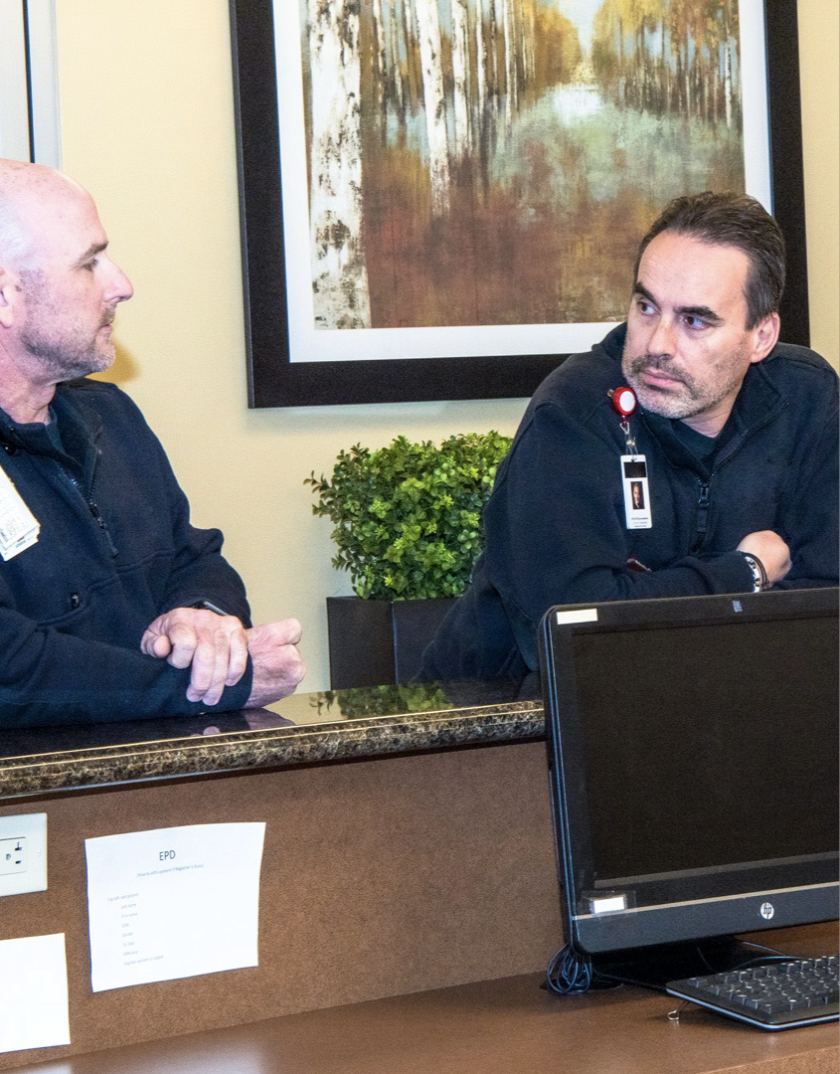

EMS – Daily Use
Wouldn’t it be great if FRO could hand off report digitally? Most of my patient report could be done already.
How long do I have to wait for the ED to answer? I need to get back to patient care!
I gave a solid report, but no one was ready when I got there.
I’m not going to log into something else just to see ED availability.
I wish I knew they were on the wall for an hour at that facility.
I sent the ECG. What do you mean you can’t find it? Did it transmit? Is the system down?
Why can’t I just take a photo of the med list or important info?
Call report. REPEAT at the front door. REPEAT at bedside. REPEAT when the doc shows up. REPEAT in ePCR…
Can I go straight to the Cath Lab or CT?
Whatever happened to that patient?
I wish I could add more info after I left the scene or ED.
We wish we had more information for billing. Says every EMS admin ever…
Traditional Patient Movement Challenges
Notes:
Although we’ve grown accustomed to this system over the years, we continue to face its challenges and limitations daily.

Slide 4
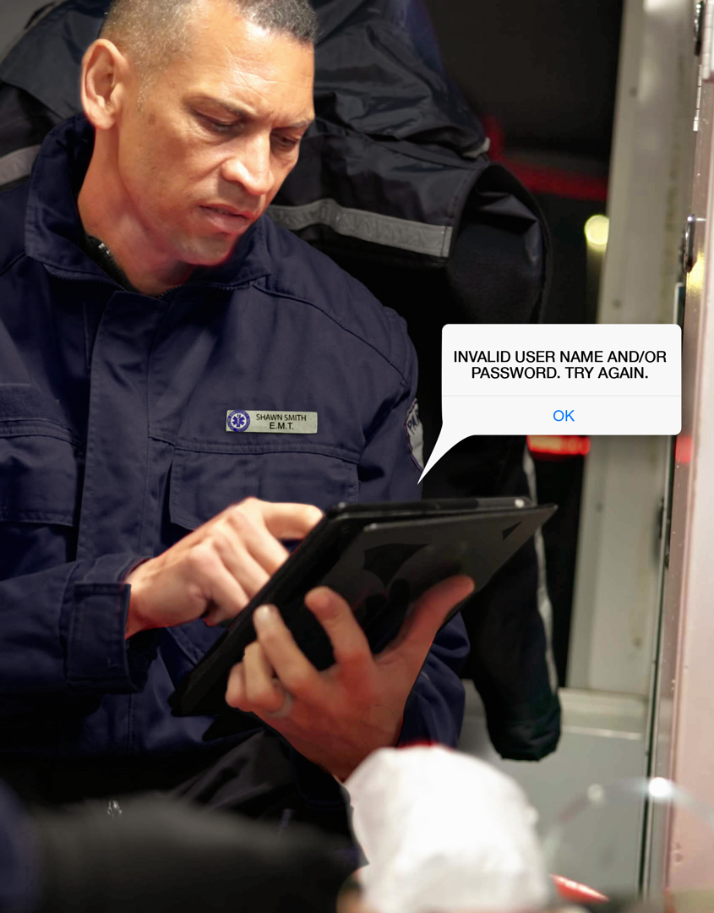
EMS - Incidents
What’s my username and password for this system? I haven’t logged on in months.
How do I use this system again? We only use it during incidents.
There are so many different tools to connect with different groups in the region.
Where are the triage tags?
These triage tags always fall off the patients.
I’m not going to log into something else just to see ED availability.
LEADERSHIP
How many patients have gone to each facility, including self-arrivals?
There is a lack of situational awareness across all participating individuals and organizations.
We can’t track John/Jane Doe patients and always have duplicates or missing records.
Traditional Patient Movement Challenges
Notes:
The challenges become even more pronounced during large-scale, multi-agency events, underscoring a fundamental infrastructure problem—especially considering advancements in communication technology and connectivity in other areas of our lives.

Slide 5
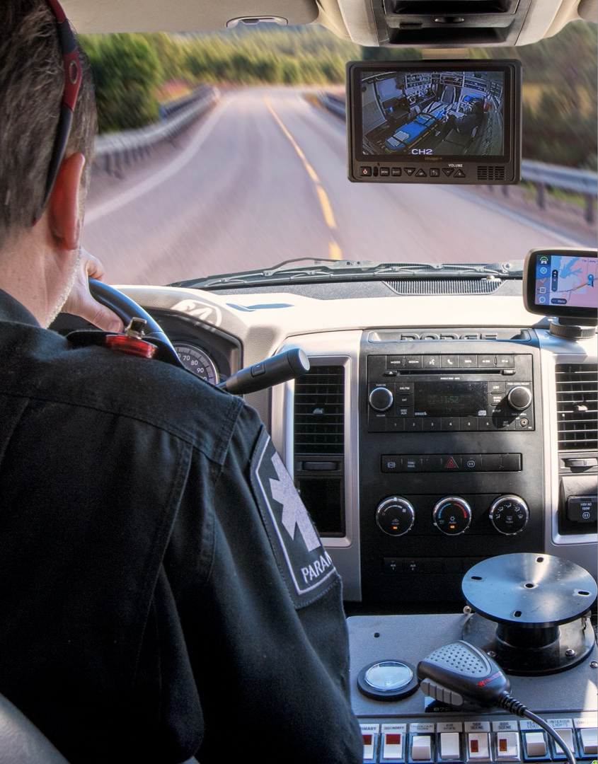
Interfacility Transport Crew
Where do I go?
It is difficult to get an updated ETA to the correct people.
It is hard to provide an update in patient condition if there are significant changes en route – especially during long transports.
It is difficult to get communication back from the facility about room changes or other pertinent updates.
Traditional Patient Movement Challenges
Notes:
Even primary inter-facility transport (IFT) agencies face challenges stemming from outdated communication technology.

Slide 6
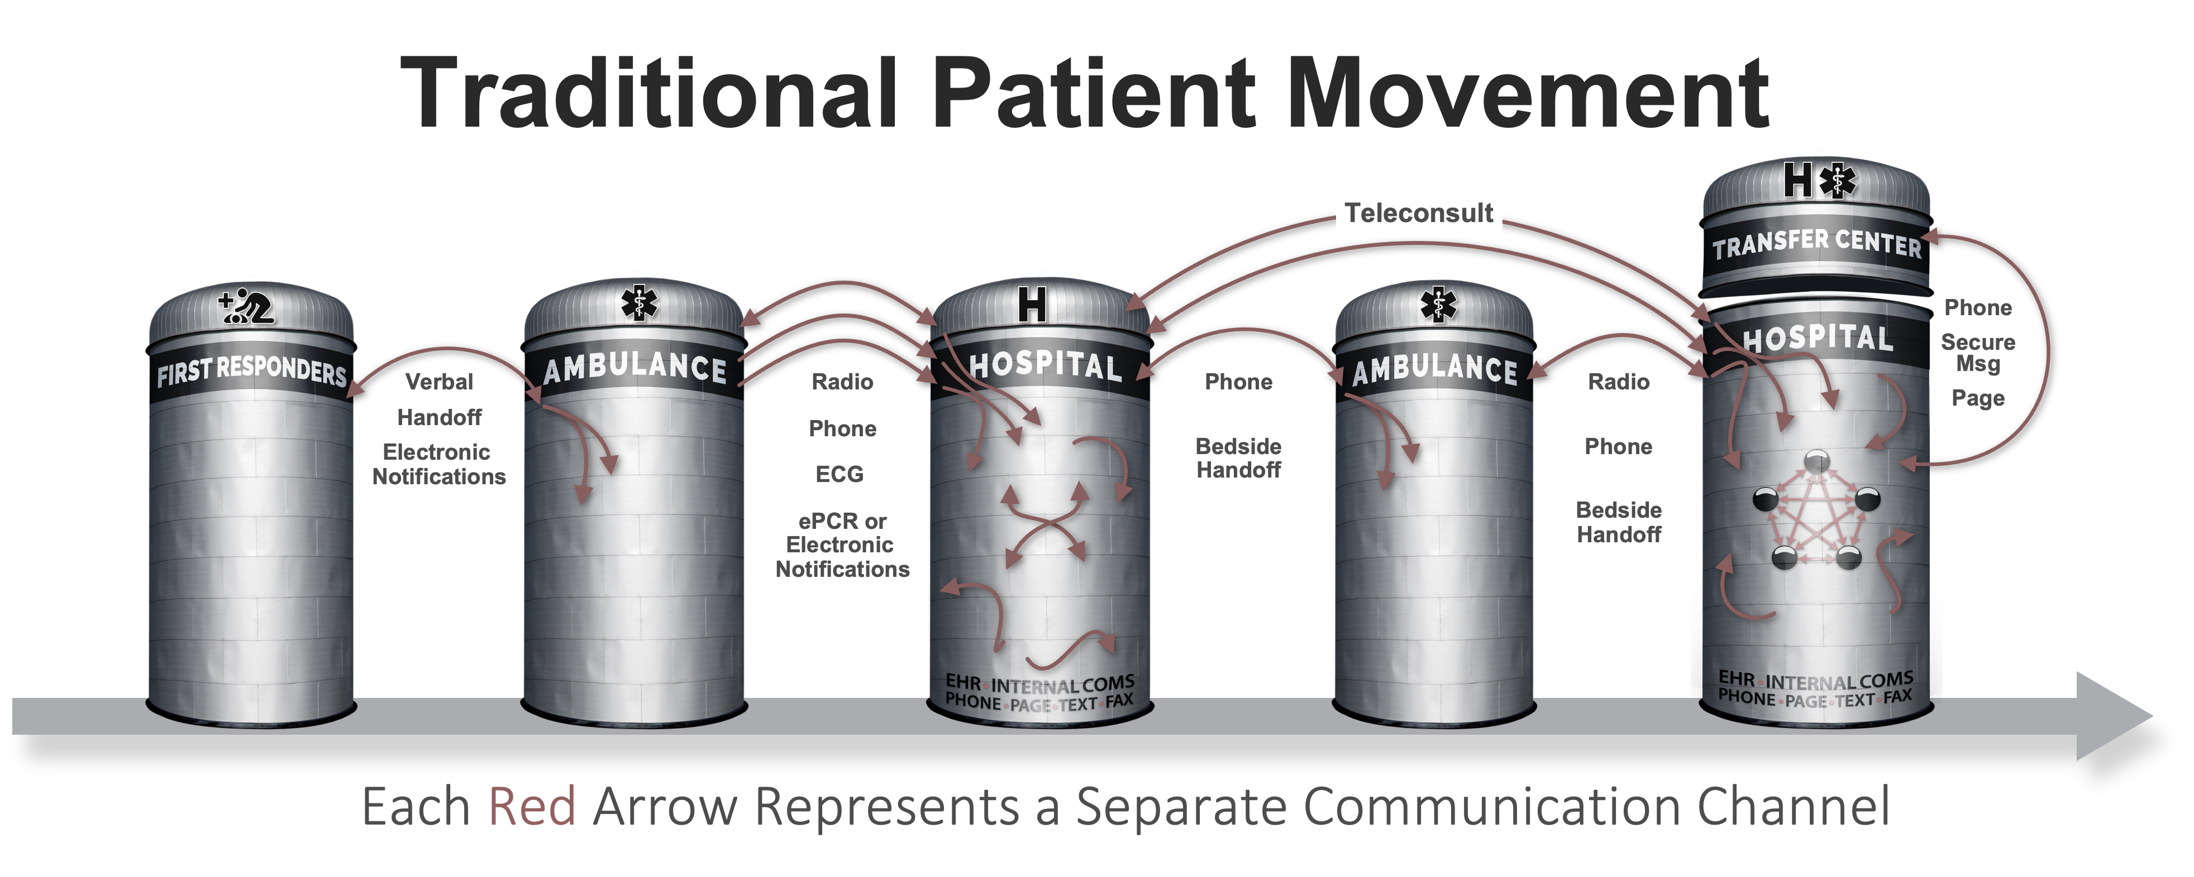




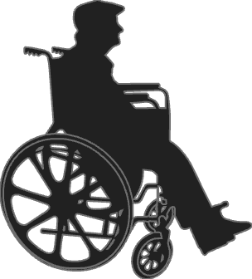

Patient Movement with
3
EHR
Radiology
EHR
Radiology
Create Channel
Build Team
Communicate
ECG
Monitor
ECG
Monitor
ePCR
…
STEPS
ePCR
…
Pulsara
API
Pulsara
API
UNIFIED CARE TEAM
PATIENT MOVEMENT
© 2025 Pulsara – Confidential and Proprietary
Notes:
Pulsara’s Patient Movement System provides a HIPAA-compliant solution to streamline communication and logistics across organizations. We leverage readily available modern technology to bring together public safety and healthcare teams.
A dedicated communication channel is created for each patient encounter, allowing the care team to be updated and expanded as the patient’s condition evolves—keeping everyone aligned on the same channel as they coordinate care.
Additionally, the Pulsara API enables seamless data transfer into and out of the channel.

Slide 7
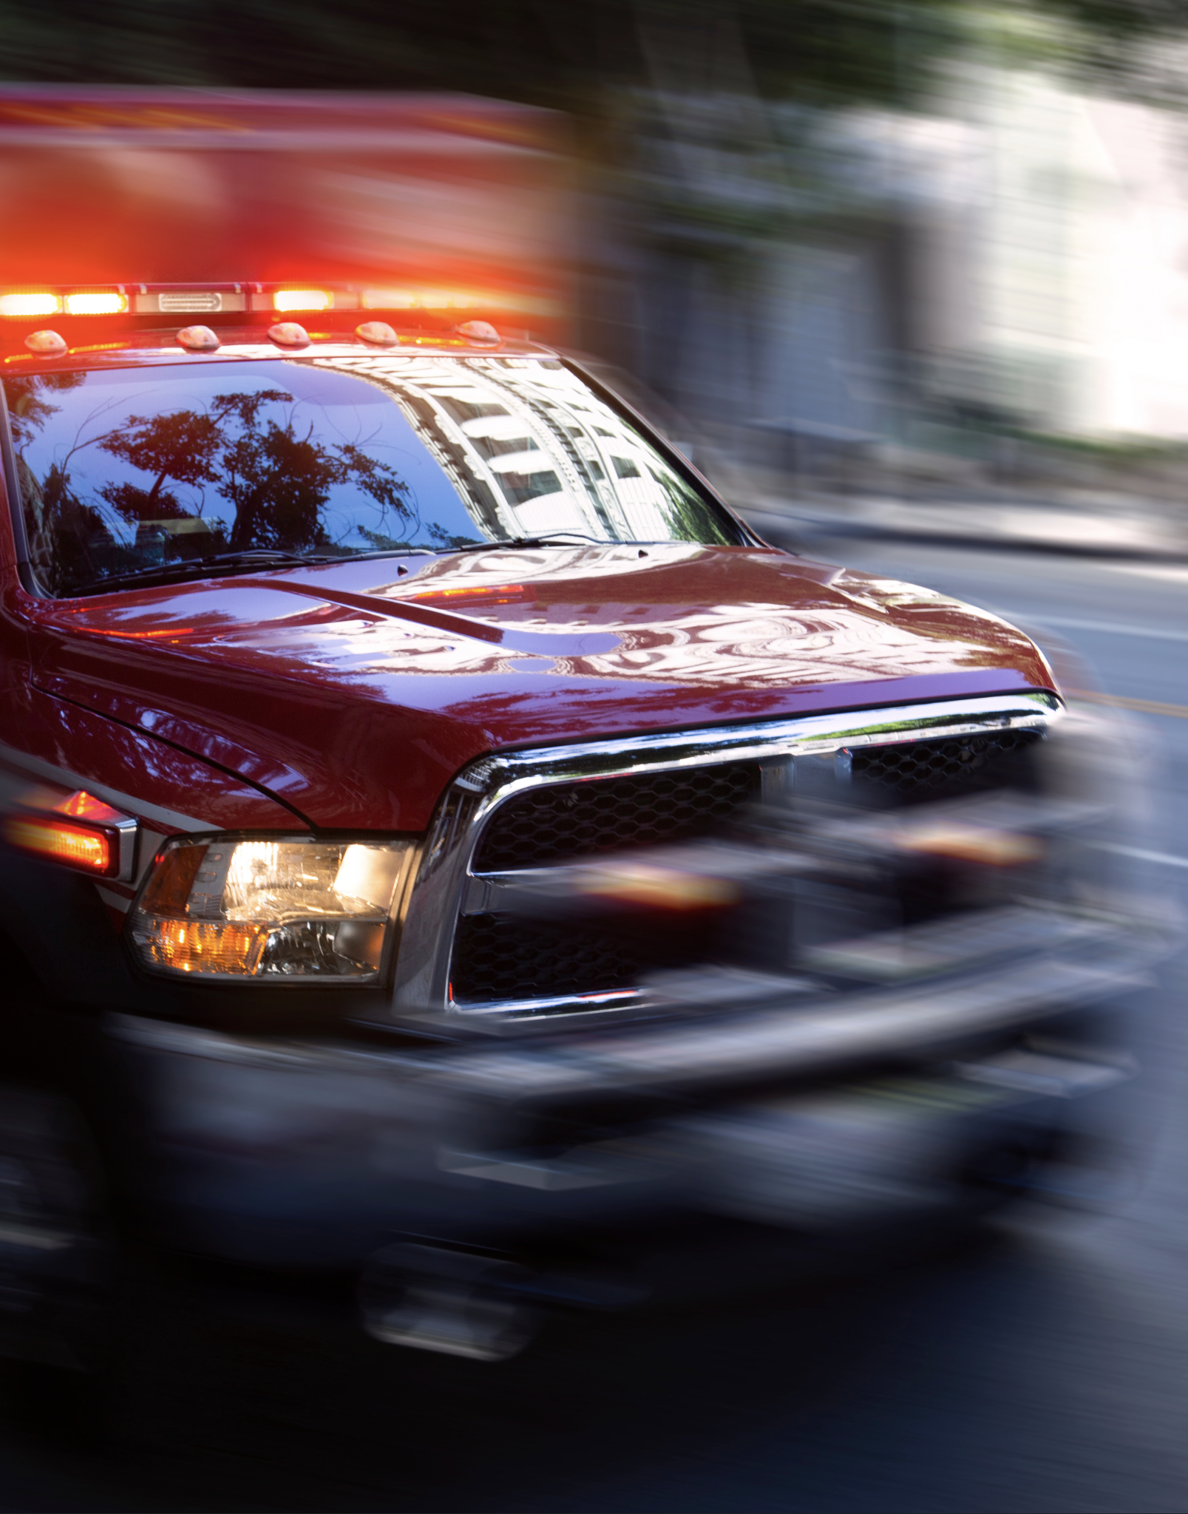
EMS: Quick Facts
DEVICE
Strongly recommend Apple or Android smartphones, or Apple Tablets
Supported devices and web browsers
Safe to use on personal device. Nothing permanently stored on device. Including photos.
WORKFLOW
Scan, photo, voice to text normal Prehospital Report.
Fire and forget. Get back to patient care.
Asynchronous communication.
Others can assist.
Scan to handoff.
Forward instead of repeat.
INTEGRATIONS: DETAILS
All major ePCRs, including AngelTrack, Beyond Lucid, Digitech, EPR, ESO, ImageTrend, ZOLL RescueNet
Cardiac Monitors: Philips, ZOLL
Notes:
We have implemented Pulsara for thousands of customers and refined our process to simplify adoption. While the platform can be accessed via a web browser, we strongly recommend using an Apple or Android smartphone or an iPad. Many medics prefer the portability of a smartphone. For added flexibility and scalability, Pulsara is designed to be safe on personal devices, with no data permanently stored on the device.
Medics follow a straightforward scan, photo, and voice-to-text workflow: they scan a patient movement wristband and driver’s license if available, take necessary photos, and dictate their usual prehospital report. This familiar report format can be seamlessly shared with all downstream care teams, including handoffs to other EMS agencies, Emergency Departments, and even hospital care teams. While users can chat or conduct video calls with the ED or a Medical Director, the primary advantage for medics is the shift to an asynchronous communication workflow—saving time through “fire-and-forget” prehospital reporting, similar to the convenience of texting.
Worried about duplicate data entry? Pulsara simplifies the process by allowing direct attachment of ECGs to prehospital reports, eliminating the need for short forms, and integrating with your ePCR system. It also streamlines handoffs: simply scan the Patient Movement Wristband and forward information, avoiding repetitive communication.

Slide 8
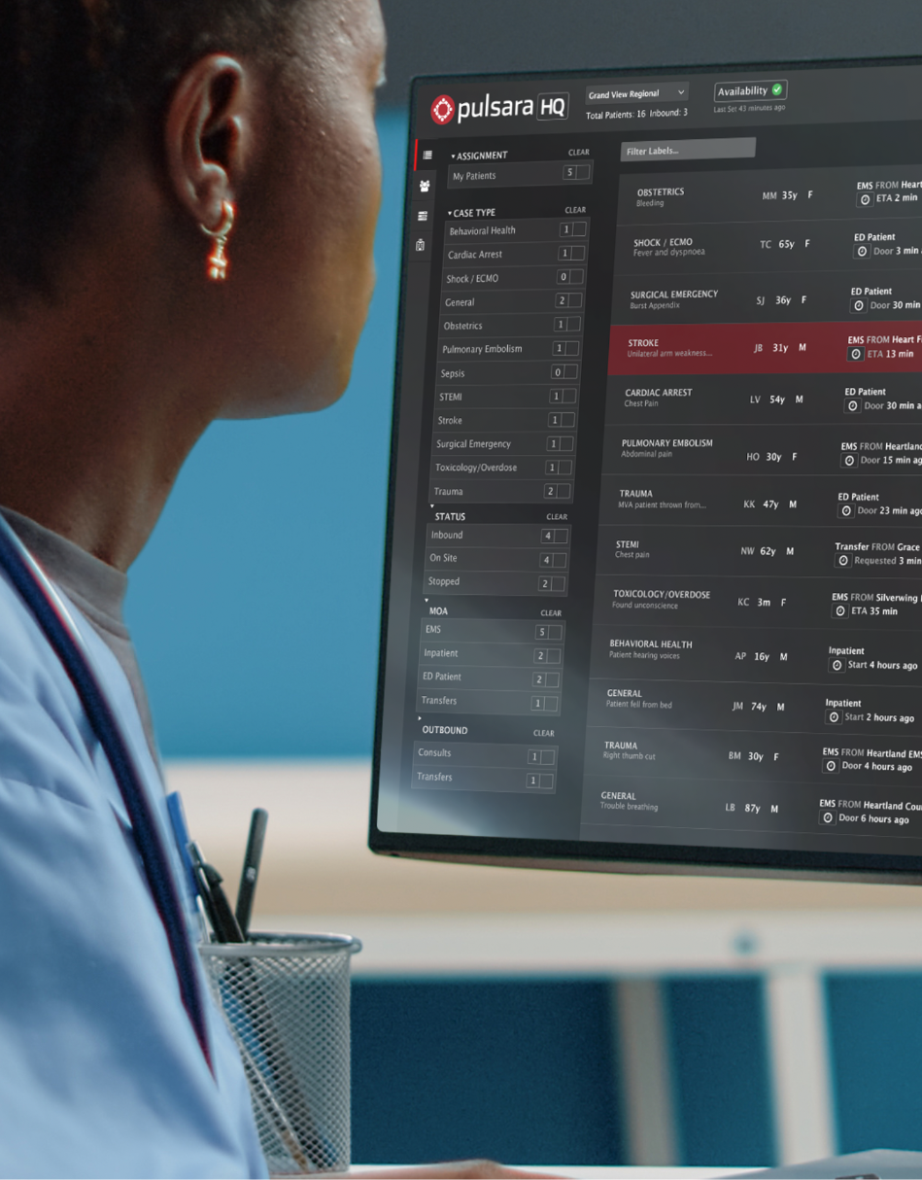
Hospital Requirements
MINIMUM
People / Team: Receive Prehospital Report
  Team: ED (EMS Acknowledge)
  Device - Supported devices and web browsers
    Single iPhone, iPad, or Android Phone. Web Browser Option
OPTIMIZE
Additional Teams
Workflow
PHASE 1: EMS to ED & INCIDENTS
Notes:
To connect your receiving facilities to the network, we’ve made the process simple. With thousands of customers already using Pulsara, there’s a good chance that the health system already lists Pulsara as an approved technology. If not, we’re experienced in navigating this approval process.
For a typical phase 1 implementation, only the individuals or teams who typically handle your calls will need training. Instead of receiving a phone call, they’ll receive alerts on a smartphone, tablet, or computer.

Slide 9
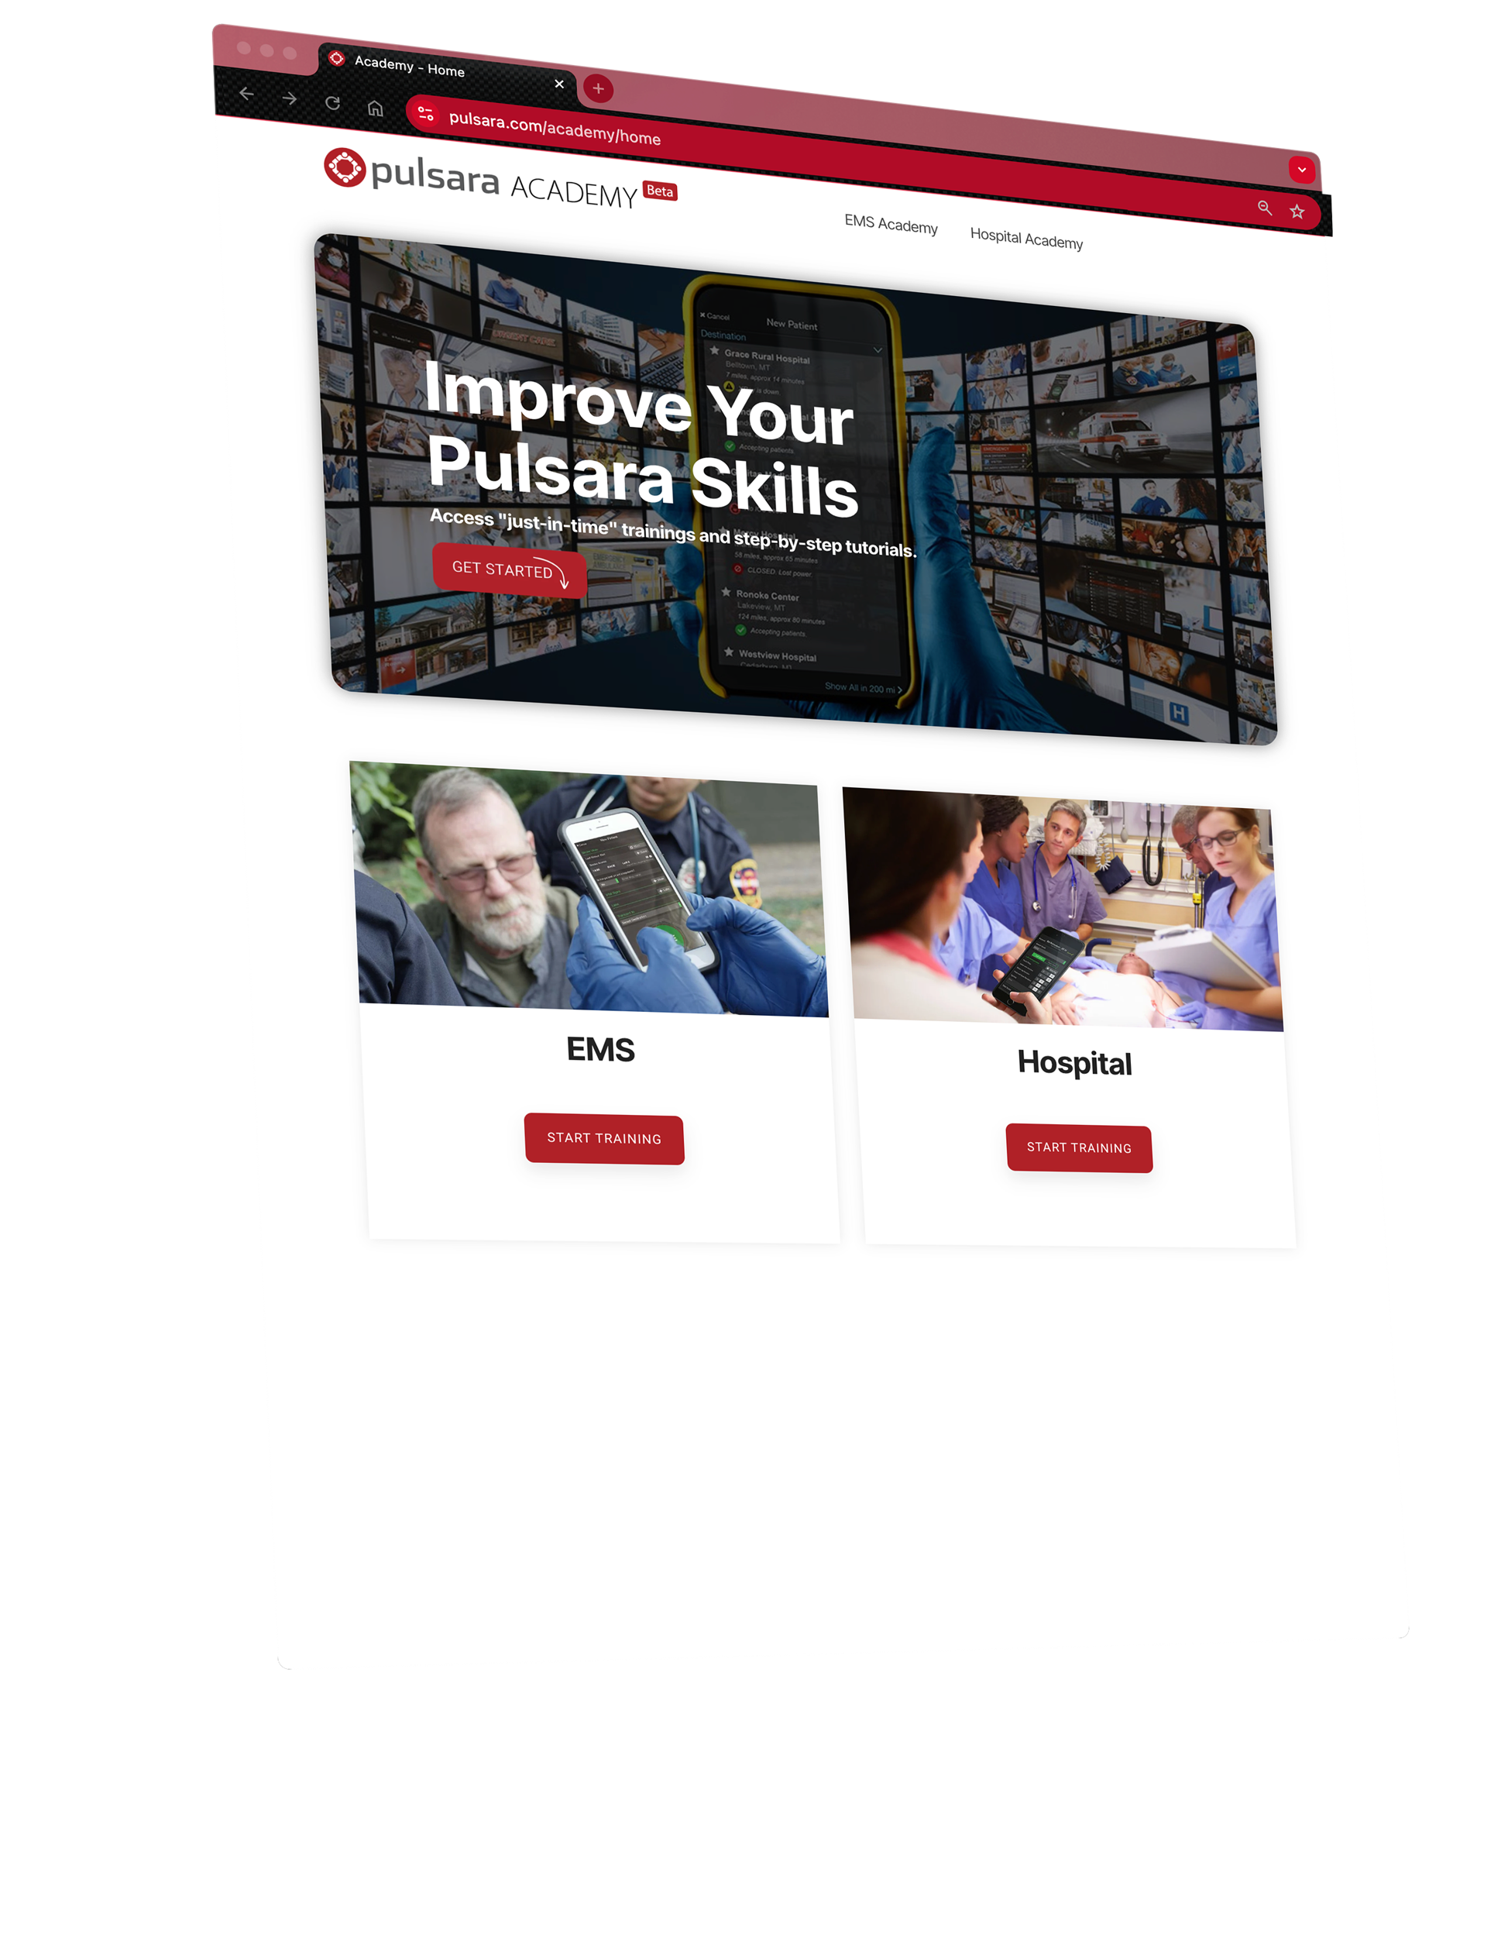

Pulsara Academy / Training
CONTENT
Socialization
Pulsara Basics (conceptual)
How To
Demos
Just In Time Training Assets
CONSUME AS NEEDED
Videos
Printable / PDF
Power Point
OPTIONS
Download & Customize
Link to your LMS
Onboarding & Ongoing Training
Notes:
To support initial and ongoing training, we offer a variety of resources, including short videos, slide presentations, and printable Just-In-Time training materials.

Slide 10
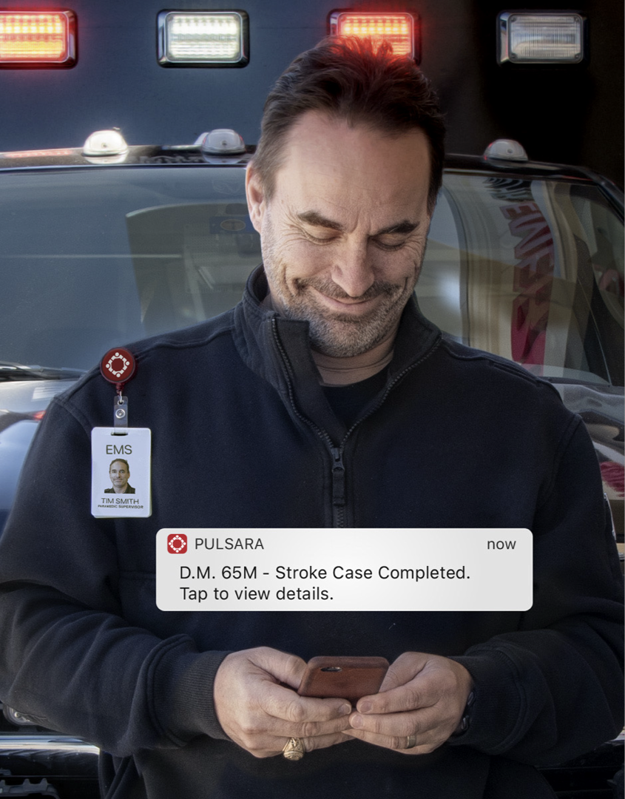
EMS
Asynchronous Communication: "Fire and forget" prehospital report with scan, photo, and voice-to-text workflow.
Reduce Data Entry Burden: Better information with less typing and tapping using multimedia reports.
Convert Communication to Documentation: Pull your communication into ePCR.
Stop Repeating Yourself: Hospital staff can access all information via app or web browser. They can even print the Pulsara Summary Report.
Improved Destination Selection: Assistance in choosing the most appropriate destination based on distance, capabilities, and availability.
ED Bypass Protocols: Direct patients to appropriate areas (specific ED Room, Cath Lab, CT, IR, OB, etc.) when needed, reducing delays.
Pre-registration: Hospitals can often pre-register patients for smoother transitions - armbands, stickers…
Safer, More-efficient Handoff: Streamlined handoffs from first responders to transport, EMS to ED, and EMS to specialty areas.
Faster Turnaround Times: Reduced EMS turnaround and wall times with efficient communication and coordination.
Better Feedback and Data: Access to additional data for billing and patient outcomes, improving care and documentation.
Unified Patient Movement System: Same tool for daily use, MCI, mass evacuation, and mass gatherings.
UNIFIED CARE TEAM - Benefits
Notes:
Your agency will experience many of these benefits simply by implementing Pulsara. However, if there are specific initiatives you’d like to prioritize, please don’t hesitate to reach out to us.

Slide 11

Next Steps
STATE RESOURCE PAGE
  Overview / Executive Summaries / Demos
  Who is on the Network
  Implementation / Training Resources
  IT Resources
  SIGN UP FORM
  Demo / Have Question Request
GET SIGNED UP TO GET IN THE QUEUE
This does not commit you to fully onboarding or a timeline.
Pulsara will work with you and your region to coordinate timeline for training and regular daily use.
Helpful Notes
Onboarding & Ongoing Training
Notes:
Your state resource page has everything you need to get started, including discovery videos, product demonstrations, and training resources. There’s also an interactive map showing who has already signed up. If you don’t see your receiving hospitals listed, direct them to this page, and feel free to connect us with them—this service is provided at no cost.
You can sign up using the form on your state resources page. Signing up doesn’t commit you to a full onboarding or a specific timeline; it simply places you in the queue and signals your interest in joining the network. We’ll work with you and your local organizations to coordinate regional onboarding. Once you sign up, Pulsara will reach out to coordinate the next steps.

