Slide 2
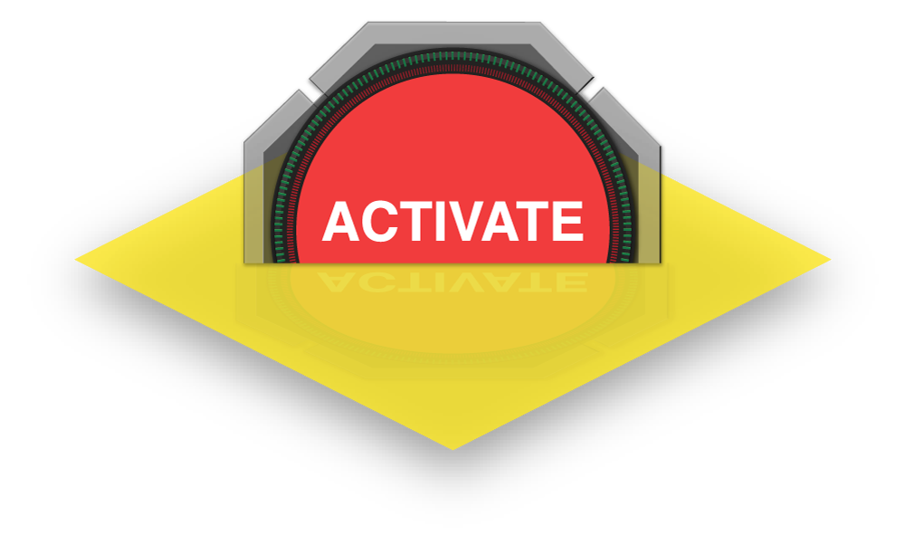
Patient Tracking Education

Slide 3
DISASTER DAY
EVERY DAY IS A
Corey Ricketson, EMT-P (R)
SVP – Strategic Accounts
Notes:
We believe in Systems of Care that Scale
Cornerstone to success during a disaster is using the same tool all day every day in blue skies that can scale to meet any stress event even in grey skies.

Slide 4
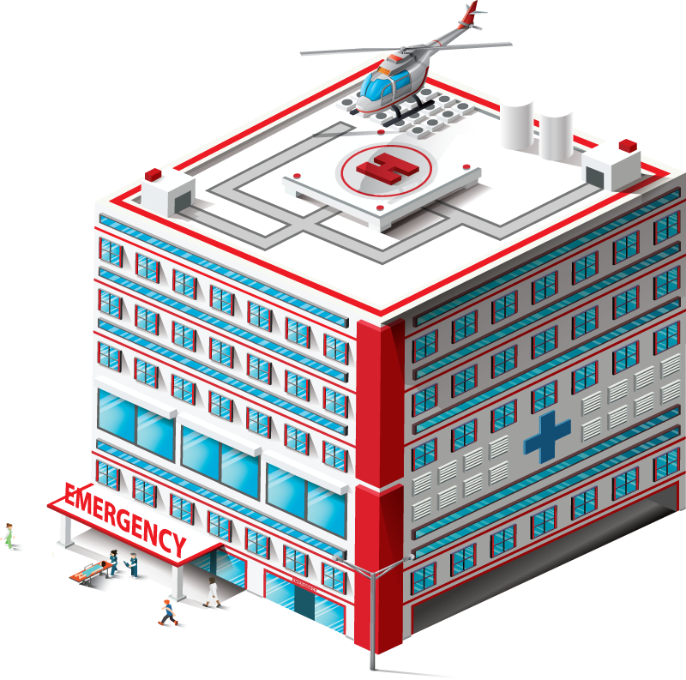
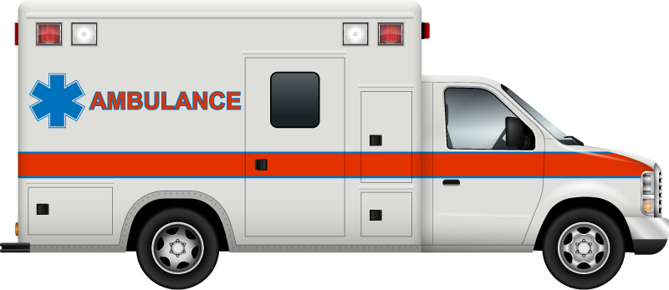
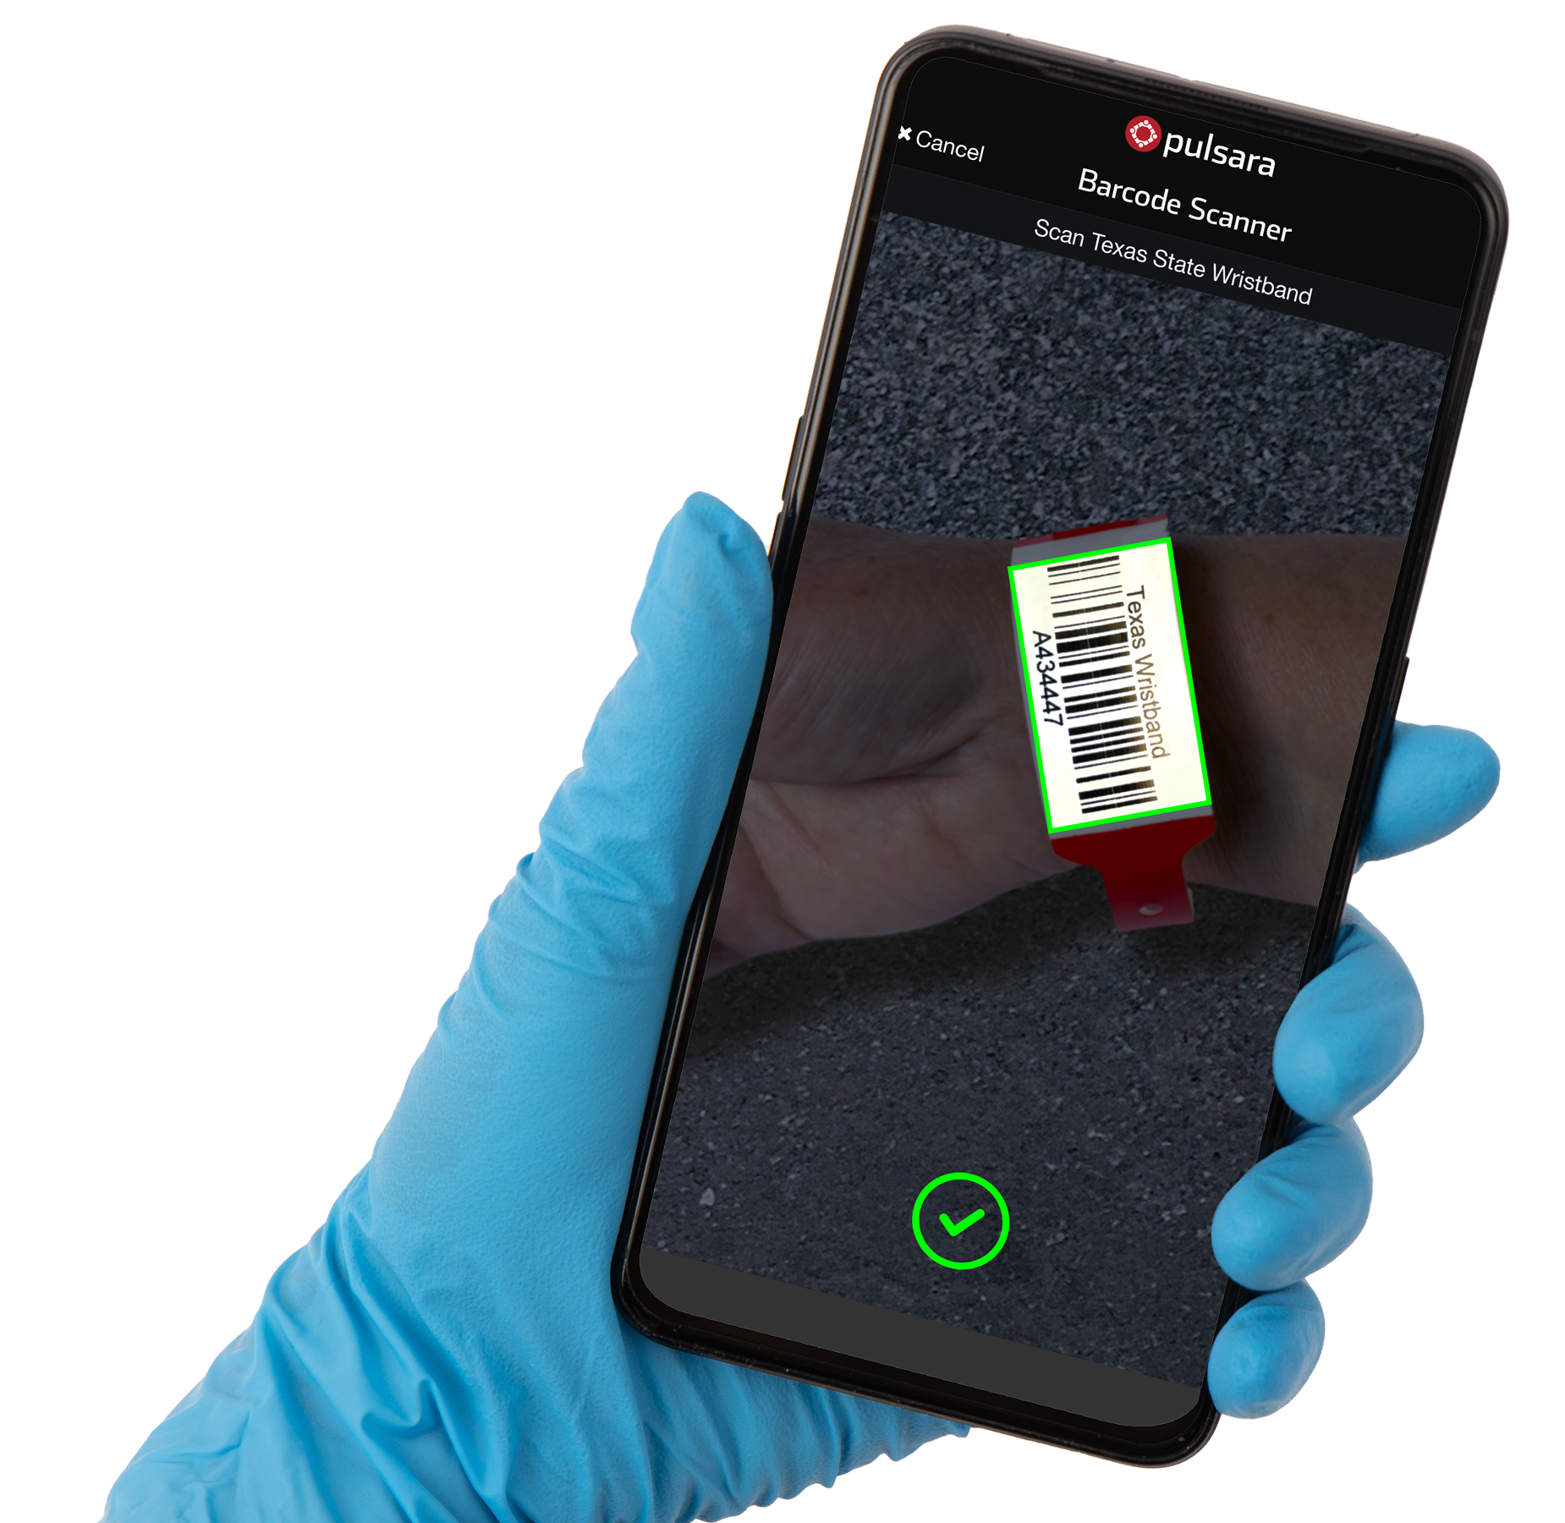
Reunification
Center
Regional MCI/Evac Management
Creates Incident and co-ownership
Lead EMS
Agency
Acute Event

Slide 5
Getting Started
MODULE #1 (04:49 min)
MODULE #1 04:49 min
Are you new to Pulsara? This module will give you an overview of the basics, including:
Texas resources located on pulsara.com/texas-resources
How to sign up your organization
Where to send your IT department for guidance
Business Associates Agreements
How to set up User Accounts
Additional training opportunities

Slide 6
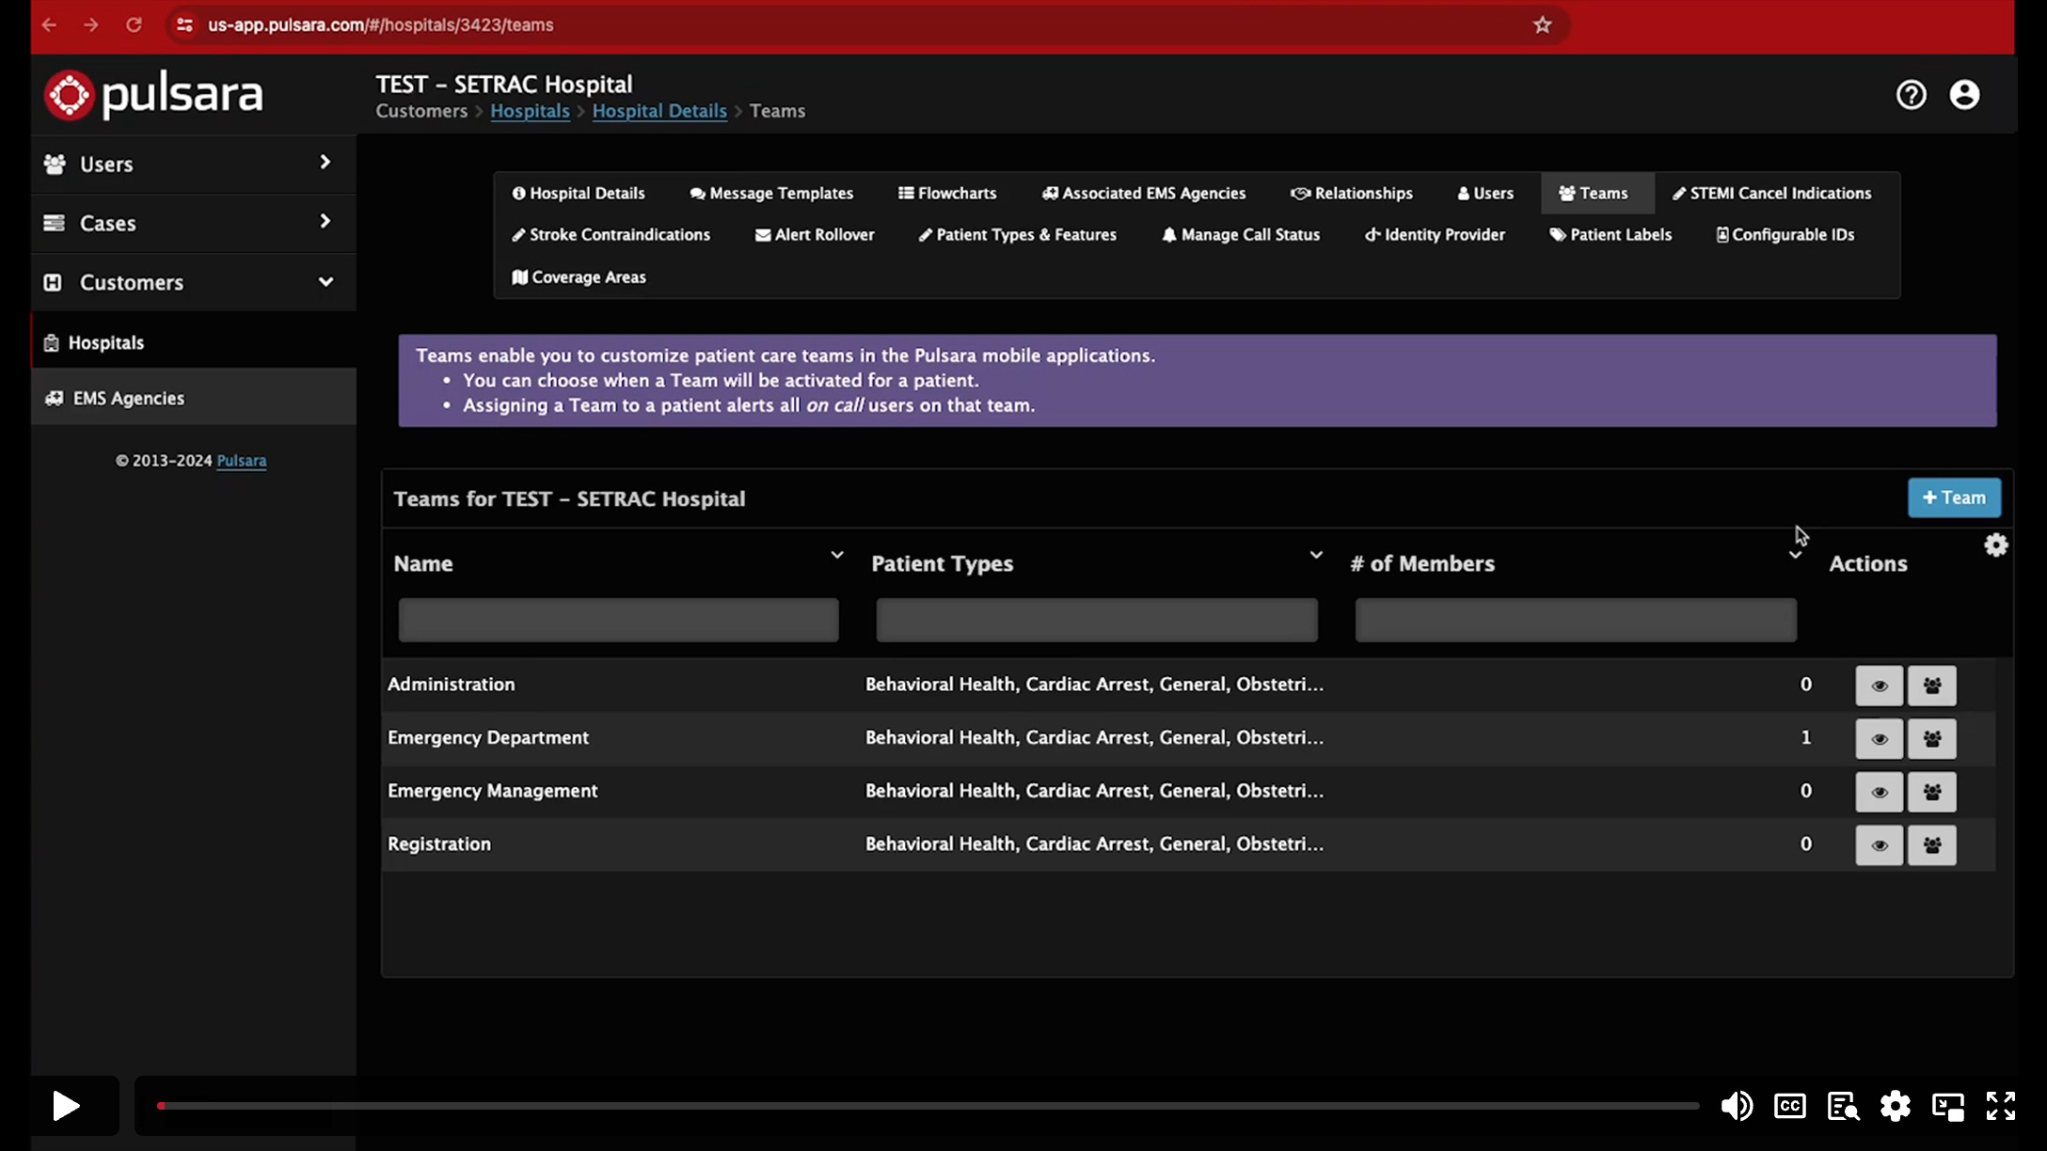
Teams & User Accounts
MODULE #2 (07:03 min)
MODULE #1 04:49 min
This module will discuss teams and user accounts, including:
How to set up standard teams for hospitals
The difference between Administrator and standard User Accounts
How to use On and Off Call Status
Web browser vs. mobile app examples

Slide 7
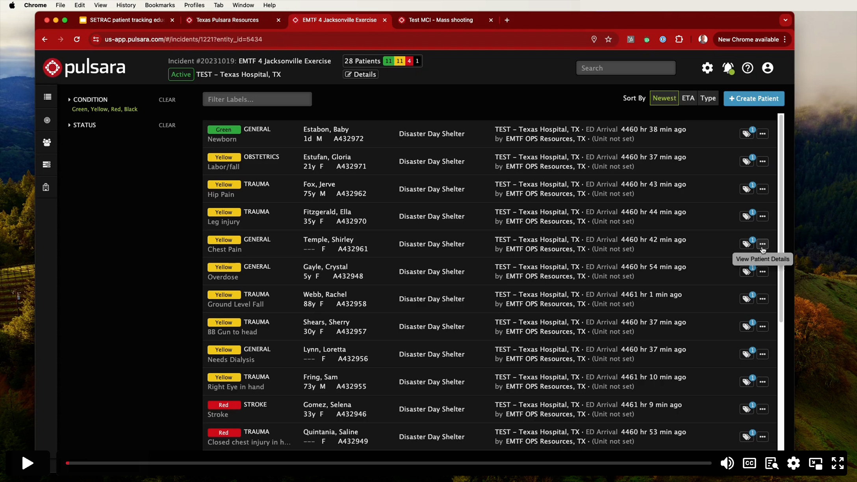
How to Create Incidents
MODULE #3 (06:29 min)
MODULE #1 04:49 min
In this module, learn about incidents. It includes:
EMS agency vs. SETRAC created
Sharing privileges and ownership
Adding entities to an incident
Alerting capabilities
Summary vs. Patient views

Slide 8
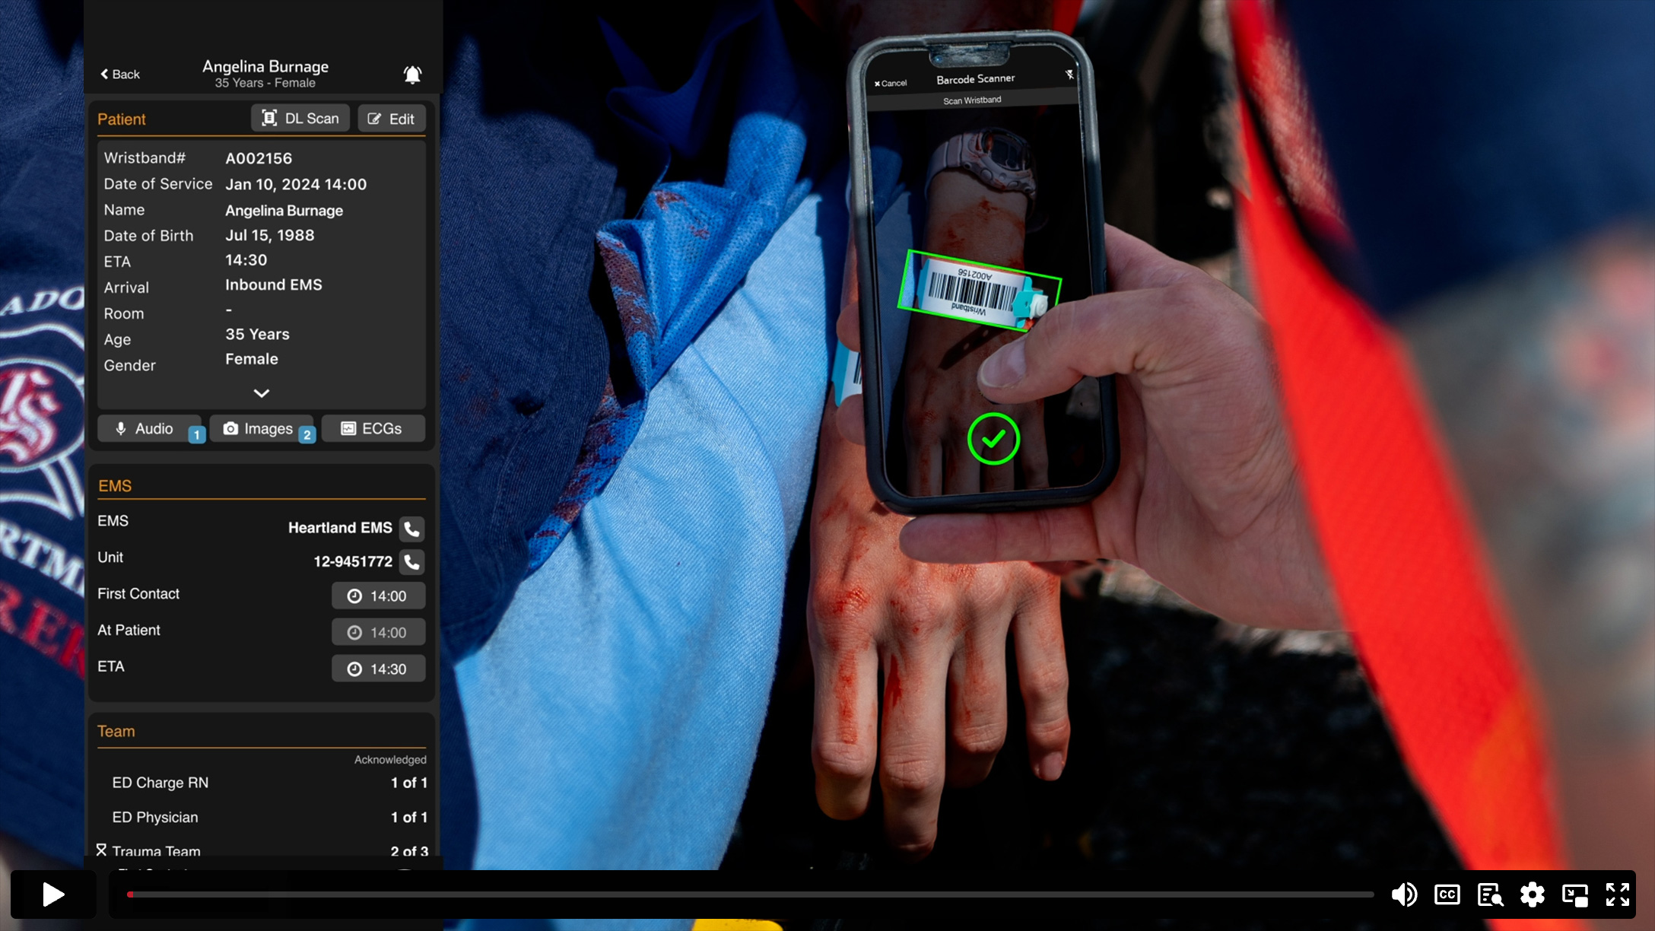
The Importance of Wristbands
MODULE #4 (03:53 min)
MODULE #1 04:49 min
Patient wristbands make all the difference. See how they work and learn the basic use guidelines:
How wristbands work
See a patient with no band? Add one.
See a patient with a band? Scan it.
No info? Add some!

Slide 9
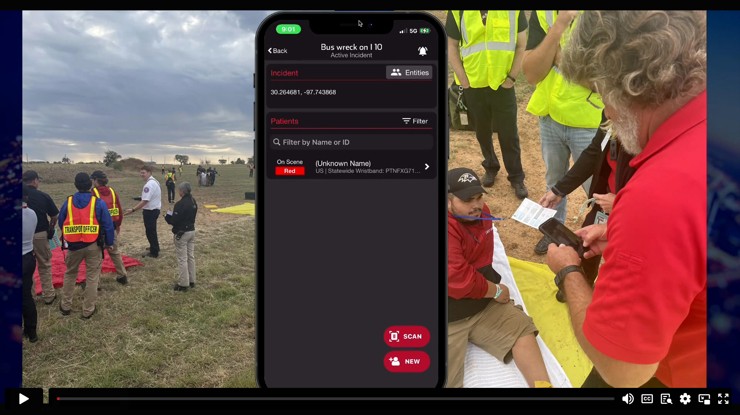
How EMS Adds Patients
MODULE #5 (02:41 min)
MODULE #1 04:49 min
Using the same tool, every day, regardless of event.
Quick data entry during triage
Handing off from triage to treatment to transport, etc.
How to alert hospitals

Slide 10
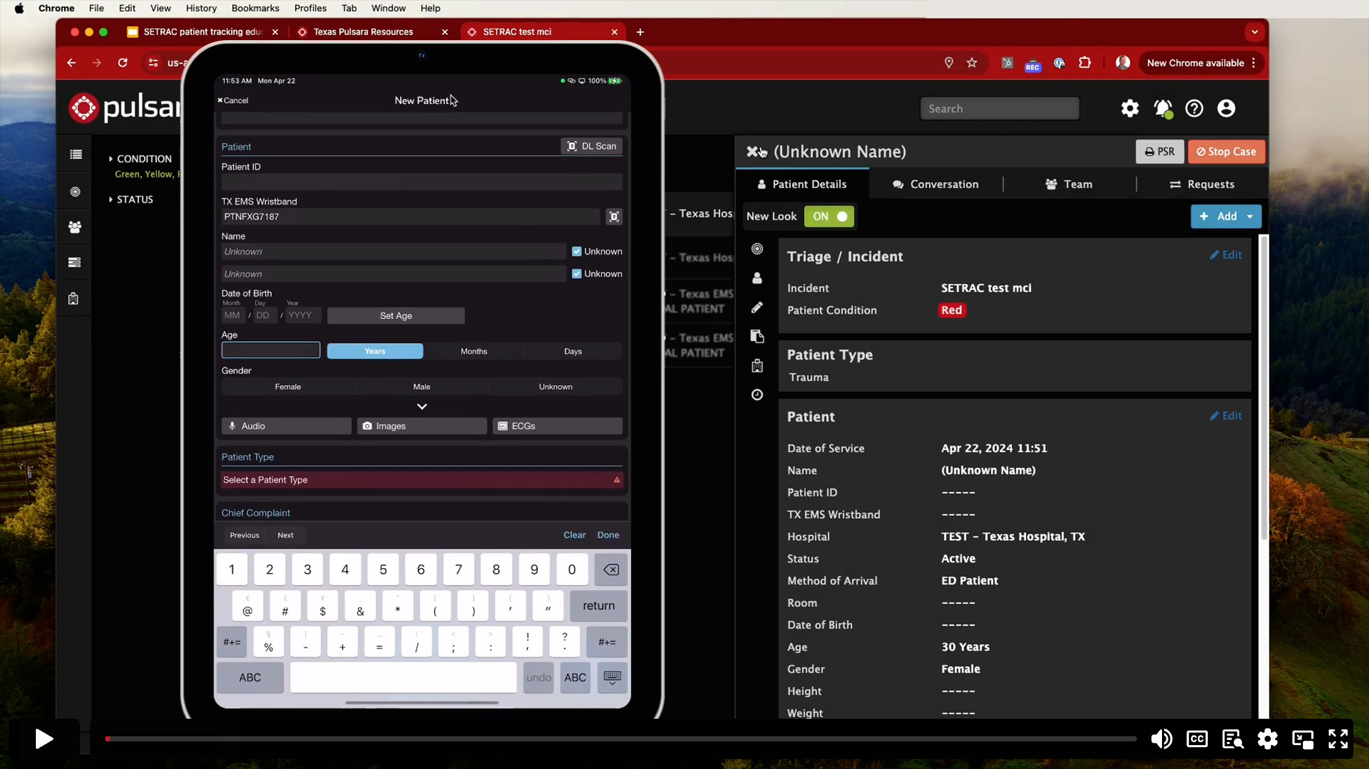
Hospitals: Receiving Patients
MODULE #6 (12:52 min)
MODULE #1 04:49 min
This module will give you a comprehensive understanding of receiving patients with:
Pre alerting vs. no alert
Wristband vs. no wristband
Mobile vs. Web
EMS arrival vs. POV arrival
Adding patient images

Slide 11
Hospitals: Creating Patients
MODULE #7 (09:35 min)
MODULE #1 04:49 min
This module will show you how to create patients using both the Pulsara mobile app and the browser version.
Adding a walk-in patient to an Incident
Creating a new patient from the browser using the Incident view
Creating a new patient from the browser using the HQ view
Wristband options
Adding Images

Slide 12
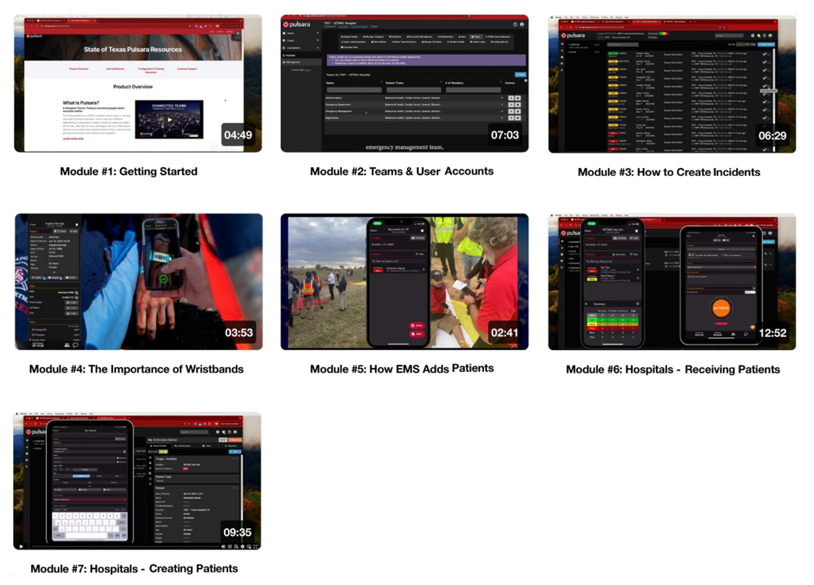
Video Playlist
ALL MODULES PLAYLIST
View all the videos in one place, or easily migrate to each video from this slide by clicking on the thumbnail image.

