Slide 1
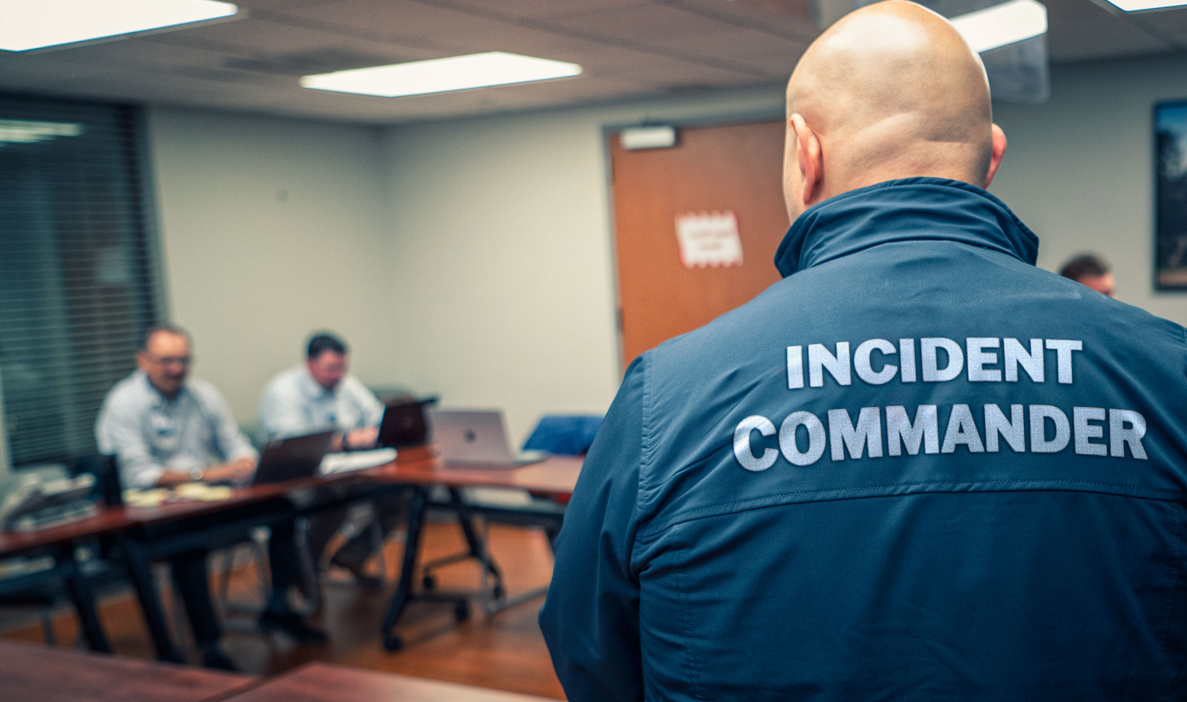
Reunification Workflow
INCIDENT COMMAND
Add
Hospital(s)
Add Reunification Center(s)
MAIN INCIDENT – Source of Truth for Patient Encounters
REUNIFICATION CENTER(S)
Key Reunification Features
Photos
ID, Patient, Family, Belongings, Documents…
Driver License Scan
Contacts
Pulsara Patient video calls
Template Forms
Labels
Status
Filtering
Search
Communication
Chat
Video or Phone Calls
View Summary and all patients for Main Incident
Notes:
To add a virtual or physical Reunification Center, Incident Command invites the Reunification Center and grants access to all patients. Most regions will choose to have a single Reunification Center that can have representatives from multiple organizations, or access is provided via liaisons, but Pulsara can support multiple reunification centers in a region. Initially, individual patient channels may contain few details or identifying information.
As receiving hospitals are added and the patient’s care team expands, more patient-identifying information is added to the individual channels. While clinicians will use patient channels to coordinate care, other hospital staff can assist with workflows aiding patient identification and reunification at the appropriate time.

Slide 2
Reunification Workflow
INCIDENT COMMAND
Add Reunification Center(s)
Add
Hospital(s)
MAIN INCIDENT – Source of Truth for Patient Encounters
MANIFEST – Source of Truth for Souls on Board, Evacuees, or Missing Persons
REUNIFICATION CENTER(S)
View Summary and all patients for Main Incident
Upload (or manually enter) Manifest
Notes:
Occasionally, there is a source of truth for potential victims. An example is an airline incident where the airline can upload a manifest and now use this as the source of truth for souls on board to help them reconcile against the main incident for reunification and reconciliation purposes. Similar roster uploads can be used to aid mass evacuations. Some communities will also create a single source of truth for missing persons, which can simplify access to this information and decrease the number of calls from people looking for duplicate missing persons.

Slide 3
FRC Stations
Entrance
Intake
Physical FRC
Ask Name
Search Manifest
Match – FRC Form and go to Intake
OPTION: Scan to enter or leave
Add Photo FRC Form in Manifest
Add Contact
Add Labels
Foreign National
Contact in FRC
Monitor Active
Compare with Manifest and FRC
Labels
REUNIFIED
Contacts Identified
Manage Communication with F | R
Virtual
FRC
Assist Physical FRC
RECONCILE
Notes:
A physical Reunification Center can be chaotic. To streamline the flow, we find it helpful to create several stations where individuals have limited responsibilities and simple workflows. Pulsara can also help optimize a hybrid environment where virtual team members can provide support.

Slide 4
Survivor Center Stations
Entrance
Intake
Physical Survivor Center
Band
Scan Band
Enter Name
Give Survivor Center Form and allow to enter
Scan Band
Add Survivor Center Info (Photo and/or Note)
Monitor Active & Manifest
Labels
Manage Communication
Reconcile / Reunify
Document
Virtual
Assist Physical
RECONCILE
Notes:
The same lessons can be applied to the physical Survivor Center.

