Slide 1
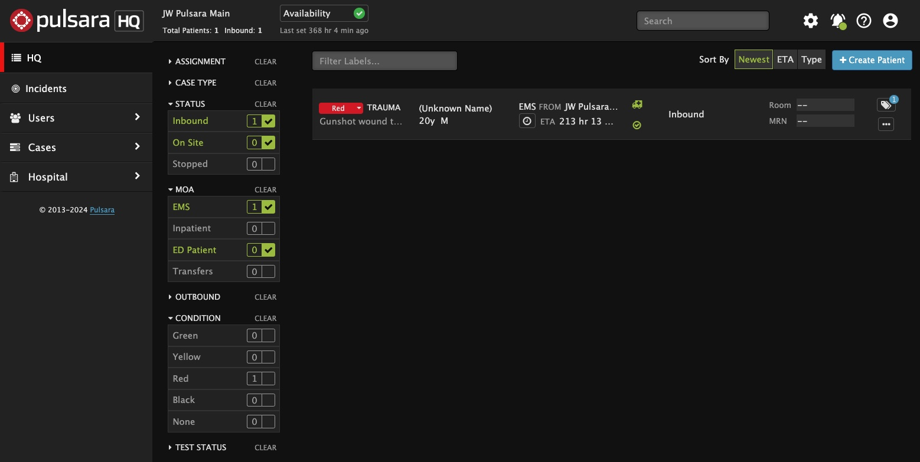
INCIDENTS | Using Pulsara HQ During an Incident
Select View
HQ: See all patient channels (Incident and non-Incident)
Best view for managing your ED
Charge, Assign Room, Situational Awareness
If you add a patient during an incident, you must manually associate them to the incident
Incident: Patient channels are grouped by Incident
Add patients in the Incident view to automatically add them to the incident
View Incident Summary in a separate window
Call & Alert
Turn My Call ON to see and be assigned to new patients
Browser (Audible) Alert: Recommend OFF
Settings
Show Patient Names and Show Chief Complaint
Additional Filters (ED Users)
Status: Inbound and On Site
Method of Arrival: EMS and ED Patients
Notes:
Let’s discuss how to use Pulsara HQ during an Incident.
Most people who use Pulsara on a browser will stay in the Pulsara HQ view, as it is their daily tool for managing the emergency department. Pulsara HQ provides broad situational awareness by allowing you to see all patients associated with an incident, as well as your non-incident patients that may still be arriving. Triage colors are a good visual clue that a patient is associated with an incident. Note that if you use HQ to add a new patient during an incident, you must then also add the patient to the incident. This workflow will be reviewed separately.
The Incident View groups patient channels by incident. One of its most beneficial features is the incident summary, which provides situational awareness around the incident. During an incident, most web browser users have both the Incident Summary View and Pulsara HQ open in separate windows.
Click the Bell icon to verify your call and alerting status. Ensure you are on call so you will be assigned to new patients. You will have the option to turn on audible alerts for new patients. However, most users keep these alerts silent to reduce noise and avoid alarm fatigue, relying instead on visual indicators of new patients.
Under the Settings icon, you can choose to show or hide patient names and the chief complaint. Unless you’re projecting the HQ screen on a large display in a public setting, most users choose to show these items.
Finally, you can use filters to display the most appropriate patients. In the emergency department, the most common settings are checking Inbound and On-Site within the Status filter, and EMS and ED patients within the Method of Arrival filter. These can be adjusted by role to best fit your needs.
ORIGINAL:
This tutorial will review how to optimize Pulsara HQ during an MCI.
Most people utilizing Pulsara on a browser will stay in the Pulsara HQ View, as it is their daily tool. This view is optimal for managing your emergency department, allowing you to see all patients associated with an incident as well as your non-incident patients that may still be arriving which provides broad situational awareness. A good visual clue a patient is associated with an incident is the patient channel will have a triage color associated with it. Note that if you use HQ to add a patient during an MCI, you must add them to a specific incident. This workflow will be reviewed separately.
The Incident View groups patient channels by incident. One of its most beneficial features is access to the incident summary, which provides situational awareness around the incident. Therefore, most web browser users during an MCI have both the Summary View and HQ open in separate windows.
Click the Bell icon to verify your call and alerting status. Ensure you are on call so you will be assigned to new patients. You can opt for an audible alert for new patients through your computer, but most users keep these alerts silent to reduce noise and avoid alarm fatigue, relying instead on visual indicators of new patients.
Under the Settings icon, you can choose to show or hide patient names and the chief complaint. Unless projecting on a large board in a public setting, most people will choose to show these items.
Finally, you can use filters to display the most appropriate patients. In the emergency department, the most common settings are checking Inbound and On-Site within the Status filter, and EMS and ED patients within the Method of Arrival filter. These can be adjusted by role to best fit your needs.

Slide 2
INCIDENTS | Using Pulsara HQ During an Incident
Select View
HQ: See all patient channels (Incident and non-Incident)
Best view for managing your ED
Charge, Assign Room, Situational Awareness
If you add a patient during an incident, you must manually associate them to the incident
Notes:
Most people who use Pulsara on a browser will stay in the Pulsara HQ view, as it is their daily tool for managing the emergency department. Pulsara HQ provides broad situational awareness by allowing you to see all patients associated with an incident, as well as your non-incident patients that may still be arriving.

Slide 3
INCIDENTS | Using Pulsara HQ During an Incident
Select View
HQ: See all patient channels (Incident and non-Incident)
Best view for managing your ED
Charge, Assign Room, Situational Awareness
If you add a patient during an incident, you must manually associate them to the incident
Notes:
Triage colors are a good visual clue that a patient is associated with an incident.

Slide 4
INCIDENTS | Using Pulsara HQ During an Incident
Select View
HQ: See all patient channels (Incident and non-Incident)
Best view for managing your ED
Charge, Assign Room, Situational Awareness
If you add a patient during an incident, you must manually associate them to the incident
Notes:
Note that if you use HQ to add a new patient during an incident, you must then also add the patient to the incident. This workflow will be reviewed separately.

Slide 5
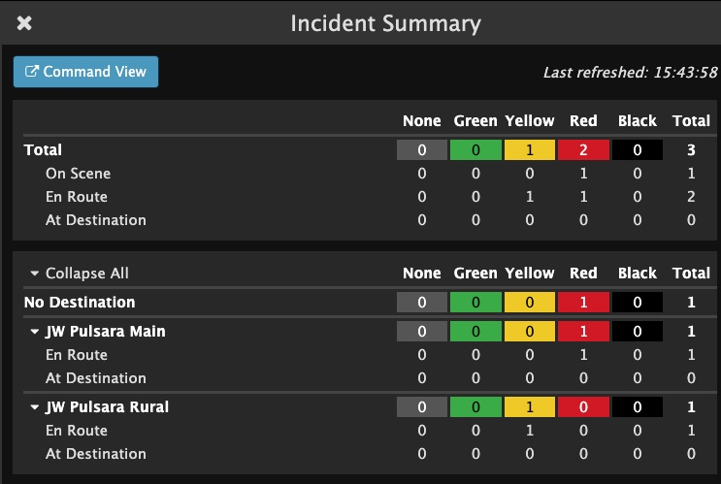
INCIDENTS | Using Pulsara HQ During an Incident
Select View
HQ: See all patient channels (Incident and non-Incident)
Best view for managing your ED
Charge, Assign Room, Situational Awareness
If you add a patient during an incident, you must manually associate them to the incident
Incident: Patient channels are grouped by Incident
Add patients in the Incident view to automatically add them to the incident
View Incident Summary in a separate window
Notes:
The Incident View groups patient channels by incident. One of its most beneficial features is the incident summary, which provides situational awareness around the incident. During an incident, most web browser users have both the Incident Summary View and Pulsara HQ open in separate windows.

Slide 6
INCIDENTS | Using Pulsara HQ During an Incident
Select View
HQ: See all patient channels (Incident and non-Incident)
Best view for managing your ED
Charge, Assign Room, Situational Awareness
If you add a patient during an incident, you must manually associate them to the incident
Incident: Patient channels are grouped by Incident
Add patients in the Incident view to automatically add them to the incident
View Incident Summary in a separate window
Call & Alert
Turn My Call ON to see and be assigned to new patients
Browser (Audible) Alert: Recommend OFF
Notes:
Click the Bell icon to verify your call and alerting status. Ensure you are on call so you will be assigned to new patients. You will have the option to turn on audible alerts for new patients. However, most users keep these alerts silent to reduce noise and avoid alarm fatigue, relying instead on visual indicators of new patients.

Slide 7
INCIDENTS | Using Pulsara HQ During an Incident
Select View
HQ: See all patient channels (Incident and non-Incident)
Best view for managing your ED
Charge, Assign Room, Situational Awareness
If you add a patient during an incident, you must manually associate them to the incident
Incident: Patient channels are grouped by Incident
Add patients in the Incident view to automatically add them to the incident
View Incident Summary in a separate window
Call & Alert
Turn My Call ON to see and be assigned to new patients
Browser (Audible) Alert: Recommend OFF
Settings
Show Patient Names and Show Chief Complaint
Notes:
Under the Settings icon, you can choose to show or hide patient names and the chief complaint. Unless you’re projecting the HQ screen on a large display in a public setting, most users choose to show these items.

Slide 8
INCIDENTS | Using Pulsara HQ During an Incident
Select View
HQ: See all patient channels (Incident and non-Incident)
Best view for managing your ED
Charge, Assign Room, Situational Awareness
If you add a patient during an incident, you must manually associate them to the incident
Incident: Patient channels are grouped by Incident
Add patients in the Incident view to automatically add them to the incident
View Incident Summary in a separate window
Call & Alert
Turn My Call ON to see and be assigned to new patients
Browser (Audible) Alert: Recommend OFF
Settings
Show Patient Names and Show Chief Complaint
Additional Filters (ED Users)
Status: Inbound and On Site
Notes:
Finally, you can use filters to display the most appropriate patients. In the emergency department, the most common settings are checking Inbound and On-Site within the Status filter,

Slide 9
INCIDENTS | Using Pulsara HQ During an Incident
Select View
HQ: See all patient channels (Incident and non-Incident)
Best view for managing your ED
Charge, Assign Room, Situational Awareness
If you add a patient during an incident, you must manually associate them to the incident
Incident: Patient channels are grouped by Incident
Add patients in the Incident view to automatically add them to the incident
View Incident Summary in a separate window
Call & Alert
Turn My Call ON to see and be assigned to new patients
Browser (Audible) Alert: Recommend OFF
Settings
Show Patient Names and Show Chief Complaint
Additional Filters (ED Users)
Status: Inbound and On Site
Method of Arrival: EMS and ED Patients
Notes:
and EMS and ED patients within the Method of Arrival filter. These can be adjusted by role to best fit your needs.

