Slide 1
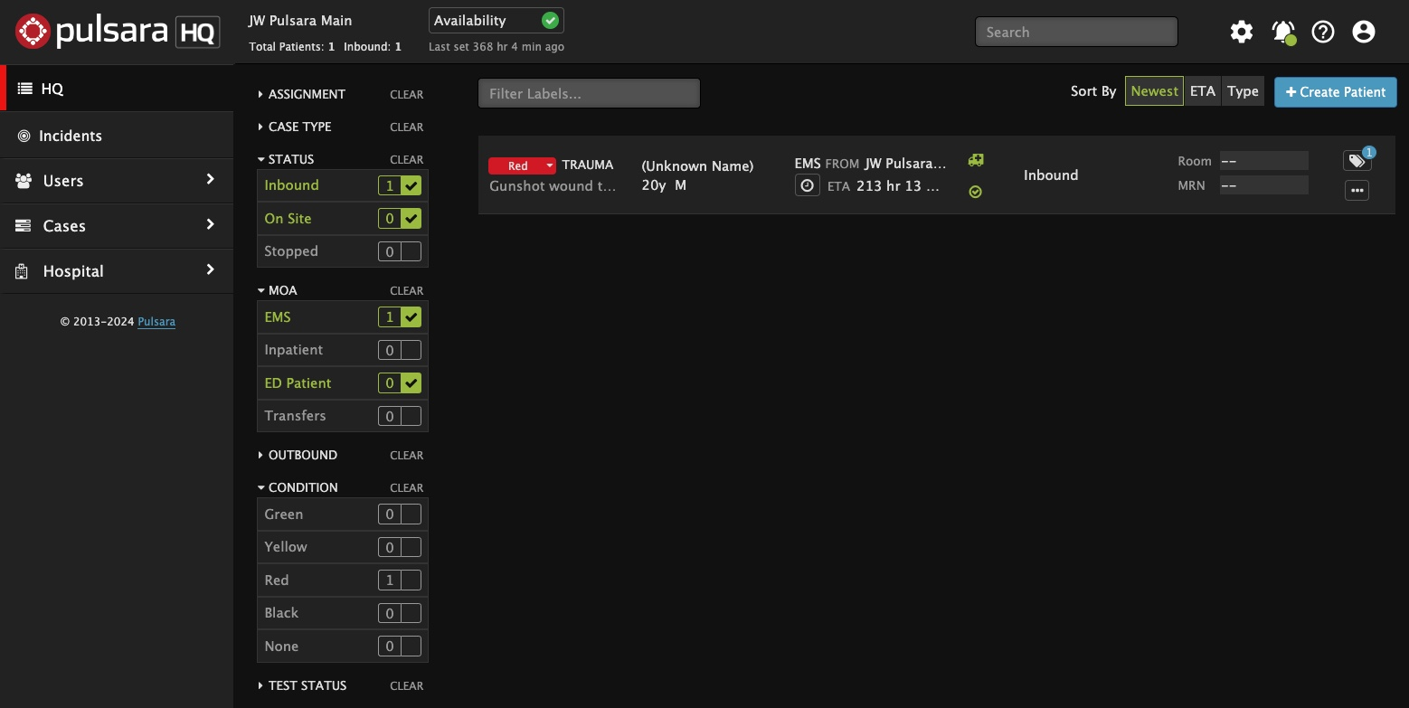
INCIDENTS | Using Pulsara HQ During an Incident
Select View
HQ: See all patient channels (Incident and non-Incident)
Best view for managing your ED
Charge, Assign Room, Situational Awareness
If you add a patient during an incident, you must manually associate them to the incident
Incident: Patient channels are grouped by Incident
Add patients in the Incident view to automatically add them to the incident
View Incident Summary in a separate window
Call & Alert
Turn My Call ON to see and be assigned to new patients
Browser (Audible) Alert: Recommend OFF
Settings
Show Patient Names and Show Chief Complaint
Additional Filters (ED Users)
Status: Inbound and On Site
Method of Arrival: EMS and ED Patients
Notes:
Let’s discuss how to use Pulsara HQ during an Incident.
Most people who use Pulsara on a browser will stay in the Pulsara HQ view, as it is their daily tool for managing the emergency department. Pulsara HQ provides broad situational awareness by allowing you to see all patients associated with an incident, as well as your non-incident patients that may still be arriving. Triage colors are a good visual clue that a patient is associated with an incident. Note that if you use HQ to add a new patient during an incident, you must then also add the patient to the incident. This workflow will be reviewed separately.
The Incident View groups patient channels by incident. One of its most beneficial features is the incident summary, which provides situational awareness around the incident. During an incident, most web browser users have both the Incident Summary View and Pulsara HQ open in separate windows.
Click the Bell icon to verify your call and alerting status. Ensure you are on call so you will be assigned to new patients. You will have the option to turn on audible alerts for new patients. However, most users keep these alerts silent to reduce noise and avoid alarm fatigue, relying instead on visual indicators of new patients.
Under the Settings icon, you can choose to show or hide patient names and the chief complaint. Unless you’re projecting the HQ screen on a large display in a public setting, most users choose to show these items.
Finally, you can use filters to display the most appropriate patients. In the emergency department, the most common settings are checking Inbound and On-Site within the Status filter, and EMS and ED patients within the Method of Arrival filter. These can be adjusted by role to best fit your needs.
ORIGINAL:
This tutorial will review how to optimize Pulsara HQ during an MCI.
Most people utilizing Pulsara on a browser will stay in the Pulsara HQ View, as it is their daily tool. This view is optimal for managing your emergency department, allowing you to see all patients associated with an incident as well as your non-incident patients that may still be arriving which provides broad situational awareness. A good visual clue a patient is associated with an incident is the patient channel will have a triage color associated with it. Note that if you use HQ to add a patient during an MCI, you must add them to a specific incident. This workflow will be reviewed separately.
The Incident View groups patient channels by incident. One of its most beneficial features is access to the incident summary, which provides situational awareness around the incident. Therefore, most web browser users during an MCI have both the Summary View and HQ open in separate windows.
Click the Bell icon to verify your call and alerting status. Ensure you are on call so you will be assigned to new patients. You can opt for an audible alert for new patients through your computer, but most users keep these alerts silent to reduce noise and avoid alarm fatigue, relying instead on visual indicators of new patients.
Under the Settings icon, you can choose to show or hide patient names and the chief complaint. Unless projecting on a large board in a public setting, most people will choose to show these items.
Finally, you can use filters to display the most appropriate patients. In the emergency department, the most common settings are checking Inbound and On-Site within the Status filter, and EMS and ED patients within the Method of Arrival filter. These can be adjusted by role to best fit your needs.

Slide 2
INCIDENTS | Using Pulsara HQ During an Incident
Select View
HQ: See all patient channels (Incident and non-Incident)
Best view for managing your ED
Charge, Assign Room, Situational Awareness
If you add a patient during an incident, you must manually associate them to the incident
Notes:
Most people who use Pulsara on a browser will stay in the Pulsara HQ view, as it is their daily tool for managing the emergency department. Pulsara HQ provides broad situational awareness by allowing you to see all patients associated with an incident, as well as your non-incident patients that may still be arriving.

Slide 3
INCIDENTS | Using Pulsara HQ During an Incident
Select View
HQ: See all patient channels (Incident and non-Incident)
Best view for managing your ED
Charge, Assign Room, Situational Awareness
If you add a patient during an incident, you must manually associate them to the incident
Notes:
Triage colors are a good visual clue that a patient is associated with an incident.

Slide 4
INCIDENTS | Using Pulsara HQ During an Incident
Select View
HQ: See all patient channels (Incident and non-Incident)
Best view for managing your ED
Charge, Assign Room, Situational Awareness
If you add a patient during an incident, you must manually associate them to the incident
Notes:
Note that if you use HQ to add a new patient during an incident, you must then also add the patient to the incident. This workflow will be reviewed separately.

Slide 5
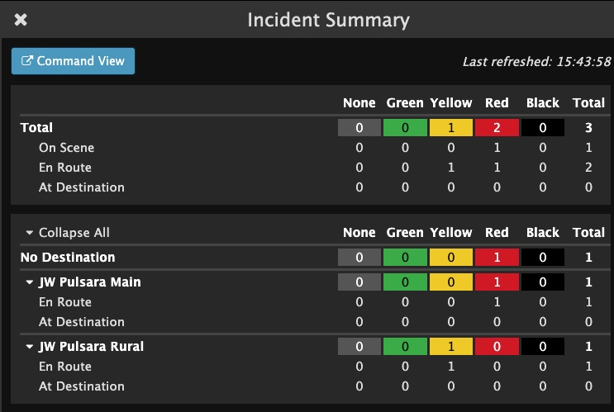
INCIDENTS | Using Pulsara HQ During an Incident
Select View
HQ: See all patient channels (Incident and non-Incident)
Best view for managing your ED
Charge, Assign Room, Situational Awareness
If you add a patient during an incident, you must manually associate them to the incident
Incident: Patient channels are grouped by Incident
Add patients in the Incident view to automatically add them to the incident
View Incident Summary in a separate window
Notes:
The Incident View groups patient channels by incident. One of its most beneficial features is the incident summary, which provides situational awareness around the incident. During an incident, most web browser users have both the Incident Summary View and Pulsara HQ open in separate windows.

Slide 6
INCIDENTS | Using Pulsara HQ During an Incident
Select View
HQ: See all patient channels (Incident and non-Incident)
Best view for managing your ED
Charge, Assign Room, Situational Awareness
If you add a patient during an incident, you must manually associate them to the incident
Incident: Patient channels are grouped by Incident
Add patients in the Incident view to automatically add them to the incident
View Incident Summary in a separate window
Call & Alert
Turn My Call ON to see and be assigned to new patients
Browser (Audible) Alert: Recommend OFF
Notes:
Click the Bell icon to verify your call and alerting status. Ensure you are on call so you will be assigned to new patients. You will have the option to turn on audible alerts for new patients. However, most users keep these alerts silent to reduce noise and avoid alarm fatigue, relying instead on visual indicators of new patients.

Slide 7
INCIDENTS | Using Pulsara HQ During an Incident
Select View
HQ: See all patient channels (Incident and non-Incident)
Best view for managing your ED
Charge, Assign Room, Situational Awareness
If you add a patient during an incident, you must manually associate them to the incident
Incident: Patient channels are grouped by Incident
Add patients in the Incident view to automatically add them to the incident
View Incident Summary in a separate window
Call & Alert
Turn My Call ON to see and be assigned to new patients
Browser (Audible) Alert: Recommend OFF
Settings
Show Patient Names and Show Chief Complaint
Notes:
Under the Settings icon, you can choose to show or hide patient names and the chief complaint. Unless you’re projecting the HQ screen on a large display in a public setting, most users choose to show these items.

Slide 8
INCIDENTS | Using Pulsara HQ During an Incident
Select View
HQ: See all patient channels (Incident and non-Incident)
Best view for managing your ED
Charge, Assign Room, Situational Awareness
If you add a patient during an incident, you must manually associate them to the incident
Incident: Patient channels are grouped by Incident
Add patients in the Incident view to automatically add them to the incident
View Incident Summary in a separate window
Call & Alert
Turn My Call ON to see and be assigned to new patients
Browser (Audible) Alert: Recommend OFF
Settings
Show Patient Names and Show Chief Complaint
Additional Filters (ED Users)
Status: Inbound and On Site
Notes:
Finally, you can use filters to display the most appropriate patients. In the emergency department, the most common settings are checking Inbound and On-Site within the Status filter,

Slide 9
INCIDENTS | Using Pulsara HQ During an Incident
Select View
HQ: See all patient channels (Incident and non-Incident)
Best view for managing your ED
Charge, Assign Room, Situational Awareness
If you add a patient during an incident, you must manually associate them to the incident
Incident: Patient channels are grouped by Incident
Add patients in the Incident view to automatically add them to the incident
View Incident Summary in a separate window
Call & Alert
Turn My Call ON to see and be assigned to new patients
Browser (Audible) Alert: Recommend OFF
Settings
Show Patient Names and Show Chief Complaint
Additional Filters (ED Users)
Status: Inbound and On Site
Method of Arrival: EMS and ED Patients
Notes:
and EMS and ED patients within the Method of Arrival filter. These can be adjusted by role to best fit your needs.

Slide 10
INCIDENTS | Hospital Incident View
Incident View
Select Correct Incident
Only see Patient Channels associated with Incident
View Patient Channel details
Wristband ID visible
Create Patient: Automatically added to this Incident
Incident Details
View Participating Entities and Privileges
Other Incident Details
Incident Summary
Command View - Separate Window
Notes:
Let’s go over the Incident View for hospitals.
When you tap Incidents, you will be prompted to select the correct incident. Once you are in the Incident View, you can only see the patient channels associated with the selected incident. The Incident view has a couple of key differences from Pulsara HQ: The filters are different, and you can see the Wristband ID at the main level. Additionally, if you want to activate downstream care teams or assign room numbers, you will need to enter the patient channel instead of doing this from the main screen.
You can create a new patient from this view, and the patient is automatically added to the incident and recorded as being at your organization.
Under Incident Details, you can see participating entities, their privileges, and additional details about the incident.
Tap on the abbreviated incident summary to expand and see more details. Here, you can view how many patients within each triage category are on scene, en route, or at the designated destination. You can even see the breakdown by receiving destinations.
If you would like to open this view in a separate window, tap “Command View.” Many people in the Emergency Department working an incident from their web browser will have Pulsara HQ open in one window and the Incident Summary open in another. Emergency Managers, Reunification Centers, and others primarily responsible for only the incident often work with Incident View open in one window and the Incident Summary in another.
ORIGINAL:
This tutorial will review the Incident View for hospitals.
When you tap Incidents, you will be prompted to select the correct incident. Once you are in the Incident View, you can only see the patient channels associated with the selected incident. This view differs slightly from Pulsara HQ as the filters are different, and you can see the Wristband ID at the main level. Additionally, if you want to activate downstream care teams or assign room numbers, you will need to enter the patient channel instead of doing this from the main screen.
You can create a new patient from this view, and the patient is automatically added to the incident and recorded as being at your organization.
Under Incident Details, you can see participating entities, their privileges, and additional details about the incident.
Tap on the abbreviated incident summary to expand and see more details. Here, you can view how many patients within each triage category are on scene, en route, or at the designated destination. You can even see the breakdown by receiving destinations.
If you would like to open this view in a separate window, simply tap “Command View.” Many people in the Emergency Department working an MCI from their web browser will have Pulsara HQ open in one window and the Incident Summary open in another. Emergency Managers, Reunification Centers, and others primarily responsible for only the incident often work with Incident View open in one window and the Incident Summary in another.

Slide 11
INCIDENTS | Hospital Incident View
Incident View
Notes:
When you tap Incidents

Slide 12
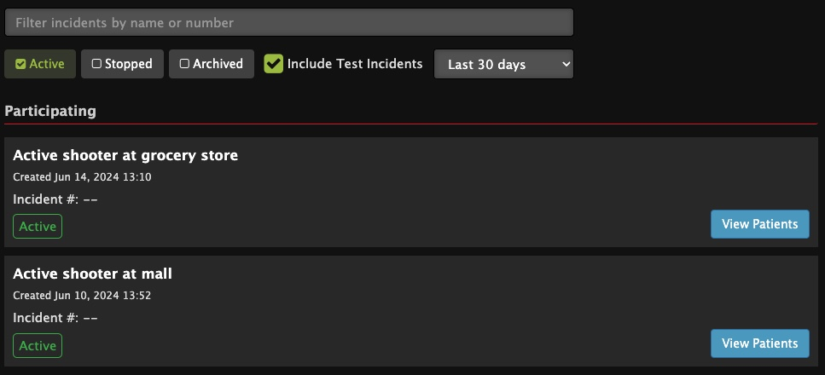
INCIDENTS | Hospital Incident View
Incident View
Select Correct Incident
Notes:
you will be prompted to select the correct incident.

Slide 13
INCIDENTS | Hospital Incident View
Incident View
Select Correct Incident
Only see Patient Channels associated with Incident
View Patient Channel details
Notes:
Once you are in the Incident View, you can only see the patient channels associated with the selected incident.

Slide 14
INCIDENTS | Hospital Incident View
Incident View
Select Correct Incident
Only see Patient Channels associated with Incident
View Patient Channel details
Notes:
The Incident view has a couple of key differences from Pulsara HQ: The filters are different,

Slide 15
INCIDENTS | Hospital Incident View
Incident View
Select Correct Incident
Only see Patient Channels associated with Incident
View Patient Channel details
Wristband ID visible
Notes:
and you can see the Wristband ID at the main level.

Slide 16
INCIDENTS | Hospital Incident View
Incident View
Select Correct Incident
Only see Patient Channels associated with Incident
View Patient Channel details
Wristband ID visible
Notes:
Additionally, if you want to activate downstream care teams or assign room numbers, you will need to enter the patient channel instead of doing this from the main screen.

Slide 17
INCIDENTS | Hospital Incident View
Incident View
Select Correct Incident
Only see Patient Channels associated with Incident
View Patient Channel details
Wristband ID visible
Create Patient: Automatically added to this Incident
Notes:
You can create a new patient from this view, and the patient is automatically added to the incident and recorded as being at your organization.

Slide 18
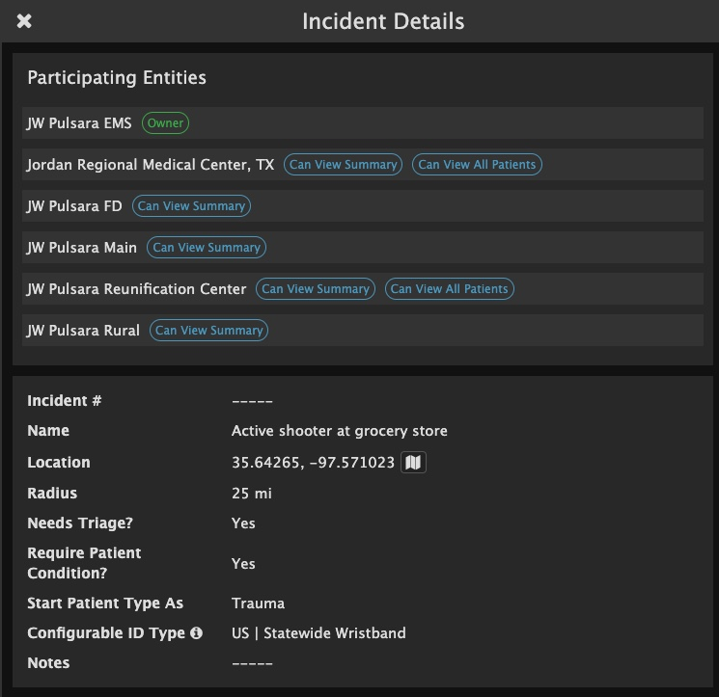
INCIDENTS | Hospital Incident View
Incident View
Select Correct Incident
Only see Patient Channels associated with Incident
View Patient Channel details
Wristband ID visible
Create Patient: Automatically added to this Incident
Incident Details
View Participating Entities and Privileges
Notes:
Under Incident Details, you can see participating entities, their privileges,

Slide 19
INCIDENTS | Hospital Incident View
Incident View
Select Correct Incident
Only see Patient Channels associated with Incident
View Patient Channel details
Wristband ID visible
Create Patient: Automatically added to this Incident
Incident Details
View Participating Entities and Privileges
Other Incident Details
Notes:
and additional details about the incident.

Slide 20
INCIDENTS | Hospital Incident View
Incident View
Select Correct Incident
Only see Patient Channels associated with Incident
View Patient Channel details
Wristband ID visible
Create Patient: Automatically added to this Incident
Incident Details
View Participating Entities and Privileges
Other Incident Details
Incident Summary
Notes:
Tap on the abbreviated incident summary

Slide 21
INCIDENTS | Hospital Incident View
Incident View
Select Correct Incident
Only see Patient Channels associated with Incident
View Patient Channel details
Wristband ID visible
Create Patient: Automatically added to this Incident
Incident Details
View Participating Entities and Privileges
Other Incident Details
Incident Summary
Notes:
to expand and see more details.

Slide 22
INCIDENTS | Hospital Incident View
Incident View
Select Correct Incident
Only see Patient Channels associated with Incident
View Patient Channel details
Wristband ID visible
Create Patient: Automatically added to this Incident
Incident Details
View Participating Entities and Privileges
Other Incident Details
Incident Summary
Notes:
Here, you can view how many patients within each triage category are on scene, en route, or at the designated destination.

Slide 23
INCIDENTS | Hospital Incident View
Incident View
Select Correct Incident
Only see Patient Channels associated with Incident
View Patient Channel details
Wristband ID visible
Create Patient: Automatically added to this Incident
Incident Details
View Participating Entities and Privileges
Other Incident Details
Incident Summary
Notes:
You can even see the breakdown by receiving destinations.

Slide 24
INCIDENTS | Hospital Incident View
Incident View
Select Correct Incident
Only see Patient Channels associated with Incident
View Patient Channel details
Wristband ID visible
Create Patient: Automatically added to this Incident
Incident Details
View Participating Entities and Privileges
Other Incident Details
Incident Summary
Command View - Separate Window
Notes:
If you would like to open this view in a separate window, tap “Command View.” Many people in the Emergency Department working an incident from their web browser will have Pulsara HQ open in one window and the Incident Summary open in another. Emergency Managers, Reunification Centers, and others primarily responsible for only the incident often work with Incident View open in one window and the Incident Summary in another.

Slide 25
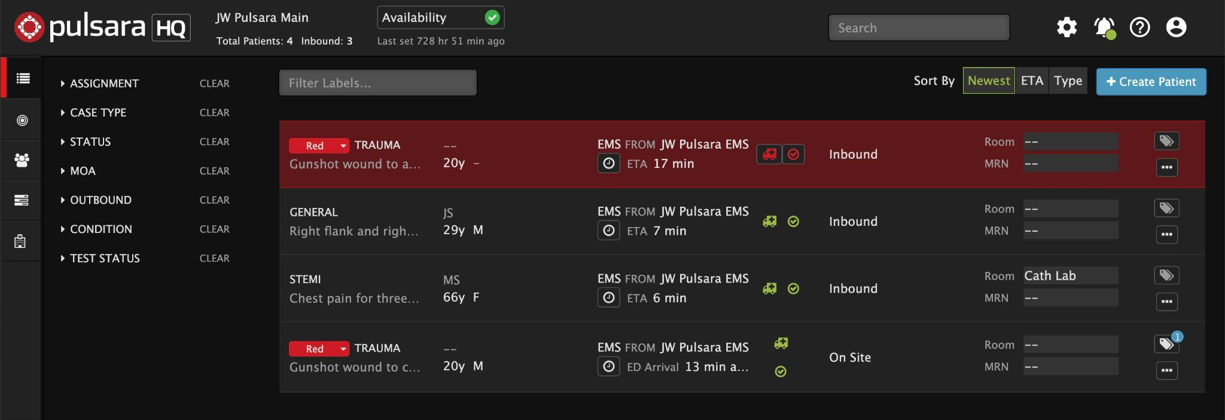
INCIDENTS | Prehospital Notifications During an Incident
New Patients
Same as Daily Prehospital Notifications
Flash Red
Audible Alert (if enabled)
Sort by Newest
Triage Color (Incident Related Patient)
Chief Complaint | Narrative
“Hover to Discover”
View Additional Details
Tap “...”
OPTIONAL
Set Room Number
EMS and Forward Triage will be able to see upon patient arrival if room is reserved
Update Availability
Transport Officer / EMS will be able to see in workflow when selecting facilities
Adjust Audible Alerts - if needed
Notes:
Let’s discuss how to receive a prehospital notification about an inbound EMS patient during an incident.
This process remains essentially unchanged from your daily routine. For situational awareness of the ongoing event, you can keep the command view open in a separate window to see a summary of the overall incident while continuing to manage your Emergency Department from Pulsara HQ.
When EMS selects your facility as a destination, the new patient channel will appear and flash red. If you have audible alerts enabled, you will also receive an alert. It is helpful to sort by the newest channels to ensure the new ones are always at the top. Please note that ETAs can be slightly inaccurate if EMS selects your facility but does not immediately transport the patient. You may receive both incident-related and non-incident-related notifications from inbound EMS units. A quick way to differentiate is that Incident-related patients are typically marked with a triage color. You can hover over the chief complaint or narrative section and tap the ellipsis to discover additional patient details.
That’s the core functionality you’ll use. Now, let’s dive into some additional features you can use to help optimize your workflow.
In larger incidents, many Emergency Departments establish a forward retriage area to better control their department. If it fits your workflow, you can pre-assign room numbers so both EMS and the forward triage team know their destination upon arrival. This can always be adjusted and communicated upon arrival as determined by the retriage assessment.
In some regions, Emergency Departments update their availability so Transport Officers or EMS can better understand their facility’s status in real time. This information helps them select destinations and load balance patients more effectively. If a patient from the incident presents directly to your facility, you can create a new patient channel for them and add them to the incident for complete situational awareness, without making phone calls. This will be reflected in the Command View.
If you have audible alerts enabled, but don’t need them because someone closely monitors this screen, you can silence these alerts by tapping the bell icon. In a separate topic, we’ll cover how to silence audible alerts on mobile during an incident.
ORIGINAL:
This tutorial will review how to receive a prehospital notification about an inbound EMS patient during a Mass Casualty Incident (MCI).
Fortunately, from a product perspective, this process remains essentially unchanged from your daily routine. For situational awareness of the ongoing event, you can keep the command view open in a separate window to see a summary of the overall incident while continuing to manage your Emergency Department from Pulsara HQ.
When EMS selects your facility as a destination, the new patient channel will appear and flash red. If you have audible alerts enabled, you will also receive an alert. It is helpful to sort by the newest channels to ensure the new ones are always at the top. Please note that ETAs can be slightly inaccurate if EMS selects your facility but does not immediately transport the patient. You may receive both incident-related and non-incident-related notifications from inbound EMS units and the incident-related patients are typically marked with a triage color. As always, you can hover over the chief complaint or narrative section and tap the ellipsis to discover additional patient details.
This represents your core functionality, but now we will cover some additional options you can use to help optimize your workflow.
In larger incidents, many Emergency Departments establish a forward retriage area to better control their department. Optionally, you can pre-assign room numbers so both EMS and the forward triage team know their destination upon arrival. This can always be adjusted and communicated upon arrival as determined by the retriage assessment.
In some regions, Emergency Departments update their availability so Transport Officers or EMS can better understand your facility’s status in realtime. This information helps them select destinations and load balance patients more effectively. Remember, patients presenting directly to your facility can be created and added to the incident for complete situational awareness without making phone calls as this is reflected in the Command View.
Finally, if you have audible alerts enabled and someone closely monitors this screen, you can silence these alerts by tapping the bell icon. How to silence audible alerts on mobile during an incident will be covered in a separate topic.

Slide 26
INCIDENTS | Prehospital Notifications During an Incident
New Patients
Same as Daily Prehospital Notifications
Flash Red
Audible Alert (if enabled)
Notes:
When EMS selects your facility as a destination, the new patient channel will appear and flash red. If you have audible alerts enabled, you will also receive an alert.

Slide 27
INCIDENTS | Prehospital Notifications During an Incident
New Patients
Same as Daily Prehospital Notifications
Flash Red
Audible Alert (if enabled)
Sort by Newest
Notes:
It is helpful to sort by the newest channels to ensure the new ones are always at the top. Please note that ETAs can be slightly inaccurate if EMS selects your facility but does not immediately transport the patient.

Slide 28
INCIDENTS | Prehospital Notifications During an Incident
New Patients
Same as Daily Prehospital Notifications
Flash Red
Audible Alert (if enabled)
Sort by Newest
Triage Color (Incident Related Patient)
Notes:
You may receive both incident-related and non-incident-related notifications from inbound EMS units. A quick way to differentiate is that Incident-related patients are typically marked with a triage color.

Slide 29
INCIDENTS | Prehospital Notifications During an Incident
New Patients
Same as Daily Prehospital Notifications
Flash Red
Audible Alert (if enabled)
Sort by Newest
Triage Color (Incident Related Patient)
Chief Complaint | Narrative
“Hover to Discover”
Notes:
You can hover over the chief complaint or narrative section

Slide 30
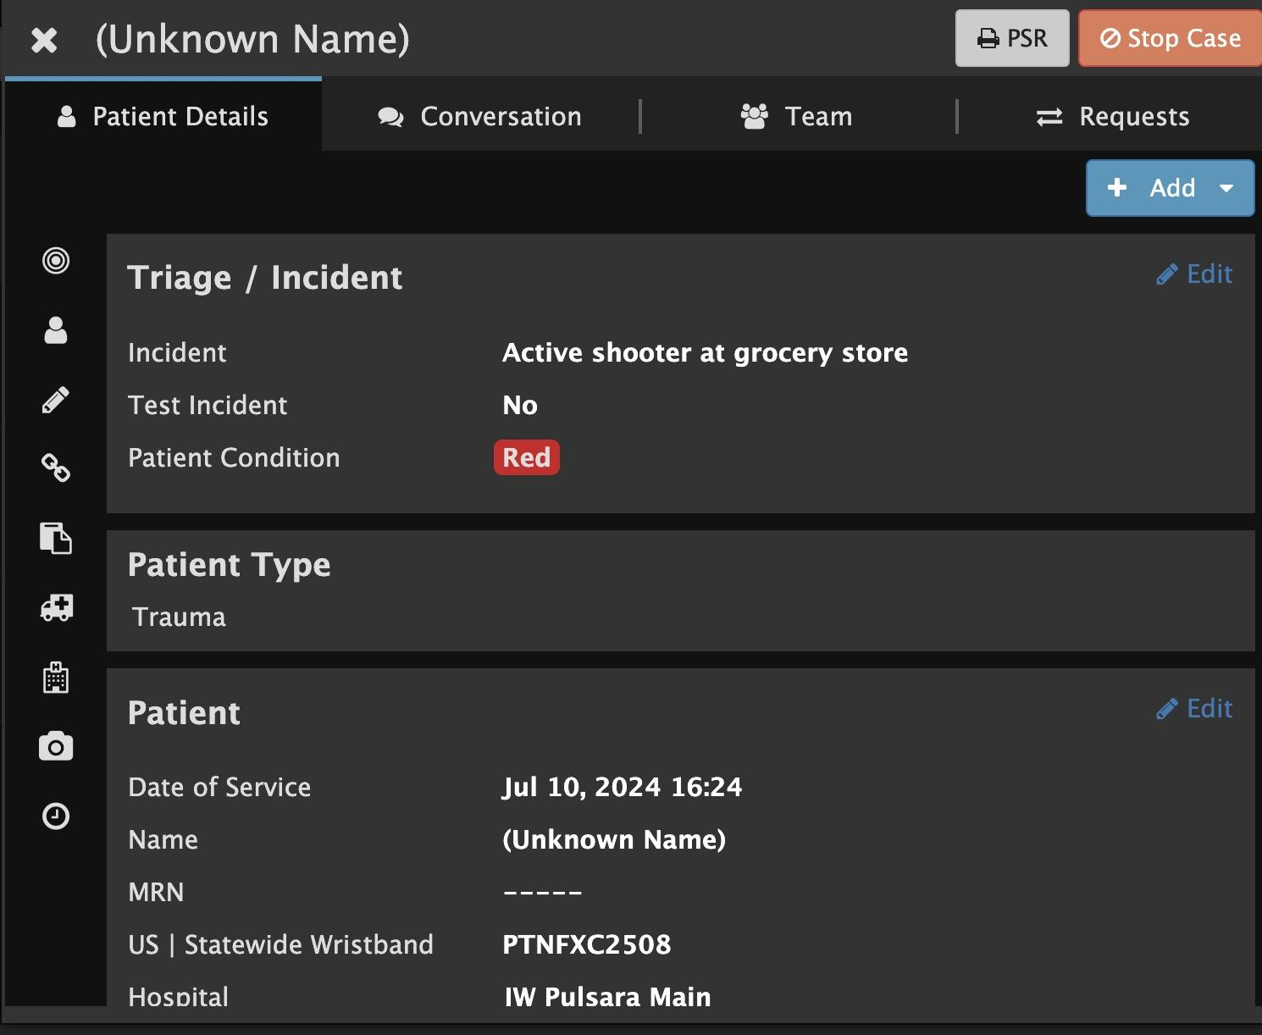
INCIDENTS | Prehospital Notifications During an Incident
New Patients
Same as Daily Prehospital Notifications
Flash Red
Audible Alert (if enabled)
Sort by Newest
Triage Color (Incident Related Patient)
Chief Complaint | Narrative
“Hover to Discover”
View Additional Details
Tap “...”
Notes:
and tap the ellipsis to discover additional patient details.
That’s the core functionality you’ll use. Now, let’s dive into some additional features you can use to help optimize your workflow.

Slide 31
INCIDENTS | Prehospital Notifications During an Incident
New Patients
Same as Daily Prehospital Notifications
Flash Red
Audible Alert (if enabled)
Sort by Newest
Triage Color (Incident Related Patient)
Chief Complaint | Narrative
“Hover to Discover”
View Additional Details
Tap “...”
OPTIONAL
Set Room Number
EMS and Forward Triage will be able to see upon patient arrival if room is reserved
Notes:
In larger incidents, many Emergency Departments establish a forward retriage area to better control their department. If it fits your workflow, you can pre-assign room numbers so both EMS and the forward triage team know their destination upon arrival. This can always be adjusted and communicated upon arrival as determined by the retriage assessment.

Slide 32
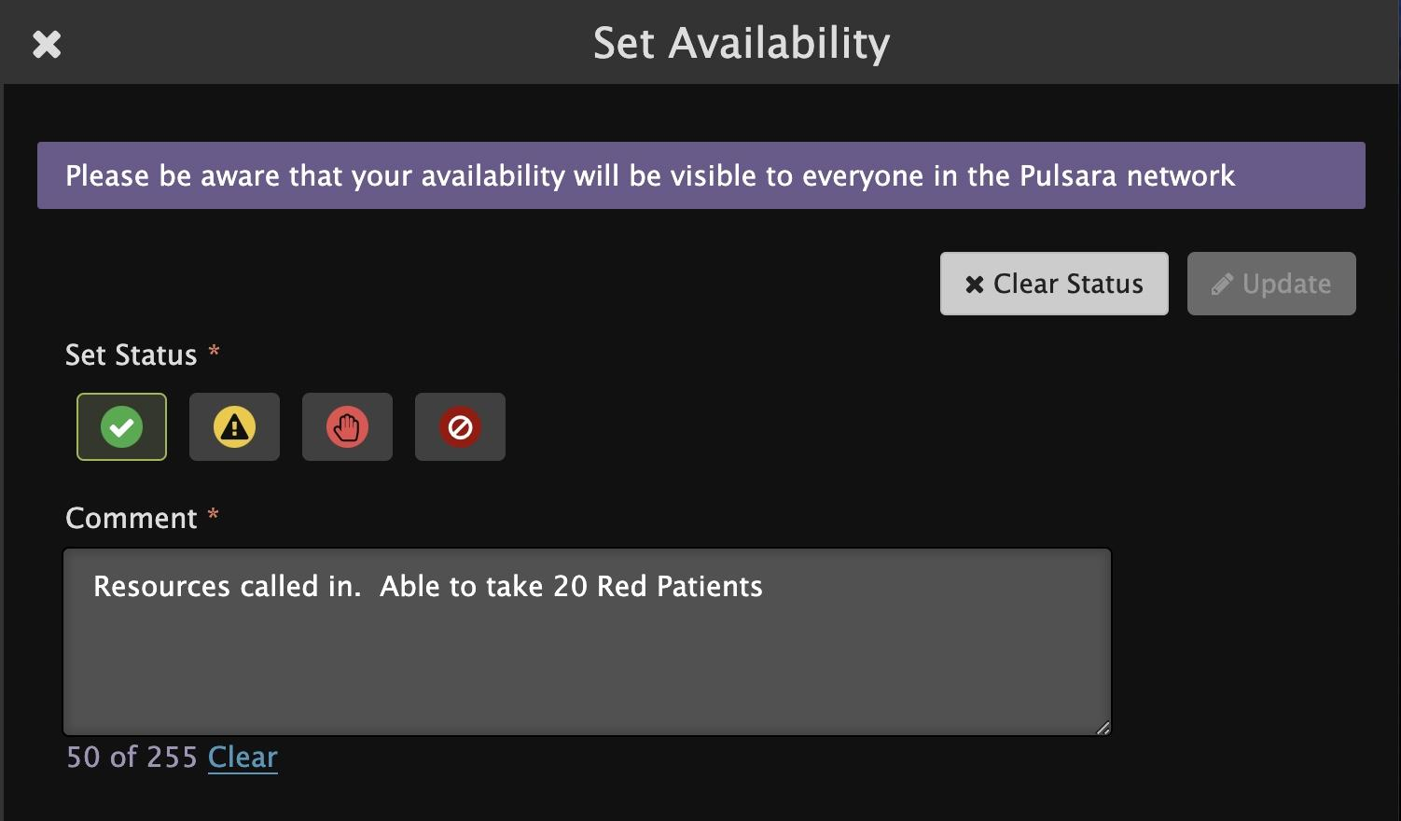
INCIDENTS | Prehospital Notifications During an Incident
New Patients
Same as Daily Prehospital Notifications
Flash Red
Audible Alert (if enabled)
Sort by Newest
Triage Color (Incident Related Patient)
Chief Complaint | Narrative
“Hover to Discover”
View Additional Details
Tap “...”
OPTIONAL
Set Room Number
EMS and Forward Triage will be able to see upon patient arrival if room is reserved
Update Availability
Transport Officer / EMS will be able to see in workflow when selecting facilities
Notes:
In some regions, Emergency Departments update their availability so Transport Officers or EMS can better understand their facility’s status in real time. This information helps them select destinations and load balance patients more effectively. If a patient from the incident presents directly to your facility, you can create a new patient channel for them and add them to the incident for complete situational awareness, without making phone calls. This will be reflected in the Command View.

Slide 33
INCIDENTS | Prehospital Notifications During an Incident
New Patients
Same as Daily Prehospital Notifications
Flash Red
Audible Alert (if enabled)
Sort by Newest
Triage Color (Incident Related Patient)
Chief Complaint | Narrative
“Hover to Discover”
View Additional Details
Tap “...”
OPTIONAL
Set Room Number
EMS and Forward Triage will be able to see upon patient arrival if room is reserved
Update Availability
Transport Officer / EMS will be able to see in workflow when selecting facilities
Adjust Audible Alerts - if needed
Notes:
If you have audible alerts enabled, but don’t need them because someone closely monitors this screen, you can silence these alerts by tapping the bell icon. In a separate topic, we’ll cover how to silence audible alerts on mobile during an incident.

Slide 34
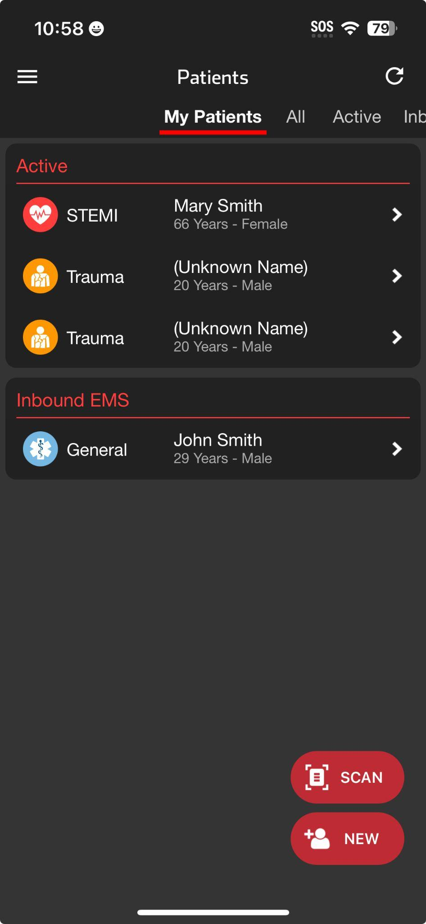
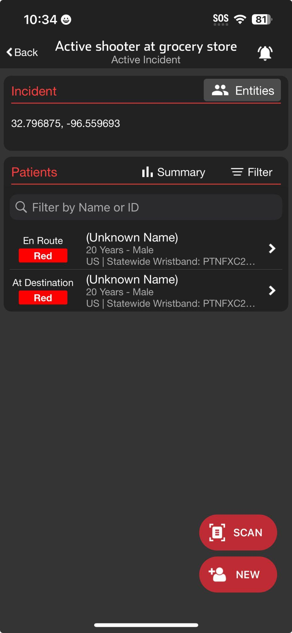
INCIDENTS | Using Mobile Devices During an Incident
Patient List View
Incident View
Patient List View
Daily Use
My Patients and All Patients at My Organization(s)
Incident View
Tap Menu, then Incidents
Groups patient channels within an Incident
My entity’s patients
All incident patients (Reunification Center)
View participating entities and privileges
Manage alerts for entire incident
Summary (Command View located on Web)
Prehospital Notifications
Notified about New Incident
Supplements other regional notifications if enabled
Will receive notifications about new patients even if not added to incident
Option: Team is notified regardless of call status
Notified about New Inbound EMS
Unchanged from daily unless incident alerts are muted
Notes:
Let’s go over the use of mobile devices, such as smartphones and tablets, during an incident.
The main screen you use daily is the Patient List View. This screen provides access to My Patients, where you can view patients you are currently assigned, and All Patients, which includes all patients at your entity or multiple entities if you have privileges at different organizations.
To access the Incident View, tap the menu and select “Incidents.” Here, you will see all incidents involving your entity. Note that you must be invited by Incident Command for the incident to appear in this view. Once you select the appropriate incident, you can view all patients en route to, consulted, or at your entity. Some entities, like a Reunification Center, may have privileges to see all patients associated with the incident. You can view all participating entities and their privileges by tapping Entities.
You can always silence alerts for an individual patient by tapping the bell icon within that patient’s channel. However, you can also silence alerts for an entire incident by tapping the bell icon in the main Incident View. This alert management is done at the individual device and user level which helps entities and departments manage alarm fatigue while ensuring critical alerts are not missed.
The Incident Summary shows patient counts broken down by condition and general location. For a more detailed view, including breakdowns by destination facility, access the Command View via the web.
Teams can be enabled to receive notifications about new incidents in the region which can supplement other established regional notifications. Entities can also enable teams to receive alerts regardless of their call status.
In line with using the same tools daily that we use during an incident, receiving prehospital notifications about new inbound patients during an incident on mobile devices remains unchanged from the daily process.
In larger Emergency Departments, a blended environment is common. Individuals needing broader situational awareness and responsible for receiving notifications about new patients typically access Pulsara via the web on a computer. Mobile users working in the Emergency Department might use Patient View, while those focused on the incident, especially those responsible for arriving patients or adding walk-in patients to an incident, may find Incident View more helpful.

Slide 35
INCIDENTS | Using Mobile Devices During an Incident
Patient List View
Patient List View
Daily Use
My Patients and All Patients at My Organization(s)
Notes:
The main screen you use daily is the Patients List View. This screen provides access to My Patients, where you can view patients you are currently assigned,

Slide 36
INCIDENTS | Using Mobile Devices During an Incident
Patient List View
Patient List View
Daily Use
My Patients and All Patients at My Organization(s)
Notes:
and All Patients, which includes all patients at your entity or multiple entities if you have privileges at different organizations.

Slide 37
INCIDENTS | Using Mobile Devices During an Incident
Patient List View
Patient List View
Daily Use
My Patients and All Patients at My Organization(s)
Incident View
Tap Menu
Notes:
To access the Incident View, tap the menu

Slide 38
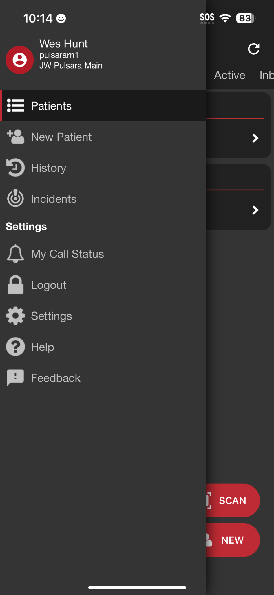
INCIDENTS | Using Mobile Devices During an Incident
Patient List View
Patient List View
Daily Use
My Patients and All Patients at My Organization(s)
Incident View
Tap Menu, then Incidents
Notes:
and select Incidents.

Slide 39
INCIDENTS | Using Mobile Devices During an Incident
Incident View
Patient List View
Daily Use
My Patients and All Patients at My Organization(s)
Incident View
Tap Menu, then Incidents
Notes:
Here, you will see all incidents involving your entity. Note that you must be invited by Incident Command for the incident to appear in this view. Once you select the appropriate incident

Slide 40
INCIDENTS | Using Mobile Devices During an Incident
Incident View
Patient List View
Daily Use
My Patients and All Patients at My Organization(s)
Incident View
Tap Menu, then Incidents
Groups patient channels within an Incident
My entity’s patients
All incident patients (Reunification Center)
Notes:
you can view all patients en route to, consulted, or at your entity. Some entities, like a Reunification Center, may have privileges to see all patients associated with the incident.

Slide 41
INCIDENTS | Using Mobile Devices During an Incident
Incident View
Patient List View
Daily Use
My Patients and All Patients at My Organization(s)
Incident View
Tap Menu, then Incidents
Groups patient channels within an Incident
My entity’s patients
All incident patients (Reunification Center)
View participating entities and privileges
Notes:
You can view all participating entities and their privileges by tapping Entities.

Slide 42
INCIDENTS | Using Mobile Devices During an Incident
Incident View
Patient List View
Daily Use
My Patients and All Patients at My Organization(s)
Incident View
Tap Menu, then Incidents
Groups patient channels within an Incident
My entity’s patients
All incident patients (Reunification Center)
View participating entities and privileges
Manage alerts for entire incident
Notes:
You can always silence alerts for an individual patient by tapping the bell icon within that patient’s channel.

Slide 43
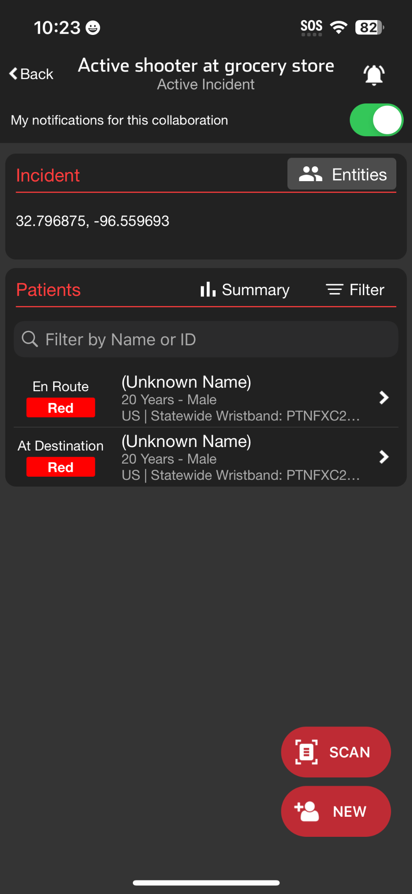
INCIDENTS | Using Mobile Devices During an Incident
Incident View
Patient List View
Daily Use
My Patients and All Patients at My Organization(s)
Incident View
Tap Menu, then Incidents
Groups patient channels within an Incident
My entity’s patients
All incident patients (Reunification Center)
View participating entities and privileges
Manage alerts for entire incident
Notes:
However, you can also silence alerts for an entire incident by tapping the bell icon in the main Incident View. This alert management is done at the individual device and user level which helps entities and departments manage alarm fatigue while ensuring critical alerts are not missed.

Slide 44
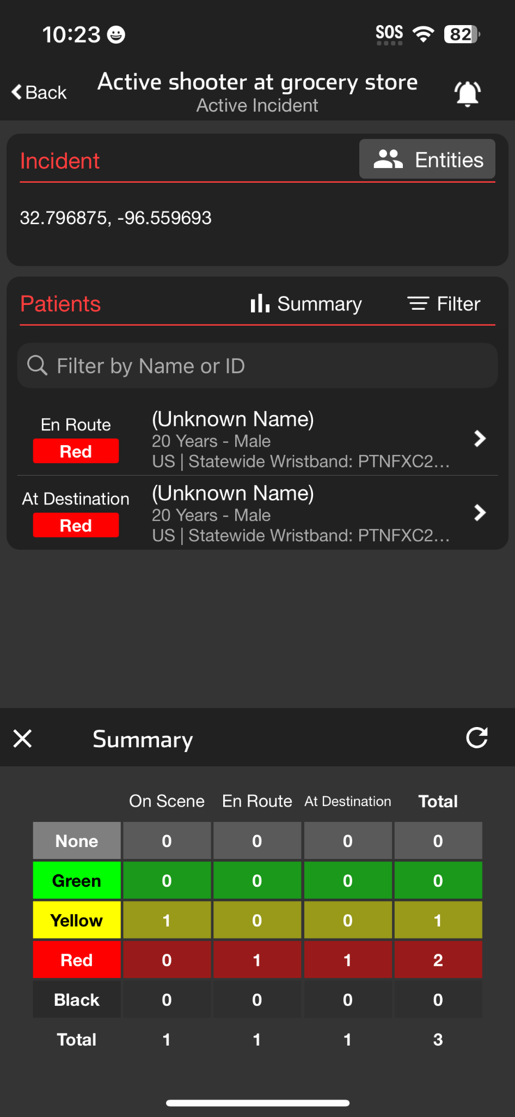
INCIDENTS | Using Mobile Devices During an Incident
Incident View
Patient List View
Daily Use
My Patients and All Patients at My Organization(s)
Incident View
Tap Menu, then Incidents
Groups patient channels within an Incident
My entity’s patients
All incident patients (Reunification Center)
View participating entities and privileges
Manage alerts for entire incident
Summary (Command View located on Web)
Notes:
The Incident Summary shows patient counts broken down by condition and general location. For a more detailed view, including breakdowns by destination facility, access the Command View via the web.

Slide 45
INCIDENTS | Using Mobile Devices During an Incident
Incident View
Patient List View
Daily Use
My Patients and All Patients at My Organization(s)
Incident View
Tap Menu, then Incidents
Groups patient channels within an Incident
My entity’s patients
All incident patients (Reunification Center)
View participating entities and privileges
Manage alerts for entire incident
Summary (Command View located on Web)
Prehospital Notifications
Notified about New Incident
Supplements other regional notifications if enabled
Will receive notifications about new patients even if not added to incident
Option: Team is notified regardless of call status
Notes:
Teams can be enabled to receive notifications about new incidents in the region which can supplement other established regional notifications. Entities can also enable teams to receive alerts regardless of their call status.

Slide 46
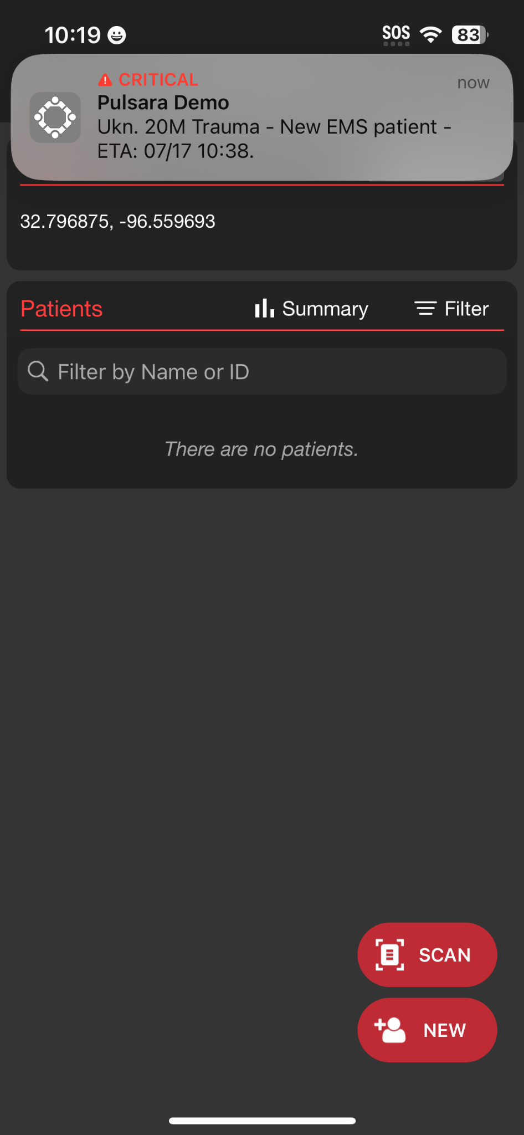
INCIDENTS | Using Mobile Devices During an Incident
Incident View
Patient List View
Daily Use
My Patients and All Patients at My Organization(s)
Incident View
Tap Menu, then Incidents
Groups patient channels within an Incident
My entity’s patients
All incident patients (Reunification Center)
View participating entities and privileges
Manage alerts for entire incident
Summary (Command View located on Web)
Prehospital Notifications
Notified about New Incident
Supplements other regional notifications if enabled
Will receive notifications about new patients even if not added to incident
Option: Team is notified regardless of call status
Notified about New Inbound EMS
Unchanged from daily unless incident alerts are muted
Notes:
In line with using the same tools daily that we use during an incident, receiving prehospital notifications about new inbound patients during an incident on mobile devices remains unchanged from the daily process.

Slide 47
INCIDENTS | Using Mobile Devices During an Incident
Patient List View
Daily Use
My Patients and All Patients at My Organization(s)
Incident View
Tap Menu, then Incidents
Groups patient channels within an Incident
My entity’s patients
All incident patients (Reunification Center)
View participating entities and privileges
Manage alerts for entire incident
Summary (Command View located on Web)
Prehospital Notifications
Notified about New Incident
Supplements other regional notifications if enabled
Will receive notifications about new patients even if not added to incident
Option: Team is notified regardless of call status
Notified about New Inbound EMS
Unchanged from daily unless incident alerts are muted
Notes:
In larger Emergency Departments, a blended environment is common. Individuals needing broader situational awareness and responsible for receiving notifications about new patients typically access Pulsara via the web on a computer.

Slide 48
INCIDENTS | Using Mobile Devices During an Incident
Patient List View
Incident View
Patient List View
Daily Use
My Patients and All Patients at My Organization(s)
Incident View
Tap Menu, then Incidents
Groups patient channels within an Incident
My entity’s patients
All incident patients (Reunification Center)
View participating entities and privileges
Manage alerts for entire incident
Summary (Command View located on Web)
Prehospital Notifications
Notified about New Incident
Supplements other regional notifications if enabled
Will receive notifications about new patients even if not added to incident
Option: Team is notified regardless of call status
Notified about New Inbound EMS
Unchanged from daily unless incident alerts are muted
Notes:
Mobile users working in the emergency department might use Patient View, while those focused on the incident, especially those responsible for arriving patients or adding walk-in patients to an incident, may find Incident View more helpful.

Slide 49
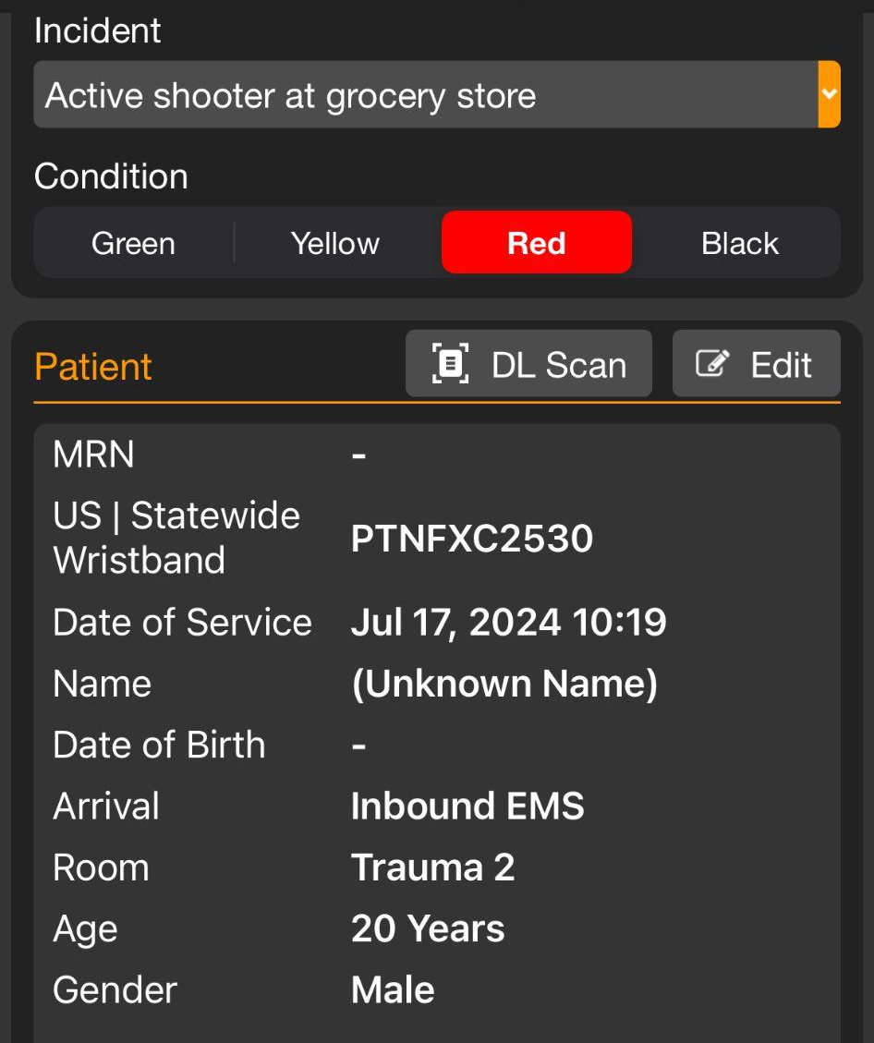
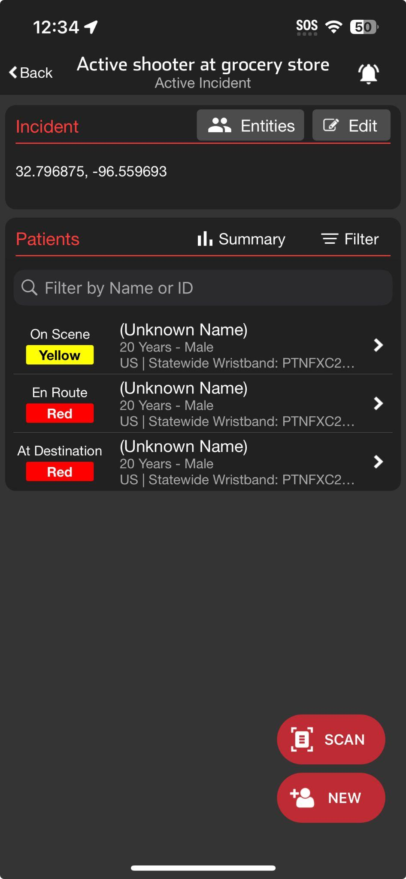
INCIDENTS | Receiving Patients During an Incident
Scan Wristband
Finds and Opens Patient Channel
Prompts to Create Patient Channel if not in system
Set ED Arrival Time
Scroll to bottom and Set ED Arrival Time
Moves Patient to At Destination Status
Options
Re-Triage and Change Condition
Room Assignment
Visible if already assigned
Able to Add / Edit
Notes:
Let’s review how to receive patients during an Incident.
During a larger incident, you may have a large volume of unidentified patients. Therefore, most emergency departments will establish a forward Triage area so they can better control their emergency department flow. Individuals stationed here will typically use a mobile device so they can use the scanning capabilities.
It is important to consider your connectivity in this location. In addition to ensuring they have WiFi coverage, many hospitals will also ensure they have access to cellular enabled devices in this location. To better manage noise, most people in this location will silence their alerts related to the incident.
Upon a patient’s arrival, scan the US Statewide Wristband, which opens that individual’s patient channel. Scroll to the bottom, and set ED Arrival Time. This task only takes a couple of seconds, and is the only required interaction for a regional Patient Movement System as it moves the patient to At Destination status on the Incident Summary.
To optimize your department further, there are additional optional functionalities available.
You can re-triage the patient and update their condition if appropriate.
If the patient was pre-assigned a room, you can view this information and direct medics accordingly. You also have the ability to add or edit room assignments as appropriate.

Slide 50
INCIDENTS | Receiving Patients During an Incident
Notes:
During a larger incident, you may have a large volume of unidentified patients. Therefore, most emergency departments will establish a forward Triage area so they can better control their emergency department flow. Individuals stationed here will typically use a mobile device so they can use the scanning capabilities.
It is important to consider your connectivity in this location. In addition to ensuring they have WiFi coverage, many hospitals will also ensure they have access to cellular enabled devices in this location.

Slide 51
INCIDENTS | Receiving Patients During an Incident
Notes:
To better manage noise, most people in this location will silence their alerts related to the incident.

Slide 52
INCIDENTS | Receiving Patients During an Incident
Scan Wristband
Notes:
Upon a patient’s arrival, scan the US Statewide Wristband,

Slide 53
INCIDENTS | Receiving Patients During an Incident
Scan Wristband
Finds and Opens Patient Channel
Prompts to Create Patient Channel if not in system
Notes:
which opens that individual’s patient channel.

Slide 54
INCIDENTS | Receiving Patients During an Incident
Scan Wristband
Finds and Opens Patient Channel
Prompts to Create Patient Channel if not in system
Set ED Arrival Time
Scroll to bottom and Set ED Arrival Time
Notes:
Scroll to the bottom, and set ED Arrival Time.

Slide 55
INCIDENTS | Receiving Patients During an Incident
Scan Wristband
Finds and Opens Patient Channel
Prompts to Create Patient Channel if not in system
Set ED Arrival Time
Scroll to bottom and Set ED Arrival Time
Moves Patient to At Destination Status
Notes:
This task only takes a couple of seconds, and is the only required interaction for a regional Patient Movement System as it moves the patient to At Destination status on the Incident Summary.

Slide 56
INCIDENTS | Receiving Patients During an Incident
Scan Wristband
Finds and Opens Patient Channel
Prompts to Create Patient Channel if not in system
Set ED Arrival Time
Scroll to bottom and Set ED Arrival Time
Moves Patient to At Destination Status
Options
Re-Triage and Change Condition
Notes:
To optimize your department further, there are additional optional functionalities available.
You can re-triage the patient and update their condition if appropriate.

Slide 57
INCIDENTS | Receiving Patients During an Incident
Scan Wristband
Finds and Opens Patient Channel
Prompts to Create Patient Channel if not in system
Set ED Arrival Time
Scroll to bottom and Set ED Arrival Time
Moves Patient to At Destination Status
Options
Re-Triage and Change Condition
Room Assignment
Visible if already assigned
Able to Add / Edit
Notes:
If the patient was pre-assigned a room, you can view this information and direct medics accordingly. You also have the ability to add or edit room assignments as appropriate.

Slide 58
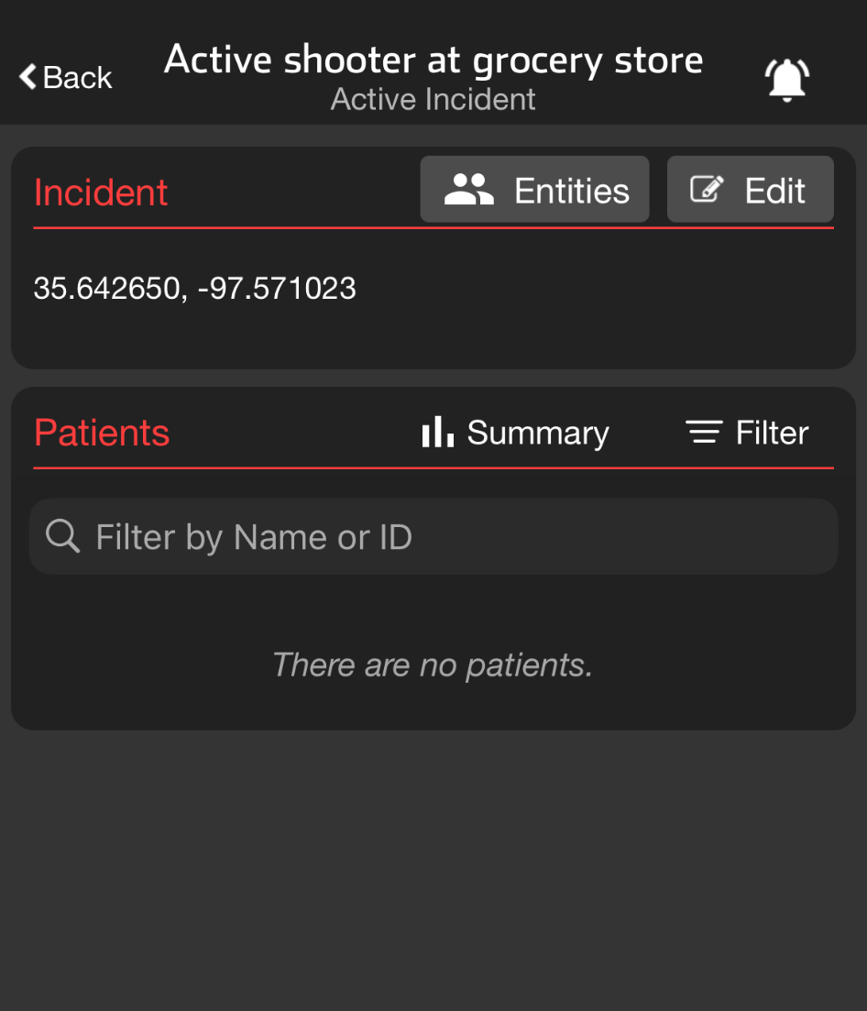
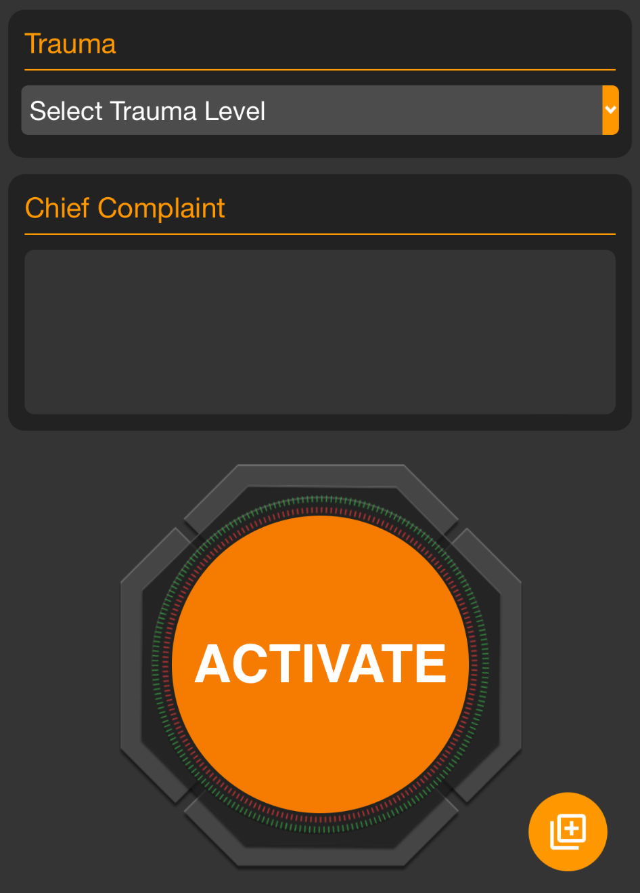
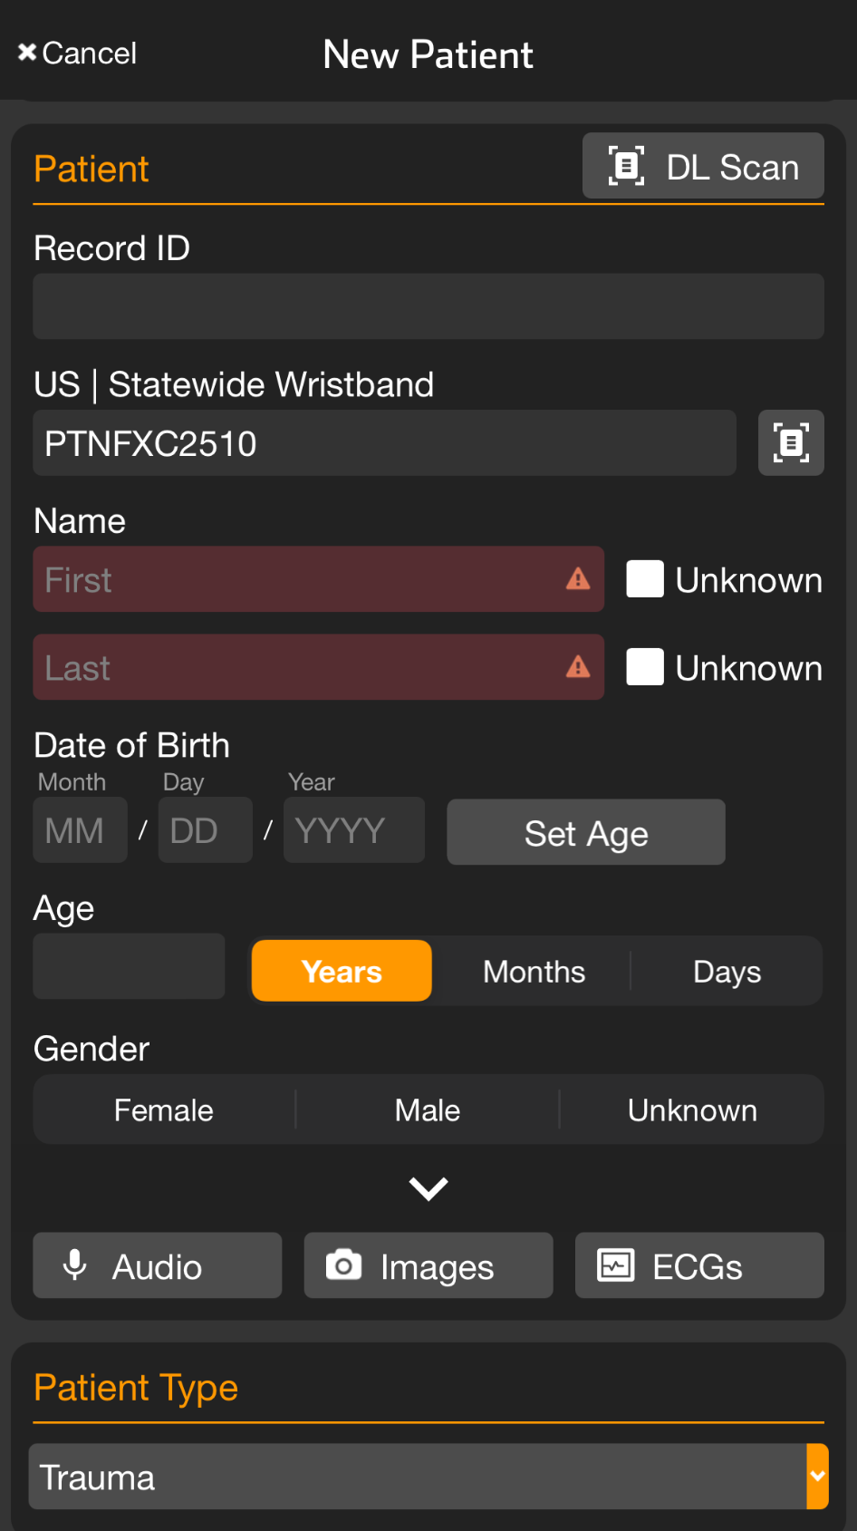
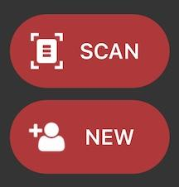
INCIDENTS | Add Patient to Incident - Mobile
Apply and Scan Wristband
Scan wristband to add a patient
Adding patients by tapping NEW increases the risk of a duplicate
Patient is automatically added to incident in Incident View
Set Method of Arrival
Set Triage Condition (Color)
Add Patient Demographics
Scan driver’s license (DL), or enter manually
Rapid: Unknown name, estimated Age, Gender
Activate Patient
Triage Section not visible?
You are in Patient View (all patients)
Tap Add, then Triage / Incident
Select Incident and Condition
Optional
Take Photos
Face, Injury…
Chief Complaint
Voice-to-text
Trauma Level
Notes:
Let’s dive into how to add patients to an incident.
From a regional perspective, it’s crucial to add patients as soon as possible. Doing so allows participating entities to monitor the burden on each facility in near real-time, which can significantly impact load balancing. The process is quick. You can add a patient in seconds with just a few details, and you can always go back to update the information later as the incident deescalates or as you begin working on reunification.
To add patients quickly, ensure you’re in the correct incident within Incident View. If you’re unsure how to navigate to the correct incident, refer to our lesson on this topic. Let’s get started.
First, apply a wristband to the patient and tap Scan. Although you have the option to tap New to create a new patient, doing so increases the risk of creating duplicates. The wristband also serves as a visual cue that the patient has already been entered into Pulsara.
Next, set the patient’s method of arrival, triage condition, and enter their demographics. You can quickly input demographic details by scanning their driver’s license or entering the information manually. If the patient’s name is unknown, simply tap Unknown. While not required, entering an estimated age and gender can be helpful.
At this point, you can tap Activate to create the channel, which assigns the patient to the incident and adds them to your facility in the summary view. It’s that simple.
If time allows, consider adding photos of the patient’s face for identification, documenting any visible injuries, and capturing other pertinent details using the camera. Additionally, if you have time, use the voice-to-text feature to quickly summarize major injuries or other important details in the chief complaint or narrative field.
If this is a Trauma Patient, you will be prompted to select the Trauma Level. Remember, to prevent overalerting in a chaotic incident environment you can always silence alerting for the incident by tapping the bell icon on main Incident view.
If you don’t see the Triage Incident card, you’re in Patient View, which shows all patients in your facility, not just those associated with the incident. To add the patient to the incident, tap the universal add button in the lower right corner and select Triage Incident. You can then assign the patient to the correct incident and select their condition. This step can be done at any time, so if you forget to add a patient to the incident or they get assigned to the wrong one, it’s easy to correct.

Slide 59
INCIDENTS | Add Patient to Incident - Mobile
Incident View
Incident Name
Notes:
To add patients quickly, ensure you’re in the correct incident within Incident View. If you’re unsure how to navigate to the correct incident, refer to our lesson on this topic.

Slide 60
INCIDENTS | Add Patient to Incident - Mobile
Apply and Scan Wristband
Scan wristband to add a patient
Adding patients by tapping NEW increases the risk of a duplicate
Patient is automatically added to incident in Incident View
Notes:
Let’s get started.
First, apply a wristband to the patient and tap Scan. Although you have the option to tap New to create a new patient, doing so increases the risk of creating duplicates. The wristband also serves as a visual cue that the patient has already been entered into Pulsara.

Slide 61
INCIDENTS | Add Patient to Incident - Mobile
Apply and Scan Wristband
Scan wristband to add a patient
Adding patients by tapping NEW increases the risk of a duplicate
Patient is automatically added to incident in Incident View
Set Method of Arrival
Notes:
Next, set the patient’s method of arrival

Slide 62
INCIDENTS | Add Patient to Incident - Mobile
Apply and Scan Wristband
Scan wristband to add a patient
Adding patients by tapping NEW increases the risk of a duplicate
Patient is automatically added to incident in Incident View
Set Method of Arrival
Set Triage Condition (Color)
Notes:
triage condition,

Slide 63
INCIDENTS | Add Patient to Incident - Mobile
Apply and Scan Wristband
Scan wristband to add a patient
Adding patients by tapping NEW increases the risk of a duplicate
Patient is automatically added to incident in Incident View
Set Method of Arrival
Set Triage Condition (Color)
Add Patient Demographics
Scan driver’s license (DL), or enter manually
Rapid: Unknown name, estimated Age, Gender
Notes:
and enter their demographics. You can quickly input demographic details by scanning their driver’s license

Slide 64
INCIDENTS | Add Patient to Incident - Mobile
Apply and Scan Wristband
Scan wristband to add a patient
Adding patients by tapping NEW increases the risk of a duplicate
Patient is automatically added to incident in Incident View
Set Method of Arrival
Set Triage Condition (Color)
Add Patient Demographics
Scan driver’s license (DL), or enter manually
Rapid: Unknown name, estimated Age, Gender
Notes:
or entering the information manually. If the patient’s name is unknown, simply tap Unknown. While not required, entering an estimated age and gender can be helpful.

Slide 65
INCIDENTS | Add Patient to Incident - Mobile
Apply and Scan Wristband
Scan wristband to add a patient
Adding patients by tapping NEW increases the risk of a duplicate
Patient is automatically added to incident in Incident View
Set Method of Arrival
Set Triage Condition (Color)
Add Patient Demographics
Scan driver’s license (DL), or enter manually
Rapid: Unknown name, estimated Age, Gender
Activate Patient
Notes:
At this point, you can tap Activate to create the channel, which assigns the patient to the incident and adds them to your facility in the summary view. It’s that simple.

Slide 66
INCIDENTS | Add Patient to Incident - Mobile
Apply and Scan Wristband
Scan wristband to add a patient
Adding patients by tapping NEW increases the risk of a duplicate
Patient is automatically added to incident in Incident View
Set Method of Arrival
Set Triage Condition (Color)
Add Patient Demographics
Scan driver’s license (DL), or enter manually
Rapid: Unknown name, estimated Age, Gender
Activate Patient
Optional
Take Photos
Face, Injury…
Notes:
If time allows, consider adding photos of the patient’s face for identification, documenting any visible injuries, and capturing other pertinent details using the camera.

Slide 67
INCIDENTS | Add Patient to Incident - Mobile
Apply and Scan Wristband
Scan wristband to add a patient
Adding patients by tapping NEW increases the risk of a duplicate
Patient is automatically added to incident in Incident View
Set Method of Arrival
Set Triage Condition (Color)
Add Patient Demographics
Scan driver’s license (DL), or enter manually
Rapid: Unknown name, estimated Age, Gender
Activate Patient
Optional
Take Photos
Face, Injury…
Chief Complaint
Voice-to-text
Notes:
Additionally, if you have time, use the voice-to-text feature to quickly summarize major injuries or other important details in the chief complaint or narrative field.

Slide 68
INCIDENTS | Add Patient to Incident - Mobile
Apply and Scan Wristband
Scan wristband to add a patient
Adding patients by tapping NEW increases the risk of a duplicate
Patient is automatically added to incident in Incident View
Set Method of Arrival
Set Triage Condition (Color)
Add Patient Demographics
Scan driver’s license (DL), or enter manually
Rapid: Unknown name, estimated Age, Gender
Activate Patient
Optional
Take Photos
Face, Injury…
Chief Complaint
Voice-to-text
Trauma Level
Notes:
If this is a Trauma Patient, you will be prompted to select the Trauma Level.

Slide 69
INCIDENTS | Add Patient to Incident - Mobile
Apply and Scan Wristband
Scan wristband to add a patient
Adding patients by tapping NEW increases the risk of a duplicate
Patient is automatically added to incident in Incident View
Set Method of Arrival
Set Triage Condition (Color)
Add Patient Demographics
Scan driver’s license (DL), or enter manually
Rapid: Unknown name, estimated Age, Gender
Activate Patient
Optional
Take Photos
Face, Injury…
Chief Complaint
Voice-to-text
Trauma Level
Notes:
Remember, to prevent overalerting in a chaotic incident environment you can always silence alerting for the incident by tapping the bell icon on main Incident view.

Slide 70
INCIDENTS | Add Patient to Incident - Mobile
Apply and Scan Wristband
Scan wristband to add a patient
Adding patients by tapping NEW increases the risk of a duplicate
Patient is automatically added to incident in Incident View
Set Method of Arrival
Set Triage Condition (Color)
Add Patient Demographics
Scan driver’s license (DL), or enter manually
Rapid: Unknown name, estimated Age, Gender
Activate Patient
Triage Section not visible?
You are in Patient View (all patients)
Optional
Take Photos
Face, Injury…
Chief Complaint
Voice-to-text
Trauma Level
Notes:
If you don’t see the Triage Incident card, you’re in Patient View, which shows all patients in your facility, not just those associated with the incident.

Slide 71
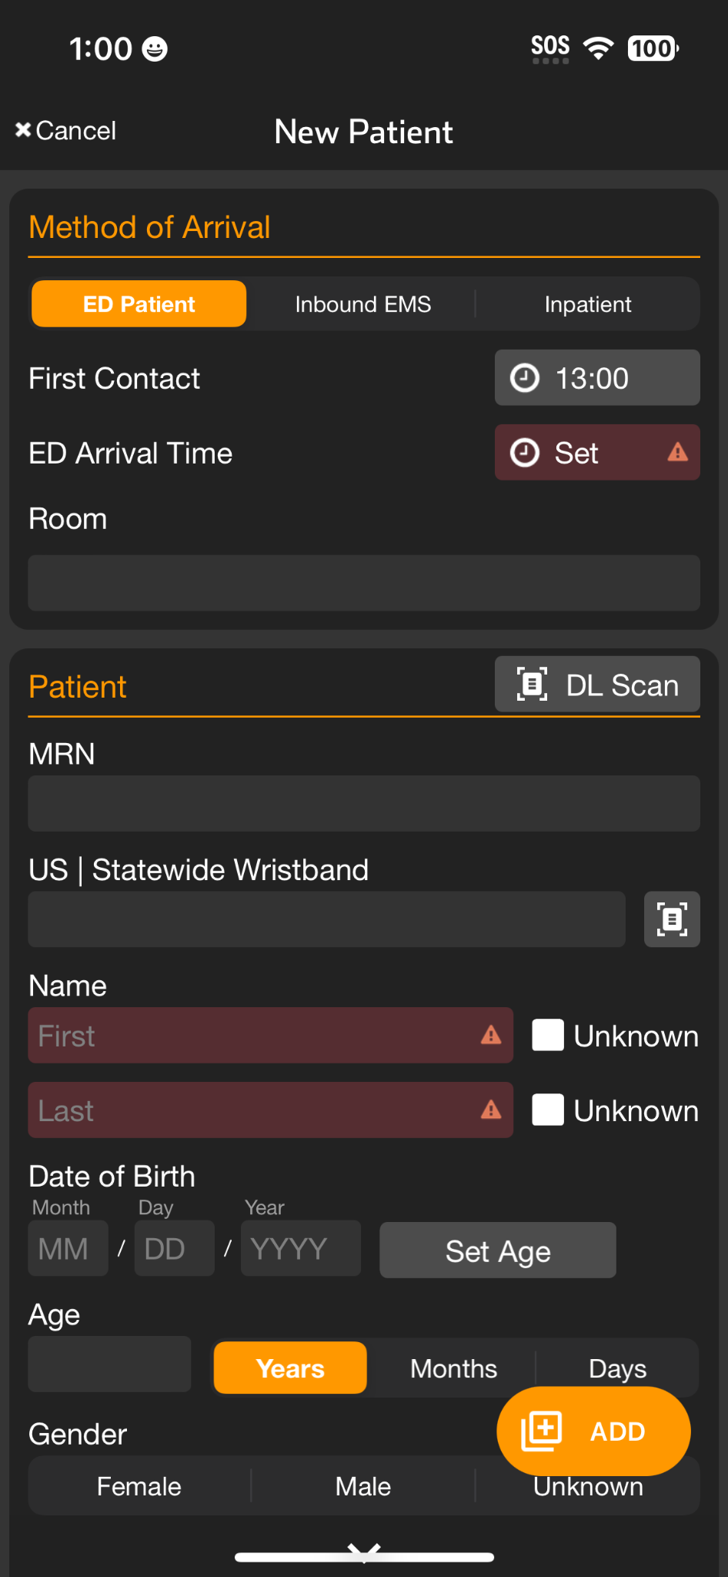
INCIDENTS | Add Patient to Incident - Mobile
Apply and Scan Wristband
Scan wristband to add a patient
Adding patients by tapping NEW increases the risk of a duplicate
Patient is automatically added to incident in Incident View
Set Method of Arrival
Set Triage Condition (Color)
Add Patient Demographics
Scan driver’s license (DL), or enter manually
Rapid: Unknown name, estimated Age, Gender
Activate Patient
Triage Section not visible?
You are in Patient View (all patients)
Tap Add,
Optional
Take Photos
Face, Injury…
Chief Complaint
Voice-to-text
Trauma Level
Notes:
To add the patient to the incident, tap the universal add button in the lower right corner

Slide 72
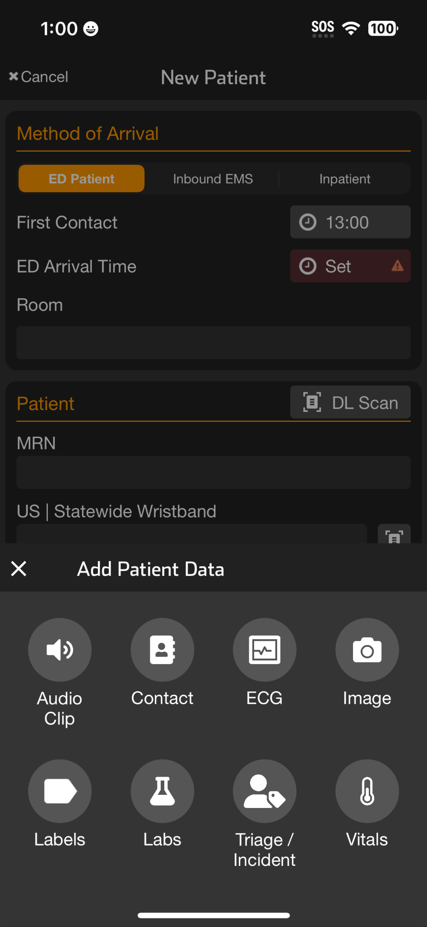
INCIDENTS | Add Patient to Incident - Mobile
Apply and Scan Wristband
Scan wristband to add a patient
Adding patients by tapping NEW increases the risk of a duplicate
Patient is automatically added to incident in Incident View
Set Method of Arrival
Set Triage Condition (Color)
Add Patient Demographics
Scan driver’s license (DL), or enter manually
Rapid: Unknown name, estimated Age, Gender
Activate Patient
Triage Section not visible?
You are in Patient View (all patients)
Tap Add, then Triage / Incident
Optional
Take Photos
Face, Injury…
Chief Complaint
Voice-to-text
Trauma Level
Notes:
and select Triage Incident.

Slide 73
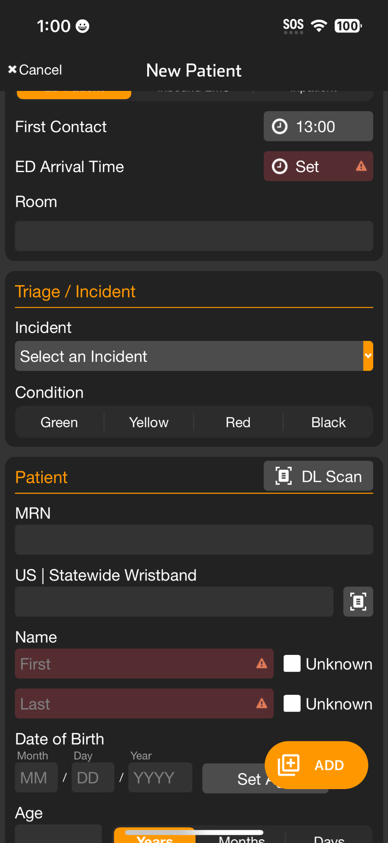
INCIDENTS | Add Patient to Incident - Mobile
Apply and Scan Wristband
Scan wristband to add a patient
Adding patients by tapping NEW increases the risk of a duplicate
Patient is automatically added to incident in Incident View
Set Method of Arrival
Set Triage Condition (Color)
Add Patient Demographics
Scan driver’s license (DL), or enter manually
Rapid: Unknown name, estimated Age, Gender
Activate Patient
Triage Section not visible?
You are in Patient View (all patients)
Tap Add, then Triage / Incident
Select Incident and Condition
Optional
Take Photos
Face, Injury…
Chief Complaint
Voice-to-text
Trauma Level
Notes:
You can then assign the patient to the correct incident and select their condition. This step can be done at any time, so if you forget to add a patient to the incident or they get assigned to the wrong one, it’s easy to correct.

