Slide 1
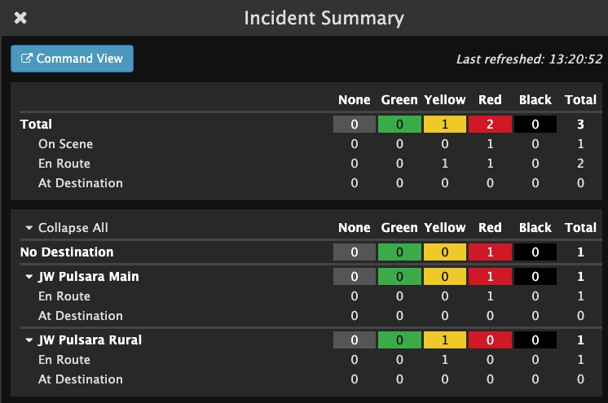
INCIDENTS | Hospital Incident View
Incident View
Select Correct Incident
Only see Patient Channels associated with Incident
View Patient Channel details
Wristband ID visible
Create Patient: Automatically added to this Incident
Incident Details
View Participating Entities and Privileges
Other Incident Details
Incident Summary
Command View - Separate Window
Notes:
Let’s go over the Incident View for hospitals.
When you tap Incidents, you will be prompted to select the correct incident. Once you are in the Incident View, you can only see the patient channels associated with the selected incident. The Incident view has a couple of key differences from Pulsara HQ: The filters are different, and you can see the Wristband ID at the main level. Additionally, if you want to activate downstream care teams or assign room numbers, you will need to enter the patient channel instead of doing this from the main screen.
You can create a new patient from this view, and the patient is automatically added to the incident and recorded as being at your organization.
Under Incident Details, you can see participating entities, their privileges, and additional details about the incident.
Tap on the abbreviated incident summary to expand and see more details. Here, you can view how many patients within each triage category are on scene, en route, or at the designated destination. You can even see the breakdown by receiving destinations.
If you would like to open this view in a separate window, tap “Command View.” Many people in the Emergency Department working an incident from their web browser will have Pulsara HQ open in one window and the Incident Summary open in another. Emergency Managers, Reunification Centers, and others primarily responsible for only the incident often work with Incident View open in one window and the Incident Summary in another.
ORIGINAL:
This tutorial will review the Incident View for hospitals.
When you tap Incidents, you will be prompted to select the correct incident. Once you are in the Incident View, you can only see the patient channels associated with the selected incident. This view differs slightly from Pulsara HQ as the filters are different, and you can see the Wristband ID at the main level. Additionally, if you want to activate downstream care teams or assign room numbers, you will need to enter the patient channel instead of doing this from the main screen.
You can create a new patient from this view, and the patient is automatically added to the incident and recorded as being at your organization.
Under Incident Details, you can see participating entities, their privileges, and additional details about the incident.
Tap on the abbreviated incident summary to expand and see more details. Here, you can view how many patients within each triage category are on scene, en route, or at the designated destination. You can even see the breakdown by receiving destinations.
If you would like to open this view in a separate window, simply tap “Command View.” Many people in the Emergency Department working an MCI from their web browser will have Pulsara HQ open in one window and the Incident Summary open in another. Emergency Managers, Reunification Centers, and others primarily responsible for only the incident often work with Incident View open in one window and the Incident Summary in another.

Slide 2
INCIDENTS | Hospital Incident View
Incident View
Notes:
When you tap Incidents

Slide 3
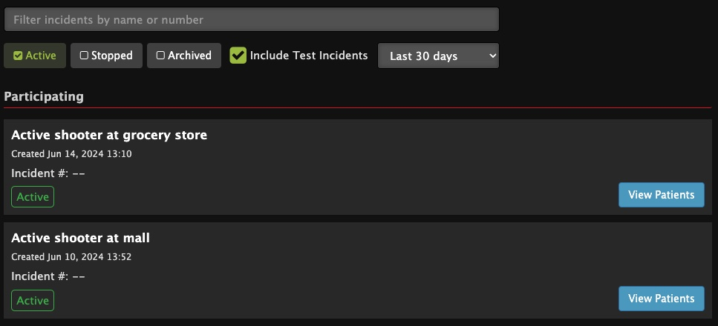
INCIDENTS | Hospital Incident View
Incident View
Select Correct Incident
Notes:
you will be prompted to select the correct incident.

Slide 4
INCIDENTS | Hospital Incident View
Incident View
Select Correct Incident
Only see Patient Channels associated with Incident
View Patient Channel details
Notes:
Once you are in the Incident View, you can only see the patient channels associated with the selected incident.

Slide 5
INCIDENTS | Hospital Incident View
Incident View
Select Correct Incident
Only see Patient Channels associated with Incident
View Patient Channel details
Notes:
The Incident view has a couple of key differences from Pulsara HQ: The filters are different,

Slide 6
INCIDENTS | Hospital Incident View
Incident View
Select Correct Incident
Only see Patient Channels associated with Incident
View Patient Channel details
Wristband ID visible
Notes:
and you can see the Wristband ID at the main level.

Slide 7
INCIDENTS | Hospital Incident View
Incident View
Select Correct Incident
Only see Patient Channels associated with Incident
View Patient Channel details
Wristband ID visible
Notes:
Additionally, if you want to activate downstream care teams or assign room numbers, you will need to enter the patient channel instead of doing this from the main screen.

Slide 8
INCIDENTS | Hospital Incident View
Incident View
Select Correct Incident
Only see Patient Channels associated with Incident
View Patient Channel details
Wristband ID visible
Create Patient: Automatically added to this Incident
Notes:
You can create a new patient from this view, and the patient is automatically added to the incident and recorded as being at your organization.

Slide 9
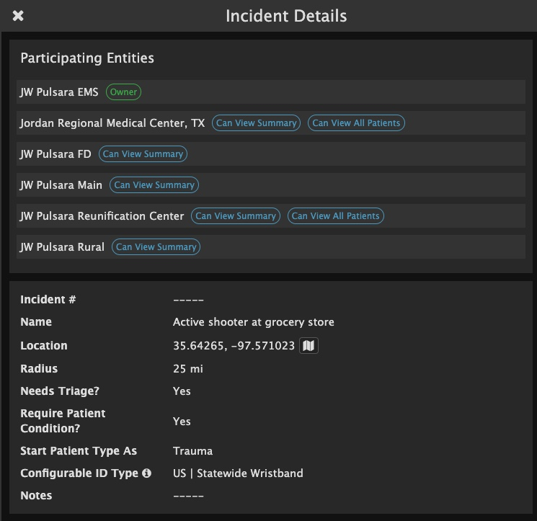
INCIDENTS | Hospital Incident View
Incident View
Select Correct Incident
Only see Patient Channels associated with Incident
View Patient Channel details
Wristband ID visible
Create Patient: Automatically added to this Incident
Incident Details
View Participating Entities and Privileges
Notes:
Under Incident Details, you can see participating entities, their privileges,

Slide 10
INCIDENTS | Hospital Incident View
Incident View
Select Correct Incident
Only see Patient Channels associated with Incident
View Patient Channel details
Wristband ID visible
Create Patient: Automatically added to this Incident
Incident Details
View Participating Entities and Privileges
Other Incident Details
Notes:
and additional details about the incident.

Slide 11
INCIDENTS | Hospital Incident View
Incident View
Select Correct Incident
Only see Patient Channels associated with Incident
View Patient Channel details
Wristband ID visible
Create Patient: Automatically added to this Incident
Incident Details
View Participating Entities and Privileges
Other Incident Details
Incident Summary
Notes:
Tap on the abbreviated incident summary

Slide 12
INCIDENTS | Hospital Incident View
Incident View
Select Correct Incident
Only see Patient Channels associated with Incident
View Patient Channel details
Wristband ID visible
Create Patient: Automatically added to this Incident
Incident Details
View Participating Entities and Privileges
Other Incident Details
Incident Summary
Notes:
to expand and see more details.

Slide 13
INCIDENTS | Hospital Incident View
Incident View
Select Correct Incident
Only see Patient Channels associated with Incident
View Patient Channel details
Wristband ID visible
Create Patient: Automatically added to this Incident
Incident Details
View Participating Entities and Privileges
Other Incident Details
Incident Summary
Notes:
Here, you can view how many patients within each triage category are on scene, en route, or at the designated destination.

Slide 14
INCIDENTS | Hospital Incident View
Incident View
Select Correct Incident
Only see Patient Channels associated with Incident
View Patient Channel details
Wristband ID visible
Create Patient: Automatically added to this Incident
Incident Details
View Participating Entities and Privileges
Other Incident Details
Incident Summary
Notes:
You can even see the breakdown by receiving destinations.

Slide 15
INCIDENTS | Hospital Incident View
Incident View
Select Correct Incident
Only see Patient Channels associated with Incident
View Patient Channel details
Wristband ID visible
Create Patient: Automatically added to this Incident
Incident Details
View Participating Entities and Privileges
Other Incident Details
Incident Summary
Command View - Separate Window
Notes:
If you would like to open this view in a separate window, tap “Command View.” Many people in the Emergency Department working an incident from their web browser will have Pulsara HQ open in one window and the Incident Summary open in another. Emergency Managers, Reunification Centers, and others primarily responsible for only the incident often work with Incident View open in one window and the Incident Summary in another.

