Slide 1

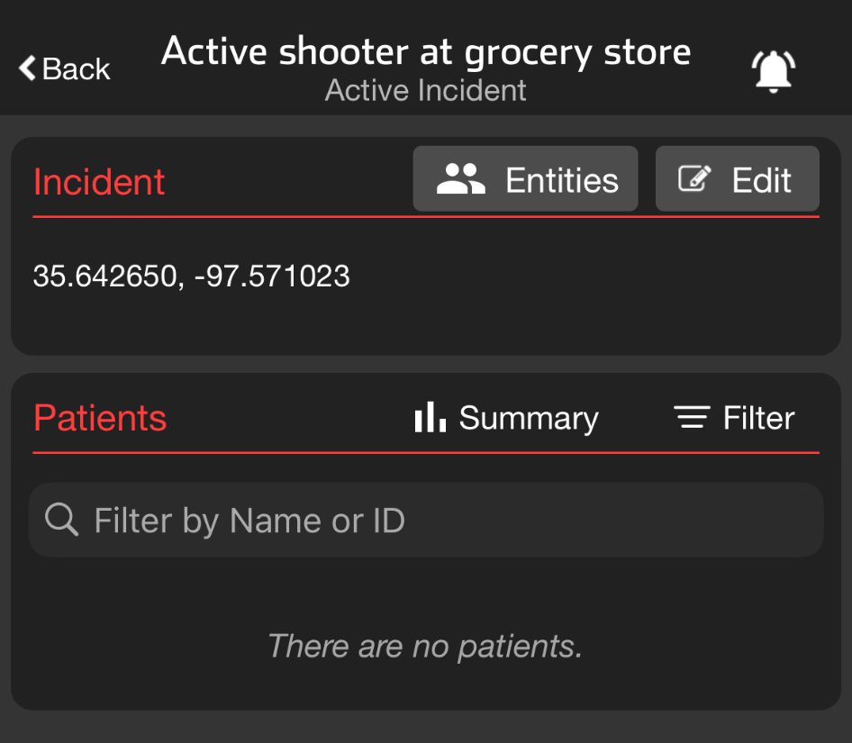
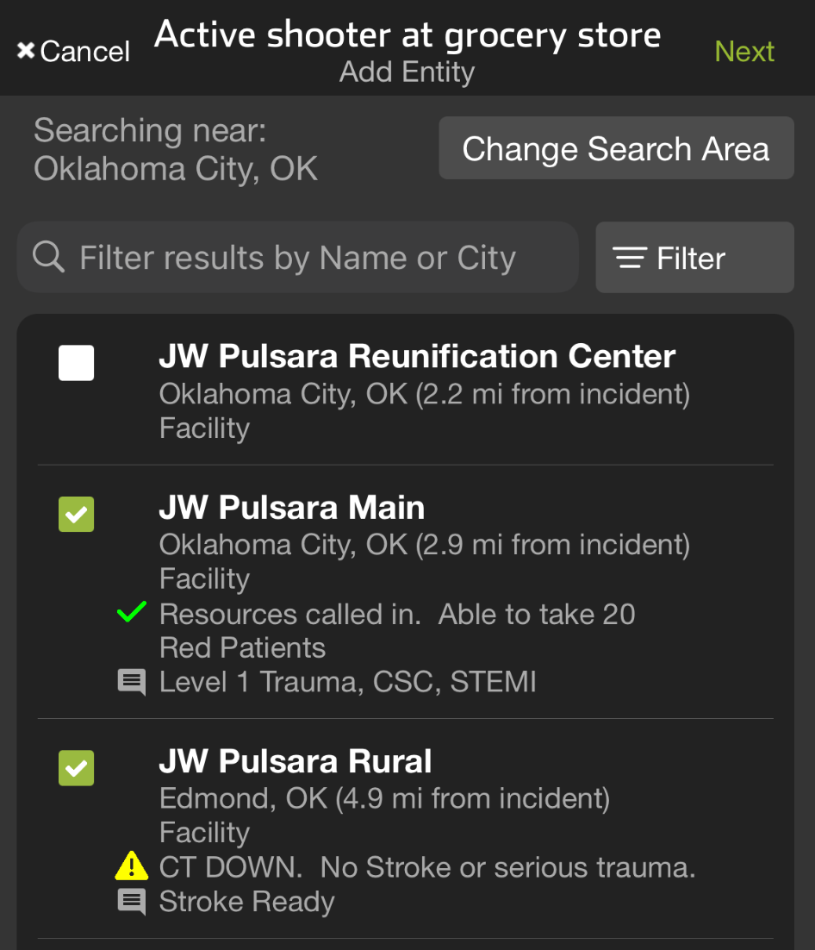



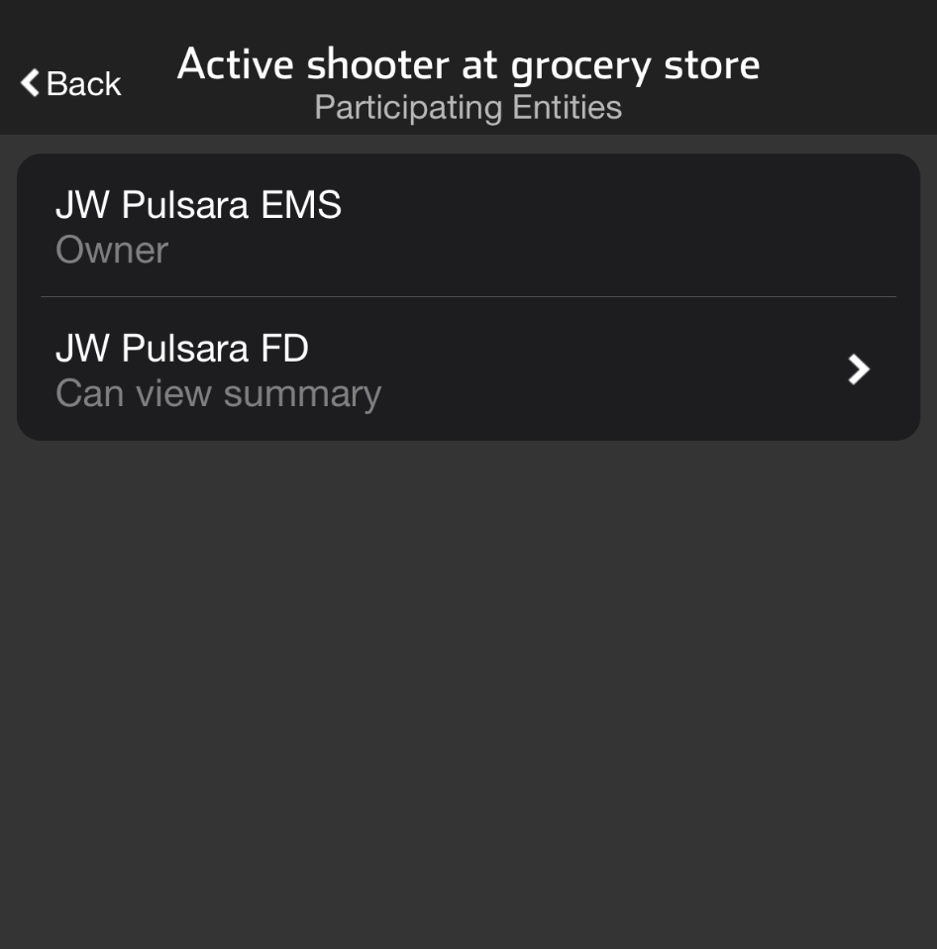
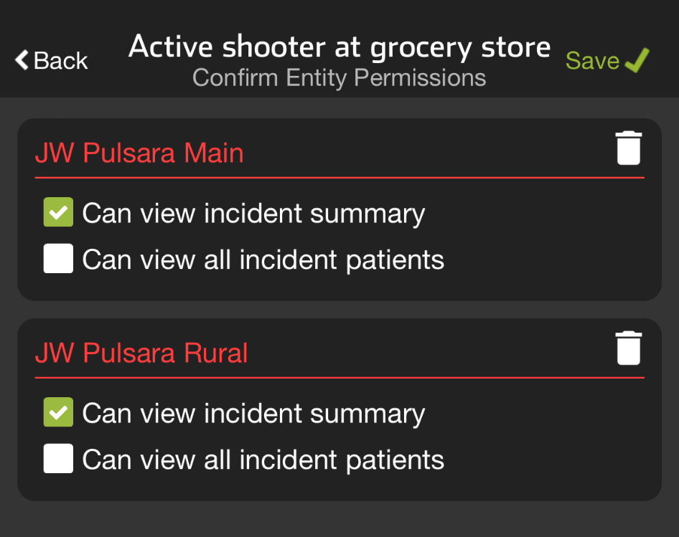


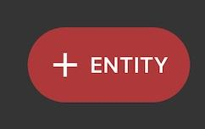
INCIDENTS | Manage Entities
Tap Entities
View Participating Entities
And their privileges
Tap + Entity
Select Entity(s)
Grant / Edit Privileges
View Incident Summary
View All Incident Patients (and Patient Data)
Save
Notes:
This tutorial will review how the incident owner can manage entities and grant or edit their privileges.
To begin, go to your main active incident screen and tap Entities. This will show you the participating entities and their current privileges.
If you need to add additional entities, tap Add Entity. Entities are initially listed by geolocation, but you can change the search area, apply filters, or search for entities on the Pulsara Network. Once you have selected the desired entities, tap Next.
At this point, you can grant privileges. You can allow entities to view the incident summary, which contains no patient information, or grant them access to view all incident patients and the data in the patient channels. Examples for this level of access might be an Incident Co-Owner or a Reunification Center.
Make sure to click Save when you are done. As the incident owner, you can always edit or remove these privileges at any time.

Slide 2
INCIDENTS | Manage Entities
Tap Entities
Notes:
To begin, go to your main active incident screen and tap Entities.

Slide 3
INCIDENTS | Manage Entities
Tap Entities
View Participating Entities
And their privileges
Notes:
This will show you the participating entities and their current privileges.

Slide 4
INCIDENTS | Manage Entities
Tap Entities
View Participating Entities
And their privileges
Tap + Entity
Notes:
If you need to add additional entities, tap Add Entity.

Slide 5
INCIDENTS | Manage Entities
Tap Entities
View Participating Entities
And their privileges
Tap + Entity
Select Entity(s)
Notes:
Entities are initially listed by geolocation

Slide 6
INCIDENTS | Manage Entities
Tap Entities
View Participating Entities
And their privileges
Tap + Entity
Select Entity(s)
Notes:
but you can change the search area, apply filters, or search for entities on the Pulsara Network.

Slide 7
INCIDENTS | Manage Entities
Tap Entities
View Participating Entities
And their privileges
Tap + Entity
Select Entity(s)
Notes:
Once you have selected the desired entities

Slide 8
INCIDENTS | Manage Entities
Tap Entities
View Participating Entities
And their privileges
Tap + Entity
Select Entity(s)
Notes:
tap Next…

Slide 9
INCIDENTS | Manage Entities
Tap Entities
View Participating Entities
And their privileges
Tap + Entity
Select Entity(s)
Grant / Edit Privileges
View Incident Summary
View All Incident Patients (and Patient Data)
Notes:
At this point, you can grant privileges. You can allow entities to view the incident summary, which contains no patient information, or grant them access to view all incident patients and the data in the patient channels. Examples for this level of access might be an Incident Co-Owner or a Reunification Center.

Slide 10
INCIDENTS | Manage Entities
Tap Entities
View Participating Entities
And their privileges
Tap + Entity
Select Entity(s)
Grant / Edit Privileges
View Incident Summary
View All Incident Patients (and Patient Data)
Save
Notes:
Make sure to click Save when you are done. As the incident owner, you can always edit or remove these privileges at any time.

