Slide 1
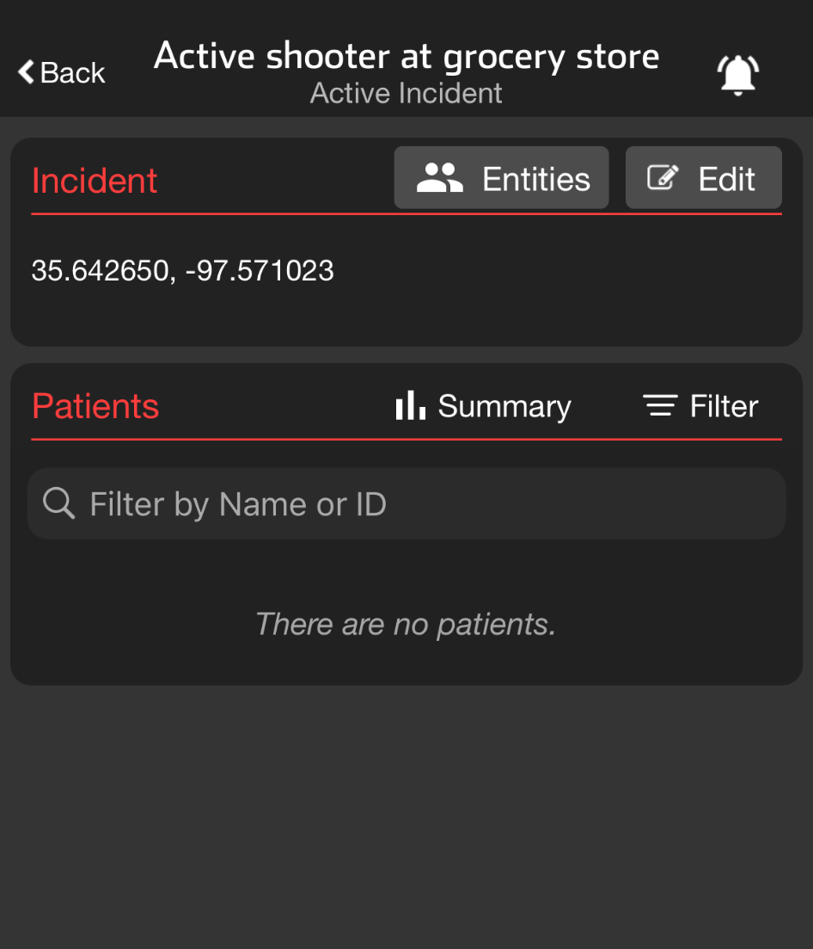
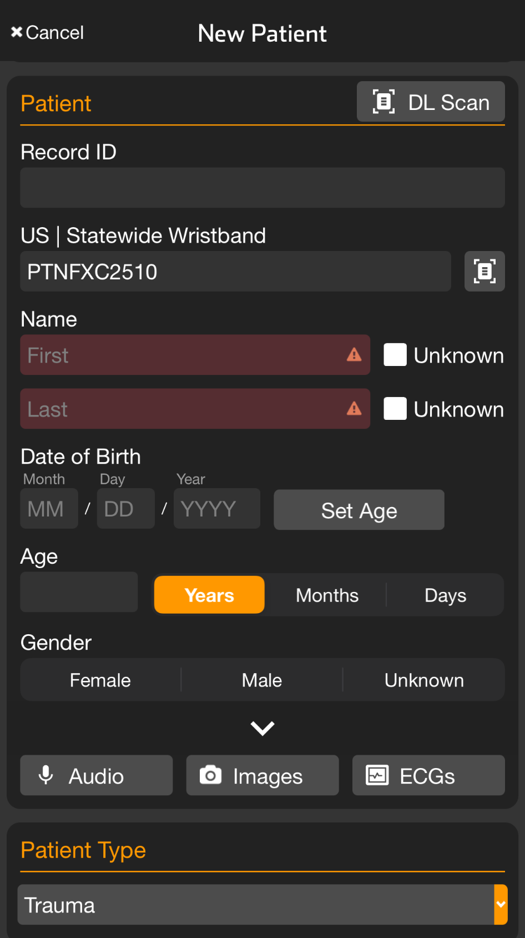
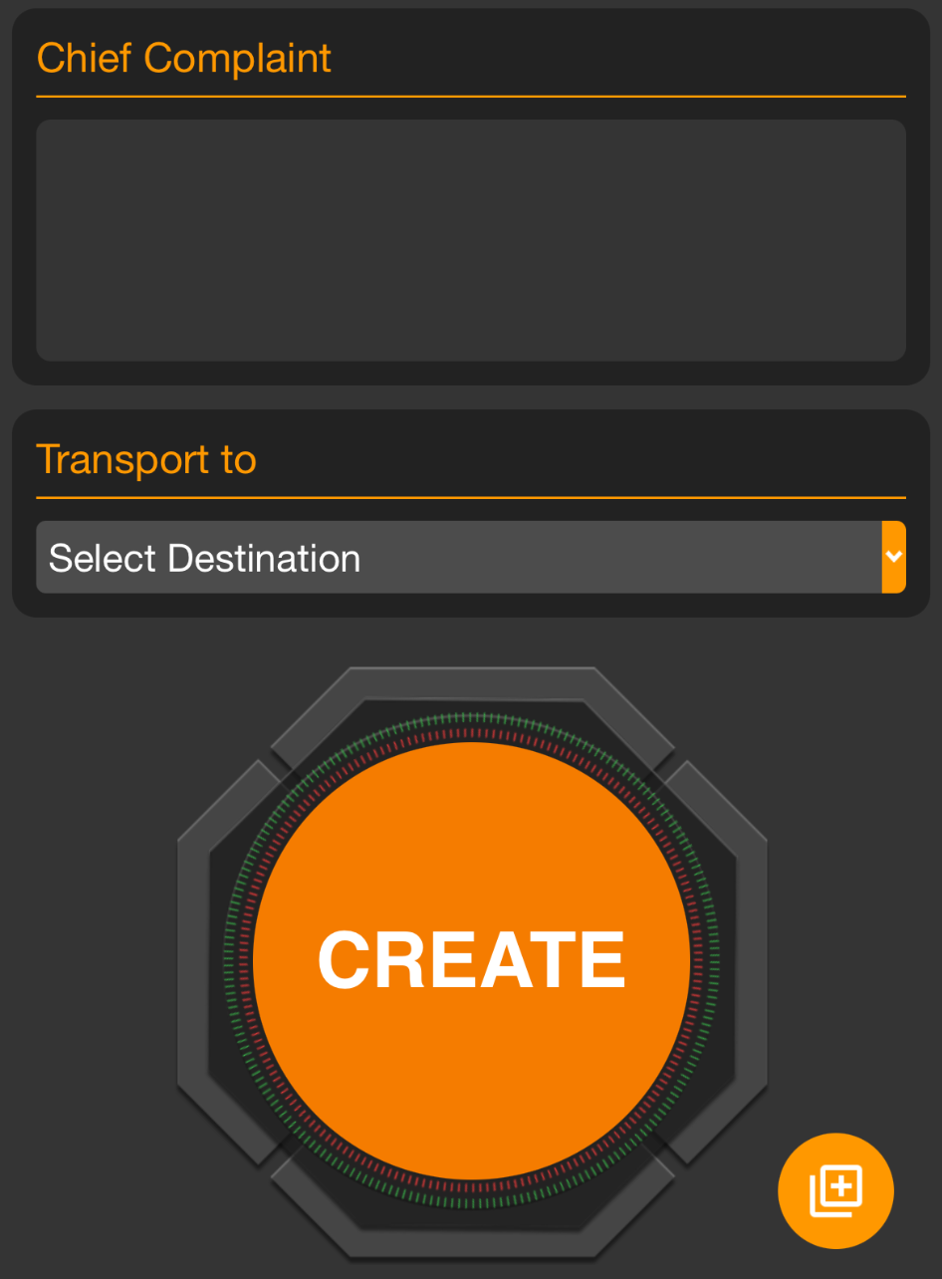
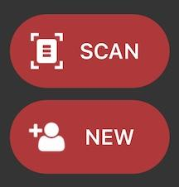
INCIDENTS | Add Patient
Note: All patient information can be added at any time, before or after patient creation.
Apply and Scan Wristband
Scan wristband to add a patient
Adding patients by tapping NEW increases the risk of a duplicate
Set Triage Condition (Color)
Add Patient Demographics
Scan driver’s license (DL), or enter manually
Rapid: Unknown name, estimated Age, Gender
Take Photos (Optional)
Face, injury, DL, belongings, family member, etc.
Chief Complaint (Optional)
Use voice-to-text to describe major injury, vitals, intervention
Create Patient
If you Select Destination prior to hitting Create, you can immediately alert the receiving facility
Quick Add
Scan Wristband
Triage Color
Unknown
Create
Notes:
Let’s talk about how to add patients to an incident.
Begin by applying a wristband to the patient and tapping Scan. Although you can tap New to create a new patient, this increases the risk of creating duplicate patients.
Next, set the patient’s triage condition and enter their demographics. You can enter demographics by scanning their driver’s license or entering the information manually. If the patient’s name is unknown, simply tap Unknown. While not required, it is helpful to enter an estimated age and gender.
If time permits, it is also beneficial to add photos of the patient’s face for identification, any injuries they may have, and other details you might be able to capture with the camera.
Additionally, if you have time, use the voice-to-text feature to quickly summarize the major injuries, vital signs, and important interventions in the chief complaint or narrative field.
To save this patient channel, tap Create. Alternatively, if you are immediately transporting the patient, you can select the destination to alert the receiving facility.
When rapidly triaging multiple patients, you can scan the wristband, set the triage color, tap Unknown for the name, and then tap Create.
In many regions, colored tape is applied to the wristband as a visual indicator on the patient of the triage condition.

Slide 2
INCIDENTS | Add Patient
Note: All patient information can be added at any time, before or after patient creation.
Apply and Scan Wristband
Scan wristband to add a patient
Adding patients by tapping NEW increases the risk of a duplicate
Notes:
Begin by applying a wristband to the patient and tapping Scan. Although you can tap New to create a new patient, this increases the risk of creating duplicate patients.

Slide 3
INCIDENTS | Add Patient
Note: All patient information can be added at any time, before or after patient creation.
Apply and Scan Wristband
Scan wristband to add a patient
Adding patients by tapping NEW increases the risk of a duplicate
Set Triage Condition (Color)
Notes:
Next, set the patient’s triage condition

Slide 4
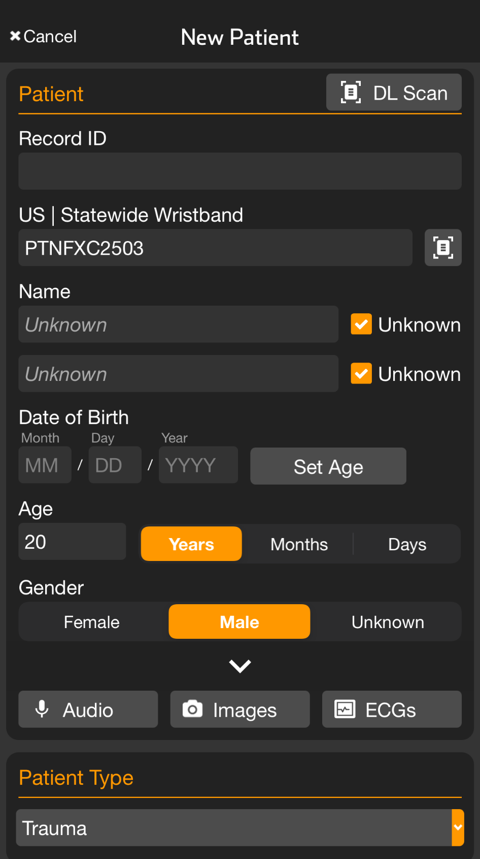
INCIDENTS | Add Patient
Note: All patient information can be added at any time, before or after patient creation.
Apply and Scan Wristband
Scan wristband to add a patient
Adding patients by tapping NEW increases the risk of a duplicate
Set Triage Condition (Color)
Add Patient Demographics
Scan driver’s license (DL), or enter manually
Rapid: Unknown name, estimated Age, Gender
Notes:
and enter their demographics. You can enter demographics by scanning their driver’s license or entering the information manually. If the patient’s name is unknown, simply tap Unknown. While not required, it is helpful to enter an estimated age and gender.

Slide 5
INCIDENTS | Add Patient
Note: All patient information can be added at any time, before or after patient creation.
Apply and Scan Wristband
Scan wristband to add a patient
Adding patients by tapping NEW increases the risk of a duplicate
Set Triage Condition (Color)
Add Patient Demographics
Scan driver’s license (DL), or enter manually
Rapid: Unknown name, estimated Age, Gender
Take Photos (Optional)
Face, injury, DL, belongings, family member, etc.
Notes:
If time permits, it is also beneficial to add photos of the patient’s face for identification, any injuries they may have, and other details you might be able to capture with the camera.

Slide 6
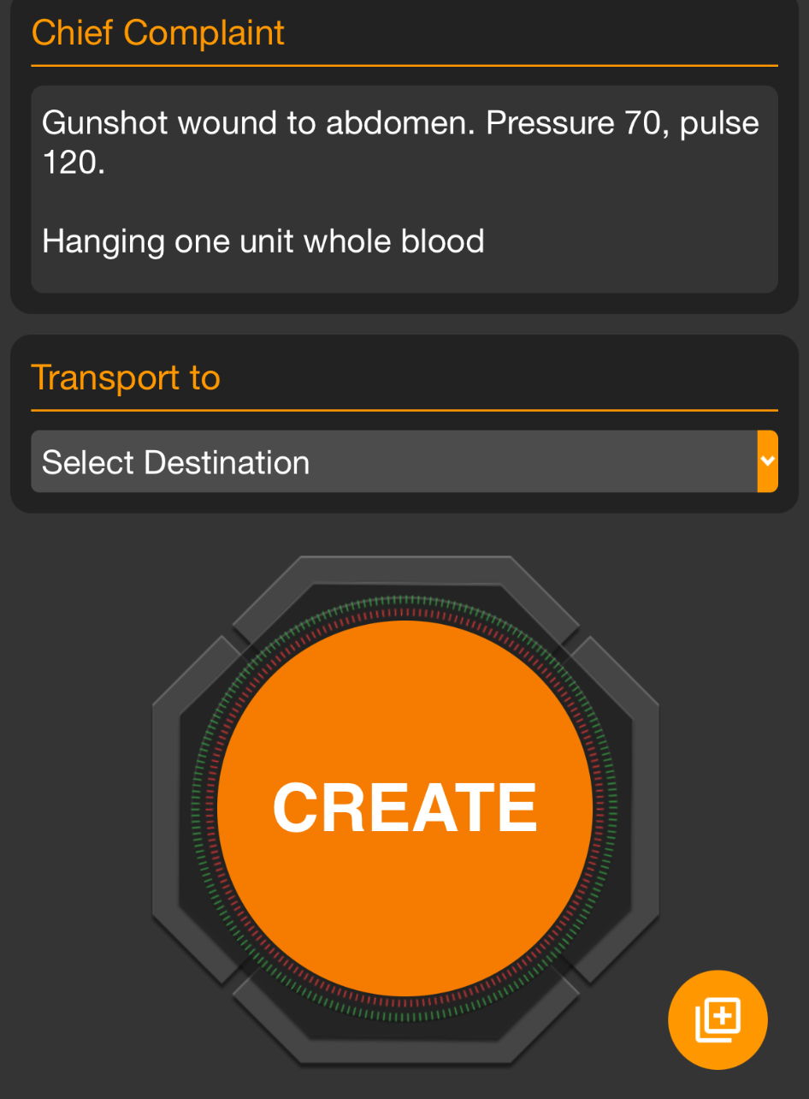
INCIDENTS | Add Patient
Note: All patient information can be added at any time, before or after patient creation.
Apply and Scan Wristband
Scan wristband to add a patient
Adding patients by tapping NEW increases the risk of a duplicate
Set Triage Condition (Color)
Add Patient Demographics
Scan driver’s license (DL), or enter manually
Rapid: Unknown name, estimated Age, Gender
Take Photos (Optional)
Face, injury, DL, belongings, family member, etc.
Chief Complaint (Optional)
Use voice-to-text to describe major injury, vitals, intervention
Notes:
Additionally, if you have time, use the voice-to-text feature to quickly summarize the major injuries, vital signs, and important interventions in the chief complaint or narrative field.

Slide 7
INCIDENTS | Add Patient
Note: All patient information can be added at any time, before or after patient creation.
Apply and Scan Wristband
Scan wristband to add a patient
Adding patients by tapping NEW increases the risk of a duplicate
Set Triage Condition (Color)
Add Patient Demographics
Scan driver’s license (DL), or enter manually
Rapid: Unknown name, estimated Age, Gender
Take Photos (Optional)
Face, injury, DL, belongings, family member, etc.
Chief Complaint (Optional)
Use voice-to-text to describe major injury, vitals, intervention
Create Patient
If you Select Destination prior to hitting Create, you can immediately alert the receiving facility
Notes:
To save this patient channel, tap Create.

Slide 8
INCIDENTS | Add Patient
Note: All patient information can be added at any time, before or after patient creation.
Apply and Scan Wristband
Scan wristband to add a patient
Adding patients by tapping NEW increases the risk of a duplicate
Set Triage Condition (Color)
Add Patient Demographics
Scan driver’s license (DL), or enter manually
Rapid: Unknown name, estimated Age, Gender
Take Photos (Optional)
Face, injury, DL, belongings, family member, etc.
Chief Complaint (Optional)
Use voice-to-text to describe major injury, vitals, intervention
Create Patient
If you Select Destination prior to hitting Create, you can immediately alert the receiving facility
Notes:
Alternatively, if you are immediately transporting the patient, you can select the destination to alert the receiving facility.

Slide 9
INCIDENTS | Add Patient
Note: All patient information can be added at any time, before or after patient creation.
Apply and Scan Wristband
Scan wristband to add a patient
Adding patients by tapping NEW increases the risk of a duplicate
Set Triage Condition (Color)
Add Patient Demographics
Scan driver’s license (DL), or enter manually
Rapid: Unknown name, estimated Age, Gender
Take Photos (Optional)
Face, injury, DL, belongings, family member, etc.
Chief Complaint (Optional)
Use voice-to-text to describe major injury, vitals, intervention
Create Patient
If you Select Destination prior to hitting Create, you can immediately alert the receiving facility
Quick Add
Scan Wristband
Triage Color
Unknown
Create
Notes:
When rapidly triaging multiple patients, you can scan the wristband, set the triage color, tap Unknown for the name, and then tap Create. In many regions, colored tape is applied to the wristband as a visual indicator on the patient of the triage condition.

