Slide 1
SAME PATIENT MOVEMENT SYSTEM
EVERY DAY
EVERY EVENT
Notes:
Pulsara is The communication and logistics platform that unites distributed teams and fragmented technologies during dynamic events.

Slide 2



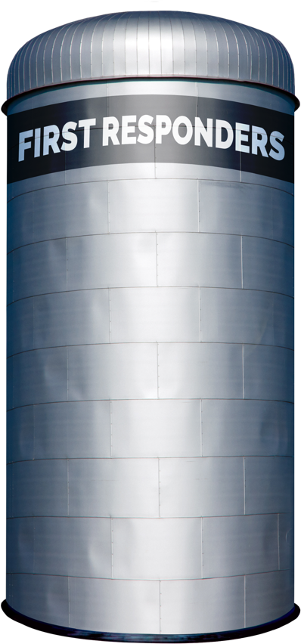
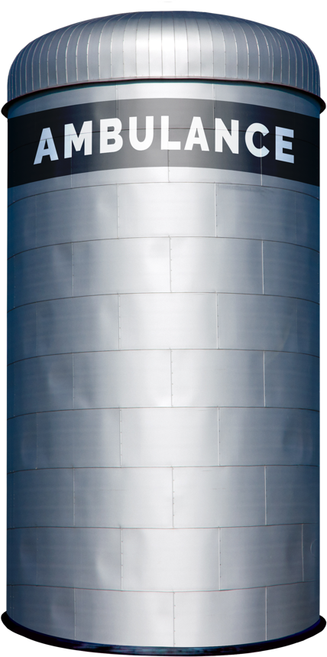

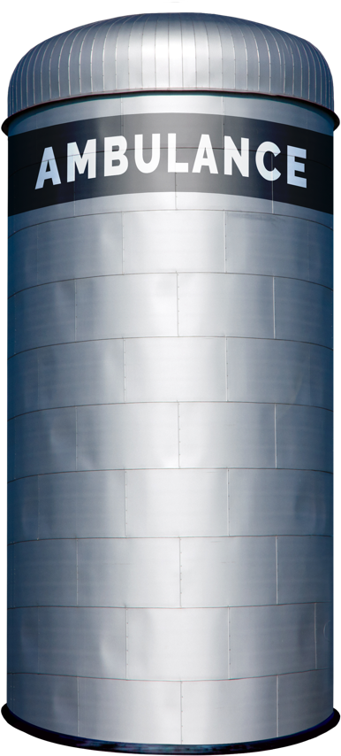


Traditional Patient Movement
Teleconsult
Phone
Secure
Msg
Page
Verbal
Handoff
Electronic
Notifications
Radio
Phone
ECG
ePCR or
Electronic
Notifications
Phone
Bedside
Handoff
Radio
Phone
Bedside
Handoff
Each Red Arrow Represents a Separate Communication Channel
COMMUNICATION CHANNELS: Numerous
Notes:
CLICK1: Show flashing red lines (loads all lines at once)
Traditionally, moving patients across organizations requires coordination through multiple communication channels like radio reports, phone calls, alerting tools, and secure messaging systems. Often intermediaries like transfer centers or a regional MedCom are required to try to coordinate all of the calls and data sources.
All the red lines in the diagram represent these different communication channels attempting to coordinate the transition of care across these siloed organizations. This workflow is highly inefficient for routine low acuity transitions of care, but is particularly ineffective for time sensitive emergencies, mass casualty incidents, mass evacuations and load balancing initiatives.

Slide 3
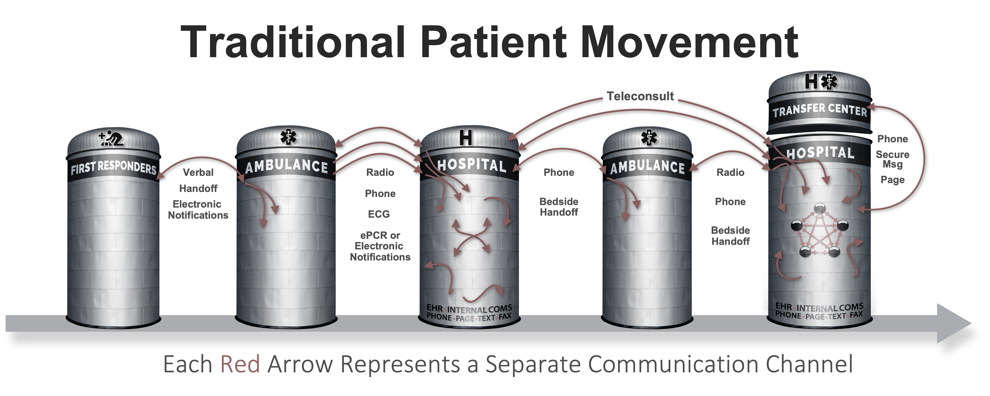




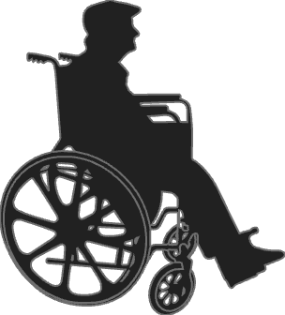

Patient Movement with
3
EHR
Radiology
EHR
Radiology
Create Channel
Build Team
Communicate
ECG
Monitor
ECG
Monitor
ePCR
…
STEPS
ePCR
…
Pulsara
API
Pulsara
API
UNIFIED CARE TEAM
PATIENT MOVEMENT
Notes:
CLICK1: Patient movement with Pusara - 3 Steps
CLICK2: Create Channel (Red Line)
CLICK3: Build Team
CLICK4: Communicate (API)
Pulsara’s Patient Movement System offers a HIPAA-compliant solution for streamlining communication and logistics across organizations. Think of it as a secure group chat that integrates public safety and healthcare teams.
You simply create a dedicated communication channel for each patient encounter, build the care team as the patient's condition evolves, and everyone is on the same communication channel as they coordinate care. The Pulsara API also allows you to move data into and out of the channel.

Slide 4
Notes:
So what does this look like? You will have multiple First Responder Organizations, EMS Agencies, and Hospitals in a region.

Slide 5
UNIFIED CARE TEAM
PATIENT MOVEMENT EVENT
Notes:
Every day, there are different people that are on shift or on call at each of these organizations for one of these unscheduled events.

Slide 6


Engine 1
FF 1, Medic 7, EMT 2
UNIFIED CARE TEAM
PATIENT MOVEMENT EVENT
Notes:
For example, Engine 1 at a specific Fire Department might be first on scene.

Slide 7
FIRE 1
FF1
EMT 2
Medic 7
PATIENT MOVEMENT EVENT
Notes:
They can create a patient channel with a simple Scan, Photo, Voice to Text workflow.

Slide 8
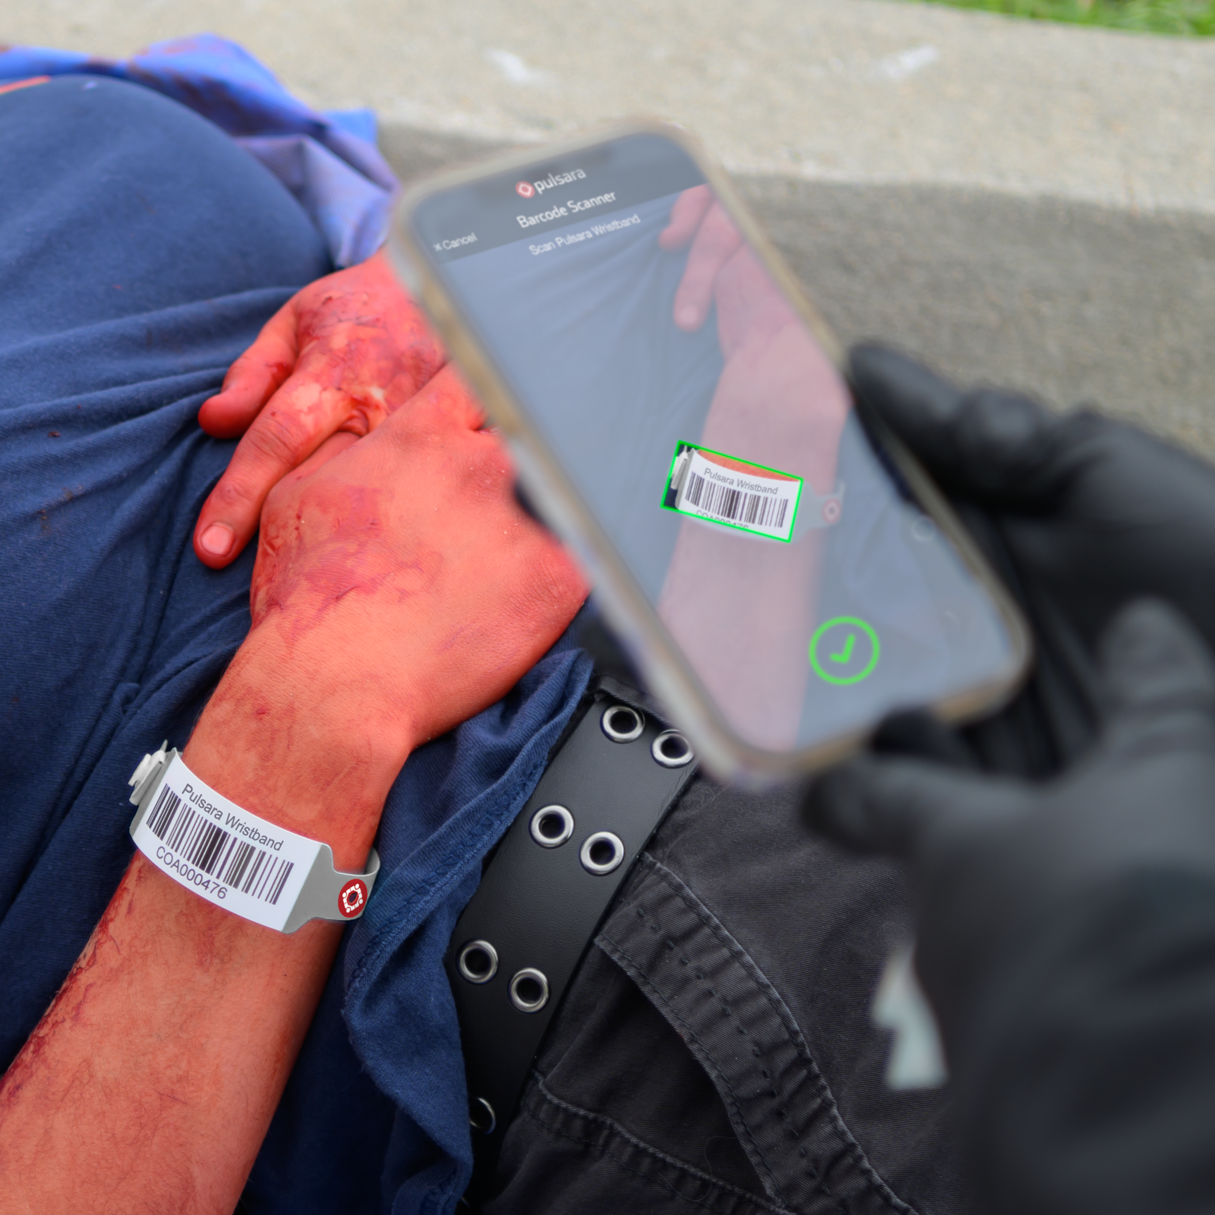
FIRE 1
FF1
EMT 2
EMS 1
Medic 1
EMT 1
Medic 7
Medic 2
PATIENT MOVEMENT EVENT
Notes:
An EMS Agency will show up on scene and they can simply scan the Patient Movement Wristband.

Slide 9
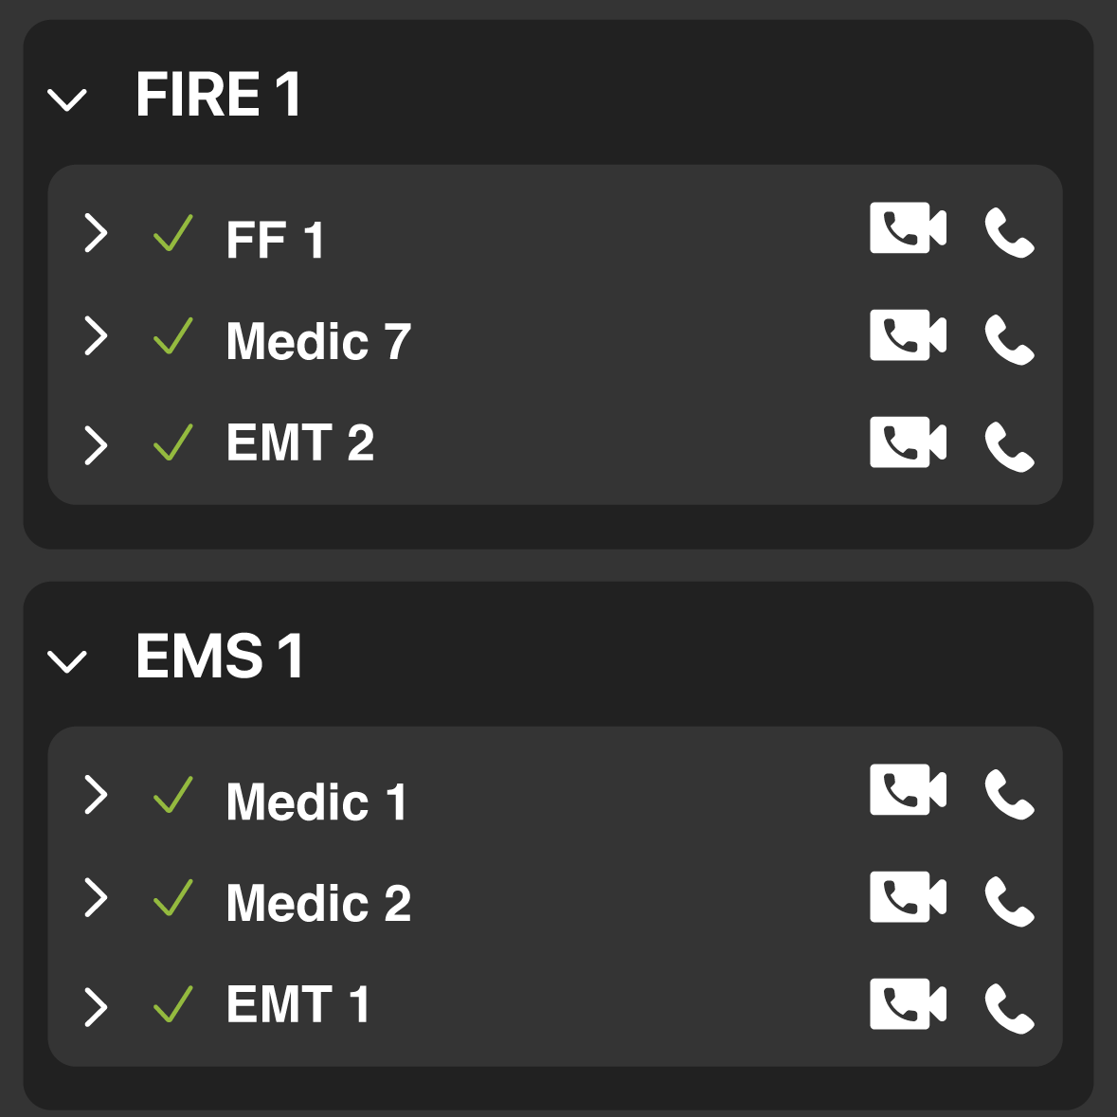
FIRE 1
FF 1
EMT 2
EMS 1
Medic 1
EMT 1
Medic 7
Medic 2
PATIENT MOVEMENT EVENT
Notes:
And now the medics are on the Patient Channel as well.

Slide 10
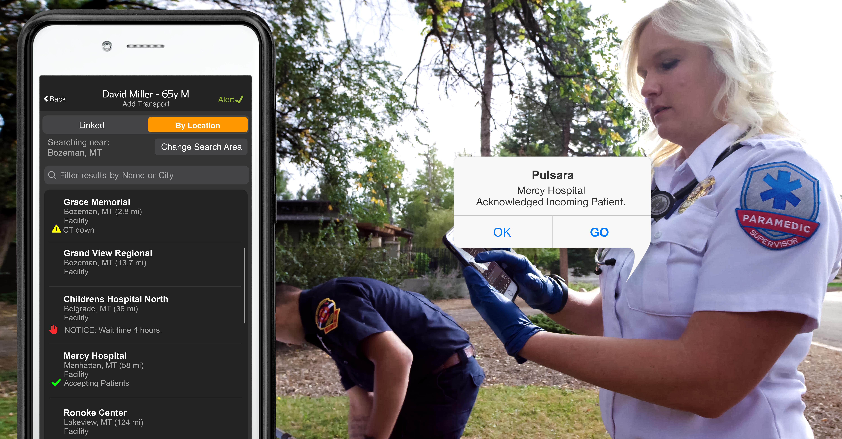
FIRE 1
FF 1
EMT 2
EMS 1
Medic 1
EMT 1
HOSP 1
EDMD
Registration
Medic 7
Medic 2
ED Charge
PATIENT MOVEMENT EVENT
Notes:
Once the decision is made to transport the patient to a specific hospital, the hospital can be easily added to the patient channel. Hospitals are listed by distance and may also include essential details, such as available resources and emergency department (ED) availability.

Slide 11
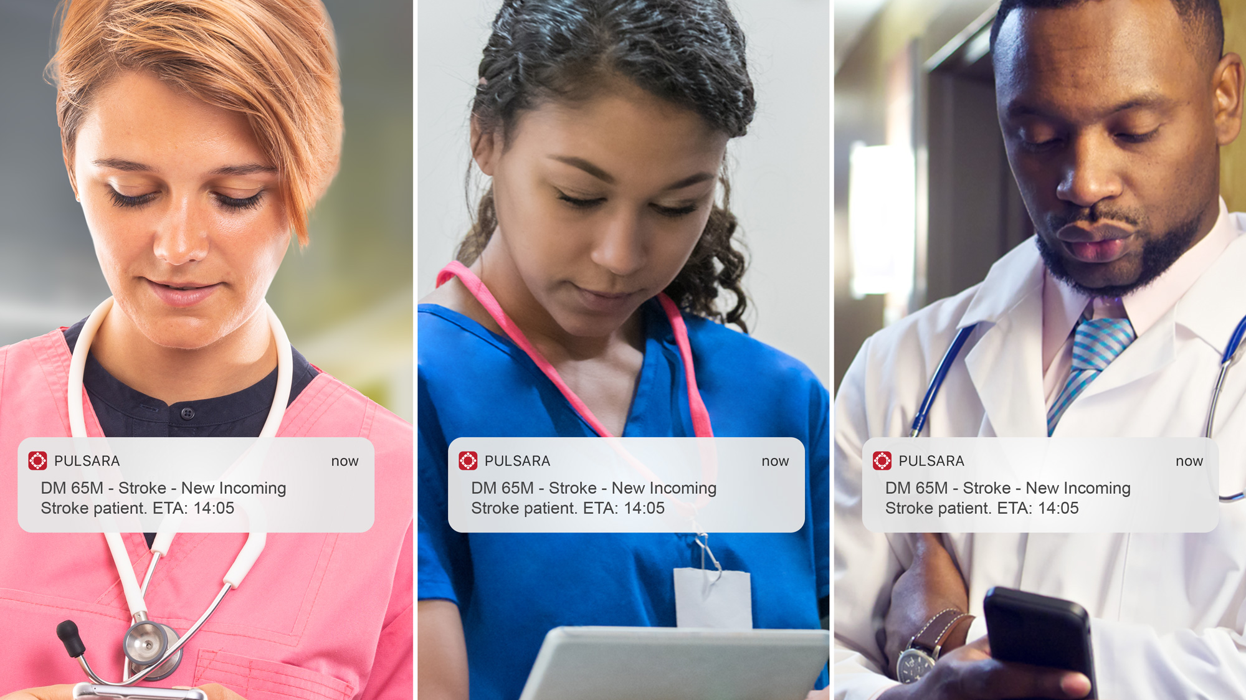
FIRE 1
FF 1
EMT 2
EMS 1
Medic 1
EMT 1
HOSP 1
EDMD
Registration
Medic 7
Medic 2
ED Charge
PATIENT MOVEMENT EVENT
Notes:
The Emergency Department receives an alert. They are now in the patient channel so they know all the details about the patient and can communicate with the prehospital team if needed.

Slide 12
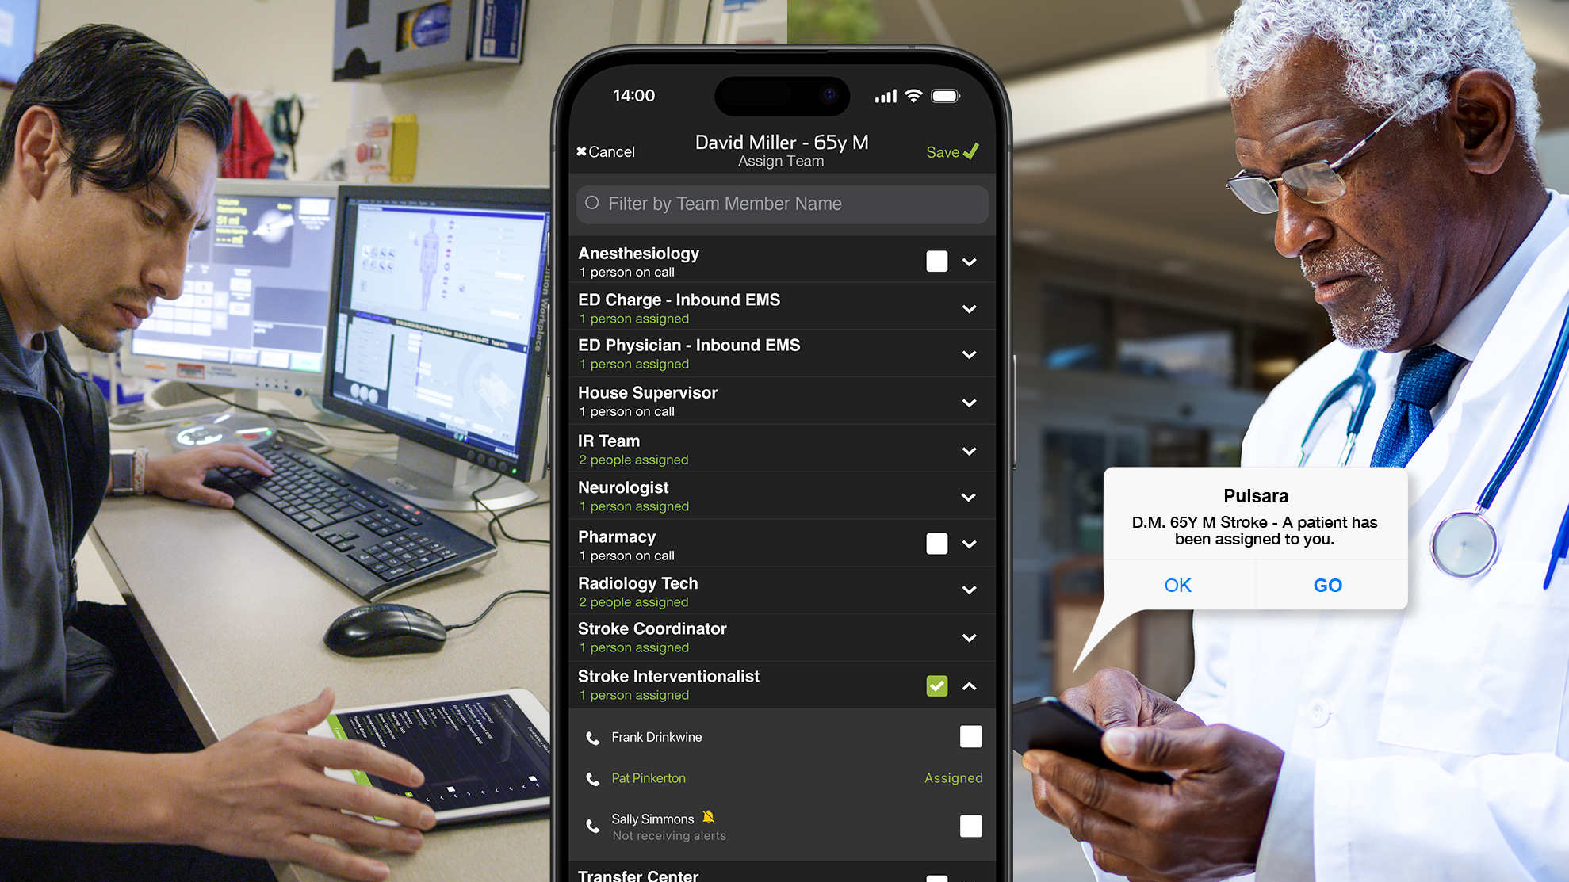
FIRE 1
FF 1
EMT 2
EMS 1
Medic 1
EMT 1
HOSP 1
EDMD
Registration
Medic 7
Medic 2
ED Charge
Stroke Interventionalist
PATIENT MOVEMENT EVENT
Notes:
They even have the option of adding their downstream care teams.

Slide 13
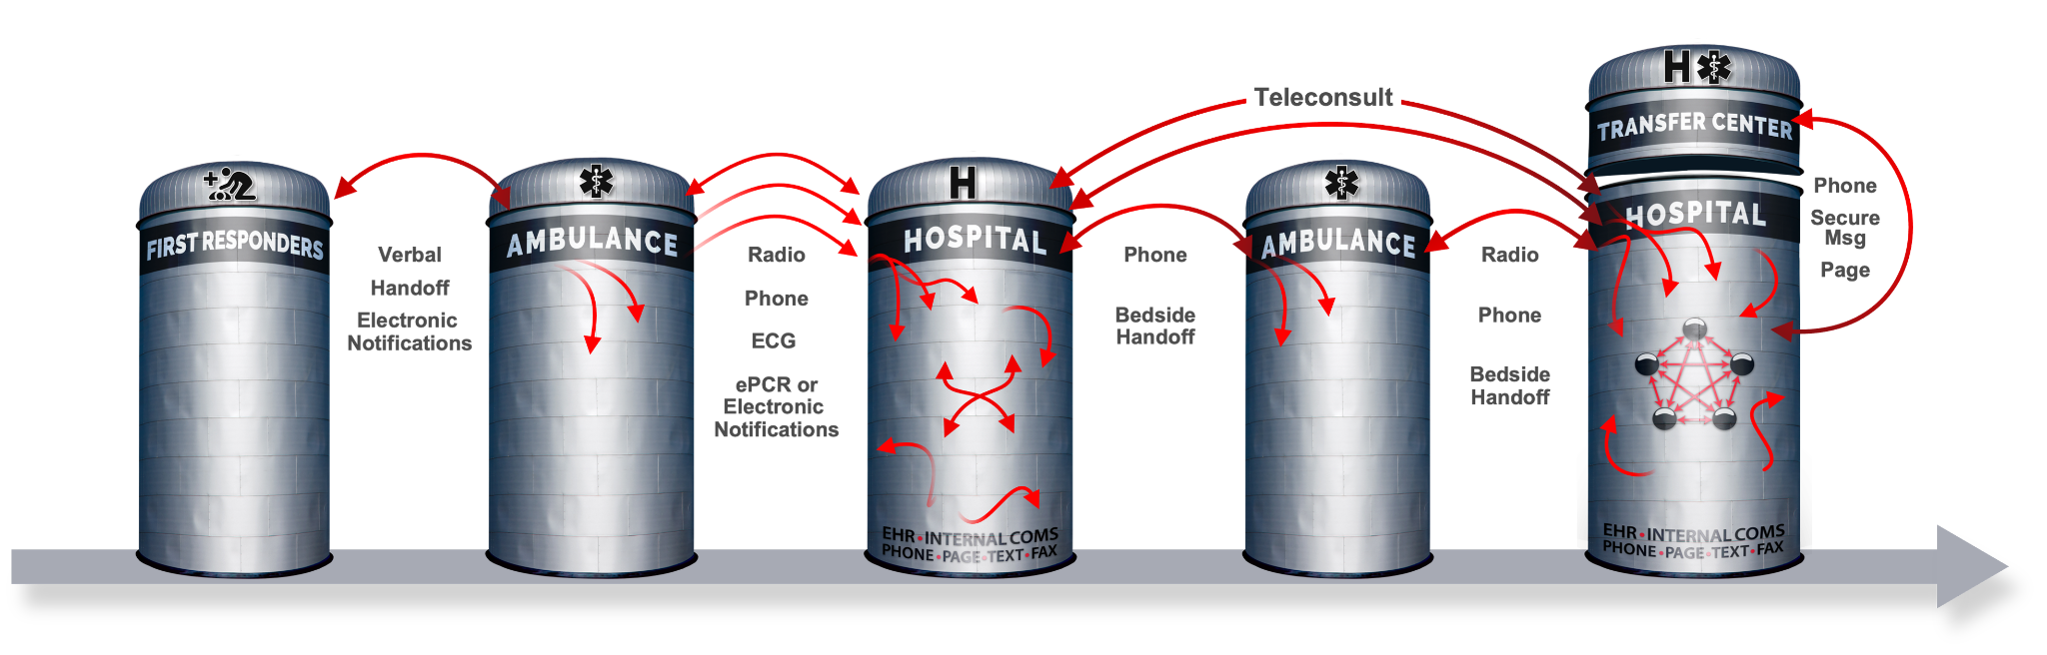
Traditional Patient Movement
Each Red Arrow Represents a Separate Communication Channel
COMMUNICATION CHANNELS: Numerous
Notes:
So instead of all the different communication channels and repeating all the verbal reports…

Slide 14
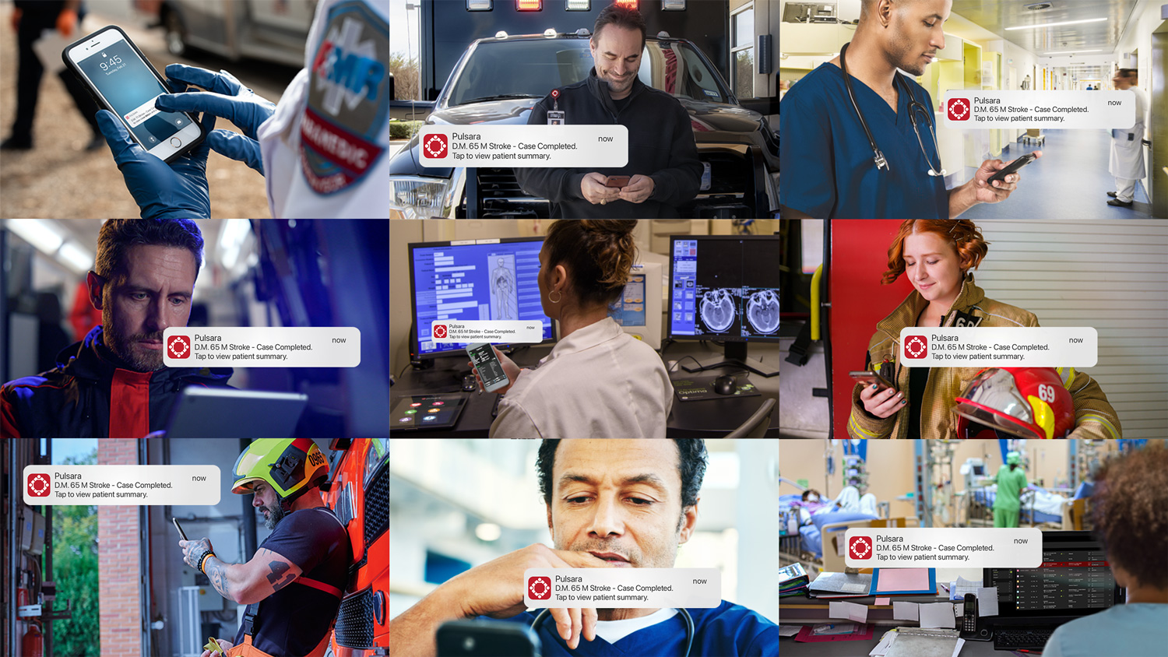
ONE UNIFIED CARE TEAM ACROSS ORGANIZATIONS
PATIENT MOVEMENT EVENT
Notes:
Everyone for this Patient Movement Event is on the same dedicated communication and logistics channel.

