Slide 1
SAME PATIENT MOVEMENT SYSTEM
EVERY DAY
EVERY EVENT
Notes:
Pulsara is The communication and logistics platform used in your region that unites distributed teams and fragmented technologies during dynamic events. This video will highlight how Pulsara is used in your Trauma System of Care.

Slide 2





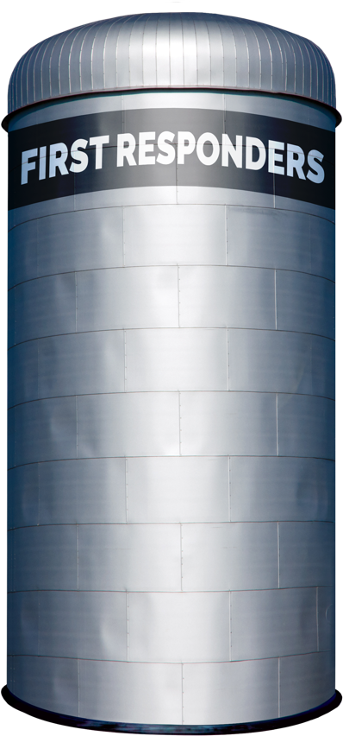
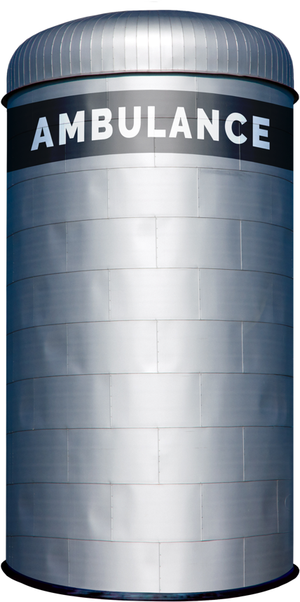


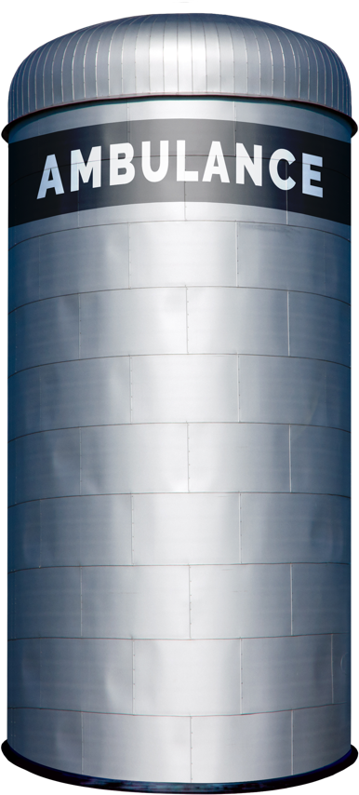
















Traditional Patient Movement
Teleconsult
Phone
Secure
Msg
Page
Verbal
Handoff
Electronic
Notifications
Radio
Phone
ECG
ePCR or
Electronic
Notifications
Phone
Bedside
Handoff
Radio
Phone
Bedside
Handoff
PATIENT JOURNEY
Each Red Arrow Represents a Separate Communication Channel
COMMUNICATION CHANNELS: Numerous
Notes:
Patient movement across organizations requires coordination through multiple communication channels like radio reports, phone calls, alerting tools, messaging systems, and intermediaries like transfer centers.
All the red lines in the diagram represent these different communication paths. This complexity is highly inefficient, particularly during time-sensitive emergencies like trauma where the patient’s care team is spread across multiple different departments and organizations.

Slide 3
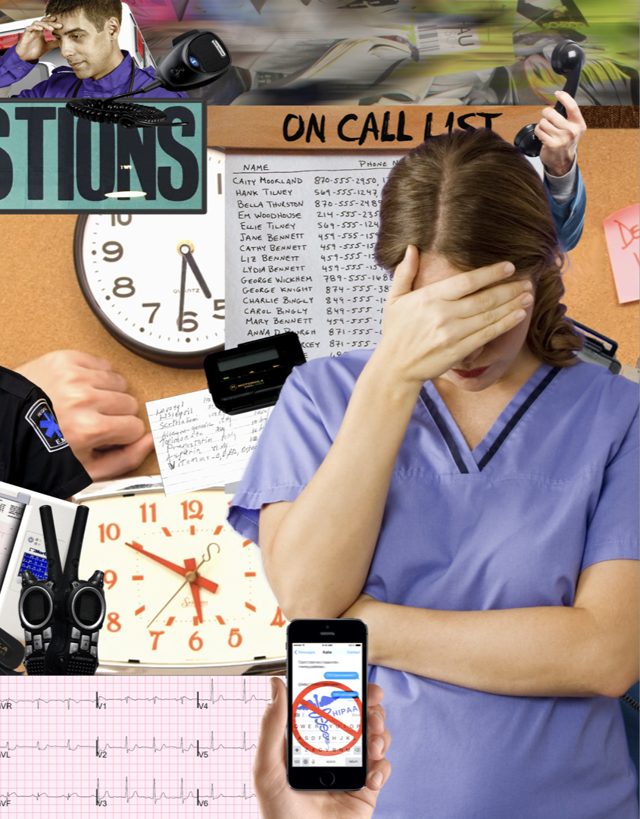

Universal Distributed Teams
CALL LIST
Who’s on call today? Did they get their alert?
The call list is wrong. What do I do?
I can’t stop my alerts when I’m done.
PATIENT IDENTIFICATION
Why can’t my alert include the patient’s name so I can pull PMH or old studies / images?
I have 5 different “secure message” threads about 2 different patients and 4 ECGs with no names on them.
I can’t do anything until the patient is registered.
UNNECESSARY COMPLEXITY
Why is it so hard to de-escalate our system once it’s in motion?
Where is the patient now?
Why do we have different protocols for different methods of arrival and different times of day?
Why can’t we provide timely feedback to EMS and referral partners?
Traditional Patient Movement Challenges
for Critical, Unscheduled Events
Notes:
These are just a few of the common issues that arise, affecting patient safety, outcomes, treatment times, efficiency, and overall costs.

Slide 4

Trauma Team
My alert has minimal or no information.
What’s the injury list? Why am I receiving this consult?
We didn’t receive enough information to assign the correct activation level; The wrong activation level is assigned, and I can’t change it.
Why can’t a medic, the ED, or the referral facility just send me a photo?
I know you're busy, but I just got paged about this patient—can someone catch me up?
I need to repeat the story for all five consultants?
We need the arrival time for proper reimbursement—why is it so hard to find?
Traditional Trauma
Patient Movement Challenges
Notes:
In the context of our Trauma Systems, in addition to all of the phone calls, adding internal communication tools like pagers and secure messaging platforms only increases the number of communication channels. When EMS uses radios or phone calls for the prehospital notification, it eliminates the possibility of them sharing photos of the patient or scene.

Slide 5
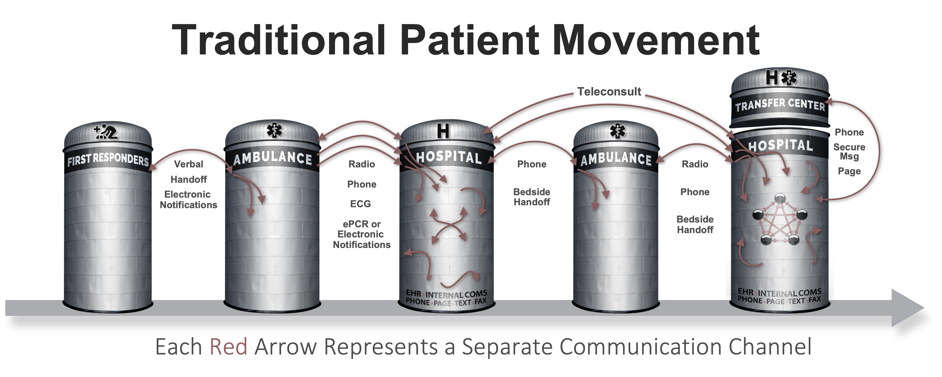






Patient Movement with
3
EHR
Radiology
EHR
Radiology
Create Channel
Build Team
Communicate
ECG
Monitor
ECG
Monitor
ePCR
…
STEPS
ePCR
…
Pulsara
API
Pulsara
API
UNIFIED CARE TEAM
PATIENT MOVEMENT
Notes:
Pulsara’s Patient Movement System offers a HIPAA-compliant solution for streamlining communication and logistics across organizations. Think of it as a secure group chat that integrates public safety and healthcare teams.
You simply create a dedicated communication channel for each patient encounter, build the care team, and begin communication.
The Pulsara API also allows you to move data into and out of the channel.
Regions use Pulsara daily for EMS-to-ED communications. Many regions and states also adopt the Patient Movement System for large-scale situations like mass casualty incidents, mass evacuations, load balancing initiatives, and more.
Hospitals can enhance their capabilities with Pulsara UNITED, which extends communication to downstream care teams like Trauma Teams and offers more robust transfer options.

Slide 6
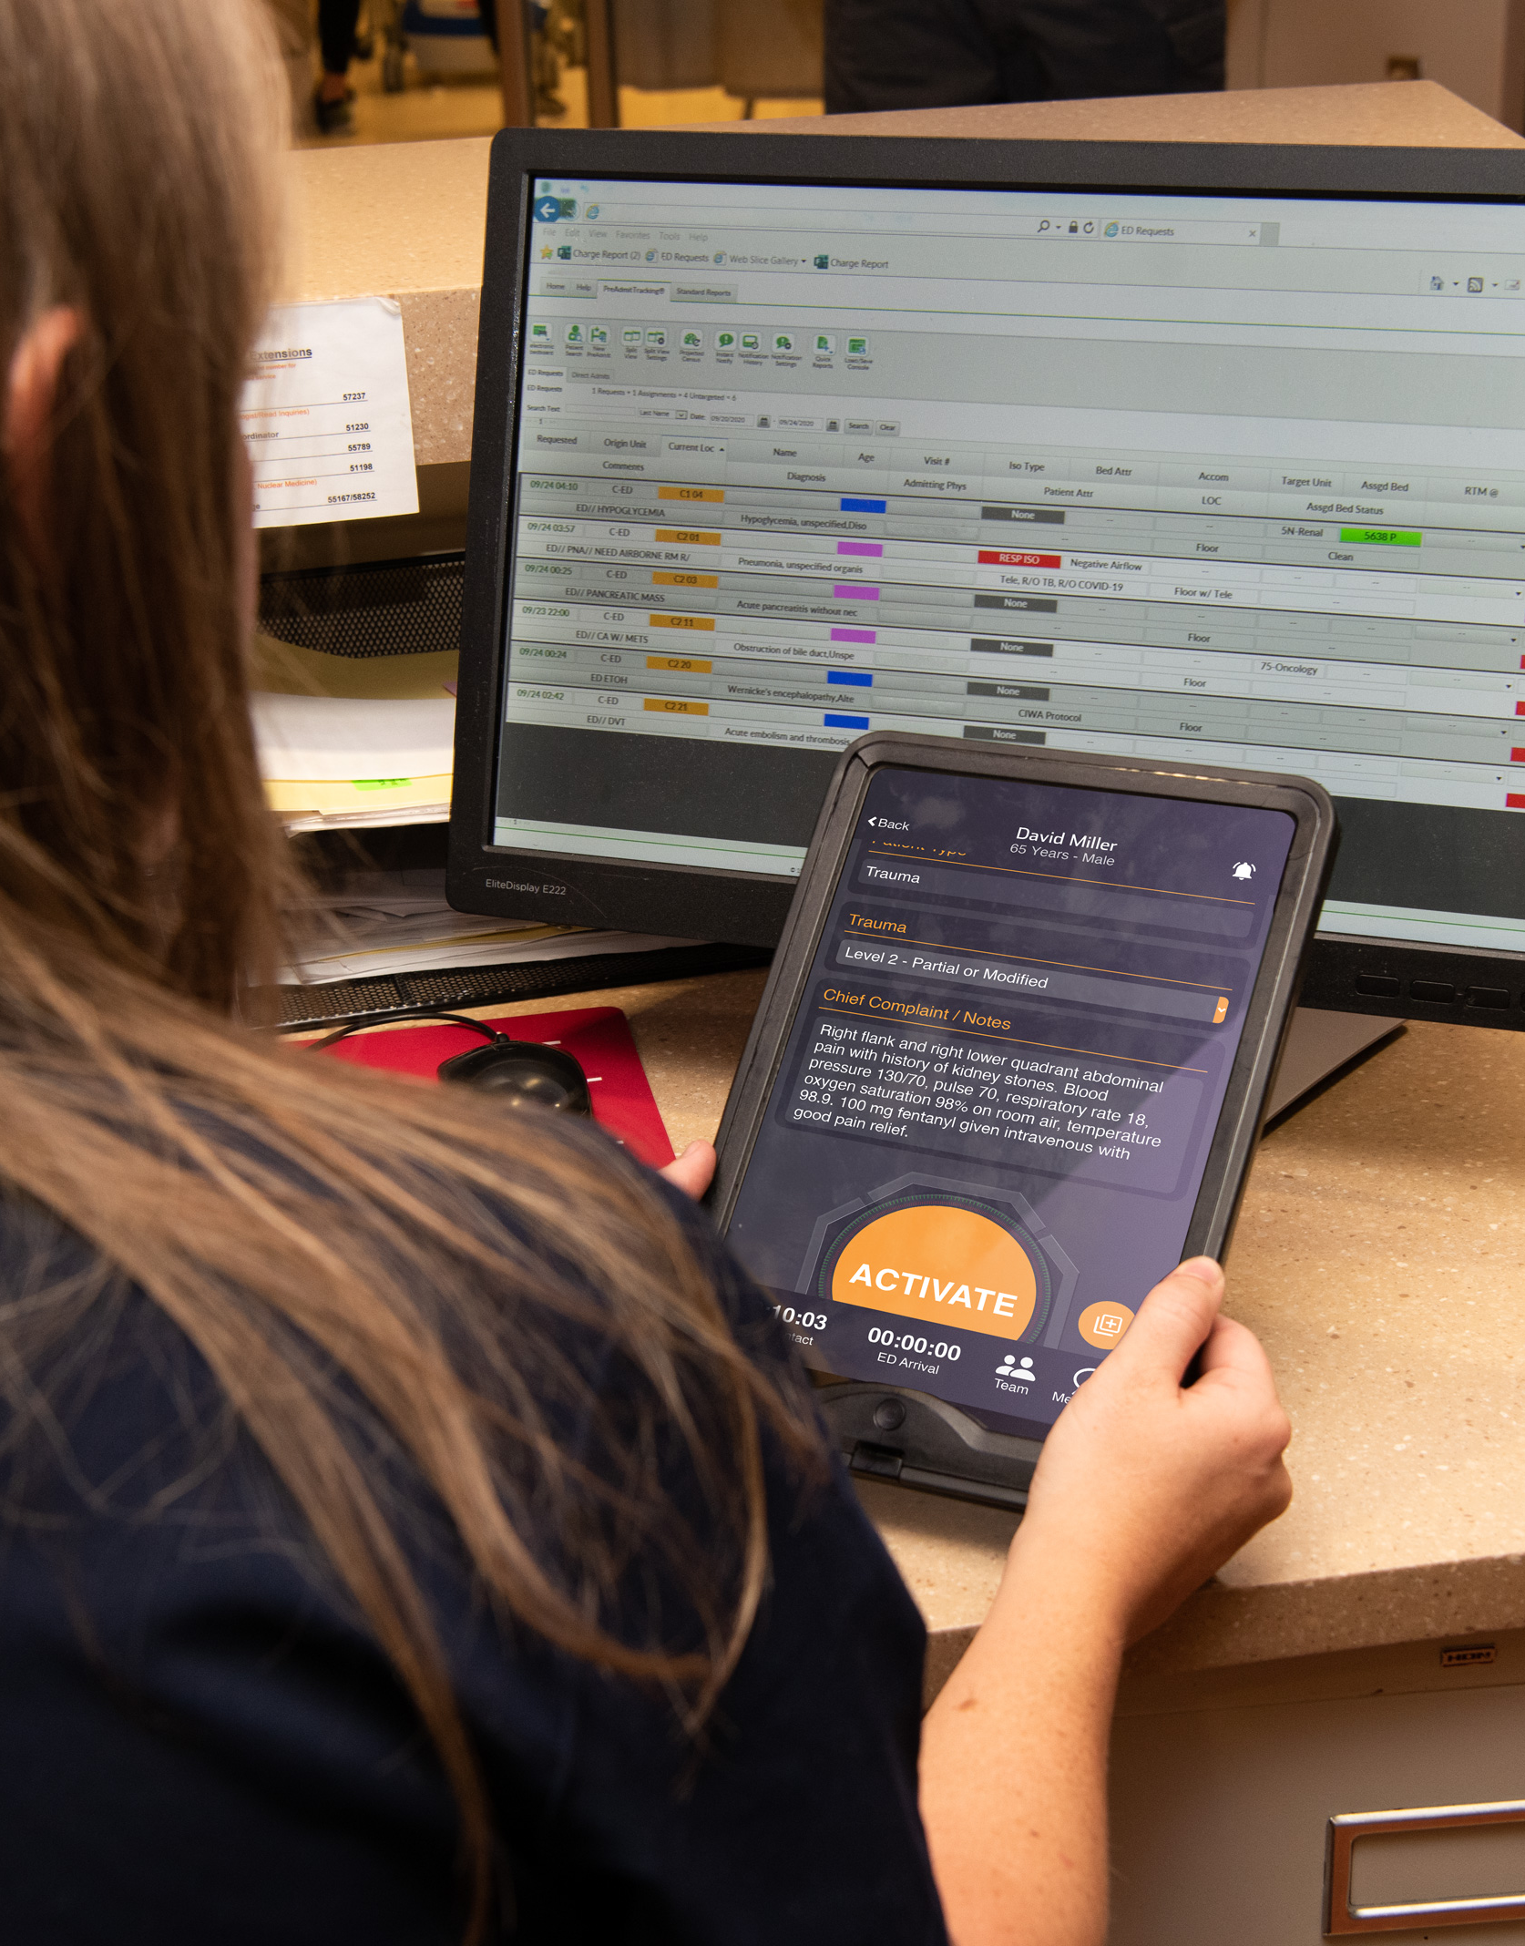
Alerting Basics
WHO
Driven by Teams
Identify your Teams
Place individuals on Teams
  Able to be on more than one Team
  HOW
Call Status
  ON Call = Alert
  OFF Call = No Alert
Workflow Triggered Alerts
  Method of Arrival / Status
  Pulsara MED OPS: Incident
  Pulsara UNITED: Other options
Manual: Team or Individual
WHO, HOW, & WHEN
Notes:
Configuring Pulsara Alerting to fit your Trauma workflows is straightforward. You simply decide WHO is alerted and WHEN they need to receive their alert.
Alerting is based on teams—like trauma team, trauma surgeon, or House Supervisor teams—and can even be configured for different specialty groups.
If you’re on call, you receive alerts for new patients; if you’re off call, you don’t.
WHEN teams are alerted is automatically triggered by workflow, but you can also manually add teams or individuals as needed.

Slide 7
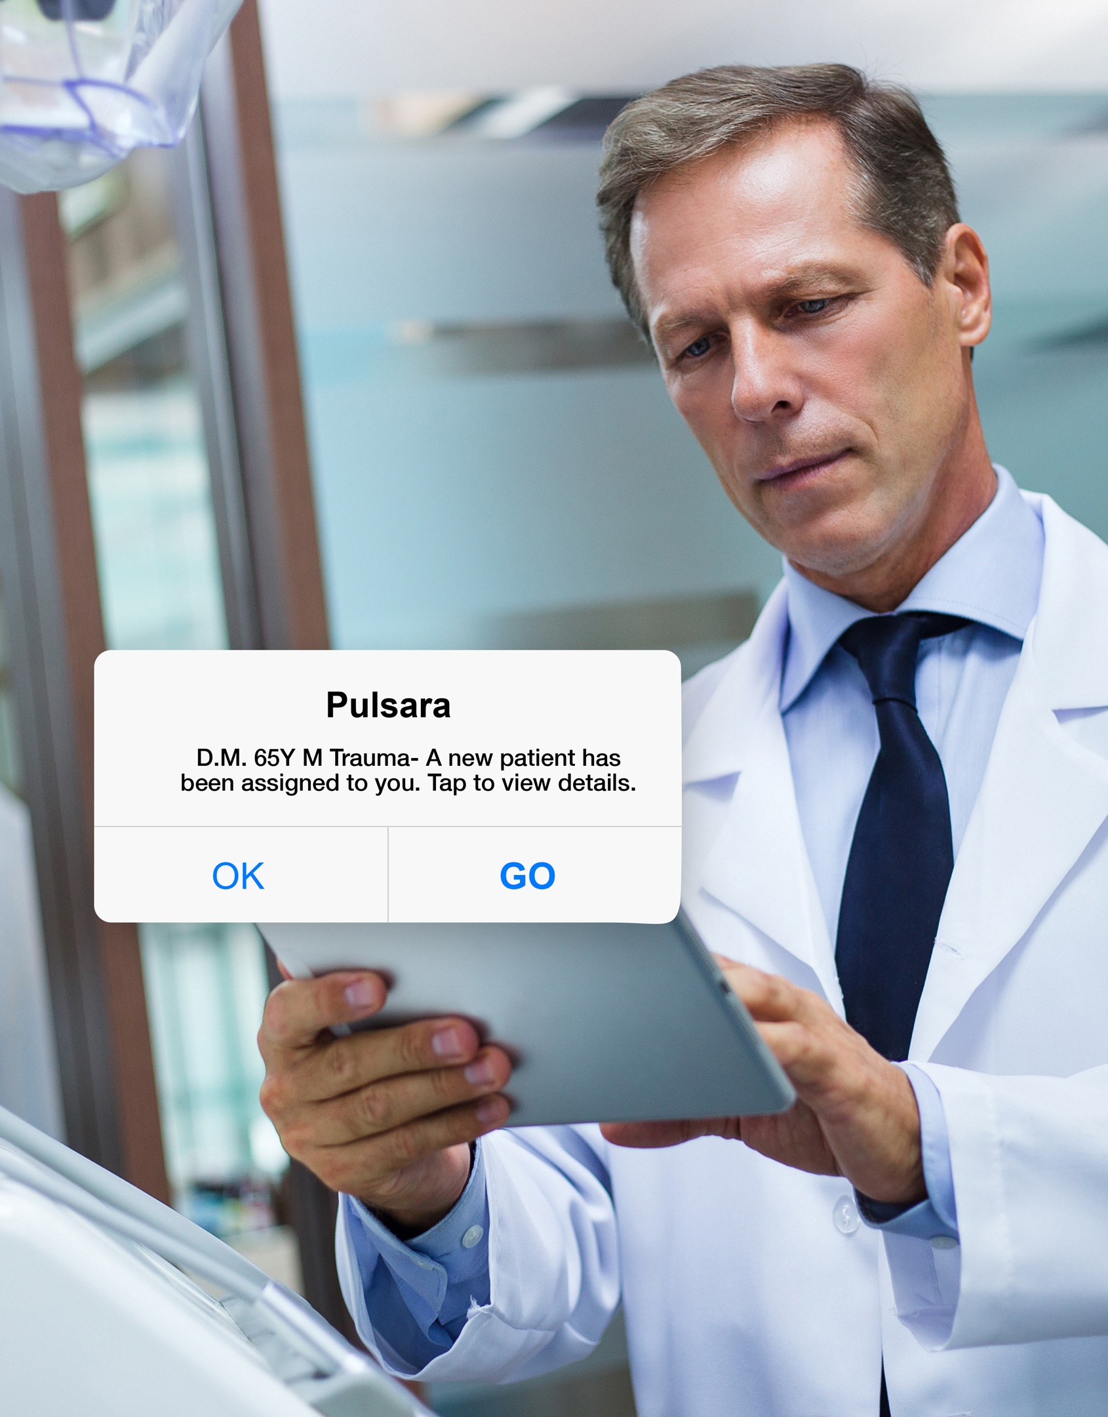
Alerting Basics
WHEN
Method of Arrival
Prehospital (EMS Alert) Options
  When prehospital sends initial notification
  When ED “Activates”
ED Activation
Inpatient Activation
Transfer Requested
Transfer Accepted
Consult Requested
Manual
Team or Individual
Designated Trauma Level
WHO, HOW, & WHEN
Notes:
For instance, a hospital can alert different teams depending on the designated trauma level. As the case evolves, they can add in on-call specialists like orthopedics, neurosurgery, or mandible.

Slide 8
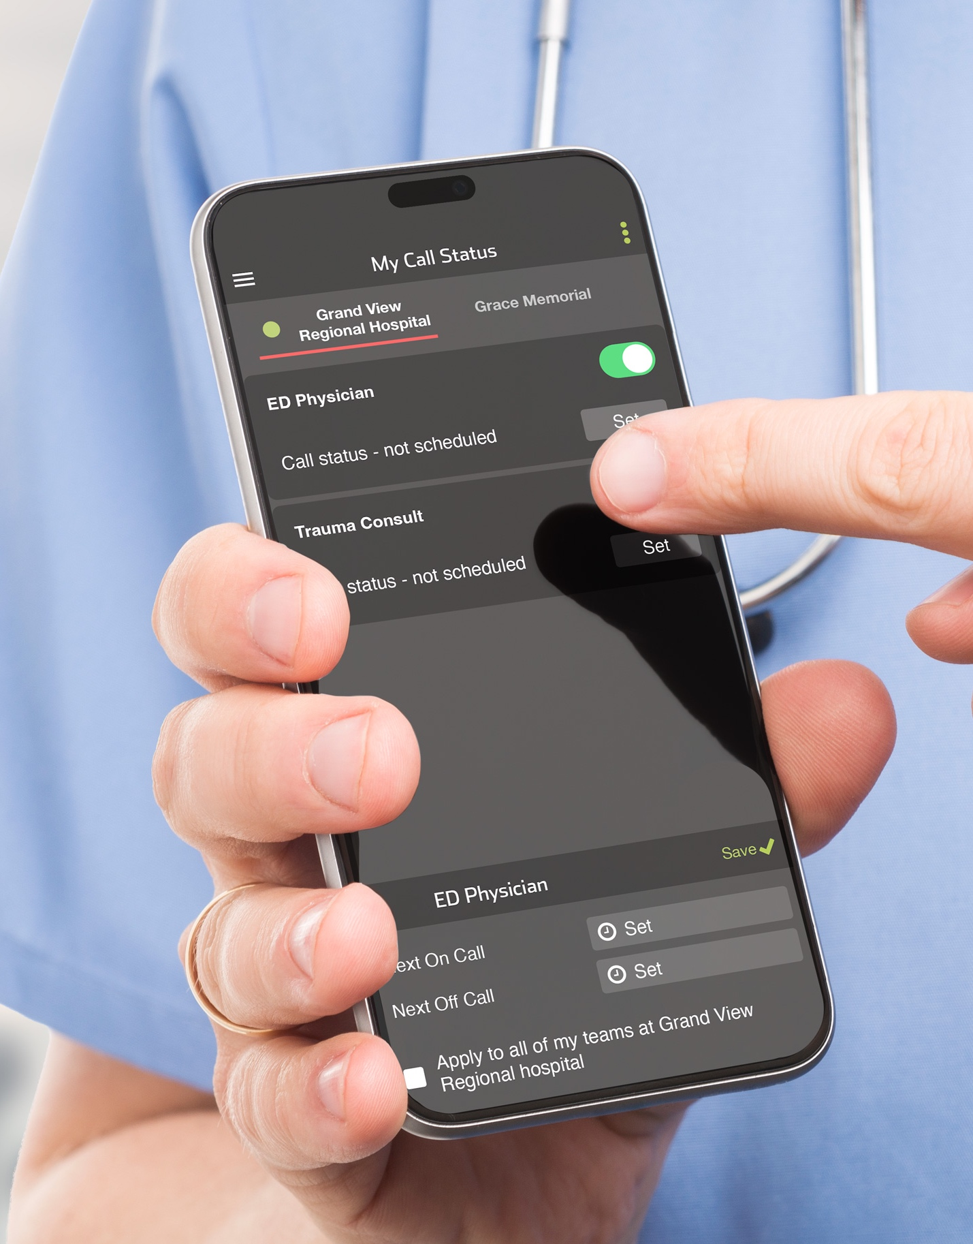
Hospital Call Status
MANAGE
Toggle ON/OFF
Set NEXT ON / OFF
Admin can Set Call Status
Integrate with Calendar
VISIBILITY ON TEAM SCREEN
Call Status of Individuals
Acknowledgement Status of Individuals
Silence Alerts Status of Individuals
MANUAL
Assign to individual in real time regardless of call status
ON | OFF | Transparency
Notes:
Managing call status is also simple. Individuals can manually toggle their status or set upcoming on/off-call times. Administrators have the ability to adjust call status as well. The most convenient method is to integrate your call status with your calendar, allowing for automatic updates.
During a trauma case, you can view the entire care team, their call status, and whether they’ve acknowledged alerts. You can also manually add teams or individuals to the case as needed.

Slide 9


Pulsara Value
FOR THE PROVIDER
Provide pre-registration information before patient arrival – simplifying identification of patient’s history, initiating proper protocols and documentation, and shortening the time to definitive treatment
Standardize communication and logistics across EMS agencies and referral organizations
Leverage the same workflow for all methods of arrival (EMS, ED, Inpatient, Transfer)
Instant transmission of crucial case details, including photos of the injury and scene
Consult specialists with a tap and they can catch up immediately.
Use photos and video to ensure consults and referrals are seen at the appropriate time and level of care
Achieve better results with less effort
FOR THE PATIENT
39% DECREASE in in Door-to-CT time for Trauma patients
5.8 MIN FASTER in Bedside Arrival Time for Trauma Surgeons
5-7 MIN SOONER in Trauma Teams being Notified
FOR THE BOTTOM LINE
INCREASE REIMBURSEMENT with key data and time stamps like Arrival Time
The Trauma Team
39% decrease in door-to-CT
Trauma surgeons at bedside 5.8 minutes faster
Trauma team notified 5-7 mins faster
Improved patient care quote
Notes:
Uniting trauma care teams on a dedicated communication channel has been studied for over a decade. Research shows that Pulsara improves treatment times, care team satisfaction, and hospital economics.

Slide 10


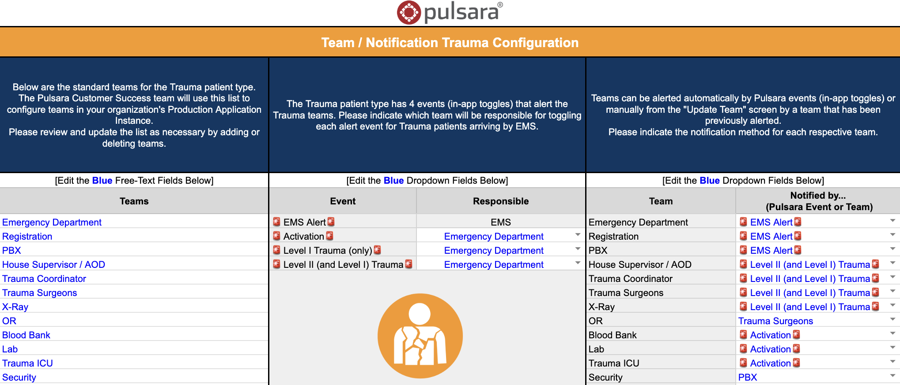
Identify | Build Team | Train | Go Live!
Identify which teams need to be notified and when they need to be notified
Complete the Team / Notification Configuration Spreadsheet
  Customizes your training materials
Share training materials with end users
Go Live
NEXT STEPS
Notes:
Once you identify your teams and when they need to be notified, you are ready to fill out the Configuration spreadsheet which will build your custom workflows and you are ready to coordinate training and GoLive.

