Slide 1
SAME PATIENT MOVEMENT SYSTEM
EVERY DAY
EVERY EVENT
Notes:
Pulsara is The communication and logistics platform that unites distributed teams and fragmented technologies during dynamic events.

Slide 2
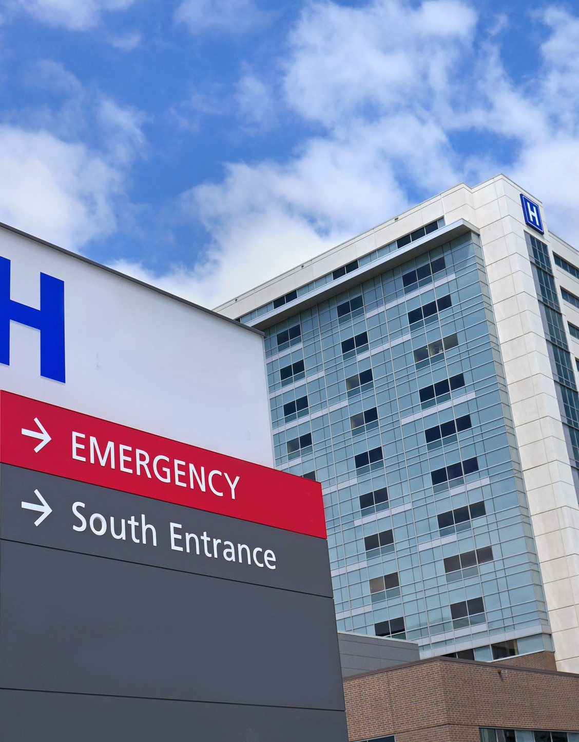
Pulsara MED OPS
PHASE 1
Replace EMS to ED Verbal Prehospital Report / Notification
Participate in Regional Incidents
  Mass Casualty
  Evacuation
  Mass Gatherings
PHASE 2
Inter-Facility Transfer
  Send
  Receive
OPT IN UPGRADE
Pulsara TRANSFER OPS – Add consultant
Pulsara UNITED - Add Downstream Teams or Consultants
Traditional Patient Movement Challenges
Notes:
We will be focusing on Phase 1 opportunities, and we’ll explore incident and transfer functionalities at another time.

Slide 3
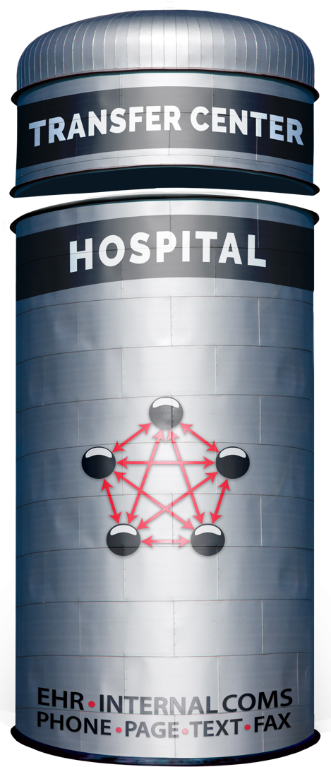


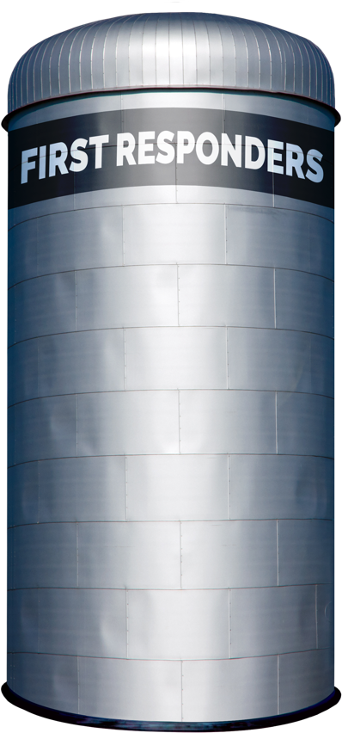
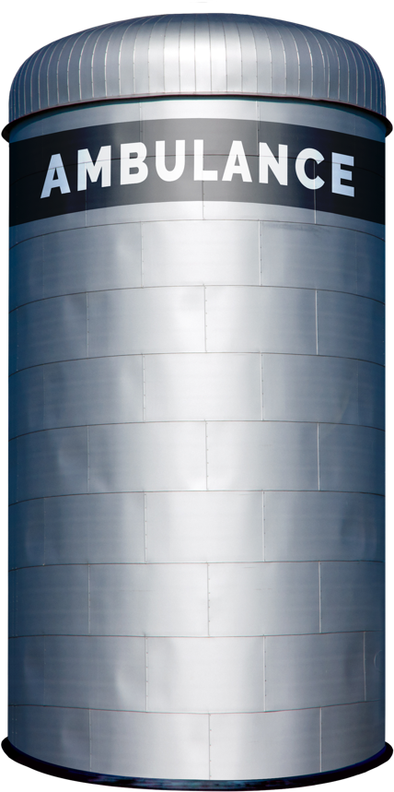

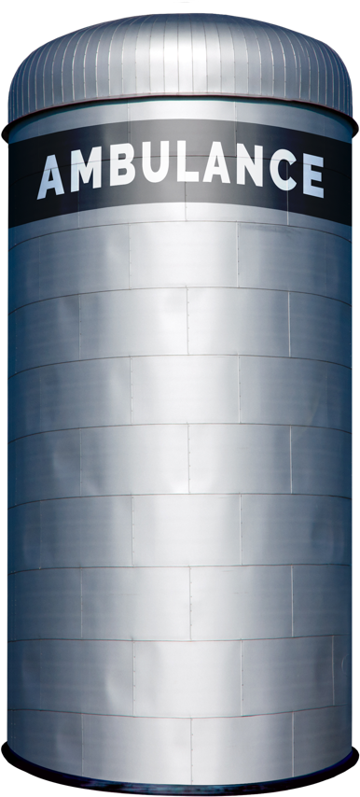


Traditional Patient Movement
Teleconsult
Phone
Secure
Msg
Page
Verbal
Handoff
Electronic
Notifications
Radio
Phone
ECG
ePCR or
Electronic
Notifications
Phone
Bedside
Handoff
Radio
Phone
Bedside
Handoff
Each Red Arrow Represents a Separate Communication Channel
COMMUNICATION CHANNELS: Numerous
Notes:
Traditionally, moving patients across organizations demands coordination through multiple communication channels, including radio reports, phone calls, alerting tools, and secure messaging systems. Often, intermediaries like transfer centers or regional “MedCom” are needed to coordinate these calls and data sources.
In the diagram, the red lines represent these distinct communication channels, each attempting to facilitate care transitions across siloed organizations. This workflow is not only inefficient for routine, low-acuity transfers but is particularly ineffective for time-sensitive emergencies, mass casualty incidents, large-scale evacuations, and load-balancing efforts.

Slide 4


Emergency Department
They didn’t give me enough information, but I don’t have time to listen to a longer report.
I can’t understand you; can you repeat that?
Why do they always say “5 minutes out” when they are actually in the ambulance bay or 15 minutes out?
I can only take one call at a time… How do I know which one to prioritize?
I wish EMS could just send a photo.
I need to jot down this information and then enter it into my notification system to get things started. I wish I could just press a button.
Where’s the ECG? Which ECG goes with which patient?
Who’s on call? Did they get their page?
Where’s the short form, med list, face sheet…
Where is the patient from, and how do we get in touch with family?
How bad is the incident? How many more patients are inbound?
Traditional Patient Movement Challenges
Notes:
Although we’ve grown accustomed to this system over the years, we continue to face its challenges and limitations daily.

Slide 5
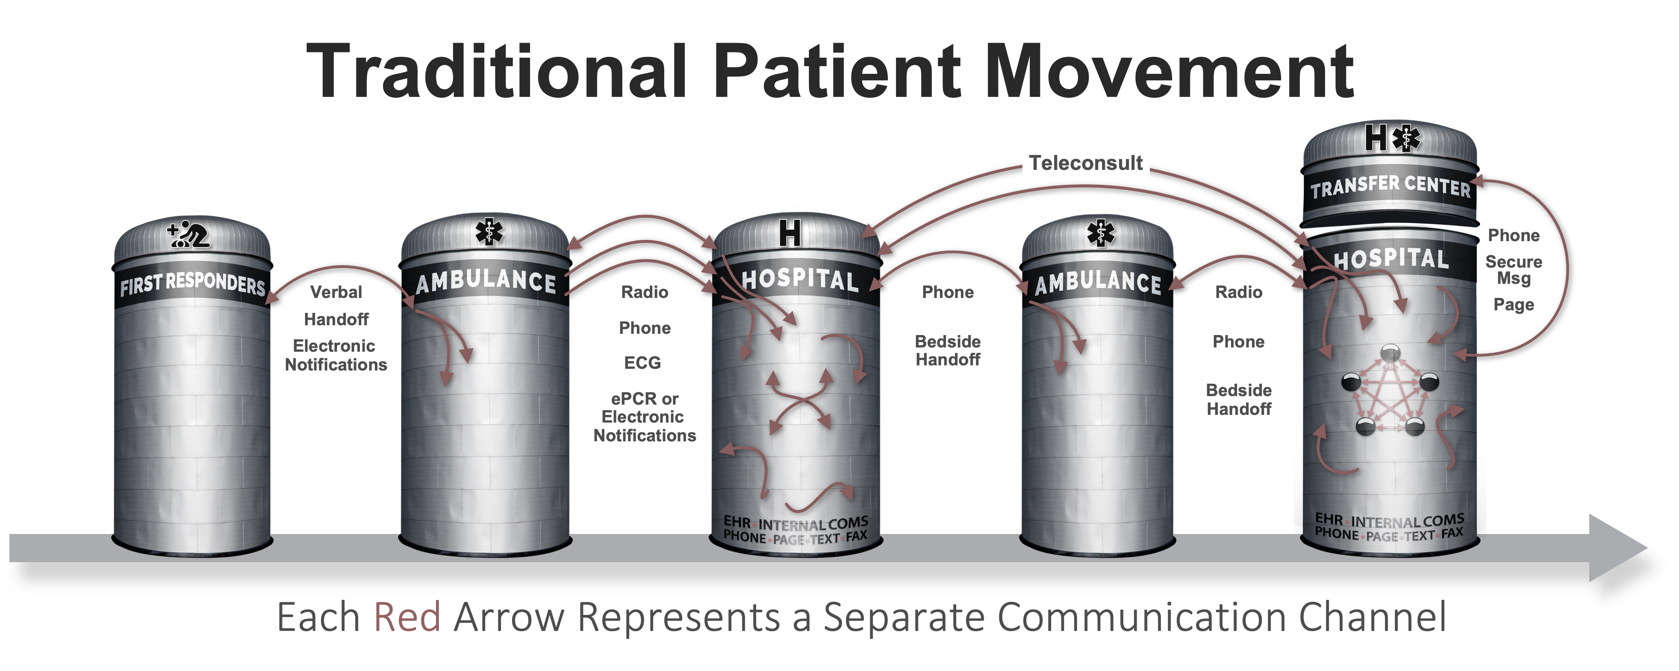






Patient Movement with
3
EHR
Radiology
EHR
Radiology
Create Channel
Build Team
Communicate
ECG
Monitor
ECG
Monitor
ePCR
…
STEPS
ePCR
…
Pulsara
API
Pulsara
API
UNIFIED CARE TEAM
PATIENT MOVEMENT
© 2025 Pulsara – Confidential and Proprietary
Notes:
Pulsara’s Patient Movement System provides a HIPAA-compliant solution to streamline communication and logistics across organizations. We leverage readily available modern technology to bring together public safety and healthcare teams.
A dedicated communication channel is created for each patient encounter, allowing the care team to be updated and expanded as the patient’s condition evolves—keeping everyone aligned on the same channel as they coordinate care.
Additionally, the Pulsara API enables seamless data transfer into and out of the channel.

Slide 6
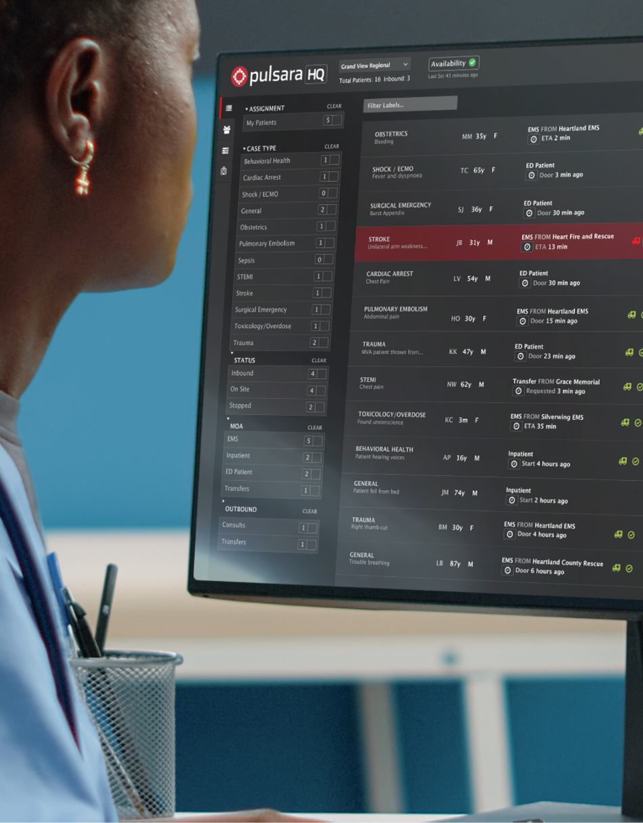
Hospital Requirements
MINIMUM
People / Team: Receive Prehospital Report
  Team: ED (EMS Acknowledge)
  Device - Supported devices and web browsers
    Single iPhone, iPad, or Android Phone. Web Browser Option
OPTIMIZE
Additional Teams
Workflow
PHASE 1: EMS to ED & INCIDENTS
Notes:
We have implemented Pulsara for thousands of customers and refined our process to simplify adoption.
For a typical phase 1 implementation, only the individuals or teams who typically receive the inbound EMS calls need to be trained. Instead of receiving a phone or radio call, they’ll receive alerts on a smartphone, tablet, or computer.
Our team will help you optimize your workflow at no additional cost.

Slide 7

EMS Adoption
WORKFLOW
Scan, photo, voice to text normal Prehospital Report.
  Fire and forget. Get back to patient care.
Others can assist.
Scan to handoff.
Forward instead of repeat.
EMS VALUE PROPOSITIONS
Asynchronous Communication
Reduce Data Entry Burden
  Integrates with ePCR and monitor
Stop Repeating Report
Pre-Registration
Support Bypass Protocols
Reduce Turnaround Times
Improved Feedback
Additional Billing Data
PHASE 1: EMS to ED & INCIDENTS
Notes:
To connect your transporting EMS agencies to the network, we’ve made adoption seamless.
A straightforward workflow lets EMS teams quickly create and send their prehospital report. This information can be imported directly into their ePCR, easing their documentation workload. Additionally, a Pulsara Summary Report can be printed to eliminate the need for a separate short form.
Reports can also be forwarded to reduce repetitive communication. Integration with prehospital cardiac monitors further simplifies attaching ECGs to prehospital reports, saving time, enhancing care, and reducing false activation costs for the hospital.

Slide 8
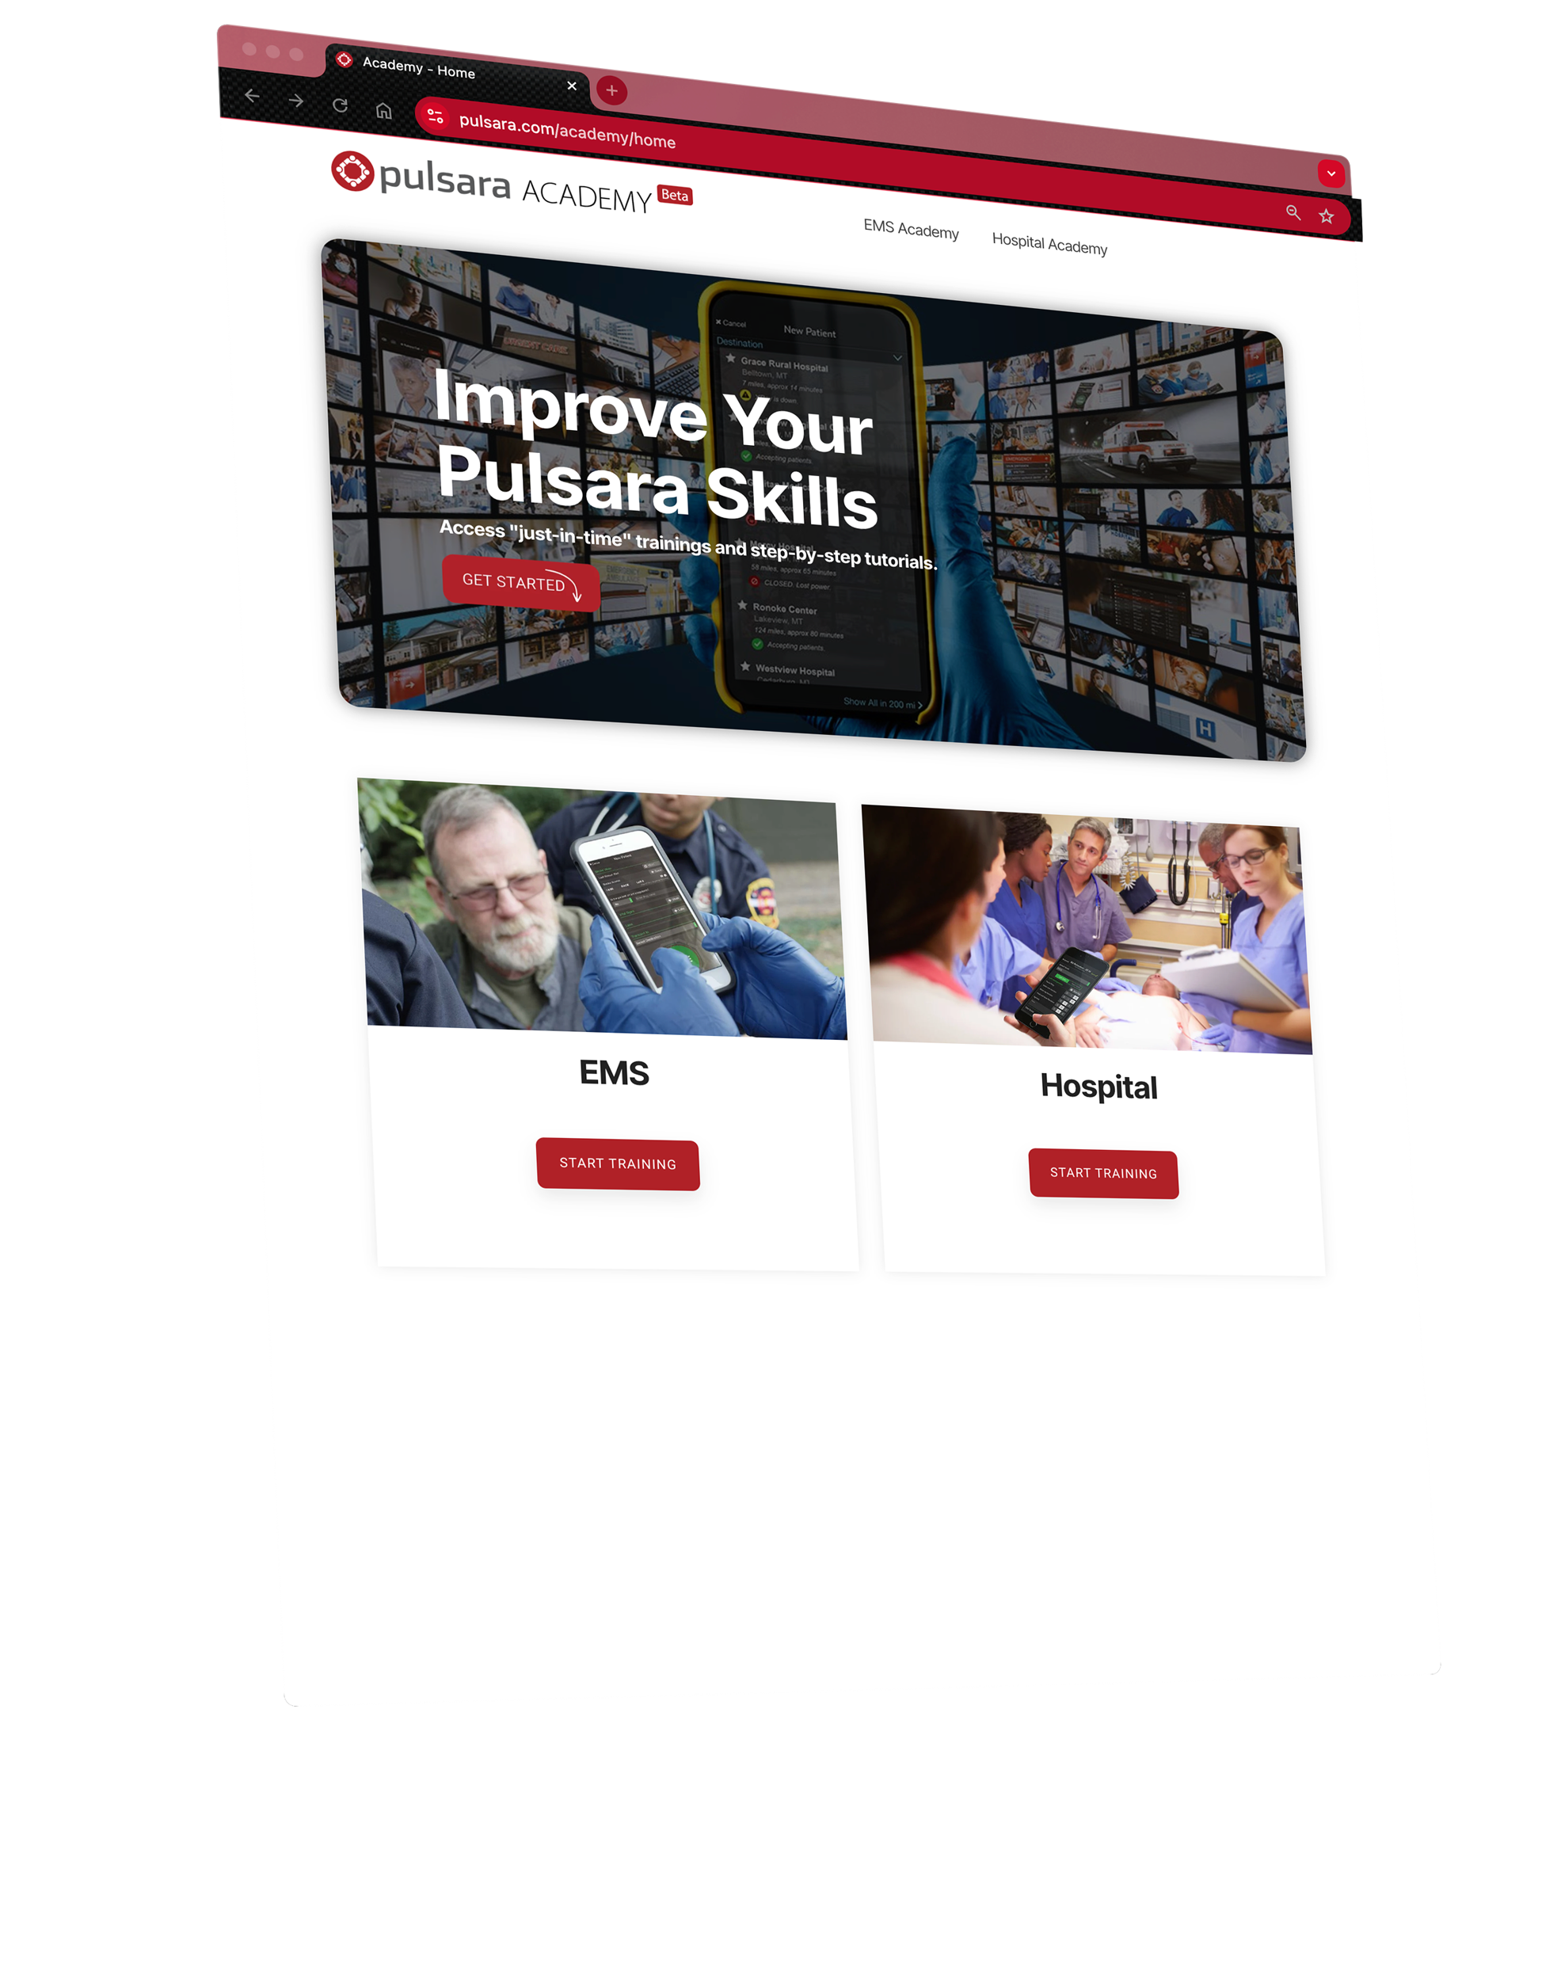

Pulsara Academy / Training
CONTENT
Socialization
Pulsara Basics (conceptual)
How To
Demos
Just-In-Time Training Assets
CONSUME AS NEEDED
Videos
Printable / PDF
Power Point
OPTIONS
Download & Customize
Link to your LMS
Onboarding & Ongoing Training
Notes:
To support initial and ongoing training, we offer a variety of resources, including short videos, slide presentations, and printable Just-In-Time training materials.

Slide 9
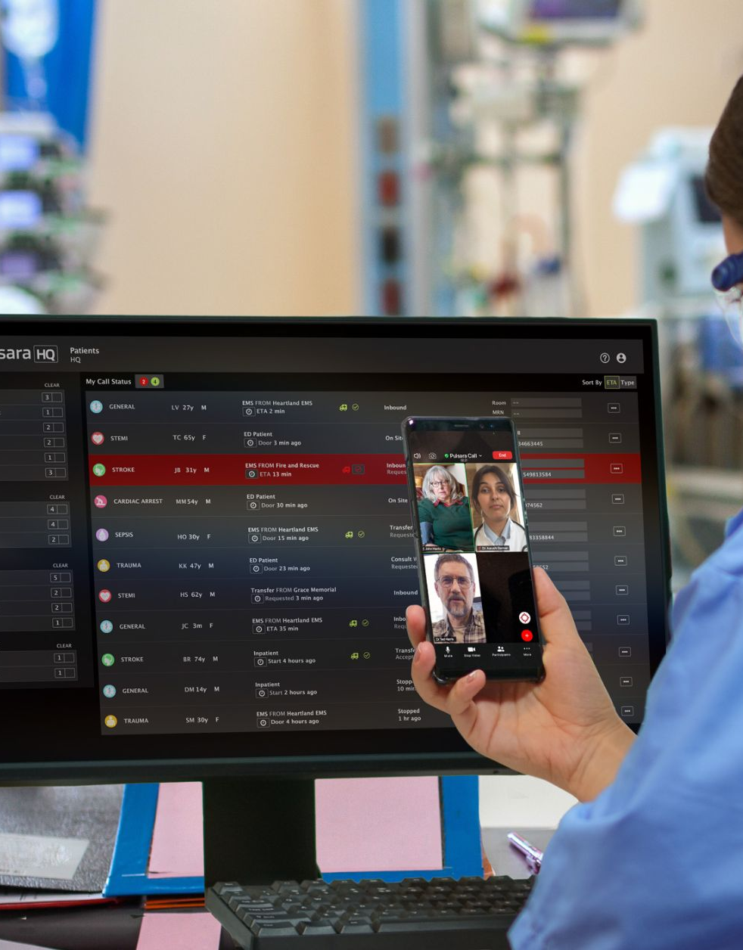
Emergency Department
Asynchronous Communication: Consume information quickly and efficiently manage multiple tasks and patients at once.
Unified Operational Environment: Centralized platform for managing patient arrival and mobilizing resources for all methods of arrival and encounter types.
Better Situational Awareness: Access patient data to improve decision-making and ensure readiness on patient arrival.
Improved Patient Access | Registration: Assist with patient registration and pre-register when possible to streamline patient intake and improve reimbursement.
Simplify Team Notifications: Simple tap-to-activate notifications for care teams, regardless of encounter type, with full transparency on alert delivery.
Stop Repeating Yourself: Forward information instead of repeating. Also able to print the Pulsara Summary Report for hand off and reference.
Improve EMS Relationships: Benefits for EMS include “fire and forget” multimedia reports that flow to ePCR instead of inbound call, room pre-assignment, eliminating the need for repeated reports, reducing turnaround times, and providing real-time feedback.
Flexible Device Access: Supports mobile, web/desktop with WiFi, cellular, and satellite connectivity to optimize utilization in your operational environment.
Enhance Patient Throughput: Direct patients to appropriate areas (specific ED Room, Cath Lab, CT, IR, OB, etc.) and streamline handoffs between departments.
UNIFIED CARE TEAM - Benefits
Notes:
Your Emergency Department will experience the benefits of asynchronous communication, a unified operational environment, and better situational awareness, among others, simply by implementing Pulsara. However, if there are specific initiatives you’d like to prioritize, please don’t hesitate to reach out to us.

Slide 10
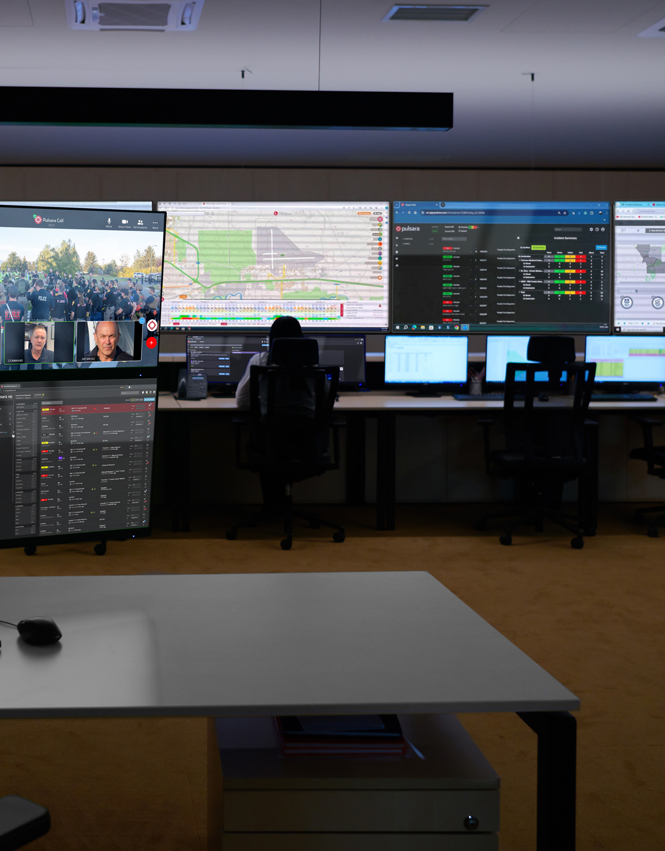
Emergency Management
MCI and Evacuation Participation: Seamless coordination across regional, state, and multi-state MCIs and evacuations.
Real-Time Situational Awareness Across Participating Organizations: Instantly assess incident scope and severity.
Decrease Reliance on Phone Calls: A unified operational view reduces the need for calls.
Incident Load Balancing: Regional visibility helps you quickly assess resource needs and facility stress levels, regardless of method of arrival.
Unified Patient Movement System: The same tool that is used by Public Safety and Hospitals daily is used for managing and tracking patient movement for MCI, mass evacuation, and mass gatherings.
Simplified Reunification: Facilitate patient reunification and repopulation with physical and virtual reunification centers.
Comprehensive Real-Time Data Visualization and Reporting: Individual providers across all participating organizations are able to deliver exceptional patient care while providing incident command insights for operational decision support.
UNIFIED CARE TEAM - Benefits
Notes:
Your participation in the network also helps you respond to regional incidents.

Slide 11

Next Steps
WHO TO ENGAGE
ED
Executive sponsors will want to know the regional implications and scope of this project.
  They can help navigate your organizations IT adoption process.
  No cost for Pulsara MED OPS
HOW TO ENGAGE
State Resource Page
Minimum Scope to get started (EMS to ED & Incidents)
Train same team that normally takes the inbound EMS Reports.
Recommend one mobile device but Pulsara can also run on web browsers.
Get Signed up to Get in the Queue
This does not commit you to fully onboarding or a timeline.
Pulsara will work with you and your region to coordinate timeline for training and regular daily use.
Want to Join the Network?
Onboarding & Ongoing Training
Notes:
Make sure to engage Emergency Department leadership. We recommended getting an executive sponsor, as they will want to know the regional implications and scope of the project. They can help you navigate your organization’s IT adoption process.
Your state resource page has everything you need to get started, including discovery videos, product demonstrations, and training resources. There’s also an interactive map showing who has already signed up. If you don’t see your transporting EMS agencies listed, direct them to this page, and feel free to connect us with them—this service is provided at no cost.
You can sign up using the form on your state resources page. Signing up doesn’t commit you to a full onboarding or a specific timeline; it simply places you in the queue and signals your interest in joining the network. We’ll work with you and your local organizations to coordinate regional onboarding. Once you sign up, we will reach out to coordinate the next steps.

