Slide 1

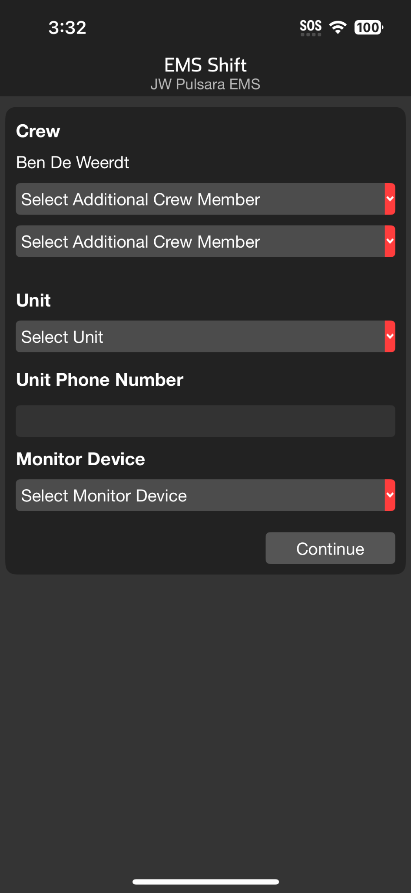
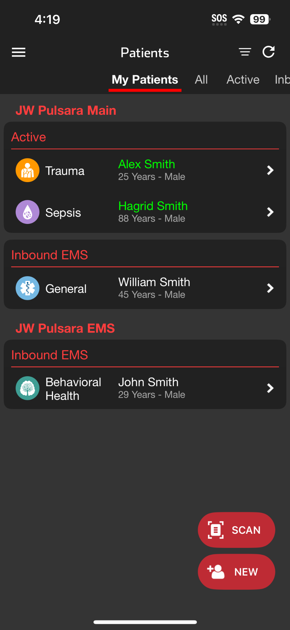





EMS | EMS Shift
Select Crew
All individuals on Crew added to Patient Channel
Select Unit
Confirm Unit Phone Number (Optional)
Team members able to call Unit Phone
Leave blank to disable this functionality
Monitor Device
Simplifies workflow to attach ECG to channel
Continue
Adjust EMS Shift Anytime
Tap Menu then EMS Shift
Remember to Save
Notes:
Let’s walk through how to set up your EMS Shift to streamline your workflow throughout your shift.
When you log in at the start of your shift, you’ll see the EMS Shift screen.
The first section is your EMS Crew. Your name appears at the top, and you have the option to add up to two additional team members. Adding them ensures that when you create or join a patient channel, they are automatically included as well. This means all of you can access that patient under “My Patients” on your patient screen, making it easy to find channels and collaborate. Your teammates will be able to assist with communication, logistics, or pulling data into your ePCR. If needed, you can update your crew at any time during your shift.
Next, select your Unit number. You can also add or confirm your Unit Phone Number, which is optional. If you enter a number, any team member in the patient channel will be able to place a direct call to the unit phone. If you prefer not to enable this feature, simply leave the field blank.
Finally, link Pulsara to the monitor you’ll be using for your shift. This makes it easy to attach an ECG to a patient channel when needed.
Once everything is set, tap Continue to proceed to the main Patients Screen. If you ever need to adjust your EMS Shift settings, just tap the menu in the upper left corner and select EMS Shift. Be sure to save any changes before exiting.

Slide 2
EMS | EMS Shift
Notes:
When you log in at the start of your shift, you’ll see the EMS Shift screen.

Slide 3
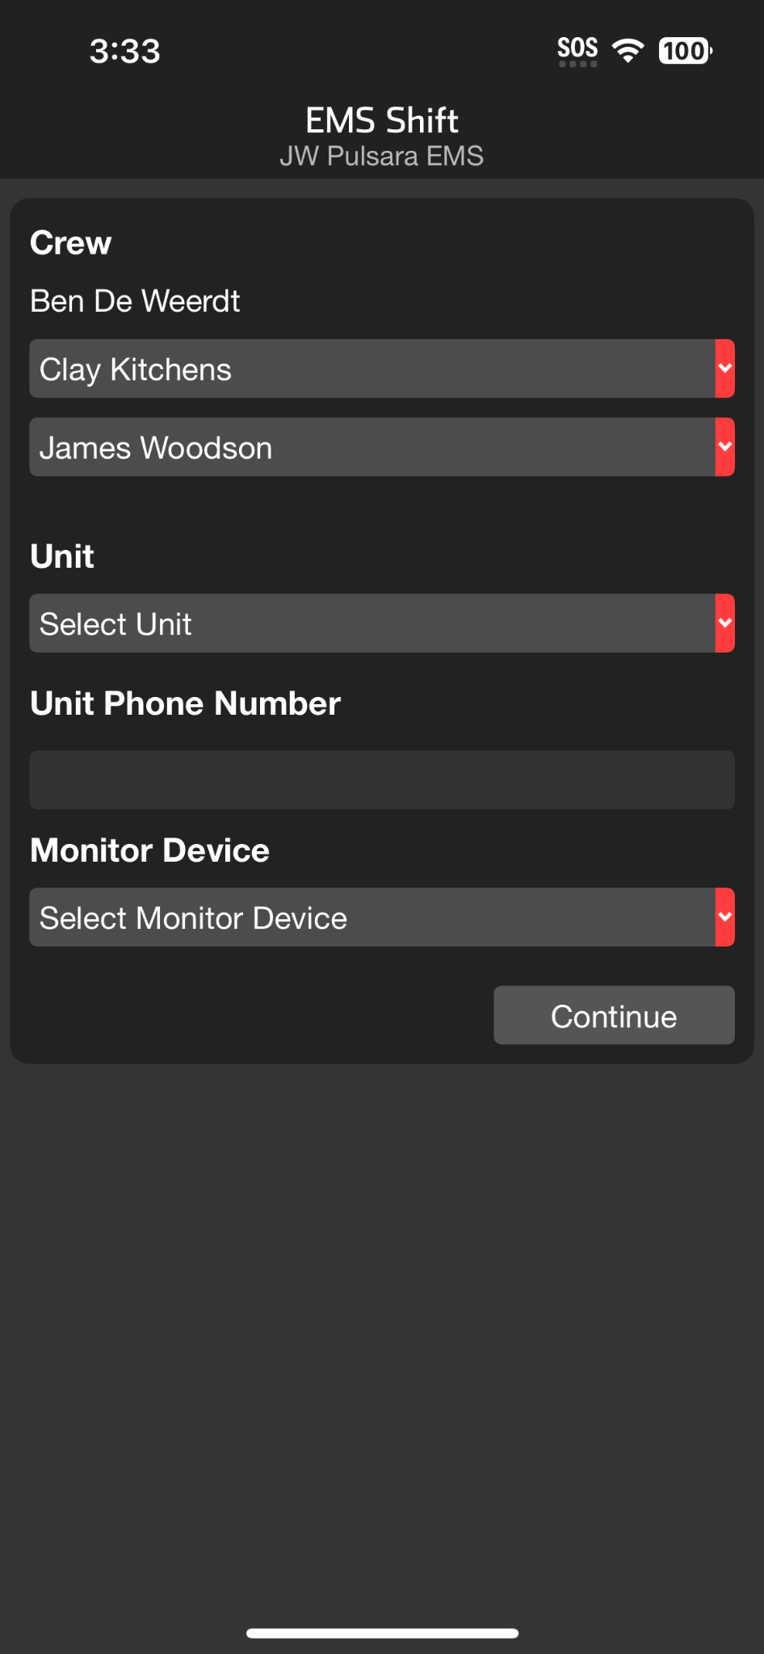
EMS | EMS Shift
Select Crew
All individuals on Crew added to Patient Channel
Notes:
The first section is your EMS Crew. Your name appears at the top, and you have the option to add up to two additional team members. Adding them ensures that when you create or join a patient channel, they are automatically included as well.

Slide 4
EMS | EMS Shift
Select Crew
All individuals on Crew added to Patient Channel
Notes:
This means all of you can access that patient under “My Patients” on your patient screen, making it easy to find channels and collaborate. Your teammates will be able to assist with communication, logistics, or pulling data into your ePCR. If needed, you can update your crew at any time during your shift.

Slide 5

EMS | EMS Shift
Select Crew
All individuals on Crew added to Patient Channel
Select Unit
Notes:
Next, select your Unit number.

Slide 6
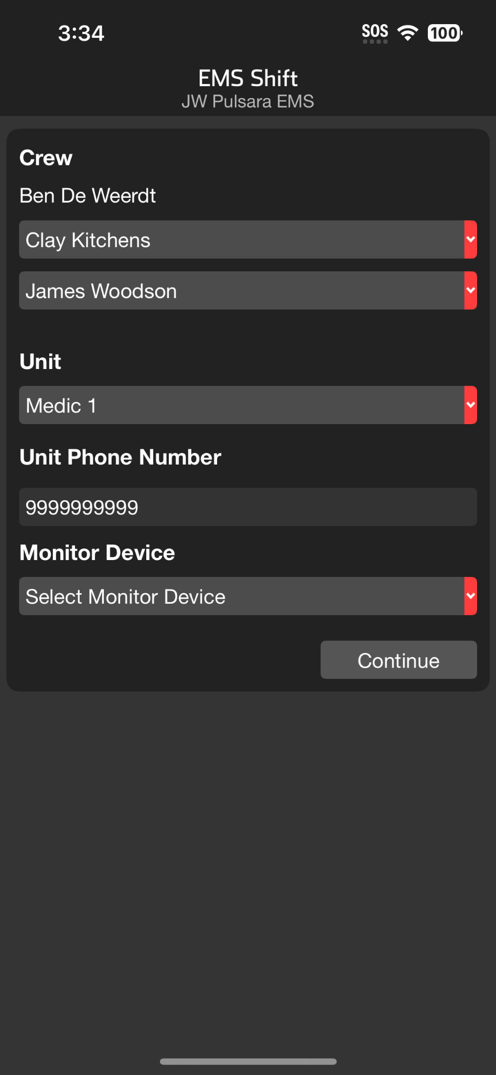
EMS | EMS Shift
Select Crew
All individuals on Crew added to Patient Channel
Select Unit
Confirm Unit Phone Number (Optional)
Team members able to call Unit Phone
Notes:
You can also add or confirm your Unit Phone Number, which is optional. If you enter a number, any team member in the patient channel will be able to place a direct call to the unit phone.

Slide 7
EMS | EMS Shift
Select Crew
All individuals on Crew added to Patient Channel
Select Unit
Confirm Unit Phone Number (Optional)
Team members able to call Unit Phone
Leave blank to disable this functionality
Notes:
If you prefer not to enable this feature, simply leave the field blank.

Slide 8
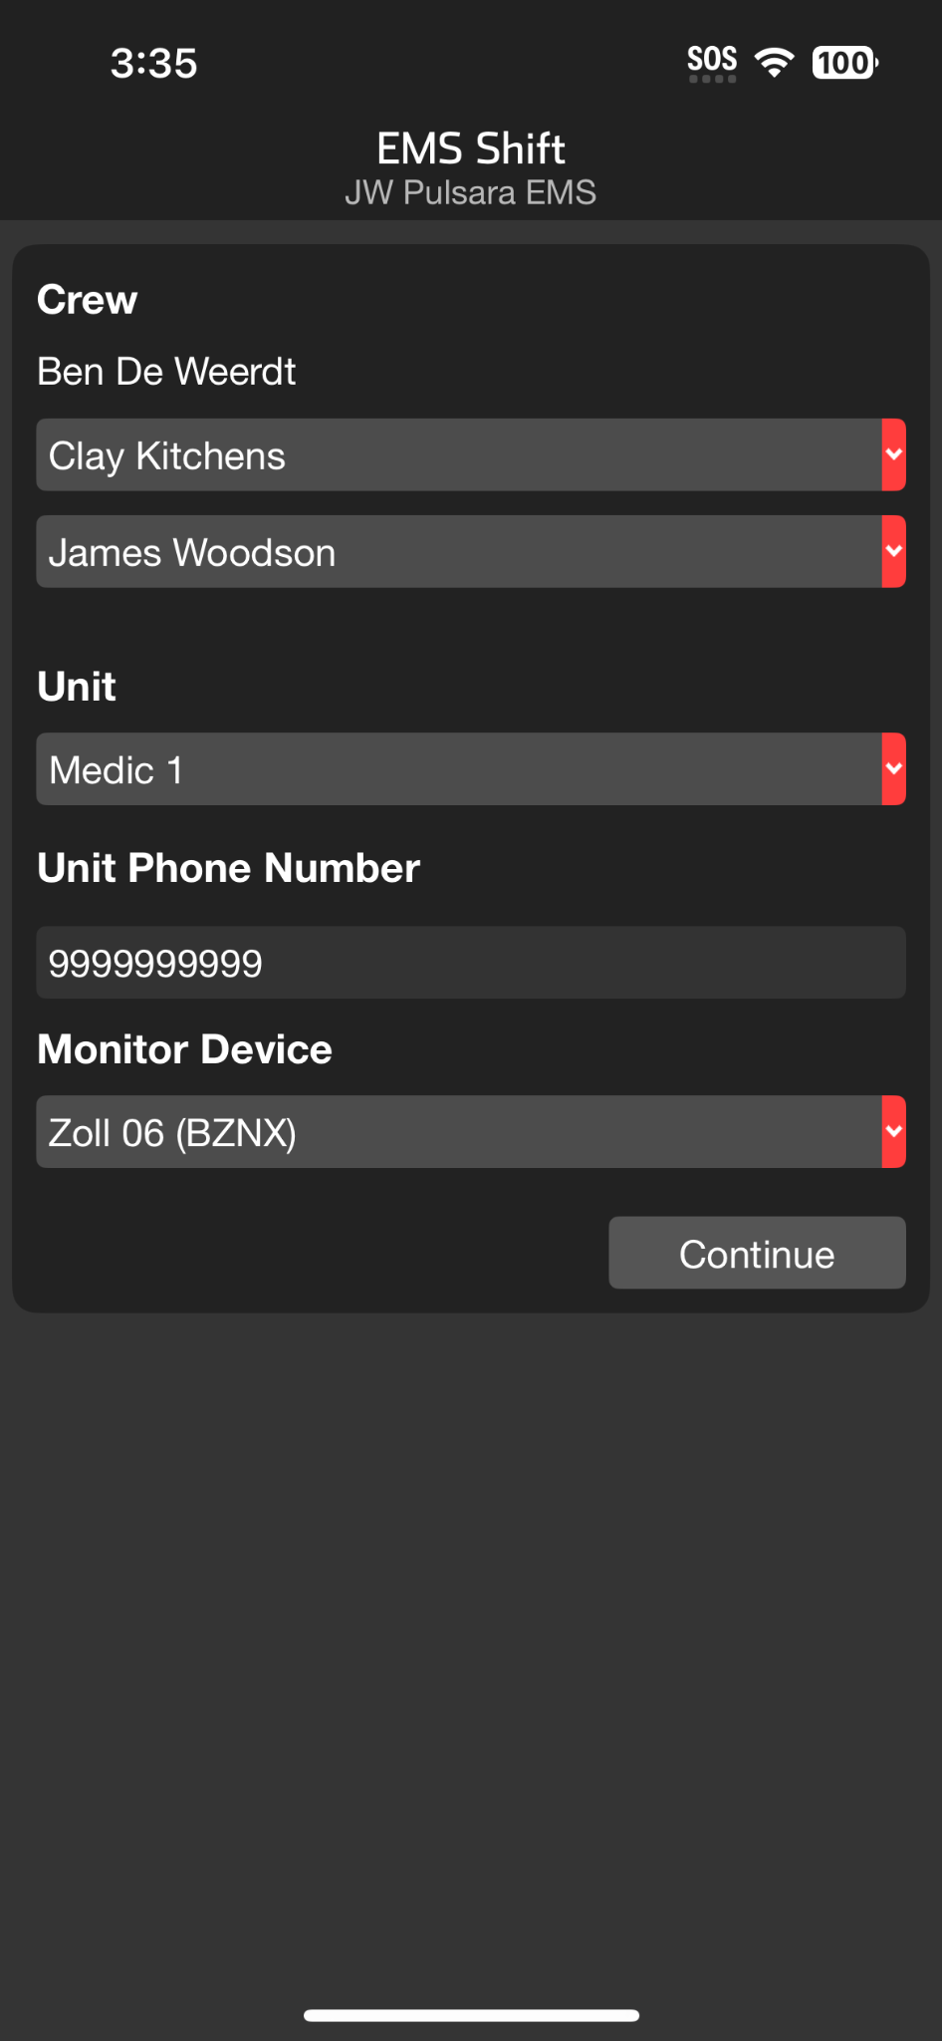
EMS | EMS Shift
Select Crew
All individuals on Crew added to Patient Channel
Select Unit
Confirm Unit Phone Number (Optional)
Team members able to call Unit Phone
Leave blank to disable this functionality
Monitor Device
Simplifies workflow to attach ECG to channel
Notes:
Finally, link Pulsara to the monitor you’ll be using for your shift. This makes it easy to attach an ECG to a patient channel when needed.

Slide 9
EMS | EMS Shift
Select Crew
All individuals on Crew added to Patient Channel
Select Unit
Confirm Unit Phone Number (Optional)
Team members able to call Unit Phone
Leave blank to disable this functionality
Monitor Device
Simplifies workflow to attach ECG to channel
Continue
Notes:
Once everything is set, tap Continue

Slide 10
EMS | EMS Shift
Select Crew
All individuals on Crew added to Patient Channel
Select Unit
Confirm Unit Phone Number (Optional)
Team members able to call Unit Phone
Leave blank to disable this functionality
Monitor Device
Simplifies workflow to attach ECG to channel
Continue
Notes:
to proceed to the main Patients Screen.

Slide 11
EMS | EMS Shift
Select Crew
All individuals on Crew added to Patient Channel
Select Unit
Confirm Unit Phone Number (Optional)
Team members able to call Unit Phone
Leave blank to disable this functionality
Monitor Device
Simplifies workflow to attach ECG to channel
Continue
Adjust EMS Shift Anytime
Tap Menu then EMS Shift
Notes:
If you ever need to adjust your EMS Shift settings, just tap the menu in the upper left corner

Slide 12
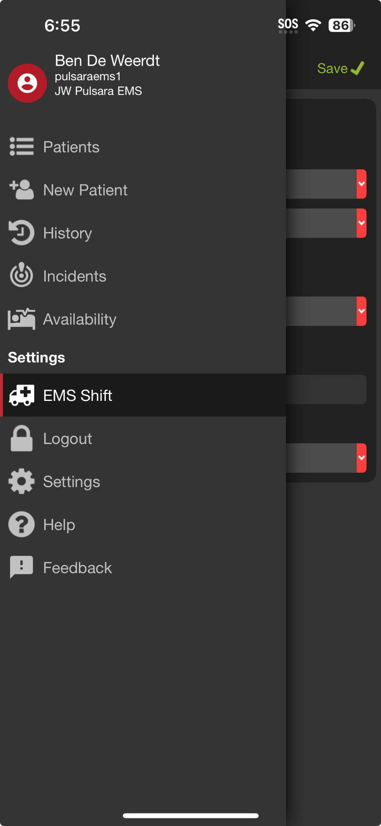
EMS | EMS Shift
Select Crew
All individuals on Crew added to Patient Channel
Select Unit
Confirm Unit Phone Number (Optional)
Team members able to call Unit Phone
Leave blank to disable this functionality
Monitor Device
Simplifies workflow to attach ECG to channel
Continue
Adjust EMS Shift Anytime
Tap Menu then EMS Shift
Notes:
and select EMS Shift.

Slide 13
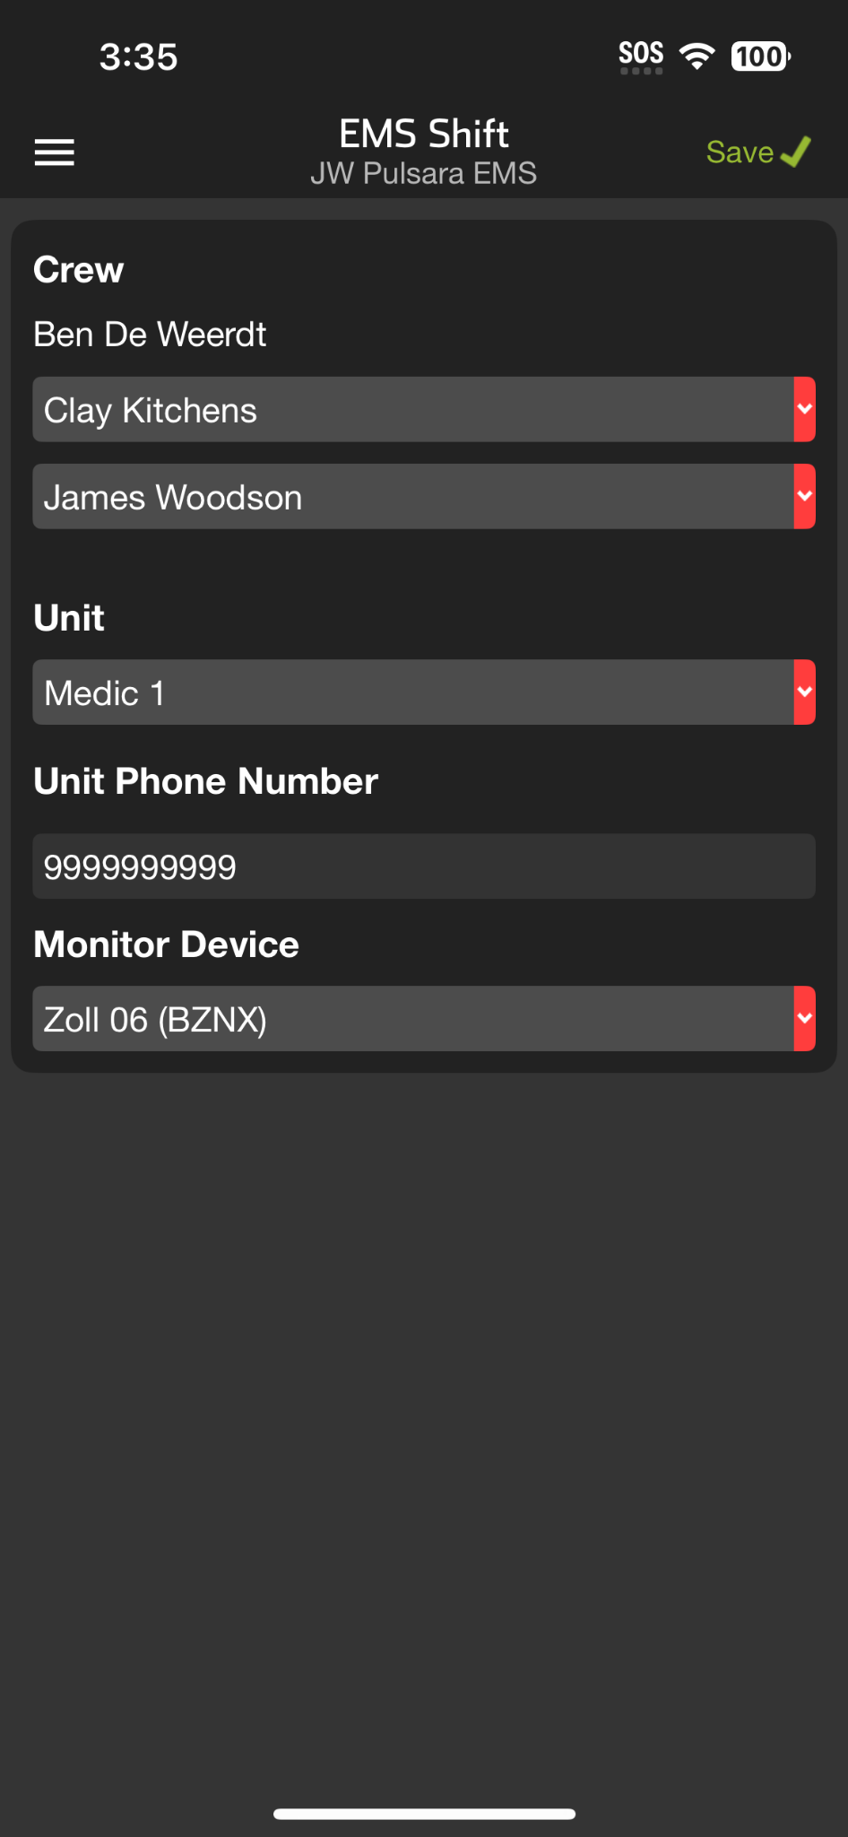
EMS | EMS Shift
Select Crew
All individuals on Crew added to Patient Channel
Select Unit
Confirm Unit Phone Number (Optional)
Team members able to call Unit Phone
Leave blank to disable this functionality
Monitor Device
Simplifies workflow to attach ECG to channel
Continue
Adjust EMS Shift Anytime
Tap Menu then EMS Shift
Remember to Save
Notes:
Be sure to save any changes before exiting.

