Slide 1






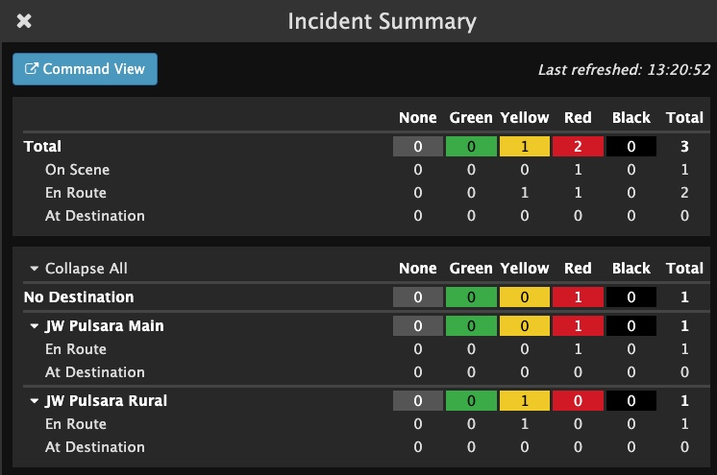


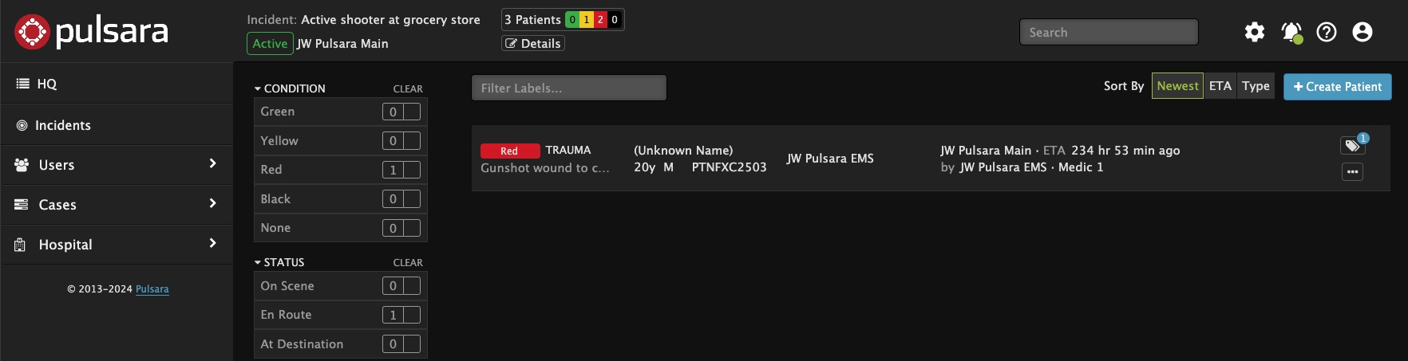


Use bolding & italicized for references inside the app; all caps is jarring.
TIPS: when dragging over a number, hold down the alt/option key and it will copy it to the new location. Shift+move keeps it in a straight line. Shift+arrow moves in smaller increments. When pasting text, choose keep text only to retain the formatting. To replace the screen, right click on the screenshot and choose, change picture (from file, or clipboard). This will maintain the crop, rounded corners. Double click the screenshot and choose crop from the shape format menu to adjust where the screenshot is in the crop. NOTE: hide the SOS
Join an Incident
INCIDENTS | Hospital Incident View - MCI
Incident View
Select Correct Incident
Only see Patient Channels associated with Incident
  View Patient Channel details
Wristband ID visible
Create Patient: Automatically added to this Incident
Incident Details
View Participating Entities and Privileges
Other Incident Details
Incident Summary
Command View - Separate Window
Scan to …
Barcodev
Notes:
This tutorial will review the Incident View for hospitals.
When you tap Incidents, you will be prompted to select the correct incident. Once you are in the Incident View, you can only see the patient channels associated with the selected incident. This view differs slightly from Pulsara HQ as the filters are different, and you can see the Wristband ID at the main level. Additionally, if you want to activate downstream care teams or assign room numbers, you will need to enter the patient channel instead of doing this from the main screen.
You can create a new patient from this view, and the patient is automatically added to the incident and recorded as being at your organization.
Under Incident Details, you can see participating entities, their privileges, and additional details about the incident.
Tap on the abbreviated incident summary to expand and see more details. Here, you can view how many patients within each triage category are on scene, en route, or at the designated destination. You can even see the breakdown by receiving destinations.
If you would like to open this view in a separate window, simply tap “Command View.” Many people in the Emergency Department working an MCI from their web browser will have Pulsara HQ open in one window and the Incident Summary open in another. Emergency Managers, Reunification Centers, and others primarily responsible for only the incident often work with Incident View open in one window and the Incident Summary in another.

Slide 2
Use bolding & italicized for references inside the app; all caps is jarring.
TIPS: when dragging over a number, hold down the alt/option key and it will copy it to the new location. Shift+move keeps it in a straight line. Shift+arrow moves in smaller increments. When pasting text, choose keep text only to retain the formatting. To replace the screen, right click on the screenshot and choose, change picture (from file, or clipboard). This will maintain the crop, rounded corners. Double click the screenshot and choose crop from the shape format menu to adjust where the screenshot is in the crop. NOTE: hide the SOS
Join an Incident
INCIDENTS | Hospital Incident View - MCI
Incident View
Scan to …
Barcodev
Notes:
When you tap Incidents

Slide 3
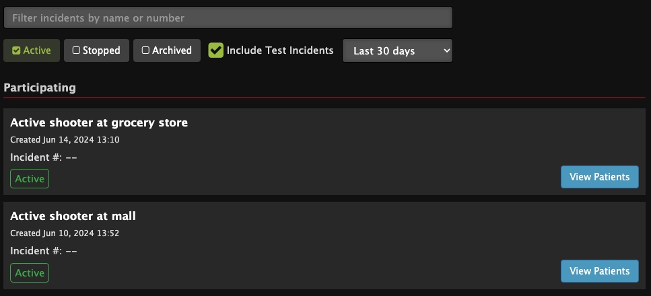
Use bolding & italicized for references inside the app; all caps is jarring.
TIPS: when dragging over a number, hold down the alt/option key and it will copy it to the new location. Shift+move keeps it in a straight line. Shift+arrow moves in smaller increments. When pasting text, choose keep text only to retain the formatting. To replace the screen, right click on the screenshot and choose, change picture (from file, or clipboard). This will maintain the crop, rounded corners. Double click the screenshot and choose crop from the shape format menu to adjust where the screenshot is in the crop. NOTE: hide the SOS
Join an Incident
INCIDENTS | Hospital Incident View - MCI
Incident View
Select Correct Incident
Scan to …
Barcodev
Notes:
you will be prompted to select the correct incident.

Slide 4
Use bolding & italicized for references inside the app; all caps is jarring.
TIPS: when dragging over a number, hold down the alt/option key and it will copy it to the new location. Shift+move keeps it in a straight line. Shift+arrow moves in smaller increments. When pasting text, choose keep text only to retain the formatting. To replace the screen, right click on the screenshot and choose, change picture (from file, or clipboard). This will maintain the crop, rounded corners. Double click the screenshot and choose crop from the shape format menu to adjust where the screenshot is in the crop. NOTE: hide the SOS
Join an Incident
INCIDENTS | Hospital Incident View - MCI
Incident View
Select Correct Incident
Only see Patient Channels associated with Incident
  View Patient Channel details
Scan to …
Barcodev
Notes:
Once you are in the Incident View, you can only see the patient channels associated with the selected incident.

Slide 5
Use bolding & italicized for references inside the app; all caps is jarring.
TIPS: when dragging over a number, hold down the alt/option key and it will copy it to the new location. Shift+move keeps it in a straight line. Shift+arrow moves in smaller increments. When pasting text, choose keep text only to retain the formatting. To replace the screen, right click on the screenshot and choose, change picture (from file, or clipboard). This will maintain the crop, rounded corners. Double click the screenshot and choose crop from the shape format menu to adjust where the screenshot is in the crop. NOTE: hide the SOS
Join an Incident
INCIDENTS | Hospital Incident View - MCI
Incident View
Select Correct Incident
Only see Patient Channels associated with Incident
  View Patient Channel details
Scan to …
Barcodev
Notes:
This view differs slightly from Pulsara HQ as the filters are different

Slide 6
Use bolding & italicized for references inside the app; all caps is jarring.
TIPS: when dragging over a number, hold down the alt/option key and it will copy it to the new location. Shift+move keeps it in a straight line. Shift+arrow moves in smaller increments. When pasting text, choose keep text only to retain the formatting. To replace the screen, right click on the screenshot and choose, change picture (from file, or clipboard). This will maintain the crop, rounded corners. Double click the screenshot and choose crop from the shape format menu to adjust where the screenshot is in the crop. NOTE: hide the SOS
Join an Incident
INCIDENTS | Hospital Incident View - MCI
Incident View
Select Correct Incident
Only see Patient Channels associated with Incident
  View Patient Channel details
Wristband ID visible
Scan to …
Barcodev
Notes:
and you can see the Wristband ID at the main level.

Slide 7
Use bolding & italicized for references inside the app; all caps is jarring.
TIPS: when dragging over a number, hold down the alt/option key and it will copy it to the new location. Shift+move keeps it in a straight line. Shift+arrow moves in smaller increments. When pasting text, choose keep text only to retain the formatting. To replace the screen, right click on the screenshot and choose, change picture (from file, or clipboard). This will maintain the crop, rounded corners. Double click the screenshot and choose crop from the shape format menu to adjust where the screenshot is in the crop. NOTE: hide the SOS
Join an Incident
INCIDENTS | Hospital Incident View - MCI
Incident View
Select Correct Incident
Only see Patient Channels associated with Incident
  View Patient Channel details
Wristband ID visible
Scan to …
Barcodev
Notes:
Additionally, if you want to activate downstream care teams or assign room numbers, you will need to enter the patient channel instead of doing this from the main screen.

Slide 8
Use bolding & italicized for references inside the app; all caps is jarring.
TIPS: when dragging over a number, hold down the alt/option key and it will copy it to the new location. Shift+move keeps it in a straight line. Shift+arrow moves in smaller increments. When pasting text, choose keep text only to retain the formatting. To replace the screen, right click on the screenshot and choose, change picture (from file, or clipboard). This will maintain the crop, rounded corners. Double click the screenshot and choose crop from the shape format menu to adjust where the screenshot is in the crop. NOTE: hide the SOS
Join an Incident
INCIDENTS | Hospital Incident View - MCI
Incident View
Select Correct Incident
Only see Patient Channels associated with Incident
  View Patient Channel details
Wristband ID visible
Create Patient: Automatically added to this Incident
Scan to …
Barcodev
Notes:
You can create a new patient from this view, and the patient is automatically added to the incident and recorded as being at your organization.

Slide 9
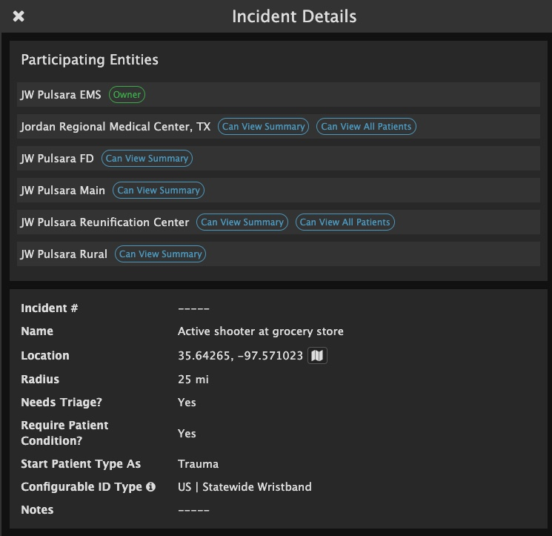
Use bolding & italicized for references inside the app; all caps is jarring.
TIPS: when dragging over a number, hold down the alt/option key and it will copy it to the new location. Shift+move keeps it in a straight line. Shift+arrow moves in smaller increments. When pasting text, choose keep text only to retain the formatting. To replace the screen, right click on the screenshot and choose, change picture (from file, or clipboard). This will maintain the crop, rounded corners. Double click the screenshot and choose crop from the shape format menu to adjust where the screenshot is in the crop. NOTE: hide the SOS
Join an Incident
INCIDENTS | Hospital Incident View - MCI
Incident View
Select Correct Incident
Only see Patient Channels associated with Incident
  View Patient Channel details
Wristband ID visible
Create Patient: Automatically added to this Incident
Incident Details
View Participating Entities and Privileges
Scan to …
Barcodev
Notes:
Under Incident Details, you can see participating entities, their privileges,

Slide 10
Use bolding & italicized for references inside the app; all caps is jarring.
TIPS: when dragging over a number, hold down the alt/option key and it will copy it to the new location. Shift+move keeps it in a straight line. Shift+arrow moves in smaller increments. When pasting text, choose keep text only to retain the formatting. To replace the screen, right click on the screenshot and choose, change picture (from file, or clipboard). This will maintain the crop, rounded corners. Double click the screenshot and choose crop from the shape format menu to adjust where the screenshot is in the crop. NOTE: hide the SOS
Join an Incident
INCIDENTS | Hospital Incident View - MCI
Incident View
Select Correct Incident
Only see Patient Channels associated with Incident
  View Patient Channel details
Wristband ID visible
Create Patient: Automatically added to this Incident
Incident Details
View Participating Entities and Privileges
Other Incident Details
Scan to …
Barcodev
Notes:
and additional details about the incident.

Slide 11
Use bolding & italicized for references inside the app; all caps is jarring.
TIPS: when dragging over a number, hold down the alt/option key and it will copy it to the new location. Shift+move keeps it in a straight line. Shift+arrow moves in smaller increments. When pasting text, choose keep text only to retain the formatting. To replace the screen, right click on the screenshot and choose, change picture (from file, or clipboard). This will maintain the crop, rounded corners. Double click the screenshot and choose crop from the shape format menu to adjust where the screenshot is in the crop. NOTE: hide the SOS
Join an Incident
INCIDENTS | Hospital Incident View - MCI
Incident View
Select Correct Incident
Only see Patient Channels associated with Incident
  View Patient Channel details
Wristband ID visible
Create Patient: Automatically added to this Incident
Incident Details
View Participating Entities and Privileges
Other Incident Details
Incident Summary
Scan to …
Barcodev
Notes:
Tap on the abbreviated incident summary

Slide 12
Use bolding & italicized for references inside the app; all caps is jarring.
TIPS: when dragging over a number, hold down the alt/option key and it will copy it to the new location. Shift+move keeps it in a straight line. Shift+arrow moves in smaller increments. When pasting text, choose keep text only to retain the formatting. To replace the screen, right click on the screenshot and choose, change picture (from file, or clipboard). This will maintain the crop, rounded corners. Double click the screenshot and choose crop from the shape format menu to adjust where the screenshot is in the crop. NOTE: hide the SOS
Join an Incident
INCIDENTS | Hospital Incident View - MCI
Incident View
Select Correct Incident
Only see Patient Channels associated with Incident
  View Patient Channel details
Wristband ID visible
Create Patient: Automatically added to this Incident
Incident Details
View Participating Entities and Privileges
Other Incident Details
Incident Summary
Scan to …
Barcodev
Notes:
to expand and see more details.

Slide 13
Use bolding & italicized for references inside the app; all caps is jarring.
TIPS: when dragging over a number, hold down the alt/option key and it will copy it to the new location. Shift+move keeps it in a straight line. Shift+arrow moves in smaller increments. When pasting text, choose keep text only to retain the formatting. To replace the screen, right click on the screenshot and choose, change picture (from file, or clipboard). This will maintain the crop, rounded corners. Double click the screenshot and choose crop from the shape format menu to adjust where the screenshot is in the crop. NOTE: hide the SOS
Join an Incident
INCIDENTS | Hospital Incident View - MCI
Incident View
Select Correct Incident
Only see Patient Channels associated with Incident
  View Patient Channel details
Wristband ID visible
Create Patient: Automatically added to this Incident
Incident Details
View Participating Entities and Privileges
Other Incident Details
Incident Summary
Scan to …
Barcodev
Notes:
Here, you can view how many patients within each triage category are on scene, en route, or at the designated destination.

Slide 14
Use bolding & italicized for references inside the app; all caps is jarring.
TIPS: when dragging over a number, hold down the alt/option key and it will copy it to the new location. Shift+move keeps it in a straight line. Shift+arrow moves in smaller increments. When pasting text, choose keep text only to retain the formatting. To replace the screen, right click on the screenshot and choose, change picture (from file, or clipboard). This will maintain the crop, rounded corners. Double click the screenshot and choose crop from the shape format menu to adjust where the screenshot is in the crop. NOTE: hide the SOS
Join an Incident
INCIDENTS | Hospital Incident View - MCI
Incident View
Select Correct Incident
Only see Patient Channels associated with Incident
  View Patient Channel details
Wristband ID visible
Create Patient: Automatically added to this Incident
Incident Details
View Participating Entities and Privileges
Other Incident Details
Incident Summary
Scan to …
Barcodev
Notes:
You can even see the breakdown by receiving destinations.

Slide 15
Use bolding & italicized for references inside the app; all caps is jarring.
TIPS: when dragging over a number, hold down the alt/option key and it will copy it to the new location. Shift+move keeps it in a straight line. Shift+arrow moves in smaller increments. When pasting text, choose keep text only to retain the formatting. To replace the screen, right click on the screenshot and choose, change picture (from file, or clipboard). This will maintain the crop, rounded corners. Double click the screenshot and choose crop from the shape format menu to adjust where the screenshot is in the crop. NOTE: hide the SOS
Join an Incident
INCIDENTS | Hospital Incident View - MCI
Incident View
Select Correct Incident
Only see Patient Channels associated with Incident
  View Patient Channel details
Wristband ID visible
Create Patient: Automatically added to this Incident
Incident Details
View Participating Entities and Privileges
Other Incident Details
Incident Summary
Command View - Separate Window
Scan to …
Barcodev
Notes:
If you would like to open this view in a separate window, simply tap “Command View.” Many people in the Emergency Department working an MCI from their web browser will have Pulsara HQ open in one window and the Incident Summary open in another. Emergency Managers, Reunification Centers, and others primarily responsible for only the incident often work with Incident View open in one window and the Incident Summary in another.

