Slide 1


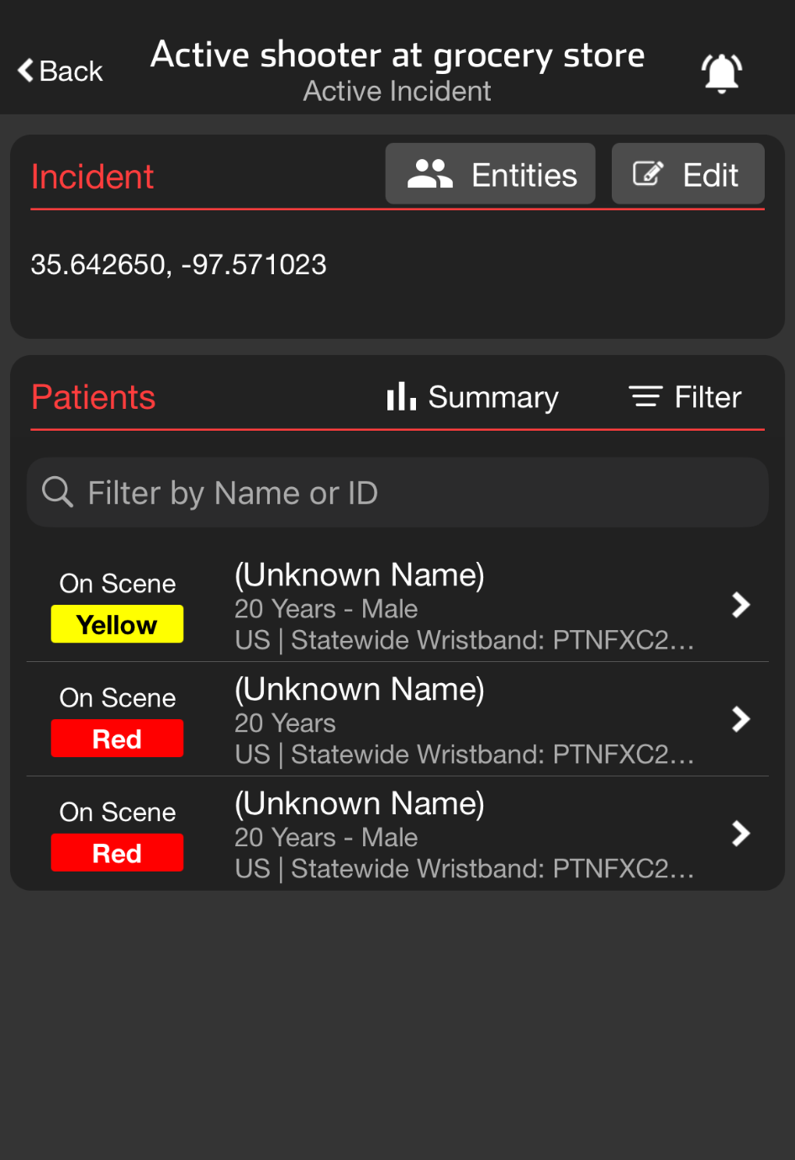
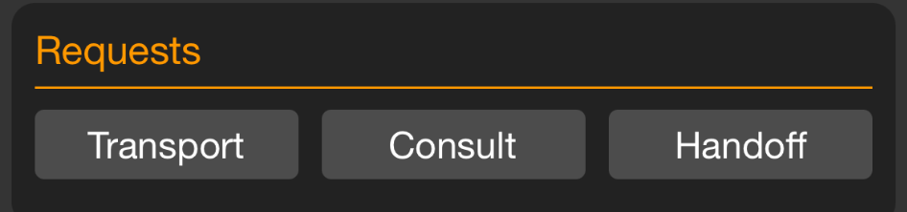

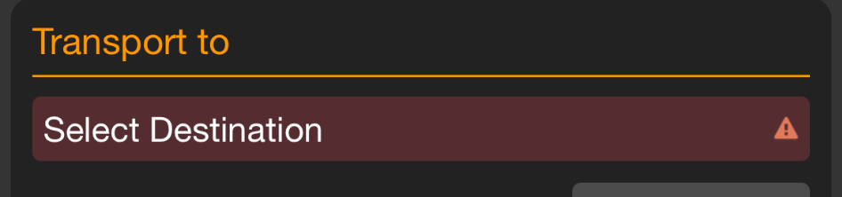


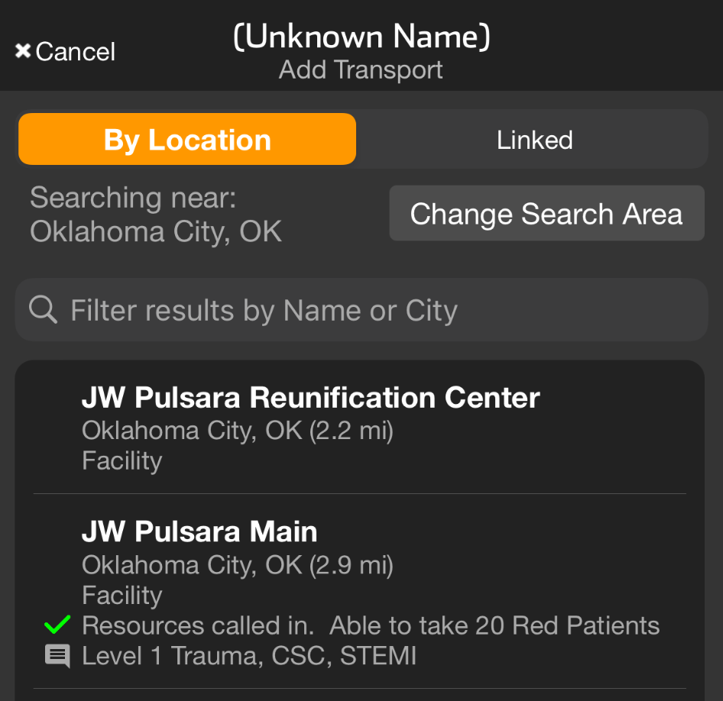


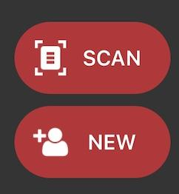


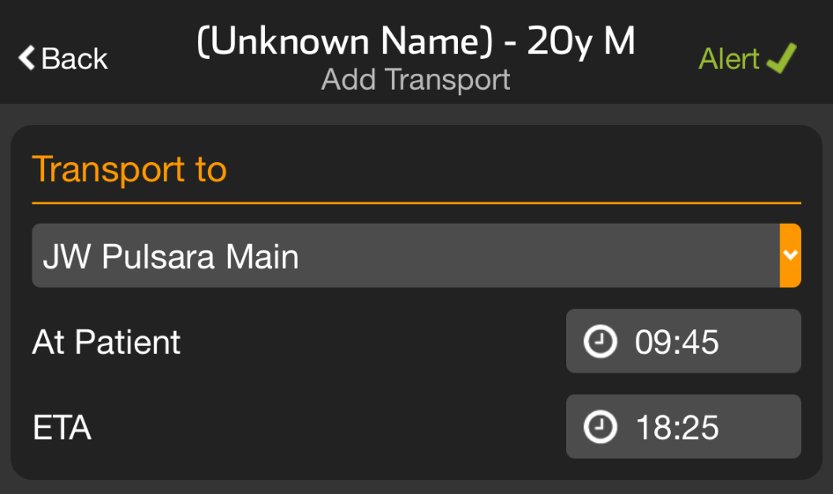
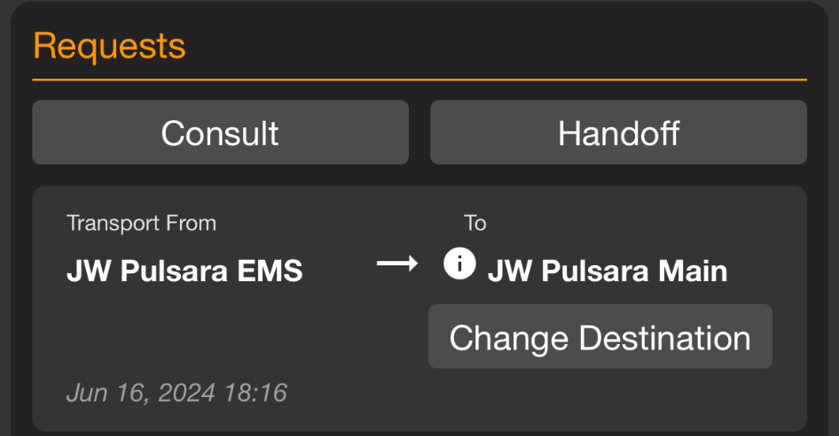
INCIDENTS | Transport
Set Transport Destination
Scan Wristband
If recognized, patient channel will open
If not recognized, you will be prompted to Create
Transport Destination
Destination already set
Displays assigned receiving facility
Able to Change Destination if appropriate
Set Transport Destination
Transport
Select Destination
Select Hospital
Alert
Destination already set
Notes:
This tutorial will review how to transport patients during an incident.
The quickest way to open a patient channel is by scanning the wristband. If the wristband is recognized, the correct patient channel will open.
If a destination has already been set, the request card will display the assigned receiving facility. Remember, you can always change the destination if needed.
If a destination has not been selected, follow your usual workflow by tapping Transport on the request card. You will then be prompted to select a destination. Facilities are listed by location, but you can also search by reviewing your linked facilities, changing the search area for long transports, or searching by the facility’s name or city.
Once you have identified the desired facility, simply tap it and then hit Alert. The hospital will be notified about the inbound patient, and the patient will move to En Route on the Summary Board.

Slide 2
INCIDENTS | Transport
Scan Wristband
If recognized, patient channel will open
If not recognized, you will be prompted to Create
Notes:
The quickest way to open a patient channel is by scanning the wristband. If the wristband is recognized, the correct patient channel will open.

Slide 3
INCIDENTS | Transport
Scan Wristband
If recognized, patient channel will open
If not recognized, you will be prompted to Create
Transport Destination
Destination already set
Destination already set
Notes:
If a destination has already been set,

Slide 4
INCIDENTS | Transport
Scan Wristband
If recognized, patient channel will open
If not recognized, you will be prompted to Create
Transport Destination
Destination already set
Displays assigned receiving facility
Destination already set
Notes:
the request card will display the assigned receiving facility.

Slide 5
INCIDENTS | Transport
Scan Wristband
If recognized, patient channel will open
If not recognized, you will be prompted to Create
Transport Destination
Destination already set
Displays assigned receiving facility
Able to Change Destination if appropriate
Destination already set
Notes:
Remember, you can always change the destination if needed.

Slide 6
INCIDENTS | Transport
Set Transport Destination
Scan Wristband
If recognized, patient channel will open
If not recognized, you will be prompted to Create
Transport Destination
Destination already set
Displays assigned receiving facility
Able to Change Destination if appropriate
Set Transport Destination
Destination already set
Notes:
If a destination has not been selected,

Slide 7
INCIDENTS | Transport
Set Transport Destination
Scan Wristband
If recognized, patient channel will open
If not recognized, you will be prompted to Create
Transport Destination
Destination already set
Displays assigned receiving facility
Able to Change Destination if appropriate
Set Transport Destination
Transport
Destination already set
Notes:
follow your usual workflow by tapping Transport on the request card.

Slide 8
INCIDENTS | Transport
Set Transport Destination
Scan Wristband
If recognized, patient channel will open
If not recognized, you will be prompted to Create
Transport Destination
Destination already set
Displays assigned receiving facility
Able to Change Destination if appropriate
Set Transport Destination
Transport
Select Destination
Destination already set
Notes:
You will then be prompted to select a destination.

Slide 9
INCIDENTS | Transport
Set Transport Destination
Scan Wristband
If recognized, patient channel will open
If not recognized, you will be prompted to Create
Transport Destination
Destination already set
Displays assigned receiving facility
Able to Change Destination if appropriate
Set Transport Destination
Transport
Select Destination
Destination already set
Notes:
Facilities are listed by location

Slide 10
INCIDENTS | Transport
Set Transport Destination
Scan Wristband
If recognized, patient channel will open
If not recognized, you will be prompted to Create
Transport Destination
Destination already set
Displays assigned receiving facility
Able to Change Destination if appropriate
Set Transport Destination
Transport
Select Destination
Destination already set
Notes:
but you can also search by reviewing your linked facilities

Slide 11
INCIDENTS | Transport
Set Transport Destination
Scan Wristband
If recognized, patient channel will open
If not recognized, you will be prompted to Create
Transport Destination
Destination already set
Displays assigned receiving facility
Able to Change Destination if appropriate
Set Transport Destination
Transport
Select Destination
Destination already set
Notes:
changing the search area for long transports,

Slide 12
INCIDENTS | Transport
Set Transport Destination
Scan Wristband
If recognized, patient channel will open
If not recognized, you will be prompted to Create
Transport Destination
Destination already set
Displays assigned receiving facility
Able to Change Destination if appropriate
Set Transport Destination
Transport
Select Destination
Destination already set
Notes:
or searching by the facility’s name or city.

Slide 13
INCIDENTS | Transport
Set Transport Destination
Scan Wristband
If recognized, patient channel will open
If not recognized, you will be prompted to Create
Transport Destination
Destination already set
Displays assigned receiving facility
Able to Change Destination if appropriate
Set Transport Destination
Transport
Select Destination
Select Hospital
Destination already set
Notes:
Once you have identified the desired facility, simply tap it

Slide 14
INCIDENTS | Transport
Set Transport Destination
Scan Wristband
If recognized, patient channel will open
If not recognized, you will be prompted to Create
Transport Destination
Destination already set
Displays assigned receiving facility
Able to Change Destination if appropriate
Set Transport Destination
Transport
Select Destination
Select Hospital
Alert
Destination already set
Notes:
then hit Alert. The hospital will be notified about the inbound patient, and the patient will move to En Route on the Summary Board.

