Slide 1

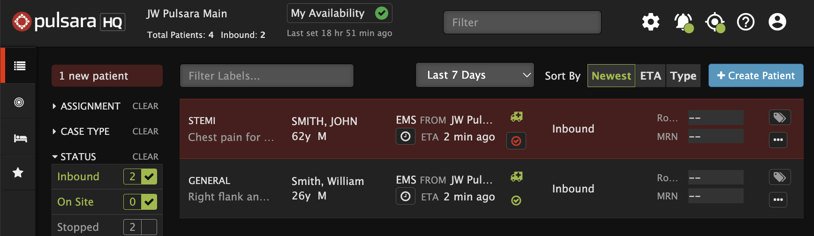










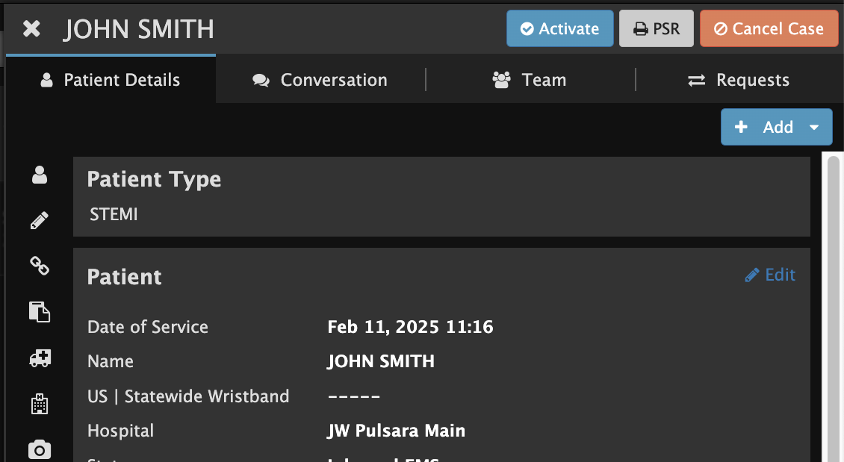


Emergency Dept | Pulsara HQ - Receive EMS Patient
New Inbound Patient
Flashes Red & Audible Alert (If Enabled)
View Patient Details
Hover to Discover
View Patient Details - tap ellipsis (...)
Send EMS Acknowledgement
Tap or ellipsis (…) to send EMS Notification
Set ED Arrival
Optional Actions
Assign Room
Activate (Add Downstream Teams)
Print Pulsara Summary Report (PSR)
Chat
Stop Patient Channel
After patient arrival and no longer needed
Drops off list (able to find in Stopped Cases)
Able to RESTART if needed.
Patient Details View
Notes:
Let’s discuss how to receive a prehospital notification about an inbound EMS patient.

Slide 2
Emergency Dept | Pulsara HQ - Receive EMS Patient
New Inbound Patient
Flashes Red & Audible Alert (If Enabled)
Notes:
When EMS selects your facility as a destination, the new patient channel will appear and flash red. If audible alerts are enabled, you’ll also hear the alert. It is helpful to sort by the newest channels to ensure the new ones are always visible at the top,

Slide 3
Emergency Dept | Pulsara HQ - Receive EMS Patient
New Inbound Patient
Flashes Red & Audible Alert (If Enabled)
Notes:
but if you prefer to sort the list by ETA you can always see if you have new patients in the upper left corner of the screen ensuring you never miss a new inbound patient.

Slide 4
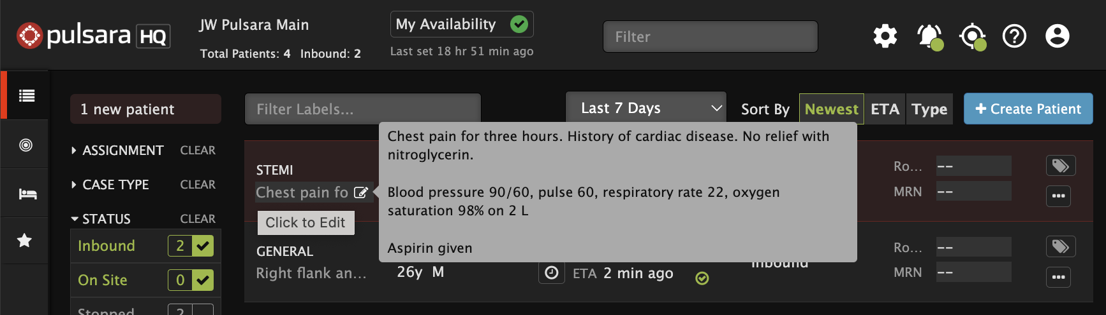
Emergency Dept | Pulsara HQ - Receive EMS Patient
New Inbound Patient
Flashes Red & Audible Alert (If Enabled)
View Patient Details
Hover to Discover
View Patient Details - tap ellipsis (...)
Notes:
To quickly view patient details, hover over the Chief Complaint and Notes fields. EMS is trained to use voice-to-text to document their historical radio report here.

Slide 5
Emergency Dept | Pulsara HQ - Receive EMS Patient
New Inbound Patient
Flashes Red & Audible Alert (If Enabled)
View Patient Details
Hover to Discover
View Patient Details - tap ellipsis (...)
Patient Details View
Notes:
If you need more information—such as ECGs, images, or additional patient details—tap the ellipsis (…) to expand the full patient channel view, similar to what you see on mobile.

Slide 6
Emergency Dept | Pulsara HQ - Receive EMS Patient
New Inbound Patient
Flashes Red & Audible Alert (If Enabled)
View Patient Details
Hover to Discover
View Patient Details - tap ellipsis (...)
Send EMS Acknowledgement
Tap or ellipsis (…) to send EMS Notification
Patient Details View
Notes:
Tapping the ellipsis to expand the details also notifies EMS that you have acknowledged the patient.

Slide 7
Emergency Dept | Pulsara HQ - Receive EMS Patient
New Inbound Patient
Flashes Red & Audible Alert (If Enabled)
View Patient Details
Hover to Discover
View Patient Details - tap ellipsis (...)
Send EMS Acknowledgement
Tap or ellipsis (…) to send EMS Notification
Patient Details View
Notes:
You can also acknowledge EMS by tapping the ambulance icon, which will turn from red to green.

Slide 8
Emergency Dept | Pulsara HQ - Receive EMS Patient
New Inbound Patient
Flashes Red & Audible Alert (If Enabled)
View Patient Details
Hover to Discover
View Patient Details - tap ellipsis (...)
Send EMS Acknowledgement
Tap or ellipsis (…) to send EMS Notification
Set ED Arrival
Patient Details View
Notes:
Once the patient arrives, manually set the ED Arrival Time to move them to On Site status.

Slide 9
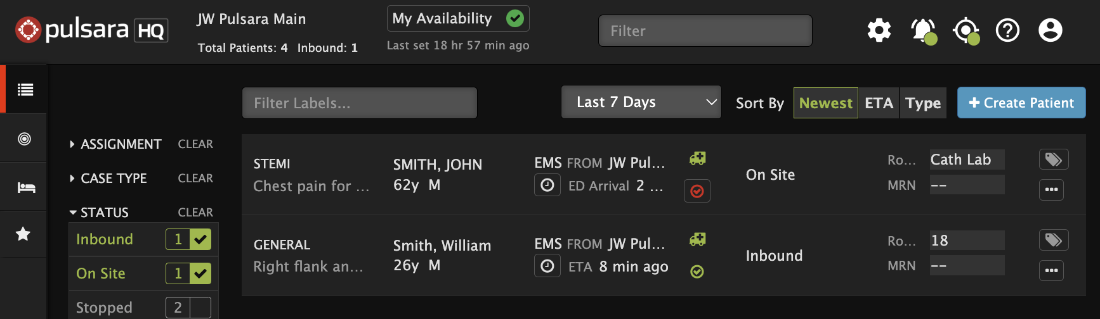
Emergency Dept | Pulsara HQ - Receive EMS Patient
New Inbound Patient
Flashes Red & Audible Alert (If Enabled)
View Patient Details
Hover to Discover
View Patient Details - tap ellipsis (...)
Send EMS Acknowledgement
Tap or ellipsis (…) to send EMS Notification
Set ED Arrival
Optional Actions
Assign Room
Patient Details View
Notes:
That is the minimum core functionality that is used to replace the traditional prehospital notification or radio report, but there are several additional features many Emergency Departments use to streamline the transfer of care. Many EDs assign a patient room number before or upon arrival. This may include direct transport to CT or the cath lab for certain cases.

Slide 10
Emergency Dept | Pulsara HQ - Receive EMS Patient
New Inbound Patient
Flashes Red & Audible Alert (If Enabled)
View Patient Details
Hover to Discover
View Patient Details - tap ellipsis (...)
Send EMS Acknowledgement
Tap or ellipsis (…) to send EMS Notification
Set ED Arrival
Optional Actions
Assign Room
Activate (Add Downstream Teams)
Patient Details View
Notes:
If your hospital uses Pulsara to coordinate downstream care teams, you can activate them by tapping the checkmark icon, which will turn from red to green, or by selecting the Activate button in the patient details view.

Slide 11
Emergency Dept | Pulsara HQ - Receive EMS Patient
New Inbound Patient
Flashes Red & Audible Alert (If Enabled)
View Patient Details
Hover to Discover
View Patient Details - tap ellipsis (...)
Send EMS Acknowledgement
Tap or ellipsis (…) to send EMS Notification
Set ED Arrival
Optional Actions
Assign Room
Activate (Add Downstream Teams)
Print Pulsara Summary Report (PSR)
Patient Details View
Notes:
Most facilities print the Pulsara Summary Report (PSR) by tapping the PSR button. This standardized report includes all relevant details—such as photos and ECGs—and helps facilitate bedside handoff. Some hospitals also save a digital copy in the EHR.

Slide 12
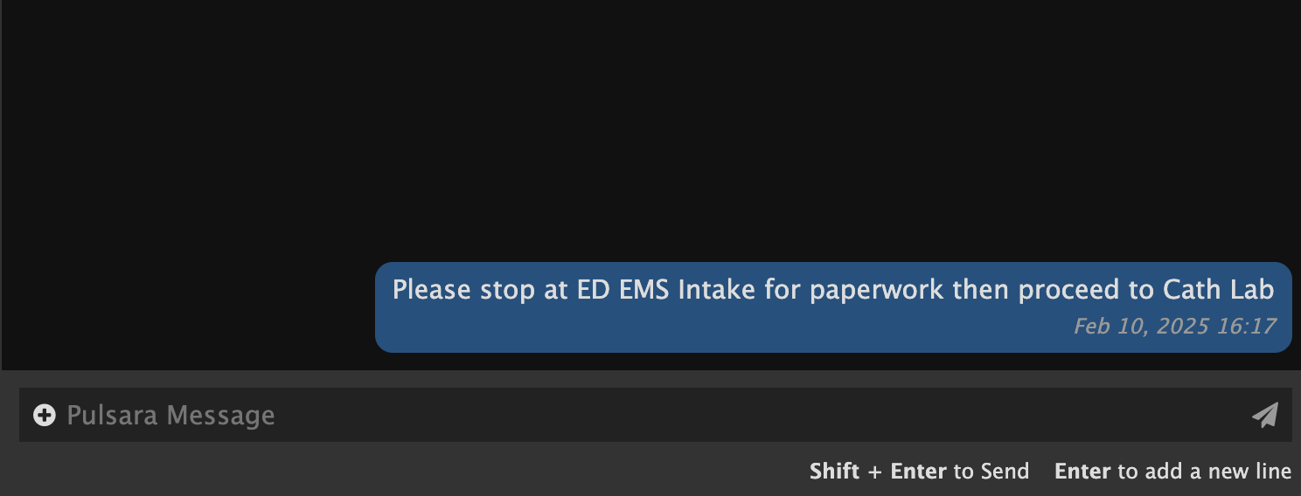
Emergency Dept | Pulsara HQ - Receive EMS Patient
New Inbound Patient
Flashes Red & Audible Alert (If Enabled)
View Patient Details
Hover to Discover
View Patient Details - tap ellipsis (...)
Send EMS Acknowledgement
Tap or ellipsis (…) to send EMS Notification
Set ED Arrival
Optional Actions
Assign Room
Activate (Add Downstream Teams)
Print Pulsara Summary Report (PSR)
Chat
Patient Details View
Notes:
Within the patient details view, you can access chat to communicate with medics and utilize other tools to view or update patient information.

Slide 13
Emergency Dept | Pulsara HQ - Receive EMS Patient
New Inbound Patient
Flashes Red & Audible Alert (If Enabled)
View Patient Details
Hover to Discover
View Patient Details - tap ellipsis (...)
Send EMS Acknowledgement
Tap or ellipsis (…) to send EMS Notification
Set ED Arrival
Optional Actions
Assign Room
Activate (Add Downstream Teams)
Print Pulsara Summary Report (PSR)
Chat
Stop Patient Channel
After patient arrival and no longer needed
Drops off list (able to find in Stopped Cases)
Able to RESTART if needed.
Patient Details View
Notes:
After the patient arrives and you no longer need the patient channel, simply tap Stop Case. In some conditions, this button might say Cancel Case. If your filters are set to show only Inbound and On Site patients, the channel will disappear from your list.

Slide 14
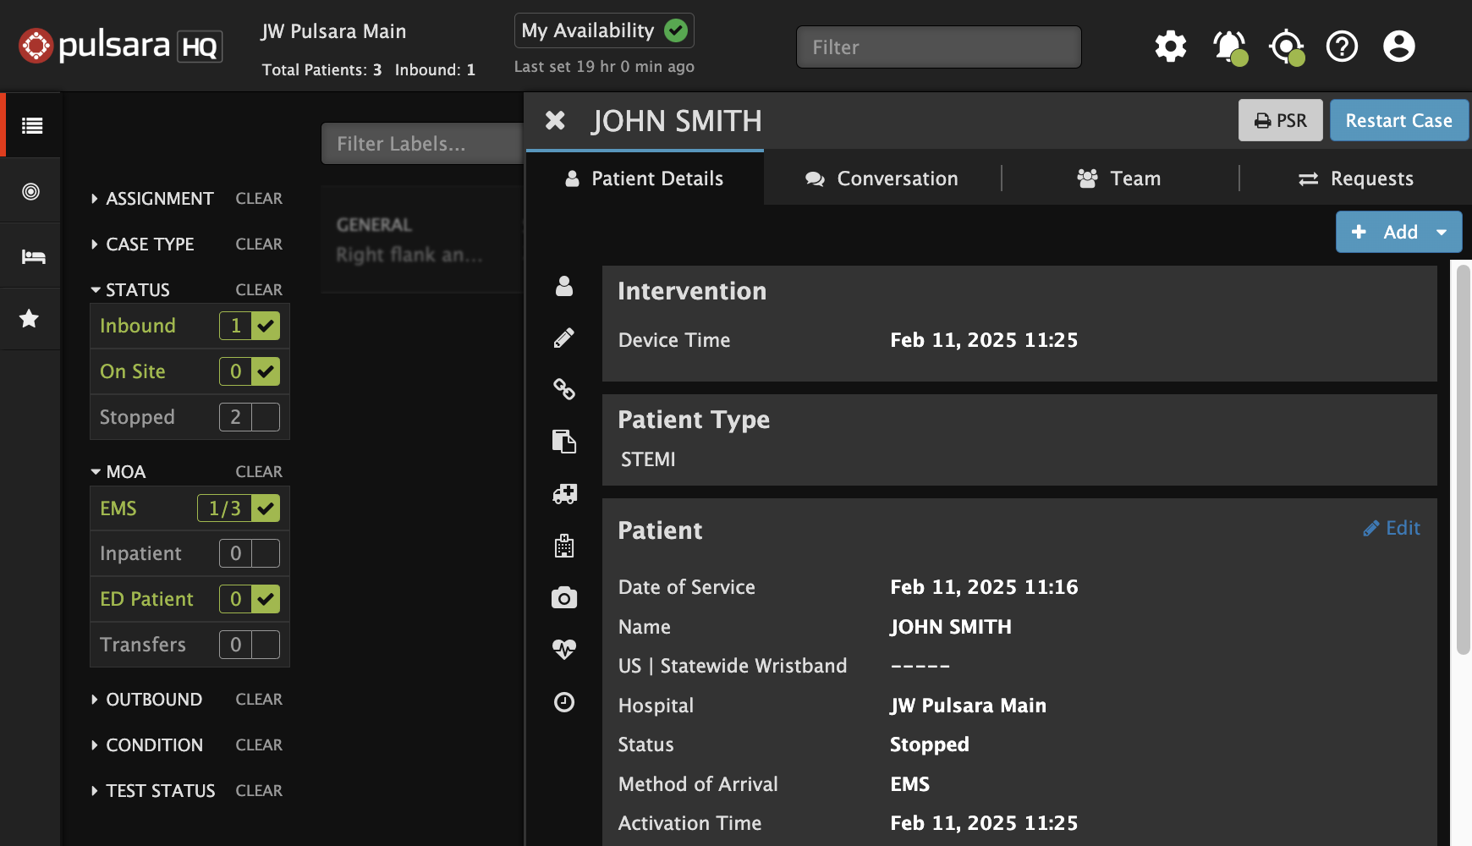
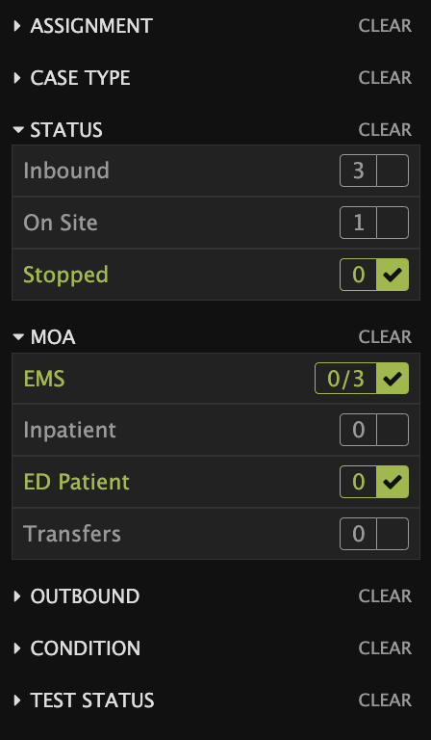
Emergency Dept | Pulsara HQ - Receive EMS Patient
New Inbound Patient
Flashes Red & Audible Alert (If Enabled)
View Patient Details
Hover to Discover
View Patient Details - tap ellipsis (...)
Send EMS Acknowledgement
Tap or ellipsis (…) to send EMS Notification
Set ED Arrival
Optional Actions
Assign Room
Activate (Add Downstream Teams)
Print Pulsara Summary Report (PSR)
Chat
Stop Patient Channel
After patient arrival and no longer needed
Drops off list (able to find in Stopped Cases)
Able to RESTART if needed.
Patient Details View
Notes:
If needed, you can restart the channel at any time by locating it in the Stopped Channels section and tapping Restart in the Patient Details View.

