Slide 1

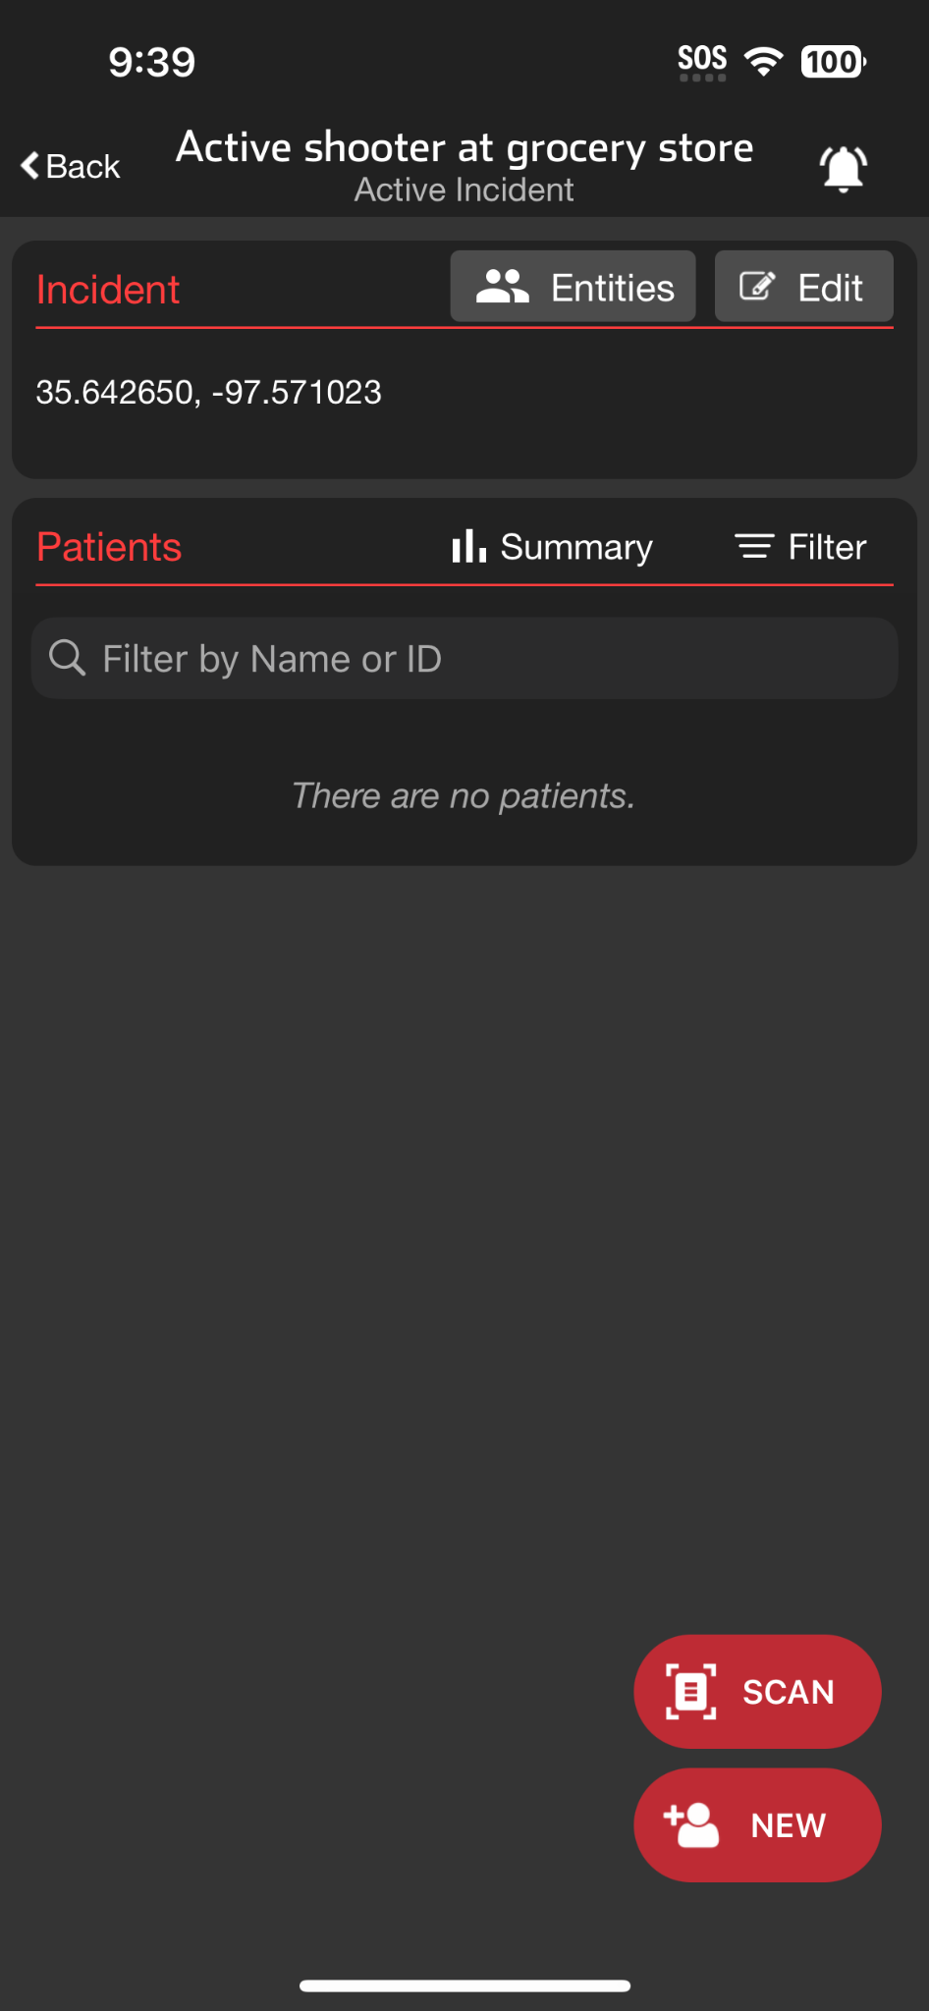
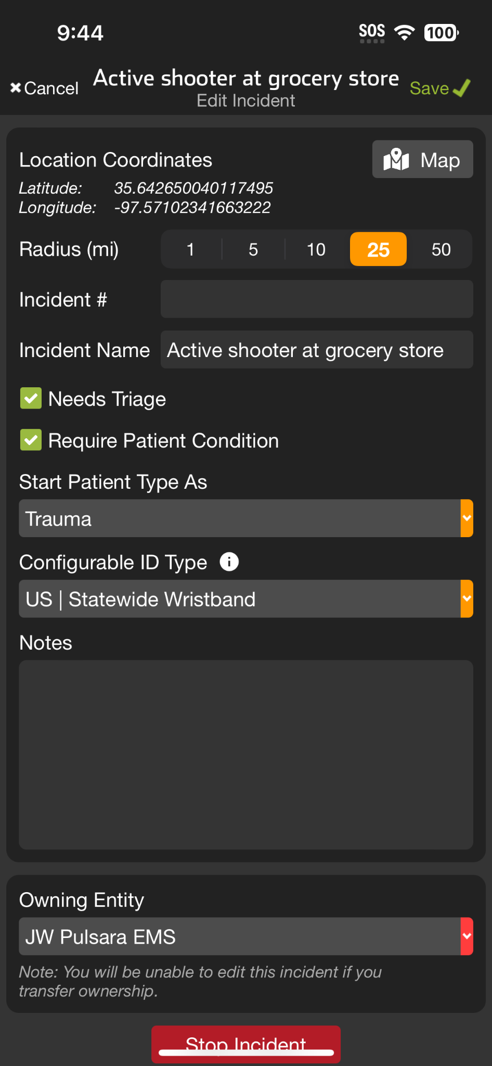




INCIDENTS | Incident Owner Privileges
Manage Entities
Others in region can See, Join, and Add Patients
Only able to see their patients unless granted additional privileges by Incident Owner
Separate tutorial will review in detail
Edit Incident
Edit details
Change Owning Entity
Stop Incident
Notes:
This tutorial will review incident owner privileges.
As an incident owner, you have the ability to add and grant additional privileges to other entities in the region. While these entities can see, join, and add patients to an incident, they can only view their own patients unless you grant them further access. For more details on managing entities, refer to the Manage Entities Tutorial.
Additionally, the incident owner has the authority to edit the incident. This includes editing the details of the incident, changing the owning entity, and stopping the incident when appropriate.

Slide 2
INCIDENTS | Incident Owner Privileges
Manage Entities
Others in region can See, Join, and Add Patients
Only able to see their patients unless granted additional privileges by Incident Owner
Separate tutorial will review in detail
Notes:
As an incident owner, you have the ability to add and grant additional privileges to other entities in the region. While these entities can see, join, and add patients to an incident, they can only view their own patients unless you grant them further access. For more details on managing entities, refer to the Manage Entities Tutorial.

Slide 3
INCIDENTS | Incident Owner Privileges
Manage Entities
Others in region can See, Join, and Add Patients
Only able to see their patients unless granted additional privileges by Incident Owner
Separate tutorial will review in detail
Edit Incident
Notes:
Additionally, the incident owner has the authority to edit the incident.

Slide 4
INCIDENTS | Incident Owner Privileges
Manage Entities
Others in region can See, Join, and Add Patients
Only able to see their patients unless granted additional privileges by Incident Owner
Separate tutorial will review in detail
Edit Incident
Edit details
Notes:
This includes editing the details of the incident,

Slide 5
INCIDENTS | Incident Owner Privileges
Manage Entities
Others in region can See, Join, and Add Patients
Only able to see their patients unless granted additional privileges by Incident Owner
Separate tutorial will review in detail
Edit Incident
Edit details
Change Owning Entity
Notes:
changing the owning entity,

Slide 6
INCIDENTS | Incident Owner Privileges
Manage Entities
Others in region can See, Join, and Add Patients
Only able to see their patients unless granted additional privileges by Incident Owner
Separate tutorial will review in detail
Edit Incident
Edit details
Change Owning Entity
Stop Incident
Notes:
and stopping the incident when appropriate.

