Slide 1

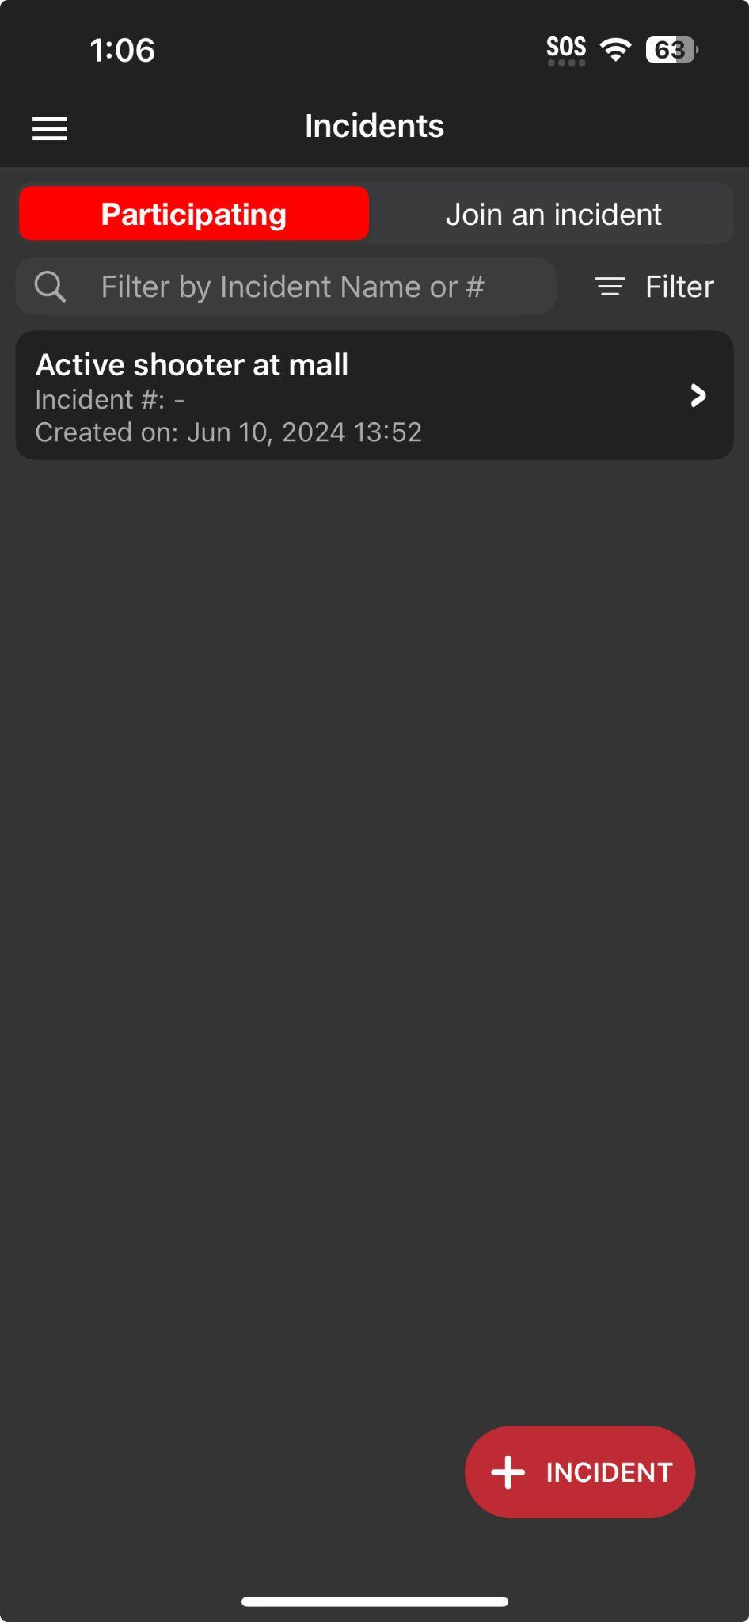
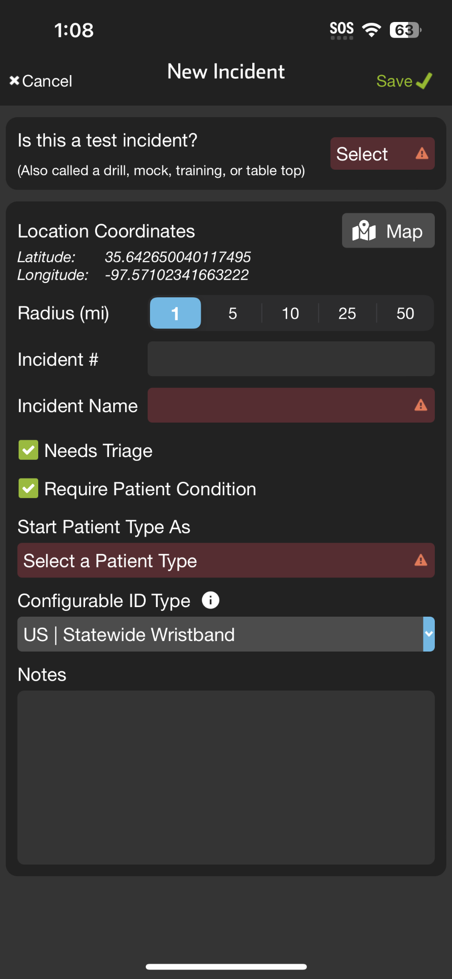




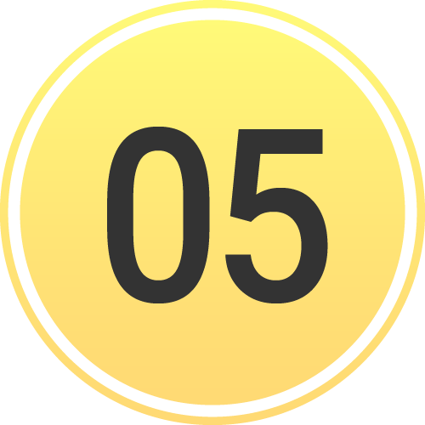



INCIDENTS | Create New Incident
Create New Incident
If not already participating or nearby
Tap + Incident
Select Test vs Real
Set Location
Defaults to current, Tap Map to adjust
Set Radius
Organizations can Join and Add Patients
Name Incident
Set Default Patient Channels
Triage Card / Require Condition
Patient Type
Configurable ID
US | Statewide Wristband or State Specific
All joining organizations “inherit” for interoperability
Save
Notes:
This tutorial will review how to create a new incident.
First, if you don’t see the appropriate incident in “Participating” or “Join an Incident,” you need to tap “Add Incident.” This will bring up a form that you will need to fill out.
Start by indicating whether this is a real or test incident. Next, set the location of the incident. The location will default to your current position, but you can tap the map to adjust it if necessary.
After setting the location, you will need to define the radius. Organizations within this radius will be able to see the incident, join it, and add patients. However, they will not be able to see the summary screen or any patients they don’t create unless you grant them these privileges. This process is covered in the “Manage Entities” section.
You will then name your incident and set your default patient channels. Selecting “Needs Triage” adds the triage card, and you can choose whether to require patient condition upon channel creation. Next, you will select your default patient type.
Finally, you need to set your Configurable ID type. Most locations will use “US | Statewide Wristband,” but some will have their state or region-specific barcode. Note that all organizations that join the incident will inherit this Configurable ID to ensure interoperability.
Make sure to save this form. After saving, ensure you are working within the incident to simplify your workflows.

Slide 2
INCIDENTS | Create New Incident
Create New Incident
If not already participating or nearby
Tap + Incident
Notes:
First, if you don’t see the appropriate incident in “Participating” or “Join an Incident,” you need to tap “Add Incident.”

Slide 3
INCIDENTS | Create New Incident
Create New Incident
If not already participating or nearby
Tap + Incident
Notes:
This will bring up a form that you will need to fill out.

Slide 4
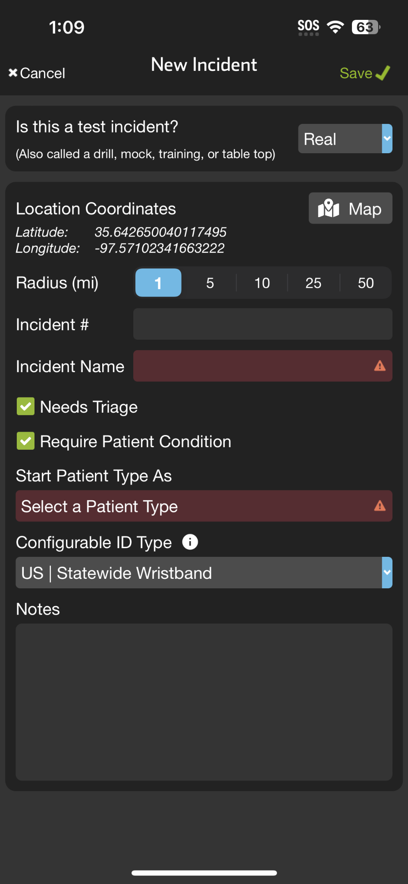
INCIDENTS | Create New Incident
Create New Incident
If not already participating or nearby
Tap + Incident
Select Test vs Real
Notes:
Start by indicating whether this is a real or test incident.

Slide 5
INCIDENTS | Create New Incident
Create New Incident
If not already participating or nearby
Tap + Incident
Select Test vs Real
Set Location
Defaults to current, Tap Map to adjust
Notes:
Next, set the location of the incident. The location will default to your current position, but you can tap the map to adjust it if necessary.

Slide 6
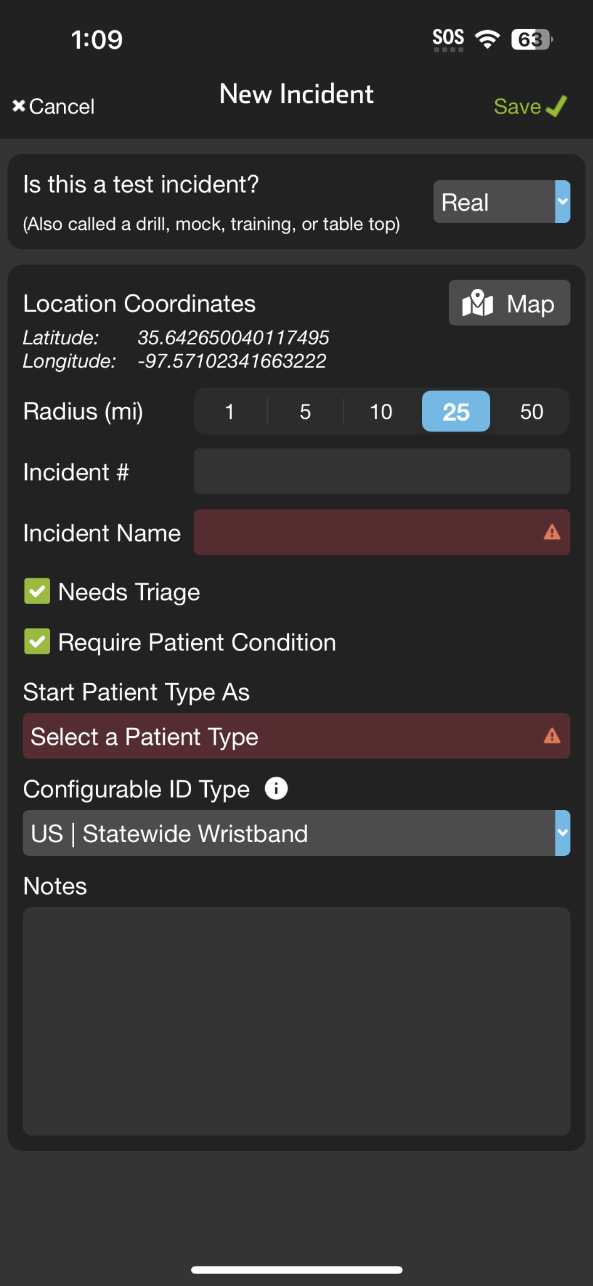
INCIDENTS | Create New Incident
Create New Incident
If not already participating or nearby
Tap + Incident
Select Test vs Real
Set Location
Defaults to current, Tap Map to adjust
Set Radius
Organizations can Join and Add Patients
Notes:
After setting the location, you will need to define the radius. Organizations within this radius will be able to see the incident, join it, and add patients. However, they will not be able to see the summary screen or any patients they don’t create unless you grant them these privileges. This process is covered in the “Manage Entities” section.

Slide 7
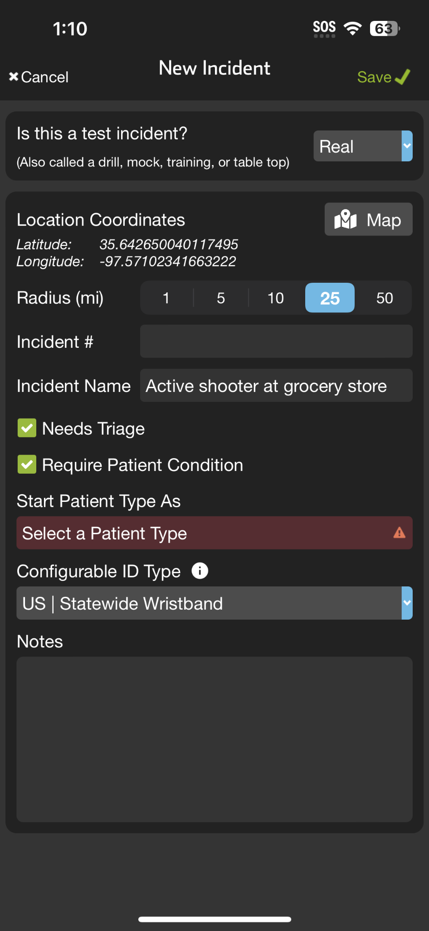
INCIDENTS | Create New Incident
Create New Incident
If not already participating or nearby
Tap + Incident
Select Test vs Real
Set Location
Defaults to current, Tap Map to adjust
Set Radius
Organizations can Join and Add Patients
Name Incident
Notes:
You will then name your incident

Slide 8
INCIDENTS | Create New Incident
Create New Incident
If not already participating or nearby
Tap + Incident
Select Test vs Real
Set Location
Defaults to current, Tap Map to adjust
Set Radius
Organizations can Join and Add Patients
Name Incident
Set Default Patient Channels
Triage Card / Require Condition
Notes:
and set your default patient channels. Selecting “Needs Triage” adds the triage card, and you can choose whether to require patient condition upon channel creation.

Slide 9
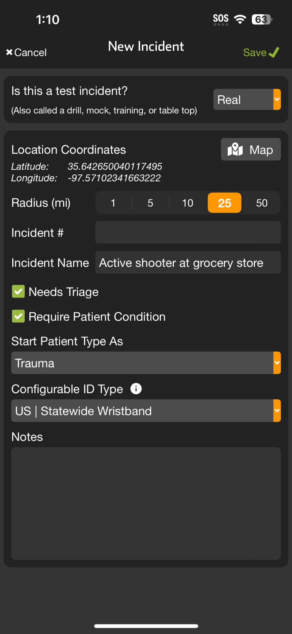
INCIDENTS | Create New Incident
Create New Incident
If not already participating or nearby
Tap + Incident
Select Test vs Real
Set Location
Defaults to current, Tap Map to adjust
Set Radius
Organizations can Join and Add Patients
Name Incident
Set Default Patient Channels
Triage Card / Require Condition
Patient Type
Notes:
Next, you select your default patient type.

Slide 10
INCIDENTS | Create New Incident
Create New Incident
If not already participating or nearby
Tap + Incident
Select Test vs Real
Set Location
Defaults to current, Tap Map to adjust
Set Radius
Organizations can Join and Add Patients
Name Incident
Set Default Patient Channels
Triage Card / Require Condition
Patient Type
Configurable ID
US | Statewide Wristband or State Specific
All joining organizations “inherit” for interoperability
Notes:
Finally, you need to set your Configurable ID type. Most locations will use “US | Statewide Wristband,” but some will have their state or region-specific barcode. Note that all organizations that join the incident will inherit this Configurable ID to ensure interoperability.

Slide 11
INCIDENTS | Create New Incident
Create New Incident
If not already participating or nearby
Tap + Incident
Select Test vs Real
Set Location
Defaults to current, Tap Map to adjust
Set Radius
Organizations can Join and Add Patients
Name Incident
Set Default Patient Channels
Triage Card / Require Condition
Patient Type
Configurable ID
US | Statewide Wristband or State Specific
All joining organizations “inherit” for interoperability
Save
Notes:
Make sure to save this form.

Slide 12
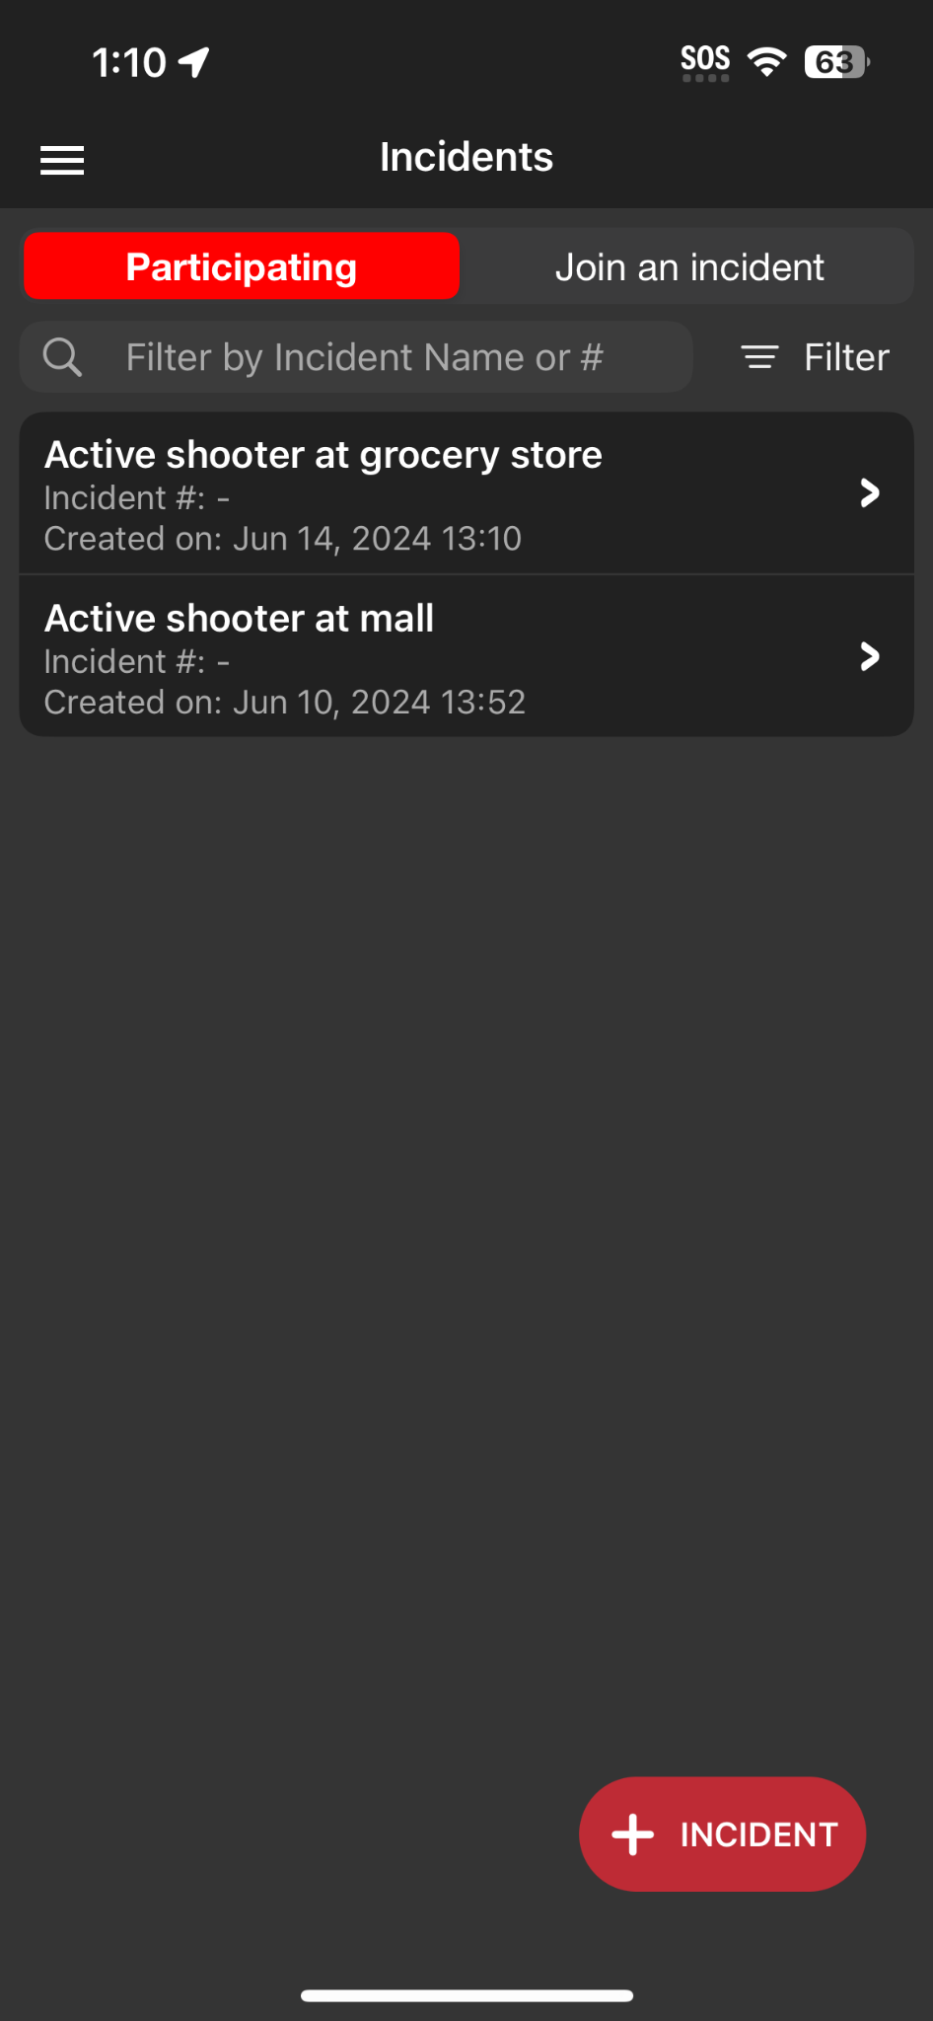
INCIDENTS | Create New Incident
Create New Incident
If not already participating or nearby
Tap + Incident
Select Test vs Real
Set Location
Defaults to current, Tap Map to adjust
Set Radius
Organizations can Join and Add Patients
Name Incident
Set Default Patient Channels
Triage Card / Require Condition
Patient Type
Configurable ID
US | Statewide Wristband or State Specific
All joining organizations “inherit” for interoperability
Save
Notes:
After saving, ensure you are working within the incident to simplify your workflows.

