Slide 1



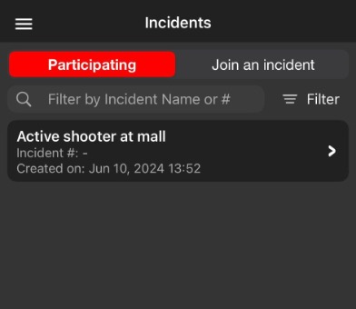
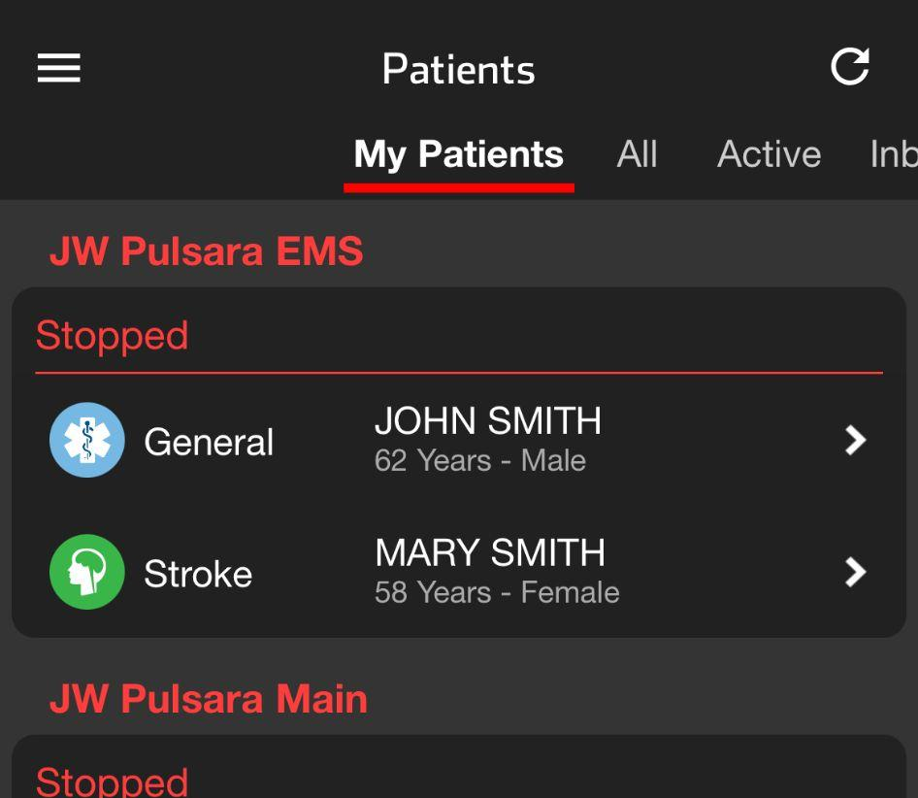



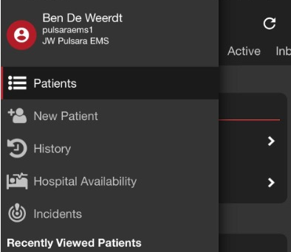
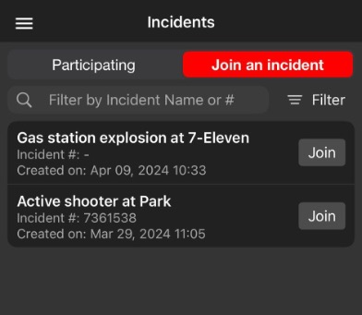



INCIDENTS | Participate & Join Incident
Patients Screen
This is what you will use daily
View your patients under My Patients
Incidents Screen
This screen groups patient channels under one Incident
Offers additional Incident functionality and workflows
To open, tap the Navigation Menu, then
tap Incidents
Identify and Work within Correct Incident
Participating shows Incidents you have joined
Tap incident to open
Join an Incident shows other Incidents in your area
Nearby Incidents
Tap Join to join an Incident
Notes:
Let’s discuss the difference between the Patients screen and the Incidents screen, and help you identify and work within the correct incident.
For everyday routine cases, you’ll use the Patients screen. This screen defaults to the My Patients view, which shows you all the patient channels you are participating in. The Incidents screen, on the other hand, groups patient channels by incident.
To see active incidents in your area, tap the navigation menu in the upper left-hand corner, then tap Incidents. This opens the Incidents screen. Here, you can access all incidents you are participating in, and view or join nearby incidents in your region.
It is important to identify and work within the correct incident. The screen defaults to the list of incidents you’re participating in. If you find the incident you are working on, simply tap on it to open. If you don’t see the appropriate incident, tap “Join an Incident.” This will list all nearby incidents. When you find the correct incident, tap “Join.”

Slide 2
INCIDENTS | Participate & Join Incident
Patients Screen
This is what you will use daily
View your patients under My Patients
Notes:
For everyday routine cases, you’ll use the Patients screen. This screen defaults to the My Patients view, which shows you all the patient channels you are participating in.

Slide 3
INCIDENTS | Participate & Join Incident
Patients Screen
This is what you will use daily
View your patients under My Patients
Incidents Screen
This screen groups patient channels under one Incident
Offers additional Incident functionality and workflows
Notes:
The Incidents screen, on the other hand, groups patient channels by incident, and offers additional functionality and workflows for incidents.

Slide 4
INCIDENTS | Participate & Join Incident
Patients Screen
This is what you will use daily
View your patients under My Patients
Incidents Screen
This screen groups patient channels under one Incident
Offers additional Incident functionality and workflows
To open, tap the Navigation Menu
Notes:
To see active incidents in your area, tap the navigation menu in the upper left-hand corner,

Slide 5
INCIDENTS | Participate & Join Incident
Patients Screen
This is what you will use daily
View your patients under My Patients
Incidents Screen
This screen groups patient channels under one Incident
Offers additional Incident functionality and workflows
To open, tap the Navigation Menu, then
tap Incidents
Notes:
Then tap Incidents.

Slide 6
INCIDENTS | Participate & Join Incident
Patients Screen
This is what you will use daily
View your patients under My Patients
Incidents Screen
This screen groups patient channels under one Incident
Offers additional Incident functionality and workflows
To open, tap the Navigation Menu, then
tap Incidents
Notes:
This opens the Incidents screen. Here, you can access all incidents you are participating in, and view or join nearby incidents in your region.

Slide 7
INCIDENTS | Participate & Join Incident
Patients Screen
This is what you will use daily
View your patients under My Patients
Incidents Screen
This screen groups patient channels under one Incident
Offers additional Incident functionality and workflows
To open, tap the Navigation Menu, then
tap Incidents
Identify and Work within Correct Incident
Notes:
It’s important to identify and work within the correct incident.

Slide 8
INCIDENTS | Participate & Join Incident
Patients Screen
This is what you will use daily
View your patients under My Patients
Incidents Screen
This screen groups patient channels under one Incident
Offers additional Incident functionality and workflows
To open, tap the Navigation Menu, then
tap Incidents
Identify and Work within Correct Incident
Participating shows Incidents you have joined
Notes:
The screen defaults to the list of incidents you’re participating in.

Slide 9
INCIDENTS | Participate & Join Incident
Patients Screen
This is what you will use daily
View your patients under My Patients
Incidents Screen
This screen groups patient channels under one Incident
Offers additional Incident functionality and workflows
To open, tap the Navigation Menu, then
tap Incidents
Identify and Work within Correct Incident
Participating shows Incidents you have joined
Tap incident to open
Notes:
If you find the incident you are working on, simply tap on it to open.

Slide 10
INCIDENTS | Participate & Join Incident
Patients Screen
This is what you will use daily
View your patients under My Patients
Incidents Screen
This screen groups patient channels under one Incident
Offers additional Incident functionality and workflows
To open, tap the Navigation Menu, then
tap Incidents
Identify and Work within Correct Incident
Participating shows Incidents you have joined
Tap incident to open
Join an Incident shows other Incidents in your area
Nearby Incidents
Notes:
If you don’t see the appropriate incident, tap “Join an Incident.” This will list all nearby incidents.

Slide 11
INCIDENTS | Participate & Join Incident
Patients Screen
This is what you will use daily
View your patients under My Patients
Incidents Screen
This screen groups patient channels under one Incident
Offers additional Incident functionality and workflows
To open, tap the Navigation Menu, then
tap Incidents
Identify and Work within Correct Incident
Participating shows Incidents you have joined
Tap incident to open
Join an Incident shows other Incidents in your area
Nearby Incidents
Tap Join to join an Incident
Notes:
When you find the correct incident, tap “Join.”

