Slide 1


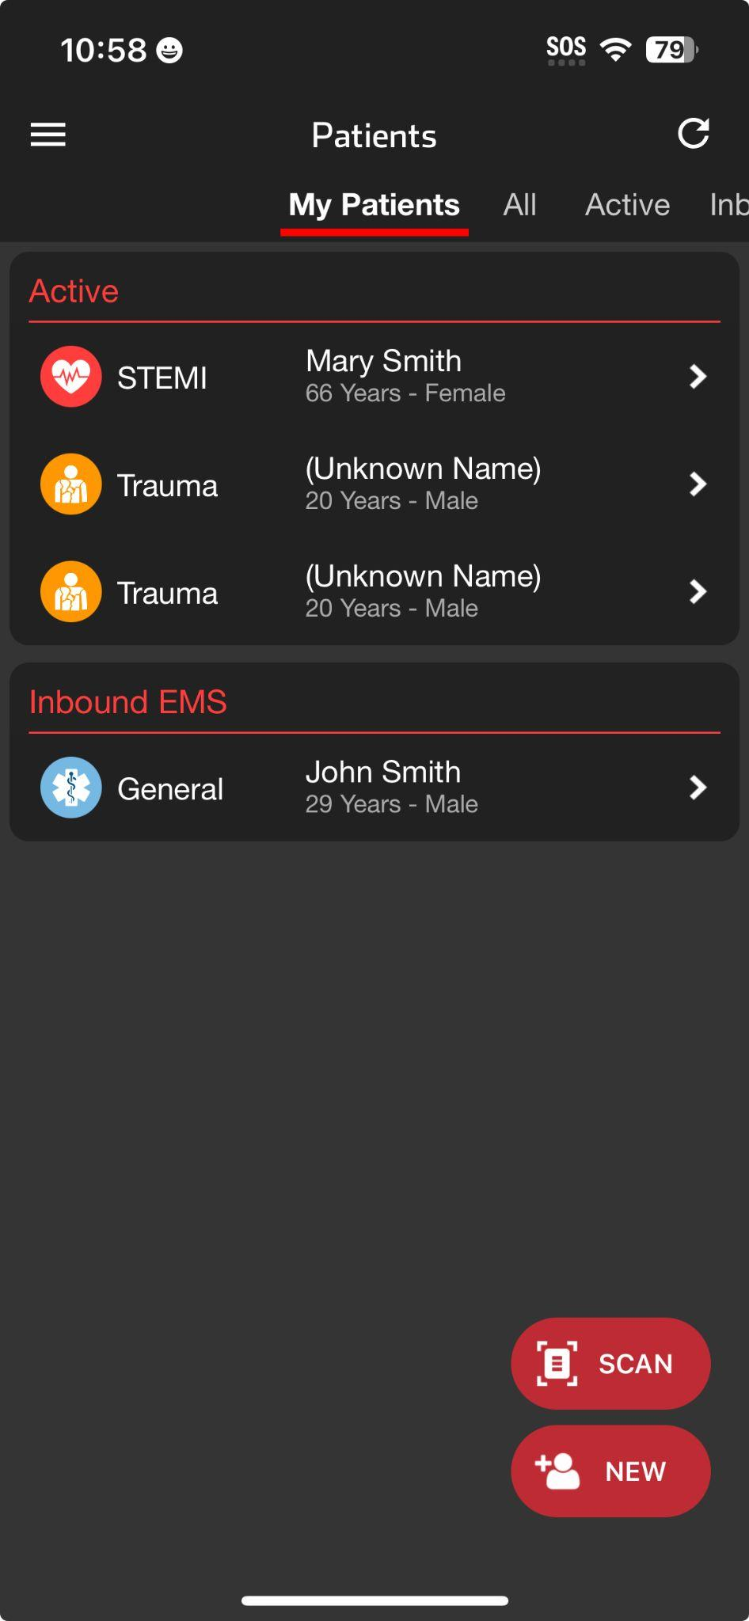
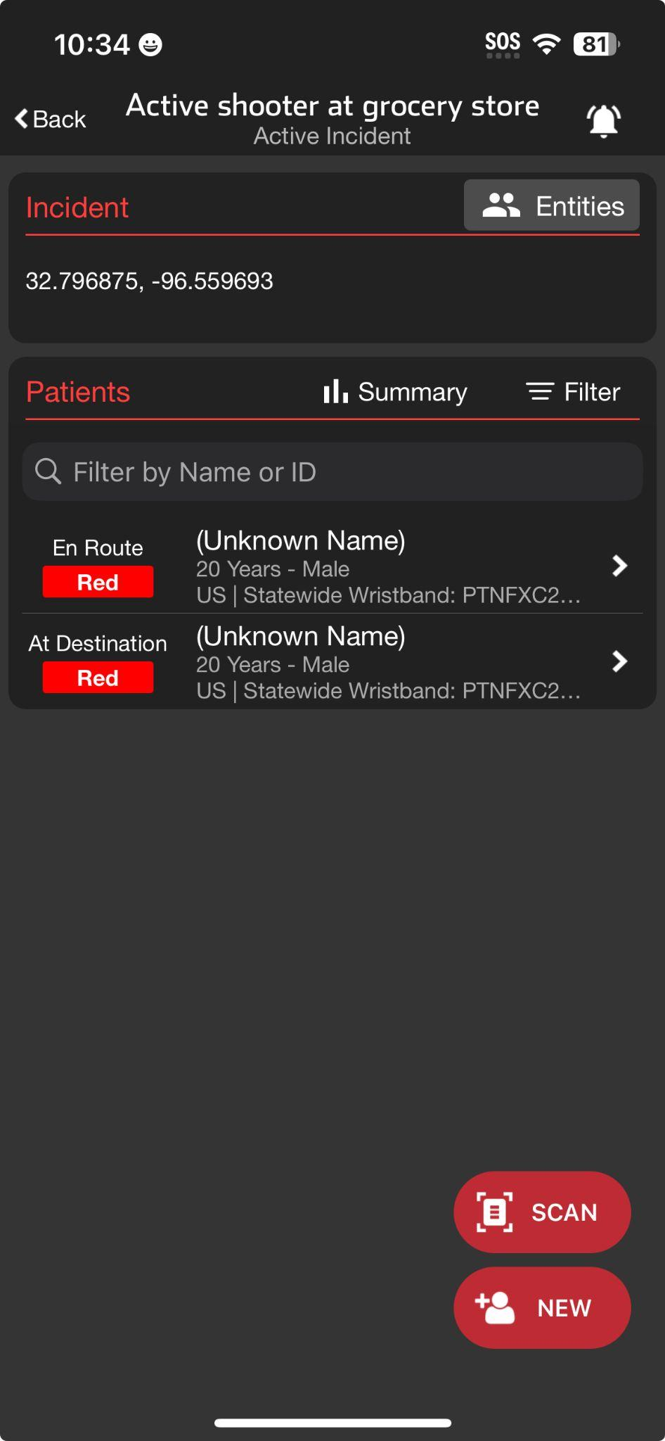




INCIDENTS | Using Mobile Devices During an Incident
Patient List View
Incident View
Patient List View
Daily Use
My Patients and All Patients at My Organization(s)
Incident View
Tap Menu, then Incidents
Groups patient channels within an Incident
  My entity’s patients
  All incident patients (Reunification Center)
View participating entities and privileges
Manage alerts for entire incident
Summary (Command View located on Web)
Prehospital Notifications
Notified about New Incident
Supplements other regional notifications if enabled
Will receive notifications about new patients even if not added to incident
Option: Team is notified regardless of call status
Notified about New Inbound EMS
Unchanged from daily unless incident alerts are muted
Notes:
Let’s go over the use of mobile devices, such as smartphones and tablets, during an incident.
The main screen you use daily is the Patient List View. This screen provides access to My Patients, where you can view patients you are currently assigned, and All Patients, which includes all patients at your entity or multiple entities if you have privileges at different organizations.
To access the Incident View, tap the menu and select “Incidents.” Here, you will see all incidents involving your entity. Note that you must be invited by Incident Command for the incident to appear in this view. Once you select the appropriate incident, you can view all patients en route to, consulted, or at your entity. Some entities, like a Reunification Center, may have privileges to see all patients associated with the incident. You can view all participating entities and their privileges by tapping Entities.
You can always silence alerts for an individual patient by tapping the bell icon within that patient’s channel. However, you can also silence alerts for an entire incident by tapping the bell icon in the main Incident View. This alert management is done at the individual device and user level which helps entities and departments manage alarm fatigue while ensuring critical alerts are not missed.
The Incident Summary shows patient counts broken down by condition and general location. For a more detailed view, including breakdowns by destination facility, access the Command View via the web.
Teams can be enabled to receive notifications about new incidents in the region which can supplement other established regional notifications. Entities can also enable teams to receive alerts regardless of their call status.
In line with using the same tools daily that we use during an incident, receiving prehospital notifications about new inbound patients during an incident on mobile devices remains unchanged from the daily process.
In larger Emergency Departments, a blended environment is common. Individuals needing broader situational awareness and responsible for receiving notifications about new patients typically access Pulsara via the web on a computer. Mobile users working in the Emergency Department might use Patient View, while those focused on the incident, especially those responsible for arriving patients or adding walk-in patients to an incident, may find Incident View more helpful.

Slide 2
INCIDENTS | Using Mobile Devices During an Incident
Patient List View
Patient List View
Daily Use
My Patients and All Patients at My Organization(s)
Notes:
The main screen you use daily is the Patients List View. This screen provides access to My Patients, where you can view patients you are currently assigned,

Slide 3
INCIDENTS | Using Mobile Devices During an Incident
Patient List View
Patient List View
Daily Use
My Patients and All Patients at My Organization(s)
Notes:
and All Patients, which includes all patients at your entity or multiple entities if you have privileges at different organizations.

Slide 4
INCIDENTS | Using Mobile Devices During an Incident
Patient List View
Patient List View
Daily Use
My Patients and All Patients at My Organization(s)
Incident View
Tap Menu
Notes:
To access the Incident View, tap the menu

Slide 5
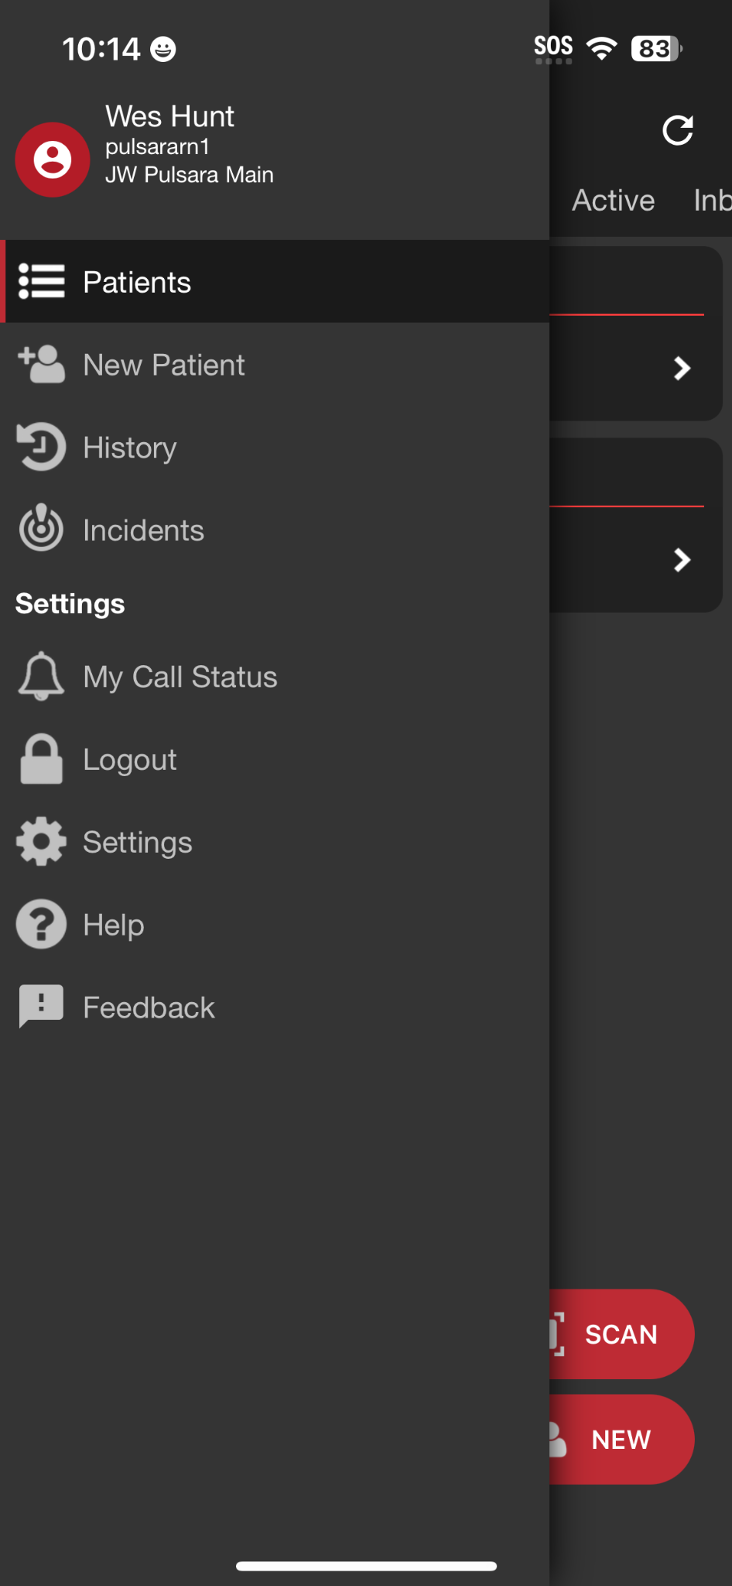
INCIDENTS | Using Mobile Devices During an Incident
Patient List View
Patient List View
Daily Use
My Patients and All Patients at My Organization(s)
Incident View
Tap Menu, then Incidents
Notes:
and select Incidents.

Slide 6
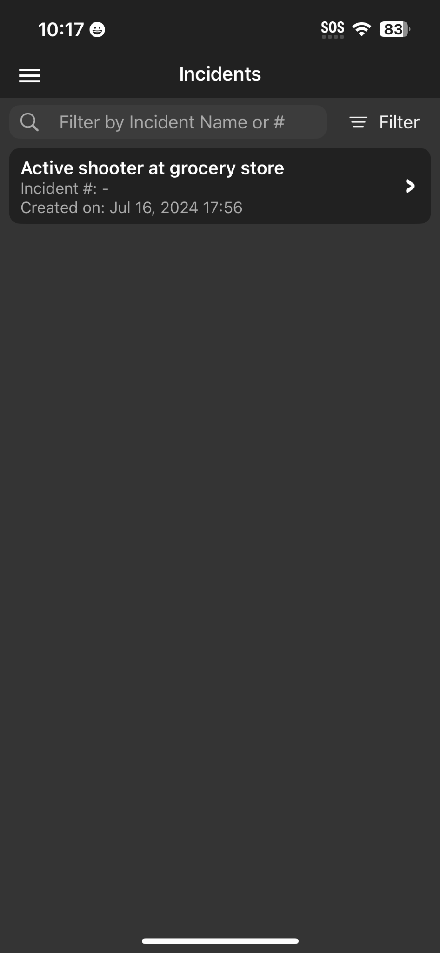
INCIDENTS | Using Mobile Devices During an Incident
Incident View
Patient List View
Daily Use
My Patients and All Patients at My Organization(s)
Incident View
Tap Menu, then Incidents
Notes:
Here, you will see all incidents involving your entity. Note that you must be invited by Incident Command for the incident to appear in this view. Once you select the appropriate incident

Slide 7
INCIDENTS | Using Mobile Devices During an Incident
Incident View
Patient List View
Daily Use
My Patients and All Patients at My Organization(s)
Incident View
Tap Menu, then Incidents
Groups patient channels within an Incident
  My entity’s patients
  All incident patients (Reunification Center)
Notes:
you can view all patients en route to, consulted, or at your entity. Some entities, like a Reunification Center, may have privileges to see all patients associated with the incident.

Slide 8
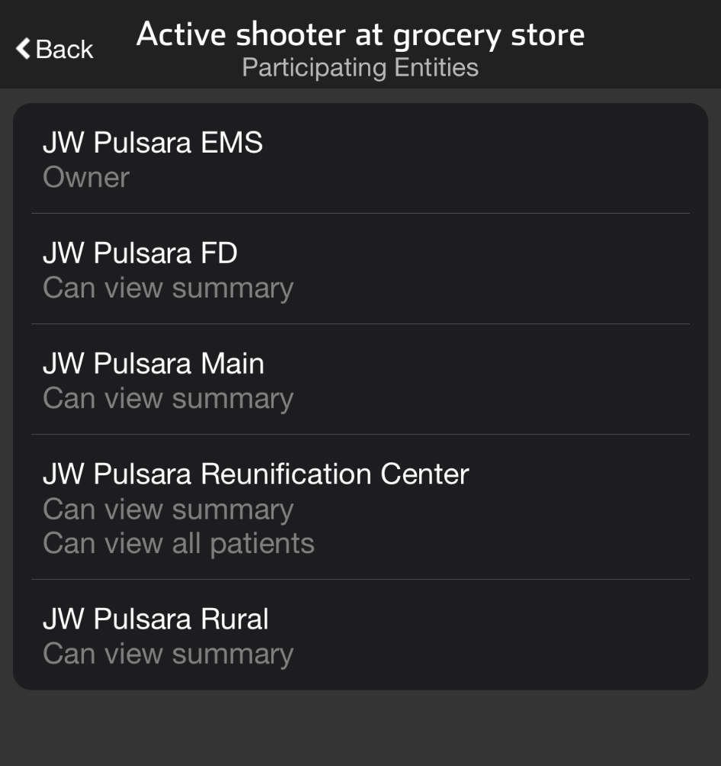
INCIDENTS | Using Mobile Devices During an Incident
Incident View
Patient List View
Daily Use
My Patients and All Patients at My Organization(s)
Incident View
Tap Menu, then Incidents
Groups patient channels within an Incident
  My entity’s patients
  All incident patients (Reunification Center)
View participating entities and privileges
Notes:
You can view all participating entities and their privileges by tapping Entities.

Slide 9
INCIDENTS | Using Mobile Devices During an Incident
Incident View
Patient List View
Daily Use
My Patients and All Patients at My Organization(s)
Incident View
Tap Menu, then Incidents
Groups patient channels within an Incident
  My entity’s patients
  All incident patients (Reunification Center)
View participating entities and privileges
Manage alerts for entire incident
Notes:
You can always silence alerts for an individual patient by tapping the bell icon within that patient’s channel.

Slide 10
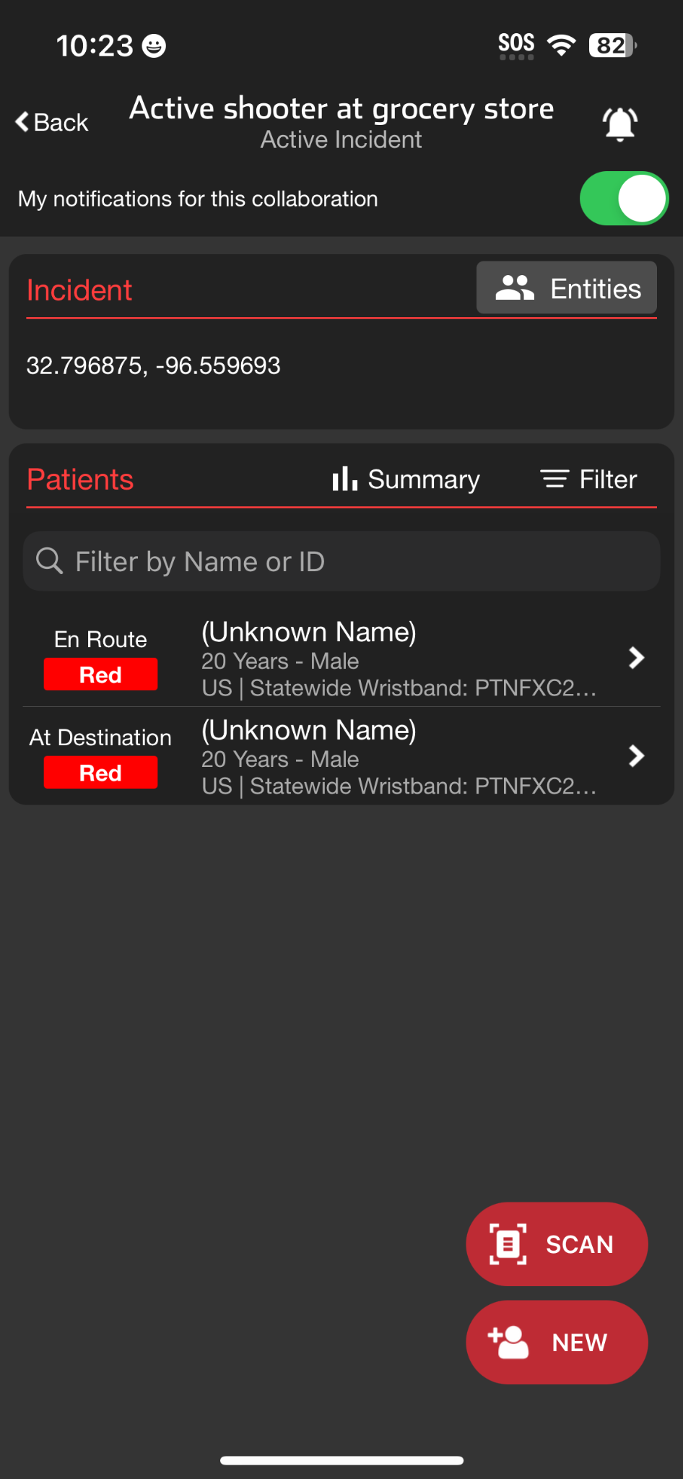
INCIDENTS | Using Mobile Devices During an Incident
Incident View
Patient List View
Daily Use
My Patients and All Patients at My Organization(s)
Incident View
Tap Menu, then Incidents
Groups patient channels within an Incident
  My entity’s patients
  All incident patients (Reunification Center)
View participating entities and privileges
Manage alerts for entire incident
Notes:
However, you can also silence alerts for an entire incident by tapping the bell icon in the main Incident View. This alert management is done at the individual device and user level which helps entities and departments manage alarm fatigue while ensuring critical alerts are not missed.

Slide 11
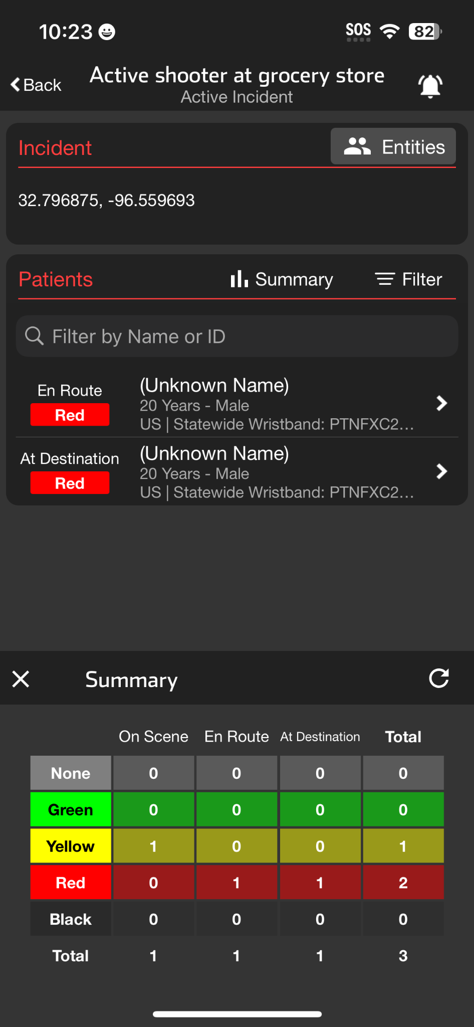
INCIDENTS | Using Mobile Devices During an Incident
Incident View
Patient List View
Daily Use
My Patients and All Patients at My Organization(s)
Incident View
Tap Menu, then Incidents
Groups patient channels within an Incident
  My entity’s patients
  All incident patients (Reunification Center)
View participating entities and privileges
Manage alerts for entire incident
Summary (Command View located on Web)
Notes:
The Incident Summary shows patient counts broken down by condition and general location. For a more detailed view, including breakdowns by destination facility, access the Command View via the web.

Slide 12
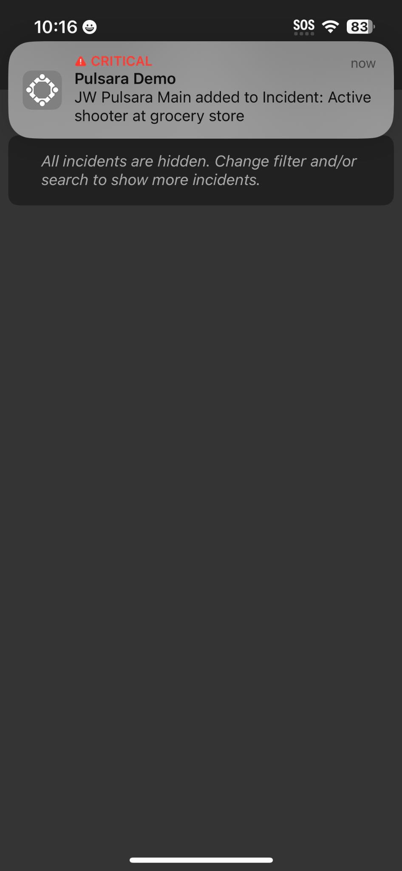
INCIDENTS | Using Mobile Devices During an Incident
Incident View
Patient List View
Daily Use
My Patients and All Patients at My Organization(s)
Incident View
Tap Menu, then Incidents
Groups patient channels within an Incident
  My entity’s patients
  All incident patients (Reunification Center)
View participating entities and privileges
Manage alerts for entire incident
Summary (Command View located on Web)
Prehospital Notifications
Notified about New Incident
Supplements other regional notifications if enabled
Will receive notifications about new patients even if not added to incident
Option: Team is notified regardless of call status
Notes:
Teams can be enabled to receive notifications about new incidents in the region which can supplement other established regional notifications. Entities can also enable teams to receive alerts regardless of their call status.

Slide 13
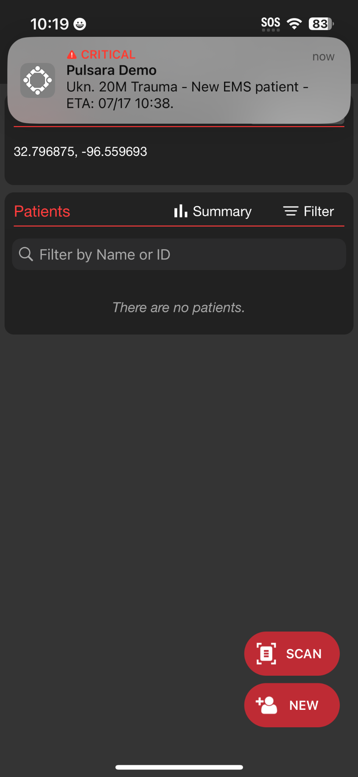
INCIDENTS | Using Mobile Devices During an Incident
Incident View
Patient List View
Daily Use
My Patients and All Patients at My Organization(s)
Incident View
Tap Menu, then Incidents
Groups patient channels within an Incident
  My entity’s patients
  All incident patients (Reunification Center)
View participating entities and privileges
Manage alerts for entire incident
Summary (Command View located on Web)
Prehospital Notifications
Notified about New Incident
Supplements other regional notifications if enabled
Will receive notifications about new patients even if not added to incident
Option: Team is notified regardless of call status
Notified about New Inbound EMS
Unchanged from daily unless incident alerts are muted
Notes:
In line with using the same tools daily that we use during an incident, receiving prehospital notifications about new inbound patients during an incident on mobile devices remains unchanged from the daily process.

Slide 14
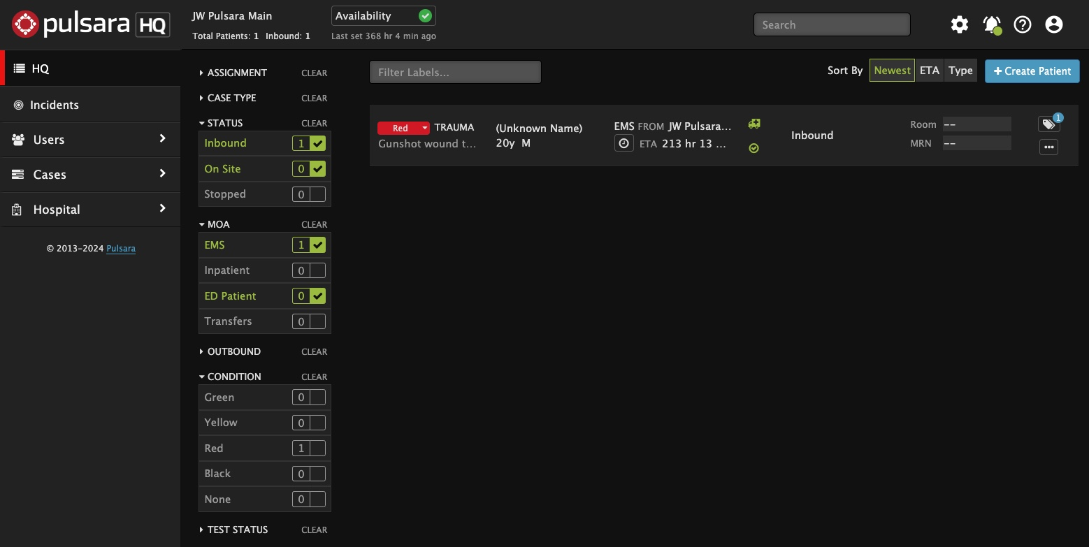
INCIDENTS | Using Mobile Devices During an Incident
Patient List View
Daily Use
My Patients and All Patients at My Organization(s)
Incident View
Tap Menu, then Incidents
Groups patient channels within an Incident
  My entity’s patients
  All incident patients (Reunification Center)
View participating entities and privileges
Manage alerts for entire incident
Summary (Command View located on Web)
Prehospital Notifications
Notified about New Incident
Supplements other regional notifications if enabled
Will receive notifications about new patients even if not added to incident
Option: Team is notified regardless of call status
Notified about New Inbound EMS
Unchanged from daily unless incident alerts are muted
Notes:
In larger Emergency Departments, a blended environment is common. Individuals needing broader situational awareness and responsible for receiving notifications about new patients typically access Pulsara via the web on a computer.

Slide 15
INCIDENTS | Using Mobile Devices During an Incident
Patient List View
Incident View
Patient List View
Daily Use
My Patients and All Patients at My Organization(s)
Incident View
Tap Menu, then Incidents
Groups patient channels within an Incident
  My entity’s patients
  All incident patients (Reunification Center)
View participating entities and privileges
Manage alerts for entire incident
Summary (Command View located on Web)
Prehospital Notifications
Notified about New Incident
Supplements other regional notifications if enabled
Will receive notifications about new patients even if not added to incident
Option: Team is notified regardless of call status
Notified about New Inbound EMS
Unchanged from daily unless incident alerts are muted
Notes:
Mobile users working in the emergency department might use Patient View, while those focused on the incident, especially those responsible for arriving patients or adding walk-in patients to an incident, may find Incident View more helpful.

