Slide 1








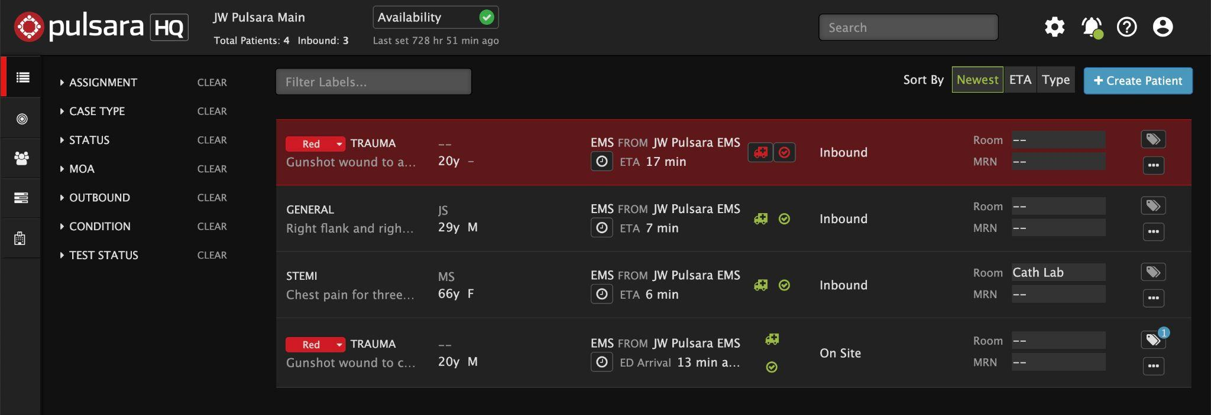
INCIDENTS | Prehospital Notifications During an Incident
New Patients
Same as Daily Prehospital Notifications
  Flash Red
  Audible Alert (if enabled)
Sort by Newest
Triage Color (Incident Related Patient)
Chief Complaint | Narrative
“Hover to Discover”
View Additional Details
Tap “...”
OPTIONAL
Set Room Number
EMS and Forward Triage will be able to see upon patient arrival if room is reserved
Update Availability
Transport Officer / EMS will be able to see in workflow when selecting facilities
Adjust Audible Alerts - if needed
Notes:
Let’s discuss how to receive a prehospital notification about an inbound EMS patient during an incident.
This process remains essentially unchanged from your daily routine. For situational awareness of the ongoing event, you can keep the command view open in a separate window to see a summary of the overall incident while continuing to manage your Emergency Department from Pulsara HQ.
When EMS selects your facility as a destination, the new patient channel will appear and flash red. If you have audible alerts enabled, you will also receive an alert. It is helpful to sort by the newest channels to ensure the new ones are always at the top. Please note that ETAs can be slightly inaccurate if EMS selects your facility but does not immediately transport the patient. You may receive both incident-related and non-incident-related notifications from inbound EMS units. A quick way to differentiate is that Incident-related patients are typically marked with a triage color. You can hover over the chief complaint or narrative section and tap the ellipsis to discover additional patient details.
That’s the core functionality you’ll use. Now, let’s dive into some additional features you can use to help optimize your workflow.
In larger incidents, many Emergency Departments establish a forward retriage area to better control their department. If it fits your workflow, you can pre-assign room numbers so both EMS and the forward triage team know their destination upon arrival. This can always be adjusted and communicated upon arrival as determined by the retriage assessment.
In some regions, Emergency Departments update their availability so Transport Officers or EMS can better understand their facility’s status in real time. This information helps them select destinations and load balance patients more effectively. If a patient from the incident presents directly to your facility, you can create a new patient channel for them and add them to the incident for complete situational awareness, without making phone calls. This will be reflected in the Command View.
If you have audible alerts enabled, but don’t need them because someone closely monitors this screen, you can silence these alerts by tapping the bell icon. In a separate topic, we’ll cover how to silence audible alerts on mobile during an incident.
ORIGINAL:
This tutorial will review how to receive a prehospital notification about an inbound EMS patient during a Mass Casualty Incident (MCI).
Fortunately, from a product perspective, this process remains essentially unchanged from your daily routine. For situational awareness of the ongoing event, you can keep the command view open in a separate window to see a summary of the overall incident while continuing to manage your Emergency Department from Pulsara HQ.
When EMS selects your facility as a destination, the new patient channel will appear and flash red. If you have audible alerts enabled, you will also receive an alert. It is helpful to sort by the newest channels to ensure the new ones are always at the top. Please note that ETAs can be slightly inaccurate if EMS selects your facility but does not immediately transport the patient. You may receive both incident-related and non-incident-related notifications from inbound EMS units and the incident-related patients are typically marked with a triage color. As always, you can hover over the chief complaint or narrative section and tap the ellipsis to discover additional patient details.
This represents your core functionality, but now we will cover some additional options you can use to help optimize your workflow.
In larger incidents, many Emergency Departments establish a forward retriage area to better control their department. Optionally, you can pre-assign room numbers so both EMS and the forward triage team know their destination upon arrival. This can always be adjusted and communicated upon arrival as determined by the retriage assessment.
In some regions, Emergency Departments update their availability so Transport Officers or EMS can better understand your facility’s status in realtime. This information helps them select destinations and load balance patients more effectively. Remember, patients presenting directly to your facility can be created and added to the incident for complete situational awareness without making phone calls as this is reflected in the Command View.
Finally, if you have audible alerts enabled and someone closely monitors this screen, you can silence these alerts by tapping the bell icon. How to silence audible alerts on mobile during an incident will be covered in a separate topic.

Slide 2
INCIDENTS | Prehospital Notifications During an Incident
New Patients
Same as Daily Prehospital Notifications
  Flash Red
  Audible Alert (if enabled)
Notes:
When EMS selects your facility as a destination, the new patient channel will appear and flash red. If you have audible alerts enabled, you will also receive an alert.

Slide 3
INCIDENTS | Prehospital Notifications During an Incident
New Patients
Same as Daily Prehospital Notifications
  Flash Red
  Audible Alert (if enabled)
Sort by Newest
Notes:
It is helpful to sort by the newest channels to ensure the new ones are always at the top. Please note that ETAs can be slightly inaccurate if EMS selects your facility but does not immediately transport the patient.

Slide 4
INCIDENTS | Prehospital Notifications During an Incident
New Patients
Same as Daily Prehospital Notifications
  Flash Red
  Audible Alert (if enabled)
Sort by Newest
Triage Color (Incident Related Patient)
Notes:
You may receive both incident-related and non-incident-related notifications from inbound EMS units. A quick way to differentiate is that Incident-related patients are typically marked with a triage color.

Slide 5
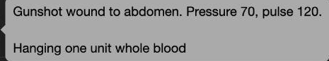
INCIDENTS | Prehospital Notifications During an Incident
New Patients
Same as Daily Prehospital Notifications
  Flash Red
  Audible Alert (if enabled)
Sort by Newest
Triage Color (Incident Related Patient)
Chief Complaint | Narrative
“Hover to Discover”
Notes:
You can hover over the chief complaint or narrative section

Slide 6
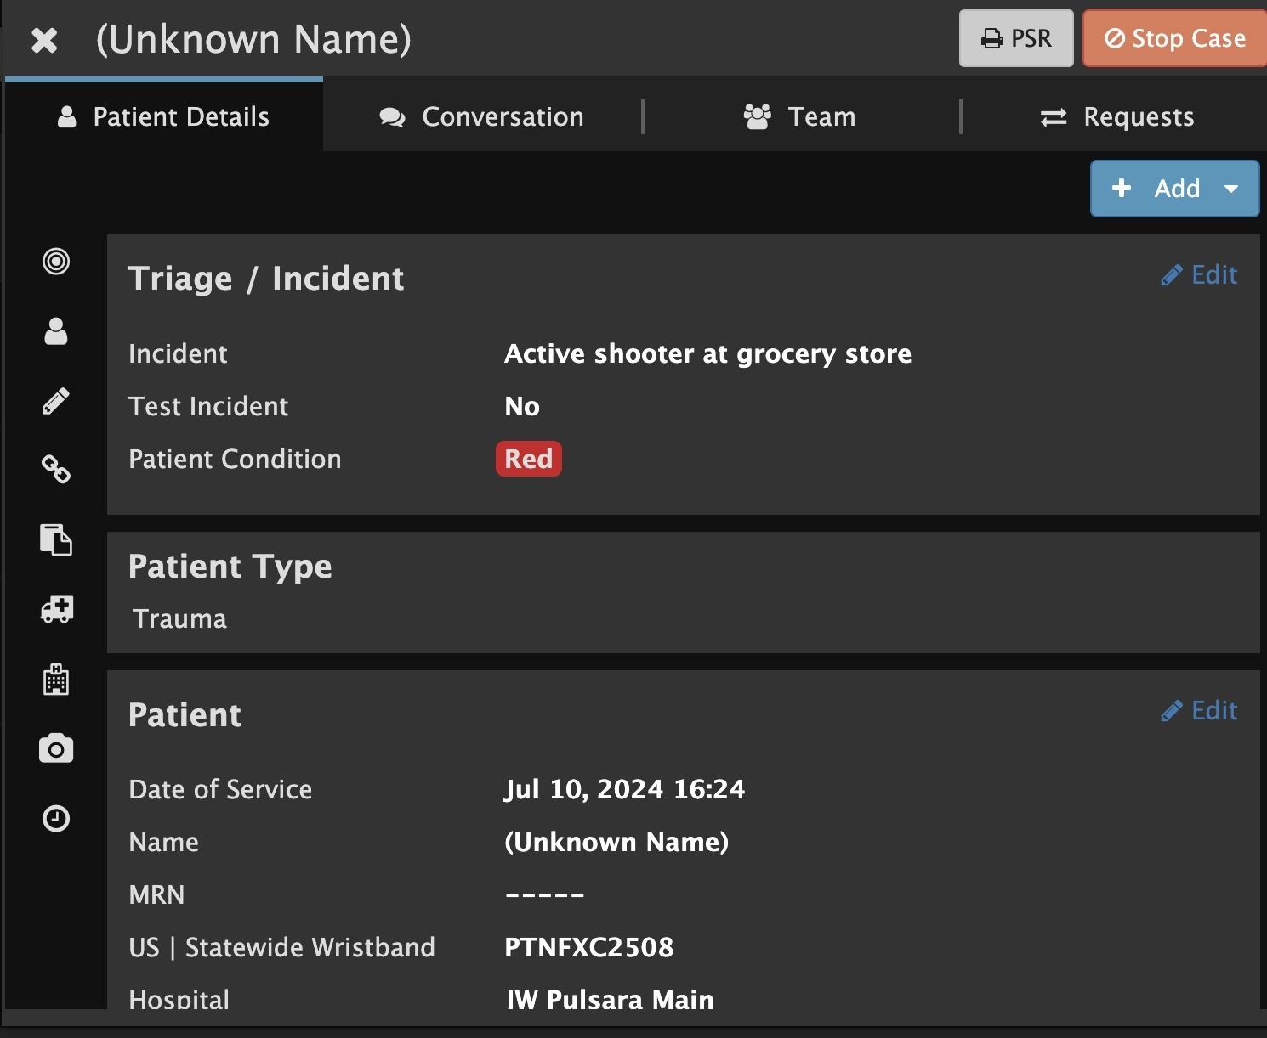
INCIDENTS | Prehospital Notifications During an Incident
New Patients
Same as Daily Prehospital Notifications
  Flash Red
  Audible Alert (if enabled)
Sort by Newest
Triage Color (Incident Related Patient)
Chief Complaint | Narrative
“Hover to Discover”
View Additional Details
Tap “...”
Notes:
and tap the ellipsis to discover additional patient details.
That’s the core functionality you’ll use. Now, let’s dive into some additional features you can use to help optimize your workflow.

Slide 7
INCIDENTS | Prehospital Notifications During an Incident
New Patients
Same as Daily Prehospital Notifications
  Flash Red
  Audible Alert (if enabled)
Sort by Newest
Triage Color (Incident Related Patient)
Chief Complaint | Narrative
“Hover to Discover”
View Additional Details
Tap “...”
OPTIONAL
Set Room Number
EMS and Forward Triage will be able to see upon patient arrival if room is reserved
Notes:
In larger incidents, many Emergency Departments establish a forward retriage area to better control their department. If it fits your workflow, you can pre-assign room numbers so both EMS and the forward triage team know their destination upon arrival. This can always be adjusted and communicated upon arrival as determined by the retriage assessment.

Slide 8
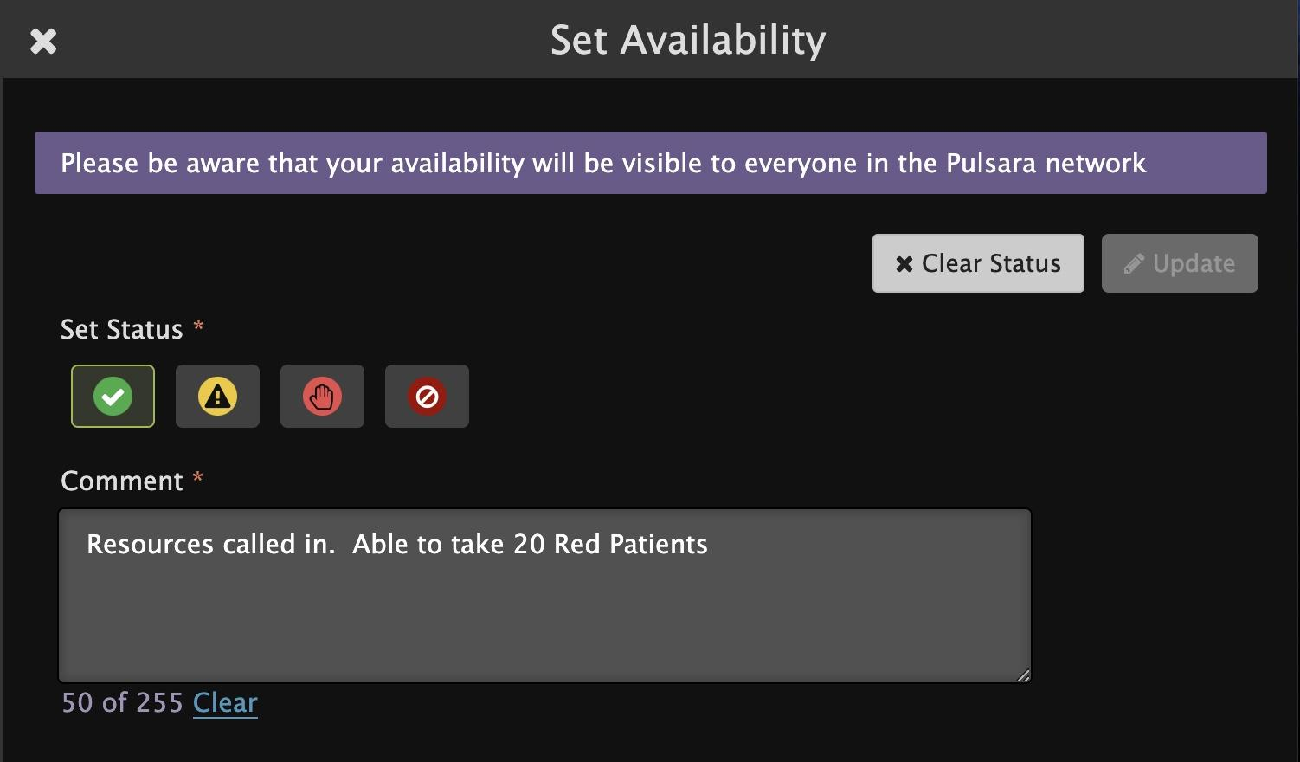
INCIDENTS | Prehospital Notifications During an Incident
New Patients
Same as Daily Prehospital Notifications
  Flash Red
  Audible Alert (if enabled)
Sort by Newest
Triage Color (Incident Related Patient)
Chief Complaint | Narrative
“Hover to Discover”
View Additional Details
Tap “...”
OPTIONAL
Set Room Number
EMS and Forward Triage will be able to see upon patient arrival if room is reserved
Update Availability
Transport Officer / EMS will be able to see in workflow when selecting facilities
Notes:
In some regions, Emergency Departments update their availability so Transport Officers or EMS can better understand their facility’s status in real time. This information helps them select destinations and load balance patients more effectively. If a patient from the incident presents directly to your facility, you can create a new patient channel for them and add them to the incident for complete situational awareness, without making phone calls. This will be reflected in the Command View.

Slide 9
INCIDENTS | Prehospital Notifications During an Incident
New Patients
Same as Daily Prehospital Notifications
  Flash Red
  Audible Alert (if enabled)
Sort by Newest
Triage Color (Incident Related Patient)
Chief Complaint | Narrative
“Hover to Discover”
View Additional Details
Tap “...”
OPTIONAL
Set Room Number
EMS and Forward Triage will be able to see upon patient arrival if room is reserved
Update Availability
Transport Officer / EMS will be able to see in workflow when selecting facilities
Adjust Audible Alerts - if needed
Notes:
If you have audible alerts enabled, but don’t need them because someone closely monitors this screen, you can silence these alerts by tapping the bell icon. In a separate topic, we’ll cover how to silence audible alerts on mobile during an incident.

