Slide 1
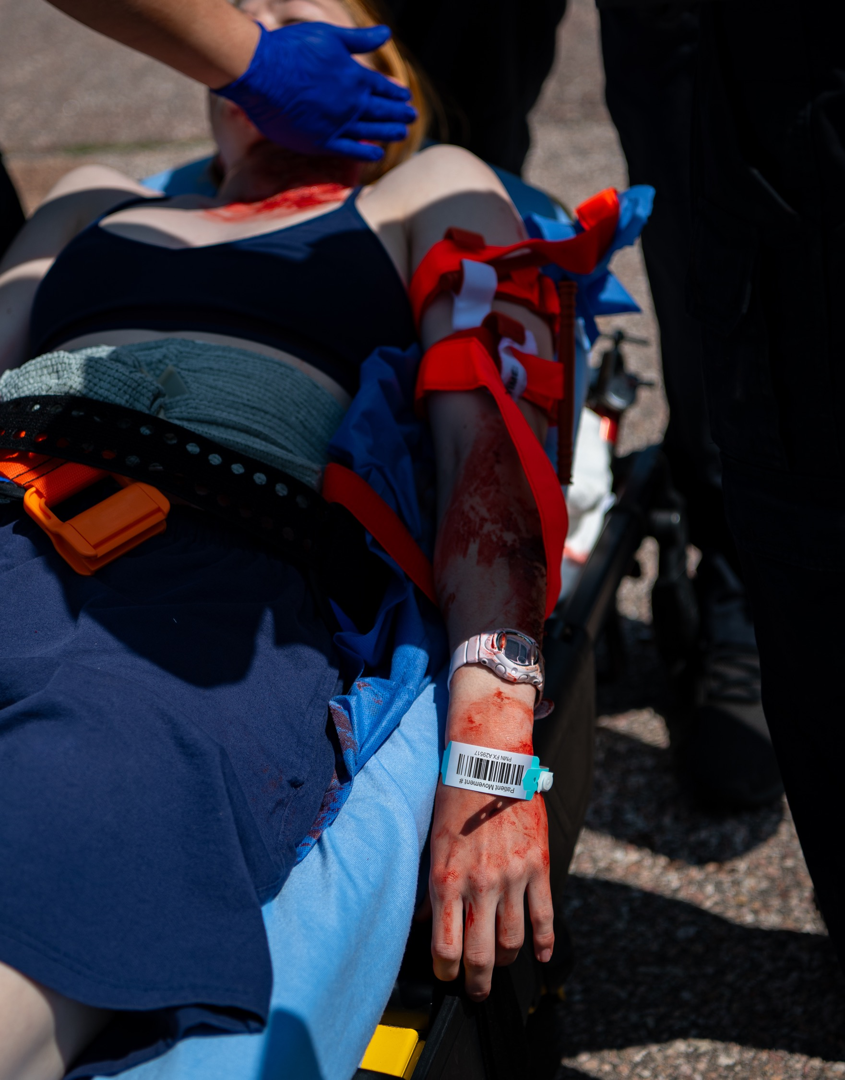
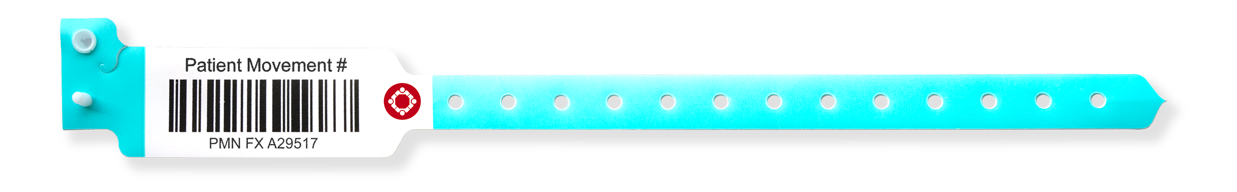
Patient Movement Wristbands
OBJECTIVES
Critical component of robust Patient Movement System
Statewide | National Interoperability
  Daily EMS to ED
  Incidents
Identify, find, move, hand off, and track “John & Jane Doe” patients
DAILY USE BENEFITS
Simplified “Scan and go” patient hand off
Unique ID from First Medical Contact to Definitive Treatment
Build Muscle Memory for Incidents
INCIDENT BENEFITS
Enable real-time situational awareness on the number and severity of patient encounters
Eliminate duplicate patients
Creates self-healing patient movement system in chaotic environments with variable connectivity
Notes:
Patient Movement Wristbands are a critical component of a robust Patient Movement System. Large-scale incidents are chaotic environments, and patient identification and tracking are not at the forefront of front-line providers' priorities. Using patient movement wristbands on a daily basis helps simplify “scan and go” routine patient handoffs and makes their application automatic when under stress. Following two simple rules provides organizations with real-time situational awareness on the number and severity of patient encounters, helping identify, find, move, and track “John and Jane Doe” patients and eliminate duplicate patients.

Slide 2
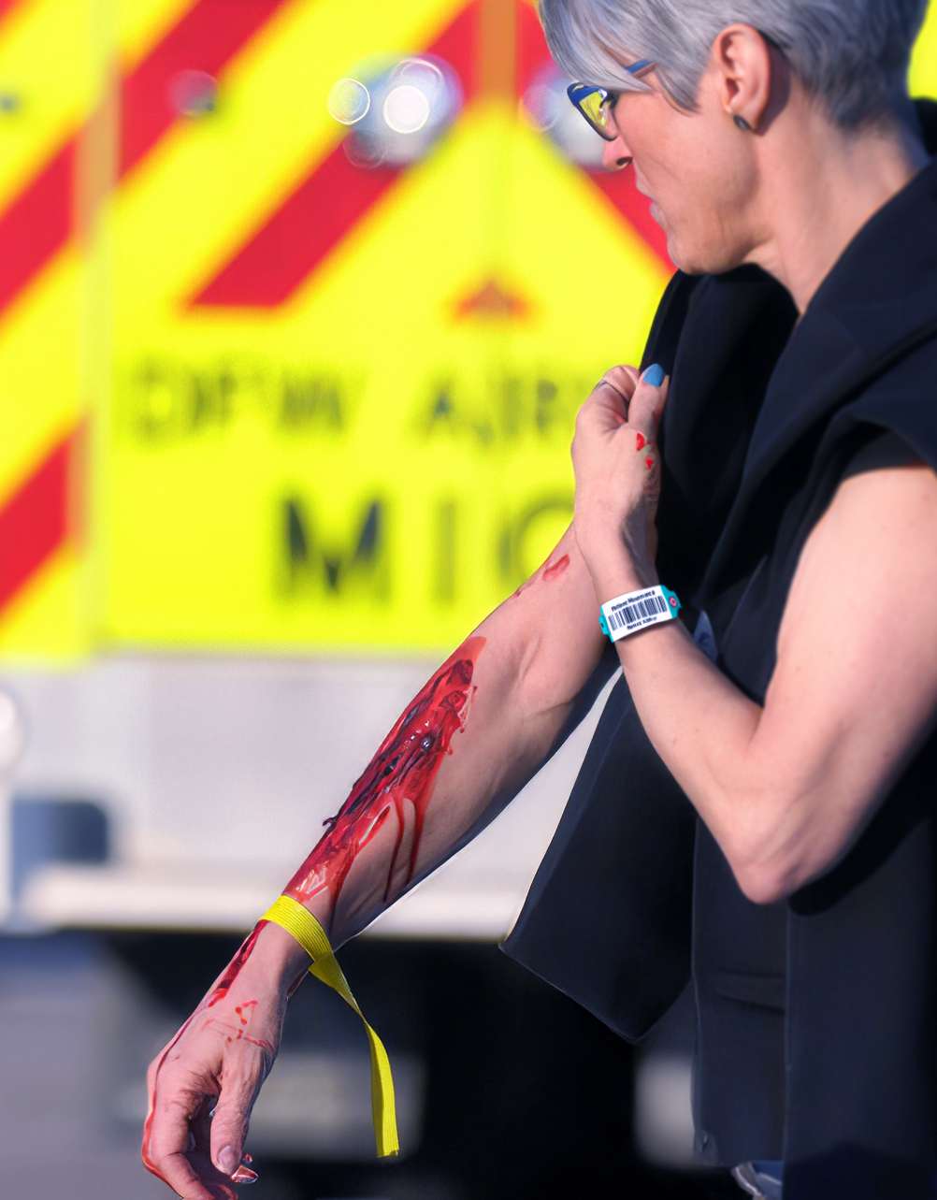
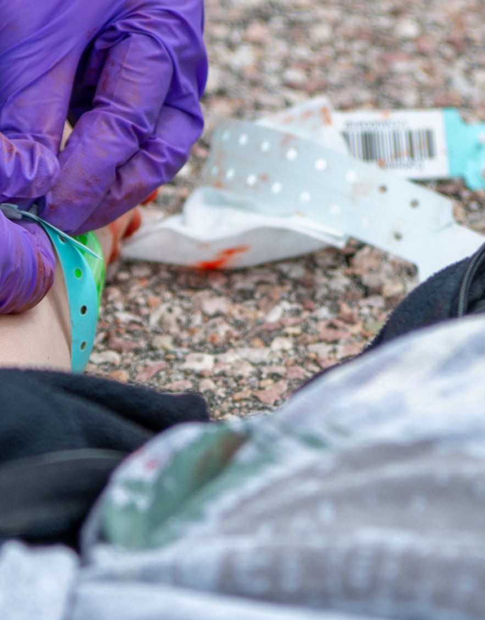
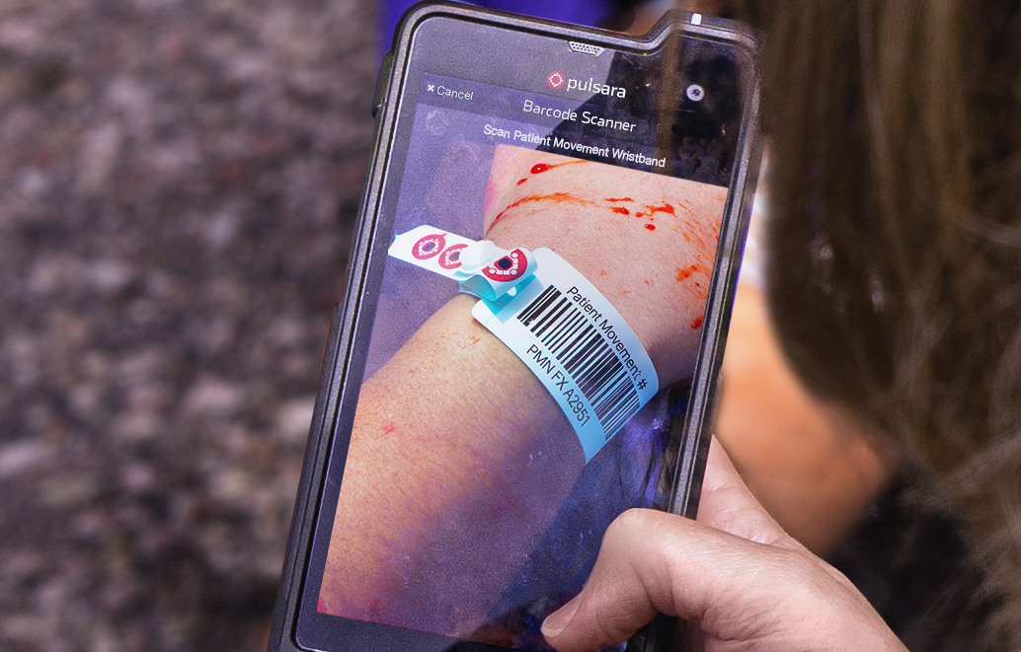
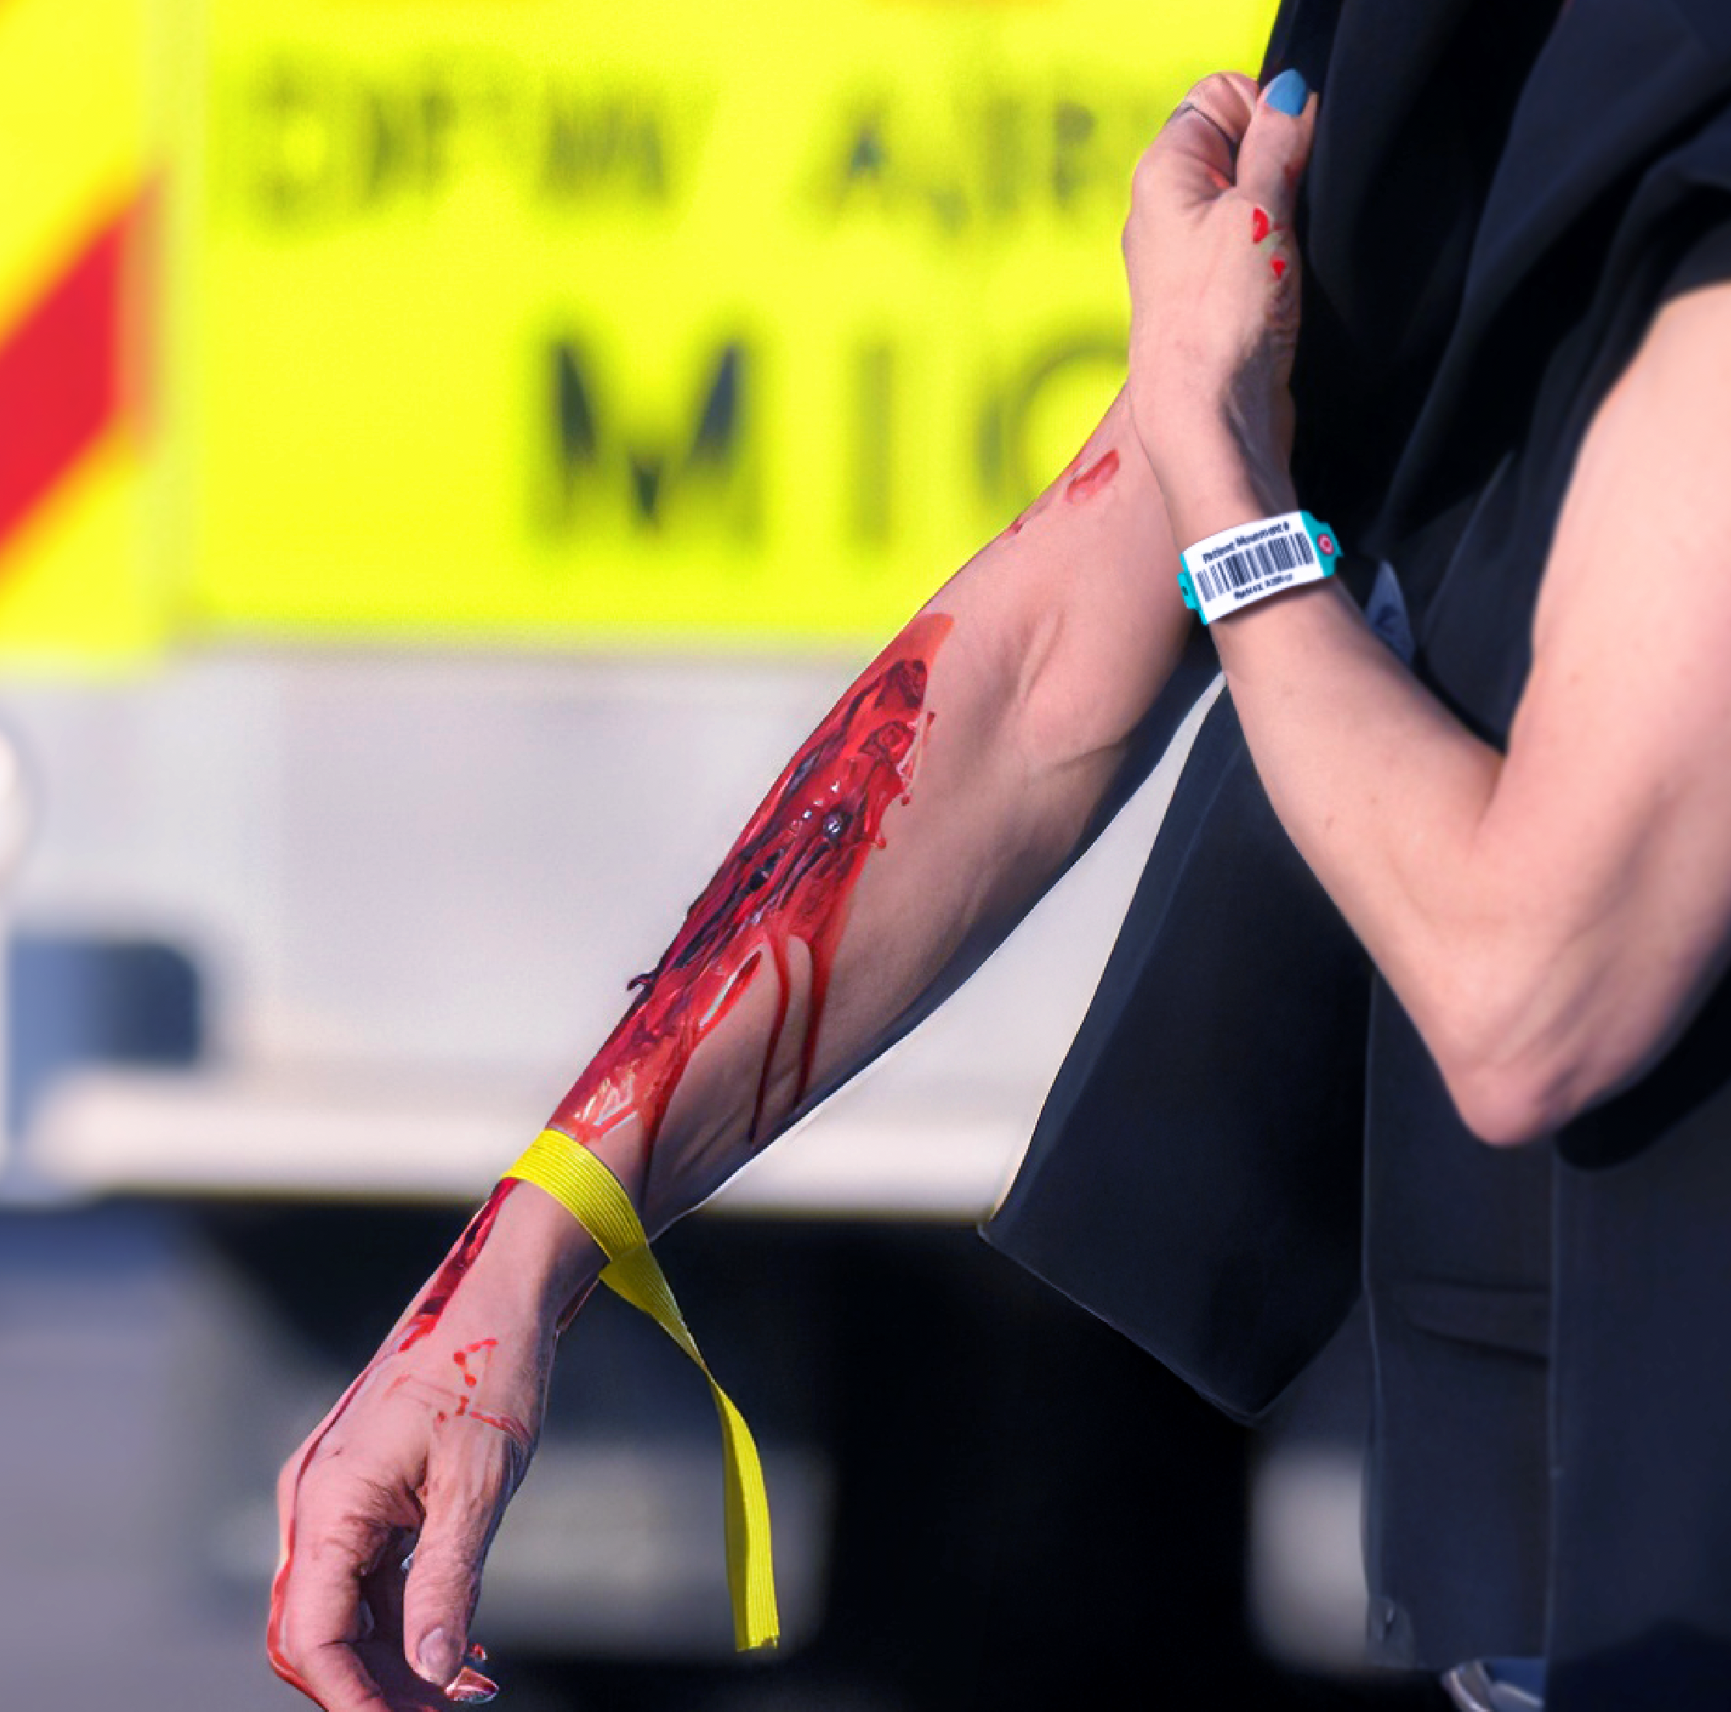
Patient Movement Wristbands
RULE 1: Band Every Patient
See a patient without a band? Add one.
RULE 2: Scan Band
See a band? Scan it.
  Newly added band: Creates new channel
  Existing band: Opens the channel
OPTION: Use colored tape for a visual
indicator of the triage condition.
Notes:
The two simple and intuitive rules of using Patient Movement Wristbands: Rule 1: If you see a patient without a band, put a band on them. It is preferred to do this immediately at first patient contact. However, it may be most appropriate to do this at a casualty collection point in large-scale chaotic or dangerous environments.
Rule 2: If you see a band, scan it. If the band is in the system, it will open that patient channel and assign you to the patient. If it is new, it will prompt you to create the channel. This creates a self-healing patient movement system in chaotic environments with variable connectivity.
While the patient channel prominently displays the triage condition, some communities like the visual of colored triage tags on patients. They replicate this by applying colored tape to the wristbands.

