Slide 1

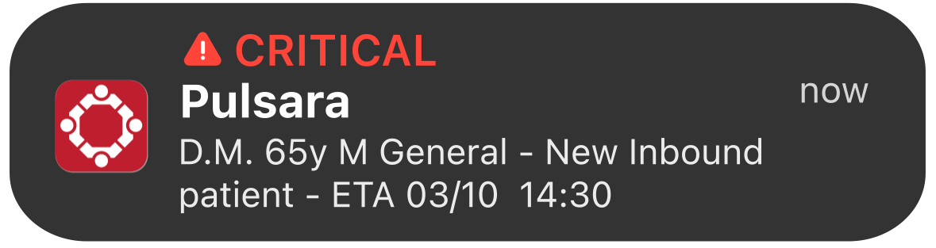
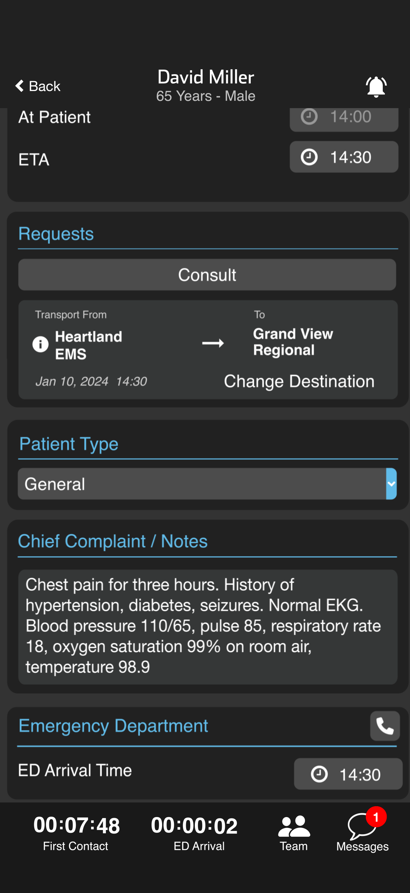
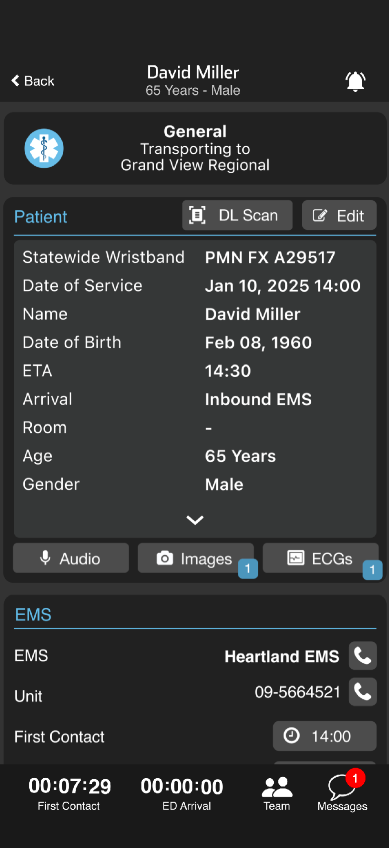








Receive Alert
Tap Notification
Opens Patient Channel & sends an
acknowledgement notification to EMS
Review Patient Details
Demographics, Multimedia, CC / Notes
Badges indicate data – tap to review
OPTIONAL
Assign Room (Patient Card)
    Tap Edit, Add Room, Save
Messaging
    Template, Voice-to-Text, or Type
Call EMS (if enabled)
    Agency
    Unit Phone
    Pulsara Call (VOIP / Video)
Notes:
Let’s review how to receive a prehospital notification, which replaces the traditional radio or phone call.
When EMS sends a prehospital alert, you’ll get a push notification and an audible alert. Tap it to open the patient channel.
If you’re on the ED-team that receives inbound EMS notifications, opening the channel automatically acknowledges receipt to EMS.
Scroll through the channel to review patient info. A blue badge will display when there is multimedia attached in the patient card. A red indicator will be shown if there are new messages to review.
Now let’s look at some optional functionality.
If your facility pre-assigns rooms, tap EDIT on the Patient Card, enter the room number, and save. Everyone in the channel gets notified.
To send a message to EMS you'll tap the Messages icon. You can use voice-to-text, type it manually, or choose a template message created by your organization. You’ll get an alert when they respond—just tap it to view.
To call EMS, just tap the phone icon next to the agency in the EMS card -- which is often a recorded line. Or tap the one next to the unit, to reach their unit phone directly. Want to start a pulsaira Call with video or recording? Tap the Team icon, then hit the video icon next to the team member you want to connect with to start the session.
No more chasing down phone or radio calls, listening to long reports, and jotting down notes—just clear, efficient communication from start to finish.

Slide 2
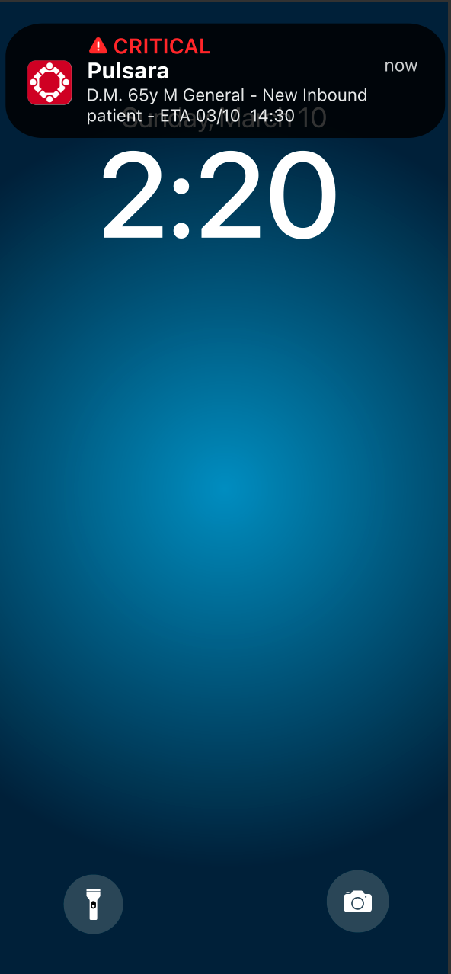
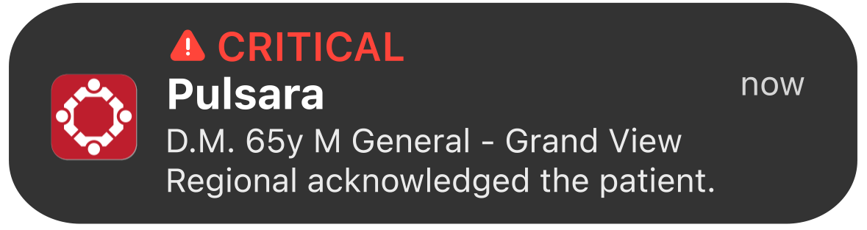
Receive Alert
Tap Notification
Opens Patient Channel & sends an
acknowledgement notification to EMS
Review Patient Details
Demographics, Multimedia, CC / Notes
Badges indicate data – tap to review
OPTIONAL
Assign Room (Patient Card)
    Tap Edit, Add Room, Save
Messaging
    Template, Voice-to-Text, or Type
Call EMS (if enabled)
    Agency
    Unit Phone
    Pulsara Call (VOIP / Video)
Notes:
When EMS sends a prehospital alert, you’ll get a push notification and an audible alert. Tap it to open the patient channel.
If you’re on the ED-team that receives inbound EMS notifications, opening the channel automatically acknowledges receipt to EMS.

Slide 3
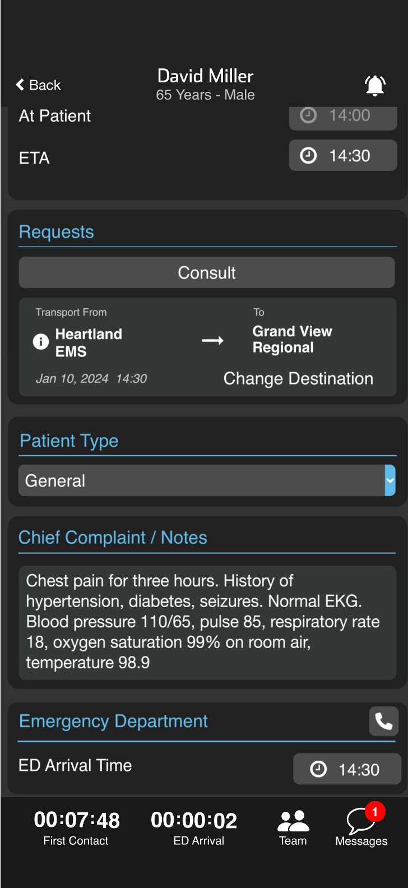
Receive Alert
Tap Notification
Opens Patient Channel & sends an
acknowledgement notification to EMS
Review Patient Details
Demographics, Multimedia, CC / Notes
Badges indicate data – tap to review
OPTIONAL
Assign Room (Patient Card)
    Tap Edit, Add Room, Save
Messaging
    Template, Voice-to-Text, or Type
Call EMS (if enabled)
    Agency
    Unit Phone
    Pulsara Call (VOIP / Video)
Notes:
Scroll through the channel to review patient info. A blue badge will display when there is multimedia attached in the patient card. A red indicator will be shown if there are new messages to review.

Slide 4
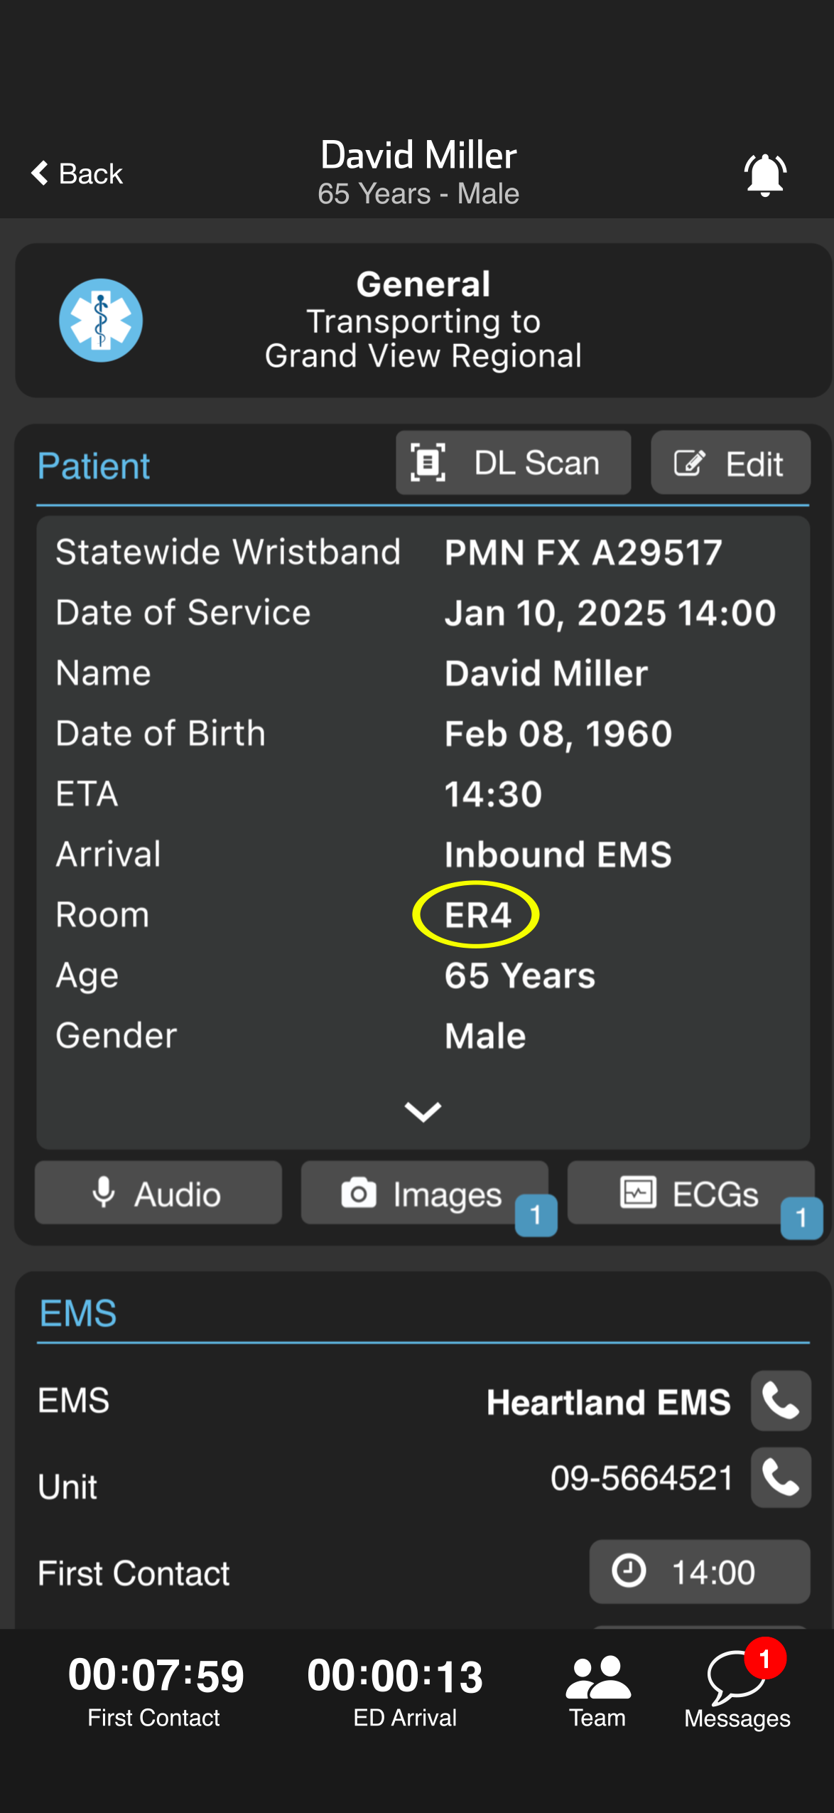
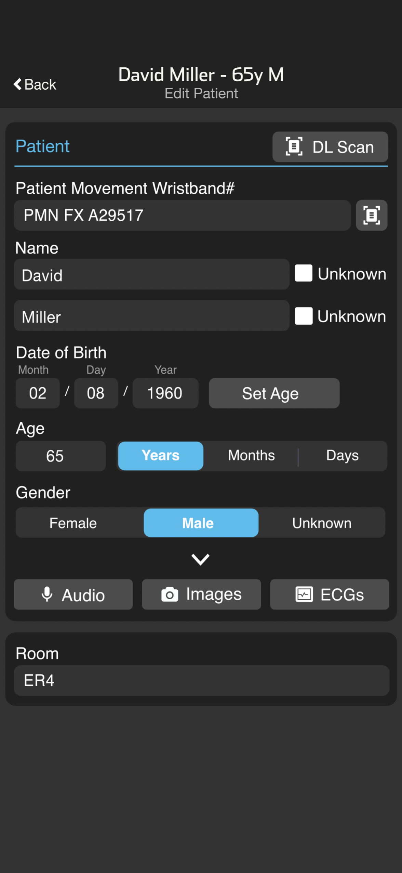
Receive Alert
Tap Notification
Opens Patient Channel & sends an
acknowledgement notification to EMS
Review Patient Details
Demographics, Multimedia, CC / Notes
Badges indicate data – tap to review
OPTIONAL
Assign Room (Patient Card)
    Tap Edit, Add Room, Save
Messaging
    Template, Voice-to-Text, or Type
Call EMS (if enabled)
    Agency
    Unit Phone
    Pulsara Call (VOIP / Video)
Notes:
Now let’s look at some optional functionality.
If your facility pre-assigns rooms, tap EDIT on the Patient Card, enter the room number, and save. Everyone in the channel gets notified.

Slide 5
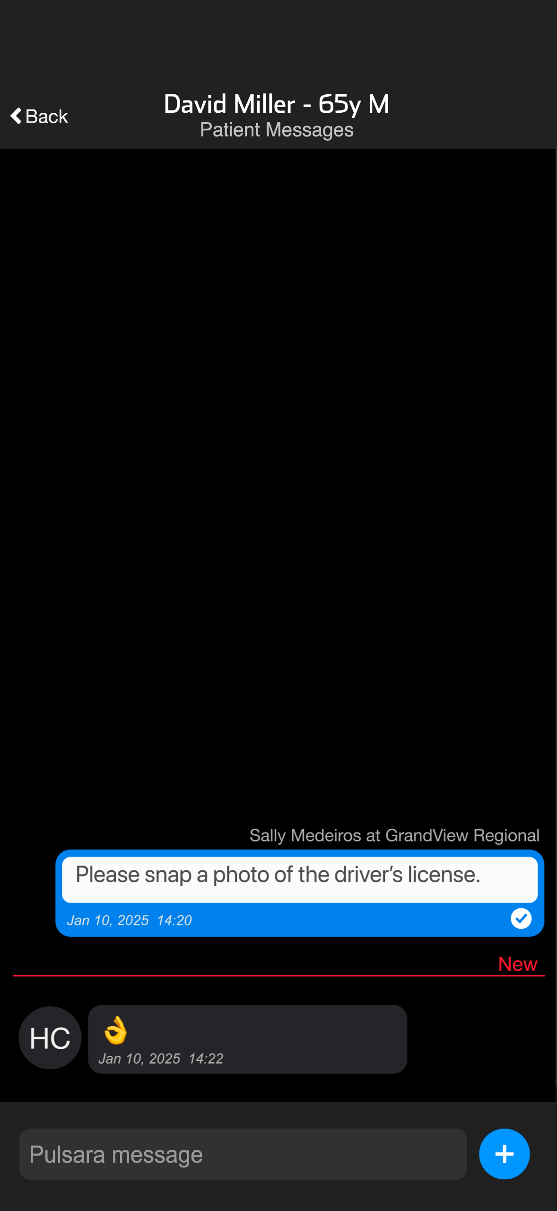
Receive Alert
Tap Notification
Opens Patient Channel & sends an
acknowledgement notification to EMS
Review Patient Details
Demographics, Multimedia, CC / Notes
Badges indicate data – tap to review
OPTIONAL
Assign Room (Patient Card)
    Tap Edit, Add Room, Save
Messaging
    Template, Voice-to-Text, or Type
Call EMS (if enabled)
    Agency
    Unit Phone
    Pulsara Call (VOIP / Video)
Notes:
To send a message to EMS you'll tap the Messages icon. You can use voice-to-text, type it manually, or choose a template message created by your organization. You’ll get an alert when they respond—just tap it to view.
To call EMS, just tap the phone icon next to the agency in the EMS card -- which is often a recorded line. Or tap the one next to the unit, to reach their unit phone directly. Want to start a pulsaira Call with video or recording? Tap the Team icon, then hit the video icon next to the team member you want to connect with to start the session.
No more chasing down phone or radio calls, listening to long reports, and jotting down notes—just clear, efficient communication from start to finish.

Slide 6
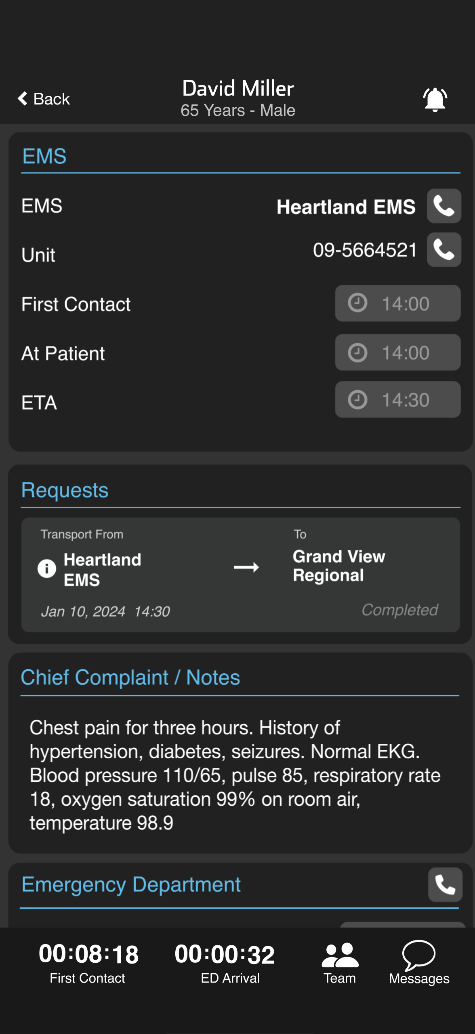
Receive Alert
Tap Notification
Opens Patient Channel & sends an
acknowledgement notification to EMS
Review Patient Details
Demographics, Multimedia, CC / Notes
Badges indicate data – tap to review
OPTIONAL
Assign Room (Patient Card)
    Tap Edit, Add Room, Save
Messaging
    Template, Voice-to-Text, or Type
Call EMS (if enabled)
    Agency
    Unit Phone
    Pulsara Call (VOIP / Video)
Notes:
To call EMS, just tap the phone icon next to the agency in the EMS card -- which is often a recorded line. Or tap the one next to the unit, to reach their unit phone directly. Want to start a pulsaira Call with video or recording? Tap the Team icon, then hit the video icon next to the team member you want to connect with to start the session.

Slide 7
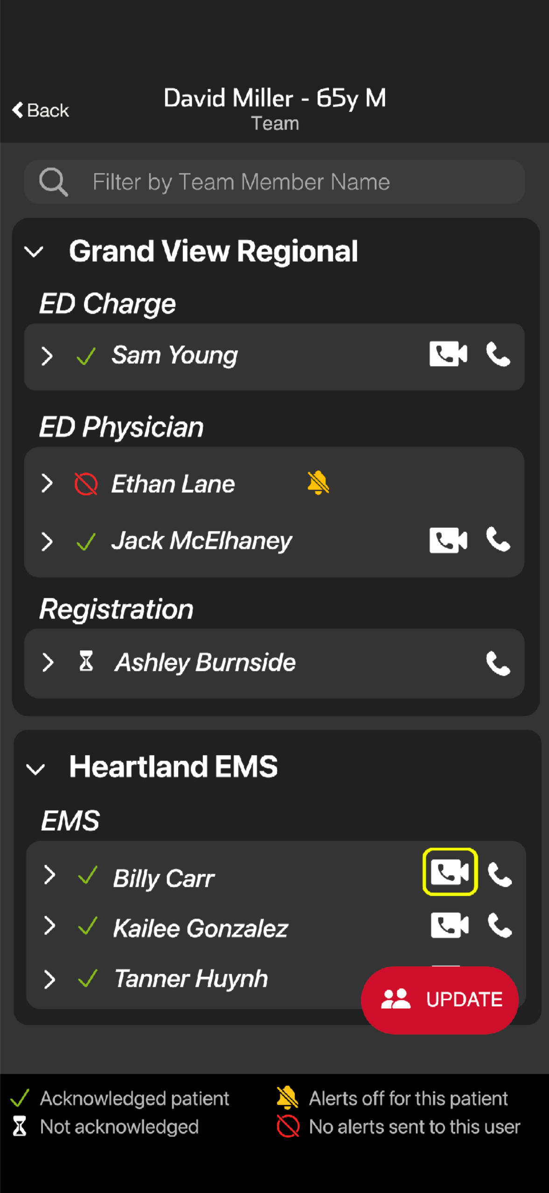
Receive Alert
Tap Notification
Opens Patient Channel & sends an
acknowledgement notification to EMS
Review Patient Details
Demographics, Multimedia, CC / Notes
Badges indicate data – tap to review
OPTIONAL
Assign Room (Patient Card)
    Tap Edit, Add Room, Save
Messaging
    Template, Voice-to-Text, or Type
Call EMS (if enabled)
    Agency
    Unit Phone
    Pulsara Call (VOIP / Video)
Notes:
Want to start a Pulsara Call with video or recording? Tap the Team icon, then hit the video icon next to the team member you want to connect with to start the session.
No more chasing down phone or radio calls, listening to long reports, and jotting down notes—just clear, efficient communication from start to finish.

