Slide 1



Notes:
Pulsara is The communication and logistics platform used in your region that unites distributed teams and fragmented technologies during dynamic events. This video will highlight how Pulsara is used in your STEMI System of Care.

Slide 2
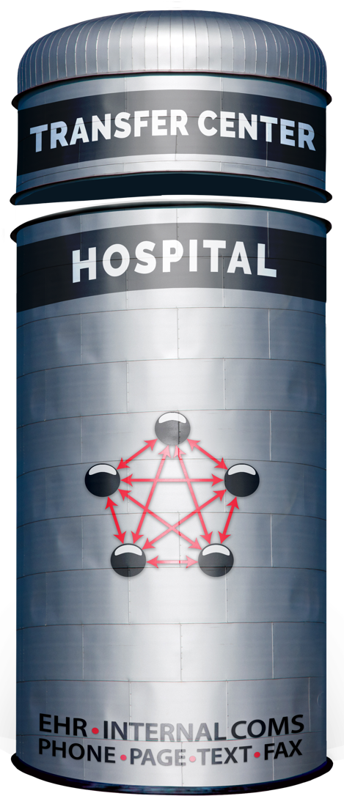




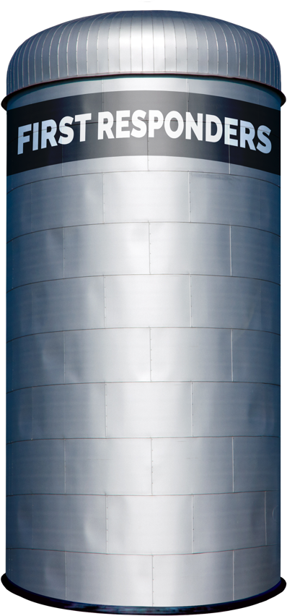
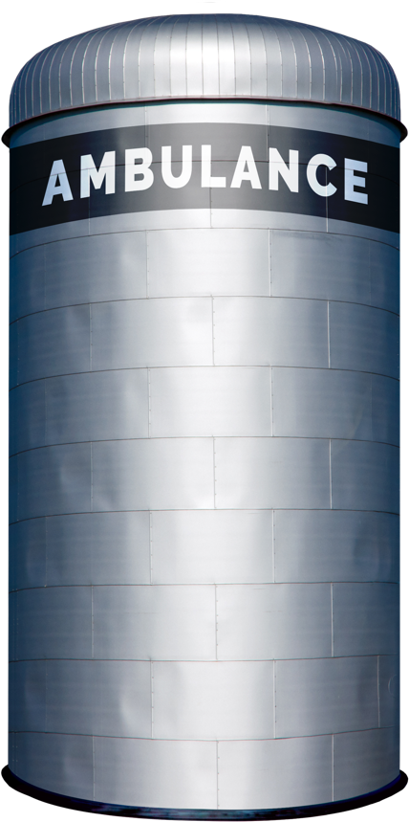


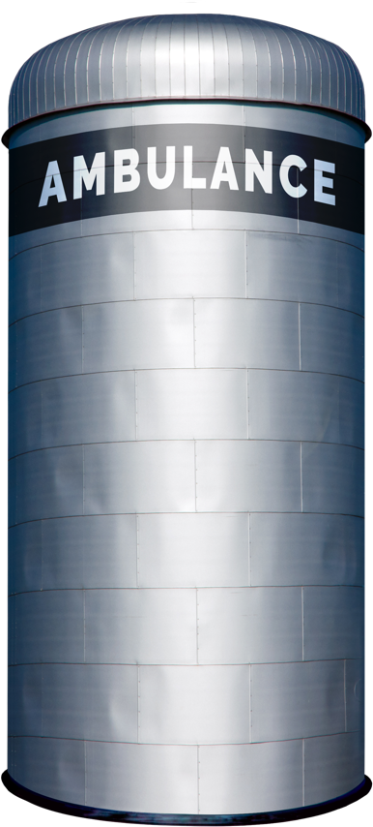
















Traditional Patient Movement
Teleconsult
Phone
Secure
Msg
Page
Verbal
Handoff
Electronic
Notifications
Radio
Phone
ECG
ePCR or
Electronic
Notifications
Phone
Bedside
Handoff
Radio
Phone
Bedside
Handoff
PATIENT JOURNEY
Each Red Arrow Represents a Separate Communication Channel
COMMUNICATION CHANNELS: Numerous
Notes:
Patient movement across organizations requires coordination through multiple communication channels like radio reports, phone calls, alerting tools, messaging systems, and intermediaries like transfer centers.
All the red lines in the diagram represent these different communication paths. This complexity is highly inefficient, particularly during time-sensitive emergencies like STEMI where the patient’s care team is spread across multiple different departments and organizations.

Slide 3


Universal Distributed Teams
CALL LIST
Who’s on call today? Did they get their alert?
The call list is wrong. What do I do?
I can’t stop my alerts when I’m done.
PATIENT IDENTIFICATION
Why can’t my alert include the patient’s name so I can pull PMH or old studies / images?
I have 5 different “secure message” threads about 2 different patients and 4 ECGs with no names on them.
I can’t do anything until the patient is registered.
UNNECESSARY COMPLEXITY
Why is it so hard to de-escalate our system once it’s in motion?
Where is the patient now?
Why do we have different protocols for different methods of arrival and different times of day?
Why can’t we provide timely feedback to EMS and referral partners?
Traditional Patient Movement Challenges
for Critical, Unscheduled Events
Notes:
These are just a few of the common issues that arise, affecting patient safety, outcomes, treatment times, efficiency, and overall costs.

Slide 4

STEMI Team
ECG
I can’t see the ECG.
Is this the right ECG?
I would love to compare this to the old ECG.
Why am I getting this ECG?
FALSE ACTIVATIONS
It’s 2am, by the time I figure out I don’t need to come in I’M FULLY AWAKE AND HALFWAY THERE.
BYPASS PROTOCOLS
Is the cath lab ready?
Can EMS go straight to cath lab? Does it depend on time of day?
Is the patient still in the ED or in the cath lab?
I have a patient on the table, can you forward to my partner?
I have 2 on the table and 2 in the ED, can you send them to our sister facility?
Traditional STEMI
Patient Movement Challenges
Impact: 3% increase in 1-year mortality for every 10 minutes of delay.
Notes:
In the context of our STEMI systems, adding internal communication tools like pagers and secure messaging platforms—along with accessing ECGs from various sources—only increases the number of communication channels.

Slide 5
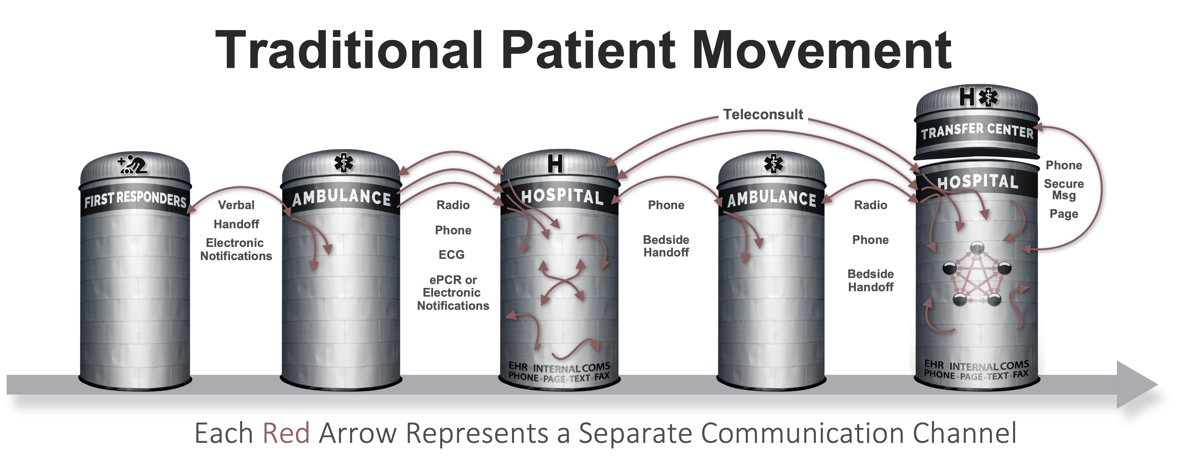






Patient Movement with
3
EHR
Radiology
Create Channel
Build Team
Communicate
ECG
Monitor
STEPS
ePCR
…
Pulsara
API
UNIFIED CARE TEAM
PATIENT MOVEMENT
Notes:
Pulsara’s Patient Movement System offers a HIPAA-compliant solution for streamlining communication and logistics across organizations. Think of it as a secure group chat that integrates public safety and healthcare teams.
You simply create a dedicated communication channel for each patient encounter, build the care team, and begin communication.
The Pulsara API also allows you to move data into and out of the channel. For example, you can attach ECGs to a patient channel and you can export Pulsara data to your ePCR or EHR.
Regions use Pulsara daily for EMS-to-ED communications. Many regions and states also adopt the Patient Movement System for large-scale situations like mass casualty incidents, mass evacuations, load balancing initiatives, and more.
Hospitals can enhance their capabilities with Pulsara UNITED, which extends communication to downstream care teams like STEMI Teams and offers more robust transfer options.

Slide 6

Alerting Basics
WHO
Driven by Teams
Identify your Teams
Place individuals on Teams
  Able to be on more than one Team
Who, How, & When
Notes:
Configuring Pulsara Alerting to fit your STEMI workflows is straightforward. You simply decide WHO is alerted and WHEN they need to receive their alert.
Alerting is based on teams—like Cath Lab, Cardiologist, or House Supervisor teams—and can even be configured for different cardiology groups.
If you’re on call, you receive alerts for new patients; if you’re off call, you don’t.
WHEN teams are alerted is automatically triggered by workflow, but you can also manually add teams or individuals as needed.

Slide 7
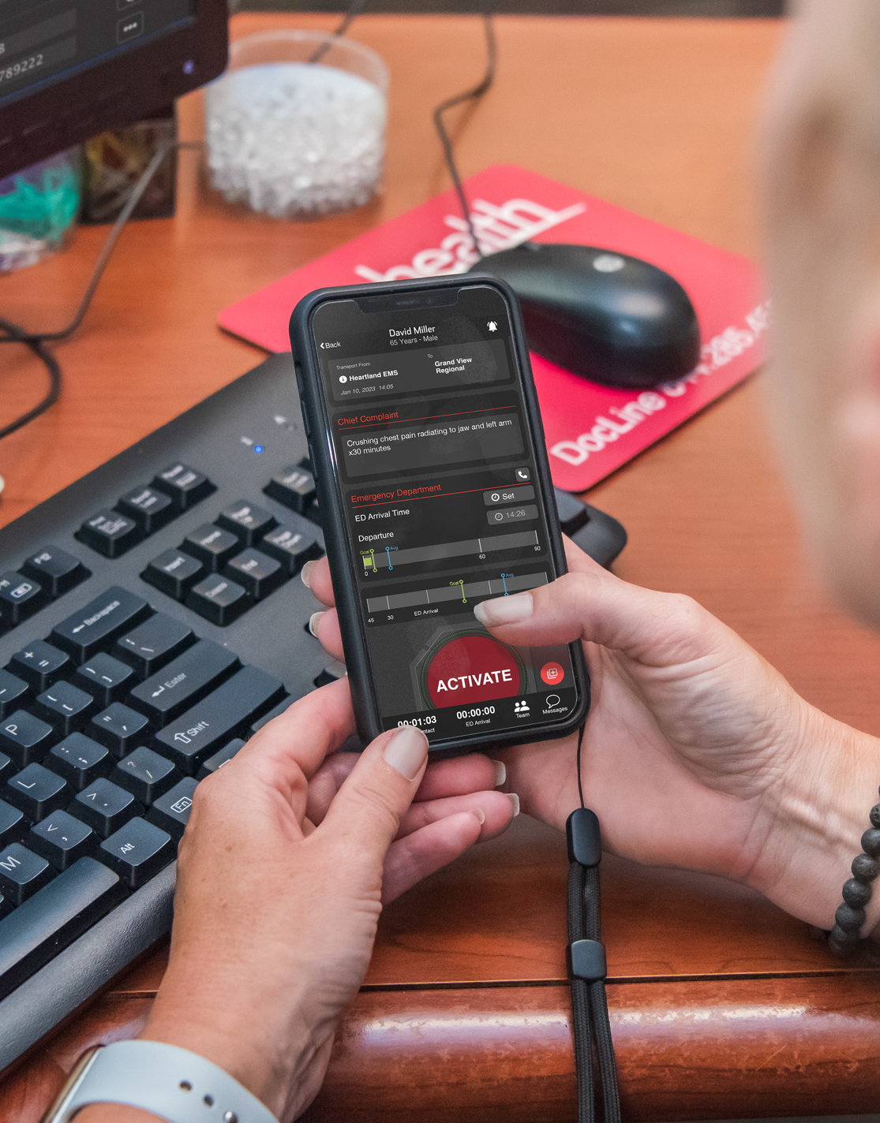
Alerting Basics
  HOW
Call Status
  ON Call = Alert
  OFF Call = No Alert
WHEN
Method of Arrival
Prehospital (EMS Alert) Options
  When prehospital sends initial notification
  When ED “Activates”
ED Activation
Inpatient Activation
Transfer Requested
Transfer Accepted
Consult Requested
Manual
Team or Individual
Who, How, & When
Notes:
For instance, a hospital can decide whether to alert the cardiologist simultaneously as the ED for incoming EMS patients or alert the cardiologist after the ED reviews the ECG and activates the STEMI team.

Slide 8
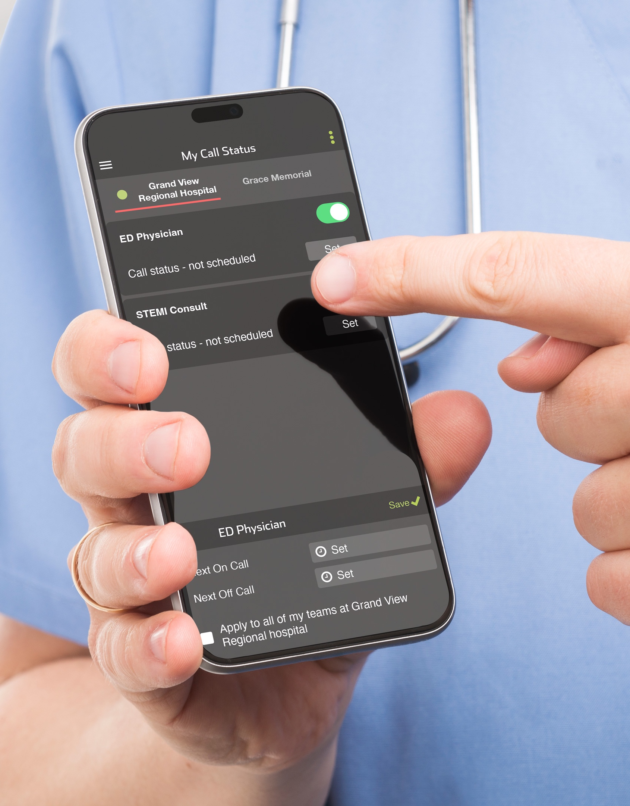
Hospital Call Status
MANAGE
Integrate with Calendar
Toggle ON/OFF
Set NEXT ON / OFF
Admin can Set Call Status
MANUAL
Assign to individual in real time regardless of call status
VISIBILITY ON TEAM SCREEN
Call Status of Individuals
Acknowledgement Status of Individuals
Silence Alerts Status of Individuals
ON | OFF | Transparency
Notes:
Managing call status is also simple. Individuals can manually toggle their status or set upcoming on/off-call times. Administrators have the ability to adjust call status as well. The most convenient method is to integrate your call status with your calendar, allowing for automatic updates.
During a STEMI case, you can view the entire care team, their call status, and whether they’ve acknowledged alerts. You can also manually add teams or individuals to the case as needed.

Slide 9

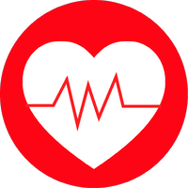
Pulsara Value
FOR THE PROVIDER
Provide pre-registration information before patient arrival – simplifying identification of patient’s history, initiating proper protocols and documentation, and shortening the time to definitive treatment.
Standardize communication and logistics across EMS agencies.
Simplify ED Bypass Protocols for EMS, ED, cath lab, and cardiology providers. Everyone knows where the patient is currently and when the patient is to arrive at the cath lab.
Leverage the same workflow for all methods of arrival (EMS, ED, Inpatient, Transfer).
Achieve better results with less effort.
FOR THE PATIENT
28% REDUCTION in first medical contact-to-device time
50% REDUCTION in average door-in-door-out time
58% IMPROVEMENT in door-to-balloon < 60 minutes after hours
FOR THE BOTTOM LINE
One customer reported an average of 39% savings from reduced false activations
$50,000 savings in one hospital because of reliable and efficient ECG transmission, in the first year of implementation
The STEMI Team
Reliable and efficient ECG transmission
28% reduction in FMC to device time
50% reduction in average door-in-door-out time
58% reduction in DTB <60 min
39% savings from reduced FA
Notes:
The impact? Better outcomes and less frustration.
Uniting STEMI care teams on a dedicated communication channel has been studied for over a decade. Research shows that Pulsara improves treatment times, care team satisfaction, and hospital economics.

Slide 10

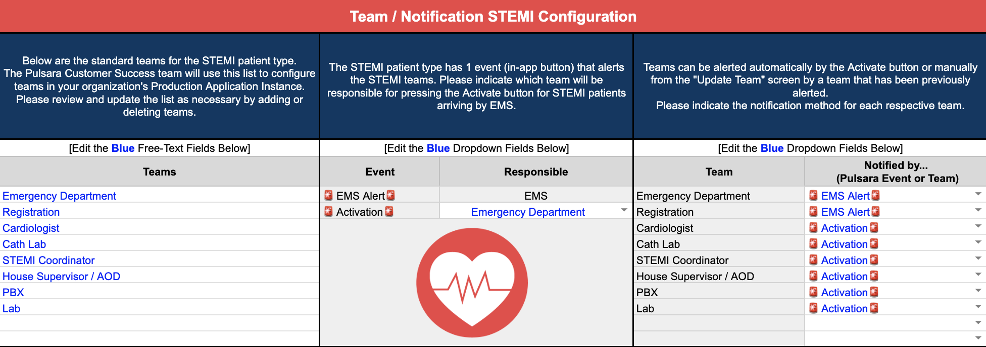
Identify | Build Team | Train | Go Live!
Identify which teams need to be notified and when they need to be notified
Complete the Team / Notification Configuration Spreadsheet
  Customizes your training materials
Share training materials with end users
Go Live
NEXT STEPS
Notes:
Once you identify your teams and when they need to be notified, you are ready to fill out the Configuration spreadsheet which will build your custom workflows and you are ready to coordinate training and GoLive.
Please watch our STEMI Demo video for an example workflow.

