Slide 1

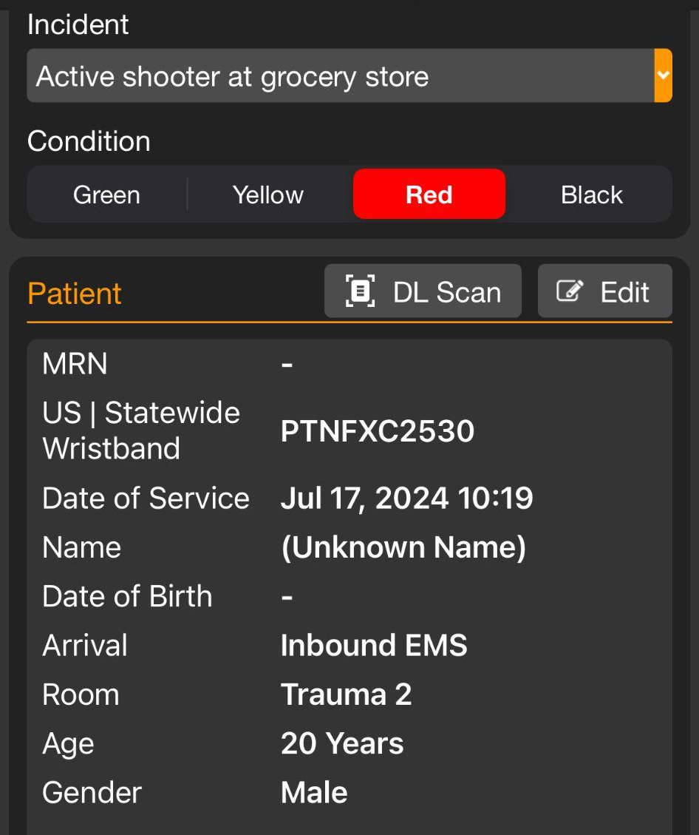
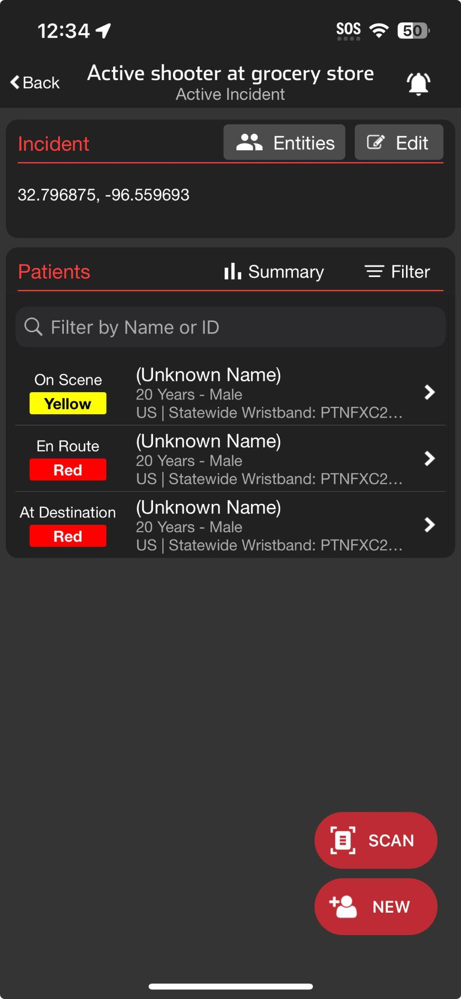



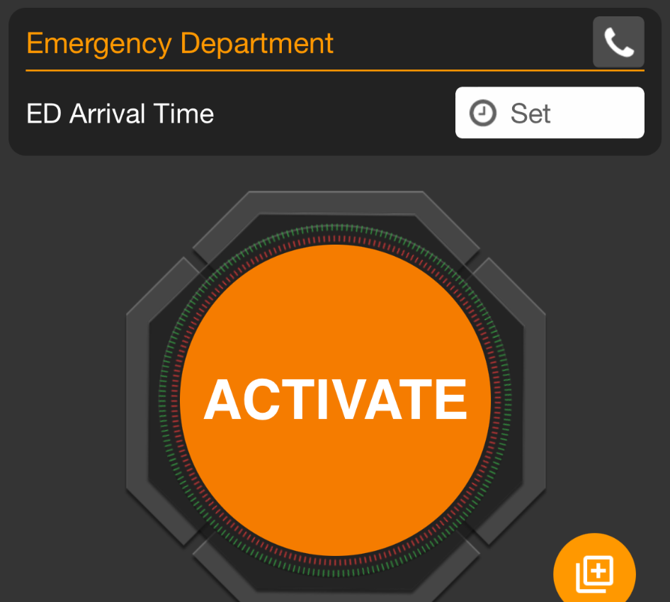
INCIDENTS | Receiving Patients During an Incident
Scan Wristband
Finds and Opens Patient Channel
Prompts to Create Patient Channel if not in system
Set ED Arrival Time
Scroll to bottom and Set ED Arrival Time
Moves Patient to At Destination Status
Options
Re-Triage and Change Condition
Room Assignment
Visible if already assigned
Able to Add / Edit
Notes:
Let’s review how to receive patients during an Incident.
During a larger incident, you may have a large volume of unidentified patients. Therefore, most emergency departments will establish a forward Triage area so they can better control their emergency department flow. Individuals stationed here will typically use a mobile device so they can use the scanning capabilities.
It is important to consider your connectivity in this location. In addition to ensuring they have WiFi coverage, many hospitals will also ensure they have access to cellular enabled devices in this location. To better manage noise, most people in this location will silence their alerts related to the incident.
Upon a patient’s arrival, scan the US Statewide Wristband, which opens that individual’s patient channel. Scroll to the bottom, and set ED Arrival Time. This task only takes a couple of seconds, and is the only required interaction for a regional Patient Movement System as it moves the patient to At Destination status on the Incident Summary.
To optimize your department further, there are additional optional functionalities available.
You can re-triage the patient and update their condition if appropriate.
If the patient was pre-assigned a room, you can view this information and direct medics accordingly. You also have the ability to add or edit room assignments as appropriate.

Slide 2
INCIDENTS | Receiving Patients During an Incident
Notes:
During a larger incident, you may have a large volume of unidentified patients. Therefore, most emergency departments will establish a forward Triage area so they can better control their emergency department flow. Individuals stationed here will typically use a mobile device so they can use the scanning capabilities.
It is important to consider your connectivity in this location. In addition to ensuring they have WiFi coverage, many hospitals will also ensure they have access to cellular enabled devices in this location.

Slide 3
INCIDENTS | Receiving Patients During an Incident
Notes:
To better manage noise, most people in this location will silence their alerts related to the incident.

Slide 4
INCIDENTS | Receiving Patients During an Incident
Scan Wristband
Notes:
Upon a patient’s arrival, scan the US Statewide Wristband,

Slide 5
INCIDENTS | Receiving Patients During an Incident
Scan Wristband
Finds and Opens Patient Channel
Prompts to Create Patient Channel if not in system
Notes:
which opens that individual’s patient channel.

Slide 6
INCIDENTS | Receiving Patients During an Incident
Scan Wristband
Finds and Opens Patient Channel
Prompts to Create Patient Channel if not in system
Set ED Arrival Time
Scroll to bottom and Set ED Arrival Time
Notes:
Scroll to the bottom, and set ED Arrival Time.

Slide 7
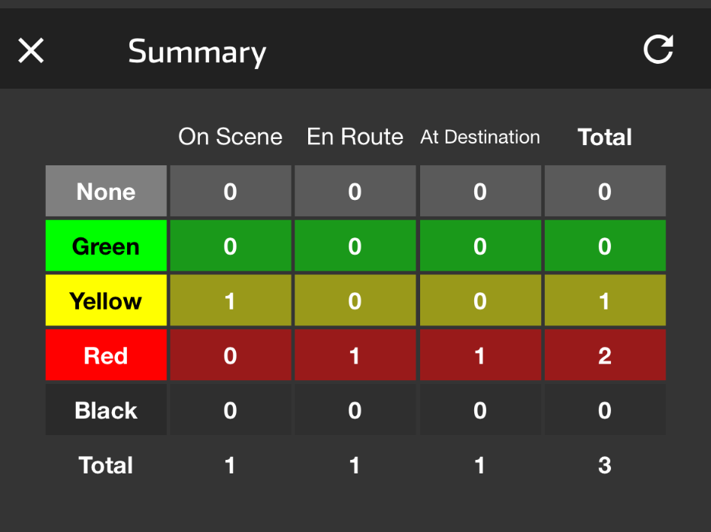
INCIDENTS | Receiving Patients During an Incident
Scan Wristband
Finds and Opens Patient Channel
Prompts to Create Patient Channel if not in system
Set ED Arrival Time
Scroll to bottom and Set ED Arrival Time
Moves Patient to At Destination Status
Notes:
This task only takes a couple of seconds, and is the only required interaction for a regional Patient Movement System as it moves the patient to At Destination status on the Incident Summary.

Slide 8
INCIDENTS | Receiving Patients During an Incident
Scan Wristband
Finds and Opens Patient Channel
Prompts to Create Patient Channel if not in system
Set ED Arrival Time
Scroll to bottom and Set ED Arrival Time
Moves Patient to At Destination Status
Options
Re-Triage and Change Condition
Notes:
To optimize your department further, there are additional optional functionalities available.
You can re-triage the patient and update their condition if appropriate.

Slide 9
INCIDENTS | Receiving Patients During an Incident
Scan Wristband
Finds and Opens Patient Channel
Prompts to Create Patient Channel if not in system
Set ED Arrival Time
Scroll to bottom and Set ED Arrival Time
Moves Patient to At Destination Status
Options
Re-Triage and Change Condition
Room Assignment
Visible if already assigned
Able to Add / Edit
Notes:
If the patient was pre-assigned a room, you can view this information and direct medics accordingly. You also have the ability to add or edit room assignments as appropriate.

