Slide 1
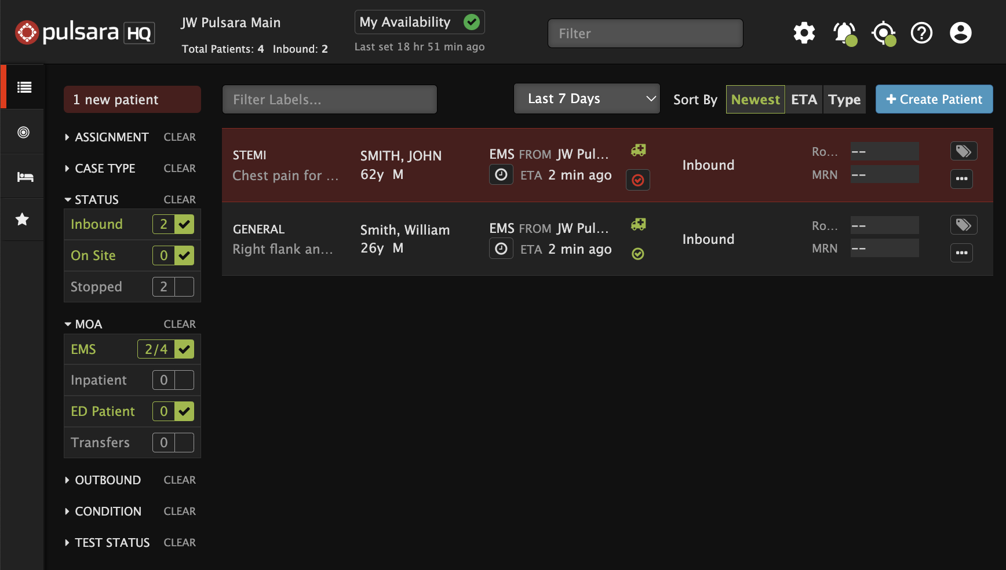
Emergency Dept | Pulsara HQ - Start of Shift
Select View
HQ: See all patient channels (Incident and non-Incident)
Best view for managing your ED
Incident: Patient channels are grouped by Incident
Call & Alert
Turn My Call ON to see and be assigned to new patients
Set Browser (Audible) Alert if needed
Settings
Show Patient Names and Show Chief Complaint
Additional Filters (ED Users)
Status: Inbound and On Site
Method of Arrival: EMS and ED Patients
List: Last 12 Hours
Sort: Newest, ETA, and Type
ED Availability
Color status
Comments
Notes:
How to set up Pulsara on a web browser for daily use in the Emergency Department.

Slide 2
Emergency Dept | Pulsara HQ - Start of Shift
Select View
HQ: See all patient channels (Incident and non-Incident)
Best view for managing your ED
Notes:
When using Pulsara in the Emergency Department, most users stay in Pulsara HQ View. This view lets you see all patient channels in one place.

Slide 3
Emergency Dept | Pulsara HQ - Start of Shift
Select View
HQ: See all patient channels (Incident and non-Incident)
Best view for managing your ED
Incident: Patient channels are grouped by Incident
Notes:
If you’re managing an Incident, you can switch to Incident View, which groups patient channels by incident for better organization.

Slide 4
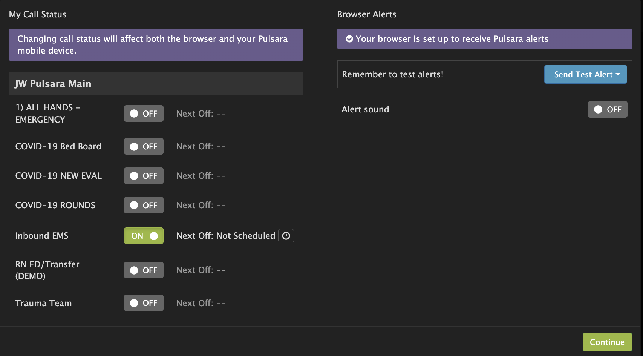
Emergency Dept | Pulsara HQ - Start of Shift
Select View
HQ: See all patient channels (Incident and non-Incident)
Best view for managing your ED
Incident: Patient channels are grouped by Incident
Call & Alert
Turn My Call ON to see and be assigned to new patients
Set Browser (Audible) Alert if needed
Notes:
Next, check your call and alerting status by clicking the Bell icon at the top of the screen. Make sure you are on call so you can be assigned to new patients. You can also enable audible alerts for new patient arrivals. For the best experience, we recommend using at least one smart device for audible alerts. But if you’re relying only on your browser, check that your computer and speaker settings are set up correctly.

Slide 5
Emergency Dept | Pulsara HQ - Start of Shift
Select View
HQ: See all patient channels (Incident and non-Incident)
Best view for managing your ED
Incident: Patient channels are grouped by Incident
Call & Alert
Turn My Call ON to see and be assigned to new patients
Set Browser (Audible) Alert if needed
Settings
Show Patient Names and Show Chief Complaint
Notes:
Now, let’s adjust your display settings. Click the Settings icon to choose whether to show or hide patient names and chief complaints. If you’re displaying Pulsara HQ on a public screen, you may want to hide this information for privacy. Otherwise, most users choose to keep it visible for quick access.

Slide 6
Emergency Dept | Pulsara HQ - Start of Shift
Select View
HQ: See all patient channels (Incident and non-Incident)
Best view for managing your ED
Incident: Patient channels are grouped by Incident
Call & Alert
Turn My Call ON to see and be assigned to new patients
Set Browser (Audible) Alert if needed
Settings
Show Patient Names and Show Chief Complaint
Additional Filters (ED Users)
Status: Inbound and On Site
Notes:
To focus on the most relevant patients, use the Filters menu. In the Emergency Department, the most common settings are checking Inbound and On-Site under the Status filter,

Slide 7
Emergency Dept | Pulsara HQ - Start of Shift
Select View
HQ: See all patient channels (Incident and non-Incident)
Best view for managing your ED
Incident: Patient channels are grouped by Incident
Call & Alert
Turn My Call ON to see and be assigned to new patients
Set Browser (Audible) Alert if needed
Settings
Show Patient Names and Show Chief Complaint
Additional Filters (ED Users)
Status: Inbound and On Site
Method of Arrival: EMS and ED Patient
Notes:
and EMS and ED patients under the Method of Arrival filter. With these settings, stopping a patient channel will automatically remove it from your list.

Slide 8
Emergency Dept | Pulsara HQ - Start of Shift
Select View
HQ: See all patient channels (Incident and non-Incident)
Best view for managing your ED
Incident: Patient channels are grouped by Incident
Call & Alert
Turn My Call ON to see and be assigned to new patients
Set Browser (Audible) Alert if needed
Settings
Show Patient Names and Show Chief Complaint
Additional Filters (ED Users)
Status: Inbound and On Site
Method of Arrival: EMS and ED Patients
List: Last 12 Hours
Notes:
In addition, most users in the ED will opt to display active patients from the Last 12 Hours to keep their patient list shorter.

Slide 9
Emergency Dept | Pulsara HQ - Settings
Select View
HQ: See all patient channels (Incident and non-Incident)
Best view for managing your ED
Incident: Patient channels are grouped by Incident
Call & Alert
Turn My Call ON to see and be assigned to new patients
Set Browser (Audible) Alert if needed
Settings
Show Patient Names and Show Chief Complaint
Additional Filters (ED Users)
Status: Inbound and On Site
Method of Arrival: EMS and ED Patients
List: Last 12 Hours
Sort: Newest, ETA, and Type
Notes:
You can also sort patient channels to match your workflow. Most Emergency Department users sort by Newest, so the latest patients appear at the top. Some prefer sorting by ETA to see incoming patients in order of arrival. Sorting preferences can be customized by role to best fit your needs.

Slide 10
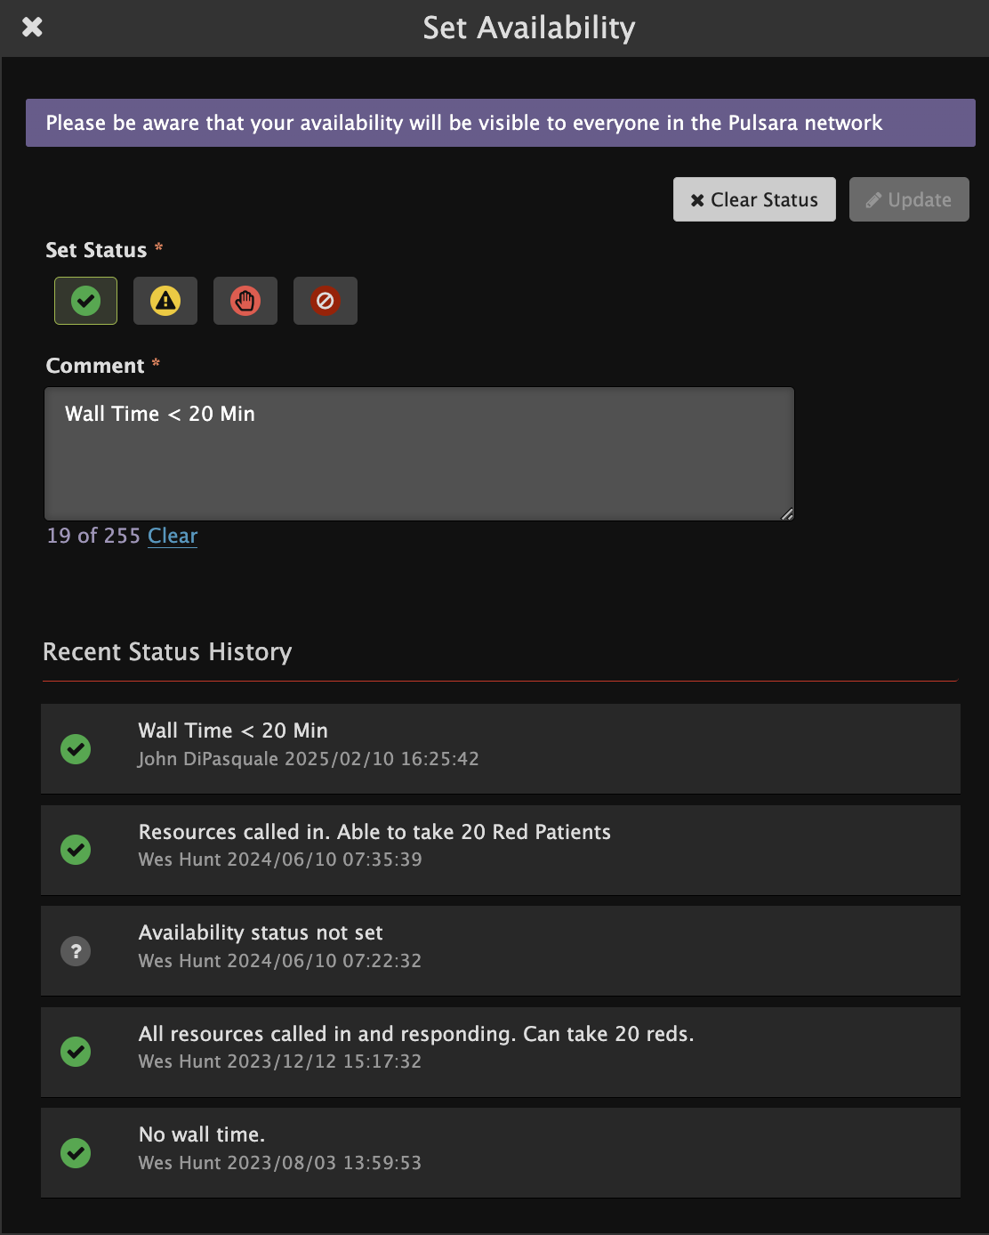
Emergency Dept | Pulsara HQ - Settings
Select View
HQ: See all patient channels (Incident and non-Incident)
Best view for managing your ED
Incident: Patient channels are grouped by Incident
Call & Alert
Turn My Call ON to see and be assigned to new patients
Set Browser (Audible) Alert if needed
Settings
Show Patient Names and Show Chief Complaint
Additional Filters (ED Users)
Status: Inbound and On Site
Method of Arrival: EMS and ED Patients
List: Last 12 Hours
Sort: Newest, ETA, and Type
ED Availability
Color status
Comments
Notes:
Some users in the Emergency Department also have the ability to edit their ED Availability. This communicates to the Pulsara Network the general availability or status of your Emergency Department. For example, when EMS is selecting their transport destination they are able to see the color status and any provided comments that you want to communicate to them.

