Slide 1
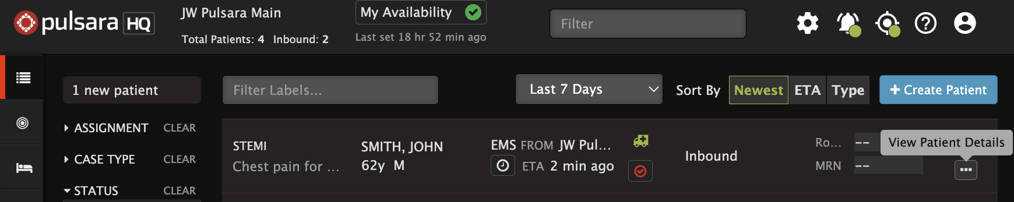



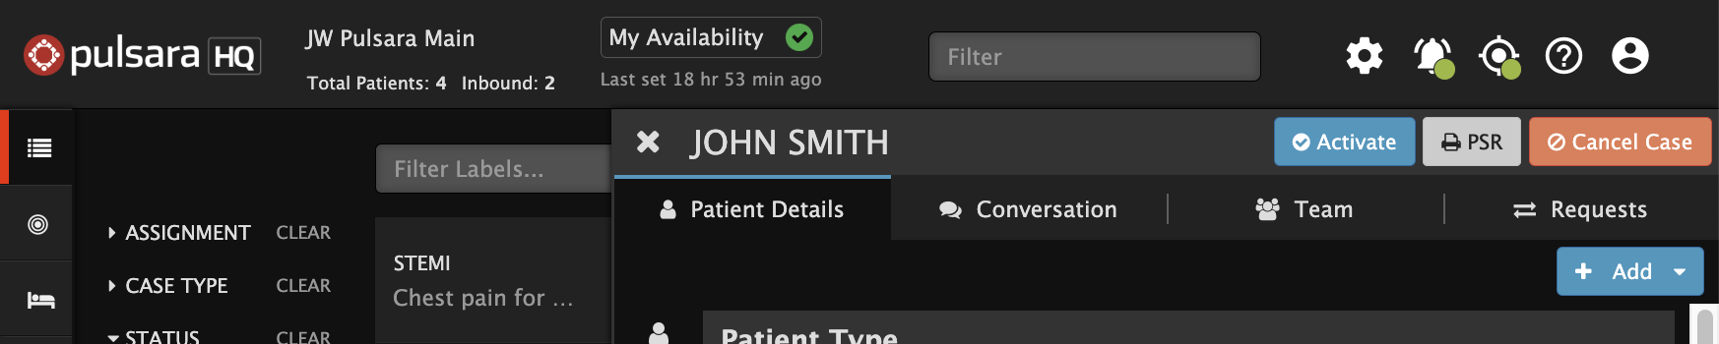


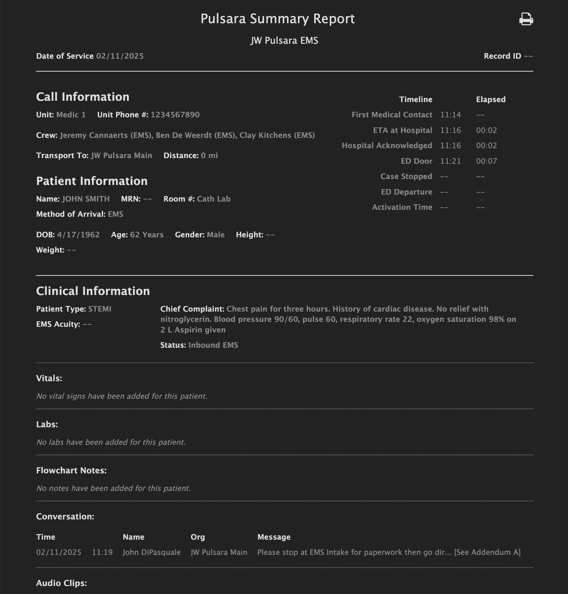
Emergency Dept | Pulsara Summary Report
Pulsara Summary Report (PSR)
Standardized View of data on patient channel
Includes Images and ECGs
Ability to Print or Save PDF
  View Patient Details
  Tap Ellipsis (...)
  View PSR
  Print Dialog
  Print
  Save as PDF
Notes:
The Pulsara Summary Report (PSR) provides a standardized view of all patient channel data, including images and ECGs. Many Emergency Departments print the PSR so that when a medic arrives, they receive it along with the hospital wristband and facesheet (if the patient was pre-registered). This is then handed off to the bedside nurse to help streamline the transition of care.
To access the PSR, tap the ellipsis to open the patient details view, then select PSR. This opens the report in a new window. Tap the printer icon to open the print dialog, where you can print or save the PSR as a PDF. Some organizations also upload it to their EHR as a media file or attach it to an alerting or messaging tool.

Slide 2
Emergency Dept | Pulsara Summary Report
Pulsara Summary Report (PSR)
Standardized View of data on patient channel
Includes Images and ECGs
Ability to Print or Save PDF
Notes:
The Pulsara Summary Report (PSR) provides a standardized view of all patient channel data, including images and ECGs. Many Emergency Departments print the PSR so that when a medic arrives, they receive it along with the hospital wristband and facesheet (if the patient was pre-registered). This is then handed off to the bedside nurse to help streamline the transition of care.

Slide 3
Emergency Dept | Pulsara Summary Report
Pulsara Summary Report (PSR)
Standardized View of data on patient channel
Includes Images and ECGs
Ability to Print or Save PDF
  View Patient Details
  Tap Ellipsis (...)
Notes:
To access the PSR, tap the ellipsis to open the patient details view

Slide 4
Emergency Dept | Pulsara Summary Report
Pulsara Summary Report (PSR)
Standardized View of data on patient channel
Includes Images and ECGs
Ability to Print or Save PDF
  View Patient Details
  Tap Ellipsis (...)
  View PSR
Notes:
then select PSR.

Slide 5
Emergency Dept | Pulsara Summary Report
Pulsara Summary Report (PSR)
Standardized View of data on patient channel
Includes Images and ECGs
Ability to Print or Save PDF
  View Patient Details
  Tap Ellipsis (...)
  View PSR
Notes:
This opens the report in a new window.

Slide 6
Emergency Dept | Pulsara Summary Report
Pulsara Summary Report (PSR)
Standardized View of data on patient channel
Includes Images and ECGs
Ability to Print or Save PDF
  View Patient Details
  Tap Ellipsis (...)
  View PSR
  Print Dialog
  Print
  Save as PDF
Notes:
Tap the printer icon to open the print dialog, where you can print or save the PSR as a PDF.

Slide 7
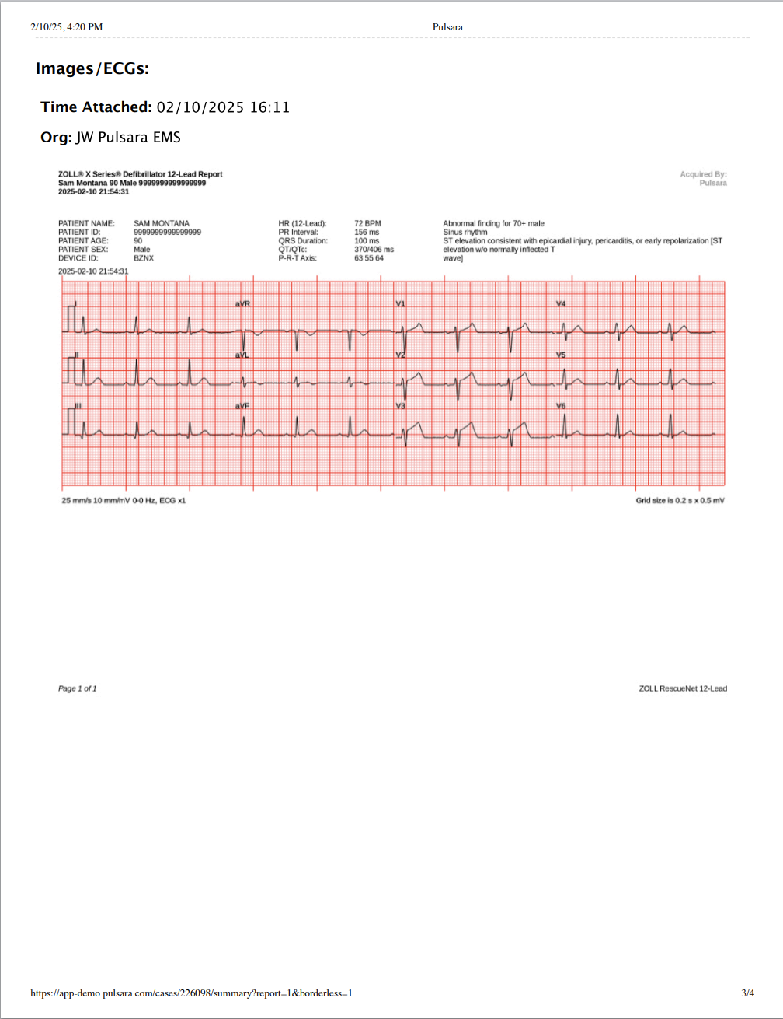
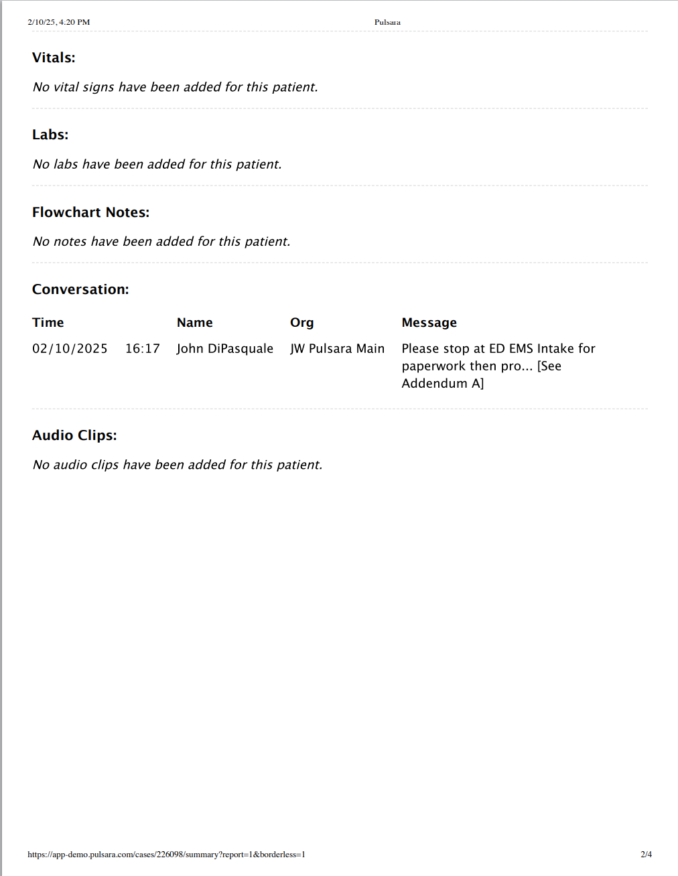
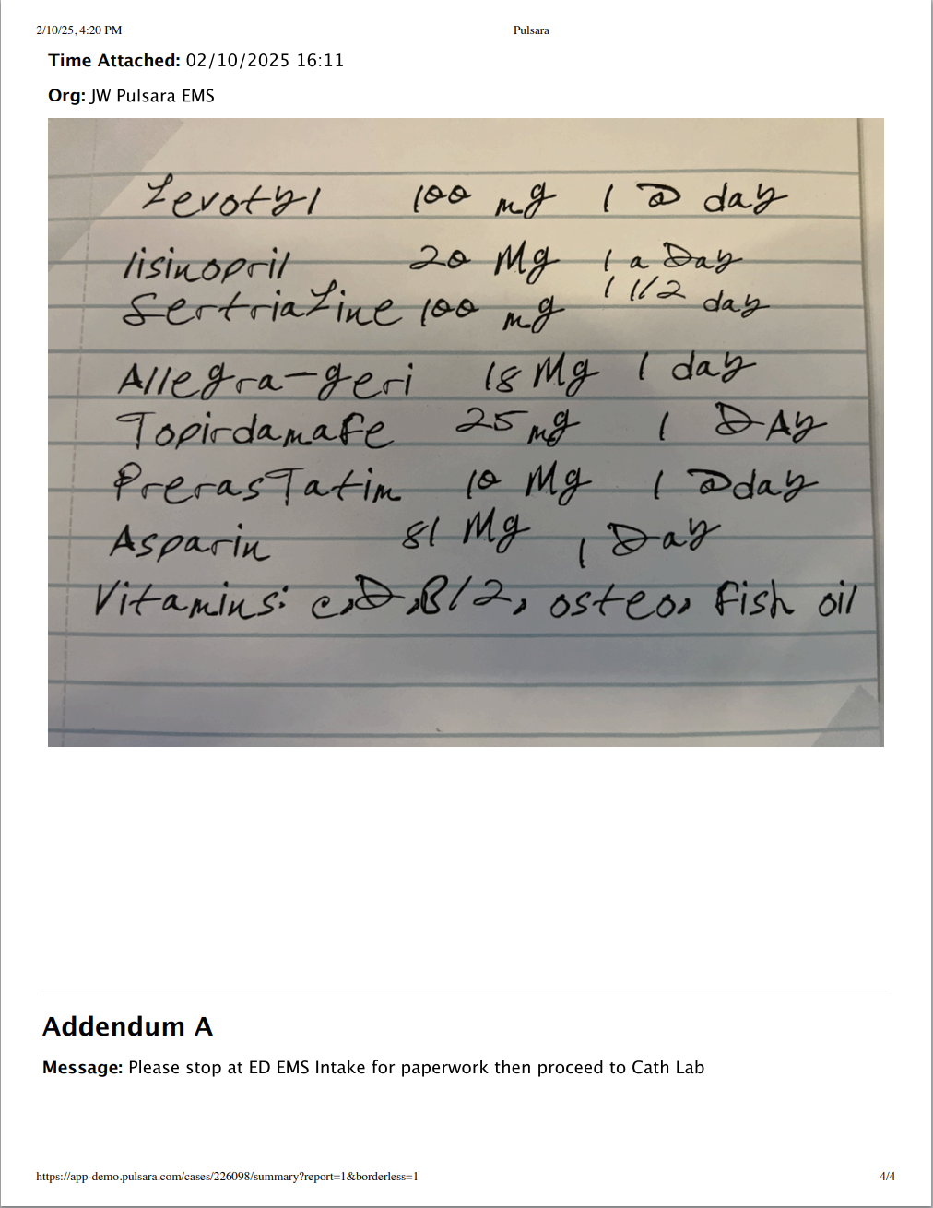
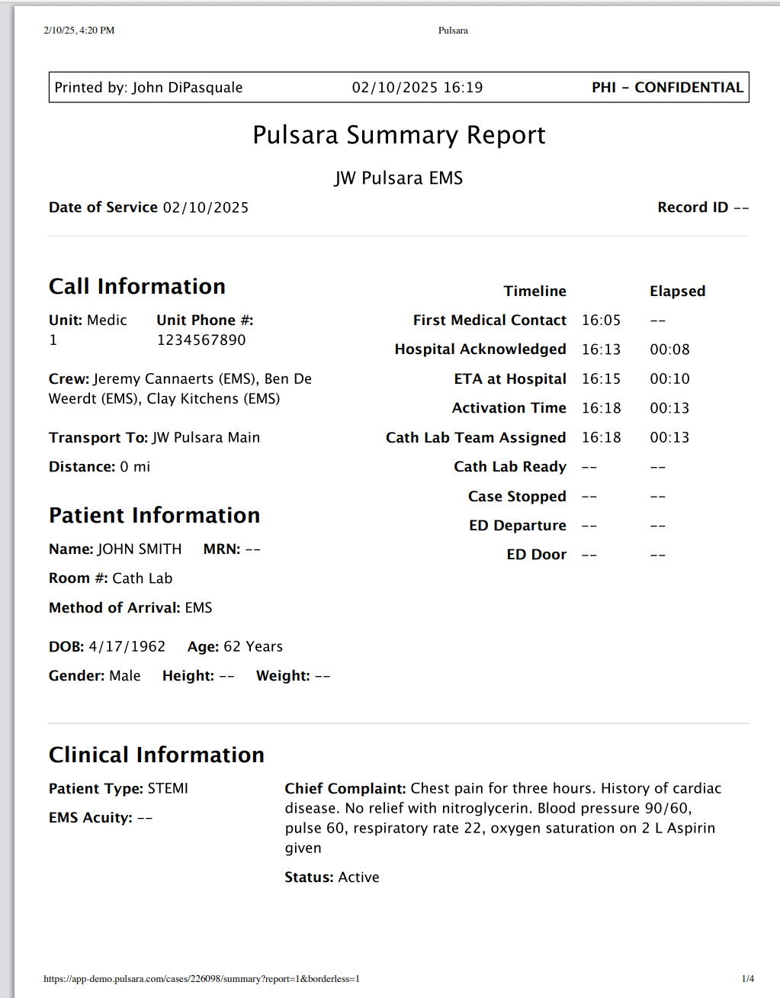
Emergency Dept | Pulsara Summary Report
Pulsara Summary Report (PSR)
Standardized View of data on patient channel
Includes Images and ECGs
Ability to Print or Save PDF
  View Patient Details
  Tap Ellipsis (...)
  View PSR
  Print Dialog
  Print
  Save as PDF
Notes:
Some organizations also upload it to their EHR as a media file or attach it to an alerting or messaging tool.

