Slide 1


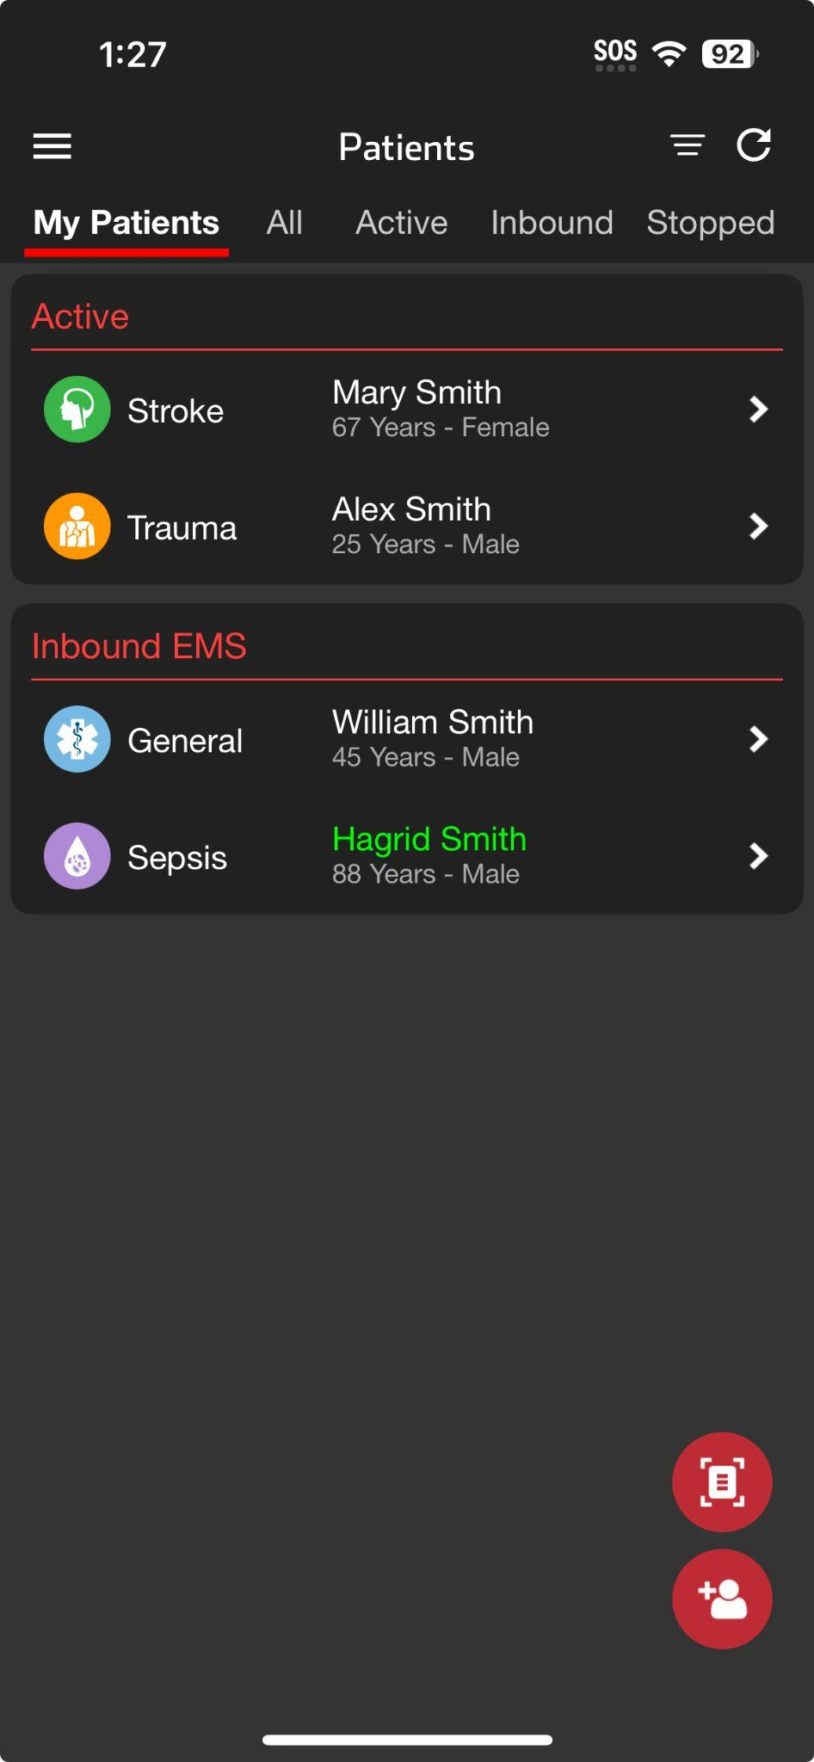
Emergency Dept | Patient List - Mobile
Status Filters
My Patients
Patients assigned to you
Green = New Information
All
  All patients at your organization(s)
      If granted privileges
  Logs you have viewed
  Able to assign to yourself and receive future alerts
Active
Inbound
Stopped
  Able to restart channel if needed
Time Filters (show patients from last)
  12 hours
  1 day
  2 days
  7 days
  30 days
Notes:
The Patient List view is the main screen for daily operations. It displays all patient channels at your organization. If you have privileges at multiple organizations and have linked your accounts, you’ll see them listed separately by organization.
To ensure the list you see is most relevant to your responsibilities, you can filter by status and time.
By default, the list shows “My Patients”—these are patients assigned to you based on your call status and alerting preferences. A green channel indicates new information has been posted.
If you have permission to view all patients, you can tap “All” to see every patient at your organization. This is especially useful during a shift change. For example, if a patient channel was added before you were on call, it won’t appear under “My Patients”—but by selecting “All,” you can find the patient and tap the bell icon in the upper right corner to assign yourself and start receiving alerts.
You can also filter to see only patients activated for downstream care teams or those currently inbound to your facility. If you need to review or restart a recently stopped channel, simply select the “Stopped” filter.
Lastly, you can use Time Filters to narrow the list to patients from the last 12 hours, or from 1, 2, 7, or 30 days.

Slide 2
Emergency Dept | Patient List - Mobile
Status Filters
My Patients
Patients assigned to you
Notes:
By default, the list shows “My Patients”—these are patients assigned to you based on your call status and alerting preferences.

Slide 3
Emergency Dept | Patient List - Mobile
Status Filters
My Patients
Patients assigned to you
Green = New Information
Notes:
A green channel indicates new information has been posted.

Slide 4
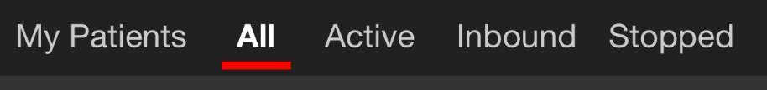
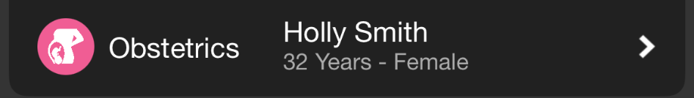
Join an Incident
Emergency Dept | Patient List - Mobile
Status Filters
My Patients
Patients assigned to you
Green = New Information
All
  All patients at your organization(s)
      If granted privileges
  Logs you have viewed
  Able to assign to yourself and receive future alerts
Notes:
If you have permission to view all patients, you can tap “All” to see every patient at your organization. This is especially useful during a shift change. For example, if a patient channel was added before you were on call, it won’t appear under “My Patients”—but by selecting “All,”

Slide 5
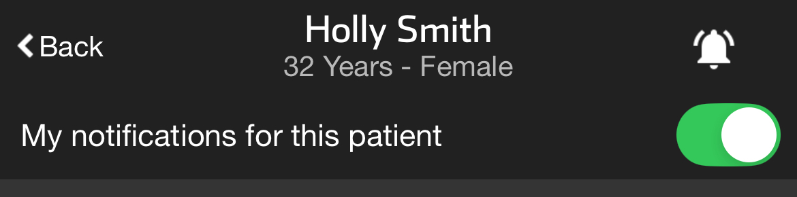
Join an Incident
Emergency Dept | Patient List - Mobile
Status Filters
My Patients
Patients assigned to you
Green = New Information
All
  All patients at your organization(s)
      If granted privileges
  Logs you have viewed
  Able to assign to yourself and receive future alerts
Notes:
you can find the patient and tap the bell icon in the upper right corner to assign yourself and start receiving alerts.

Slide 6
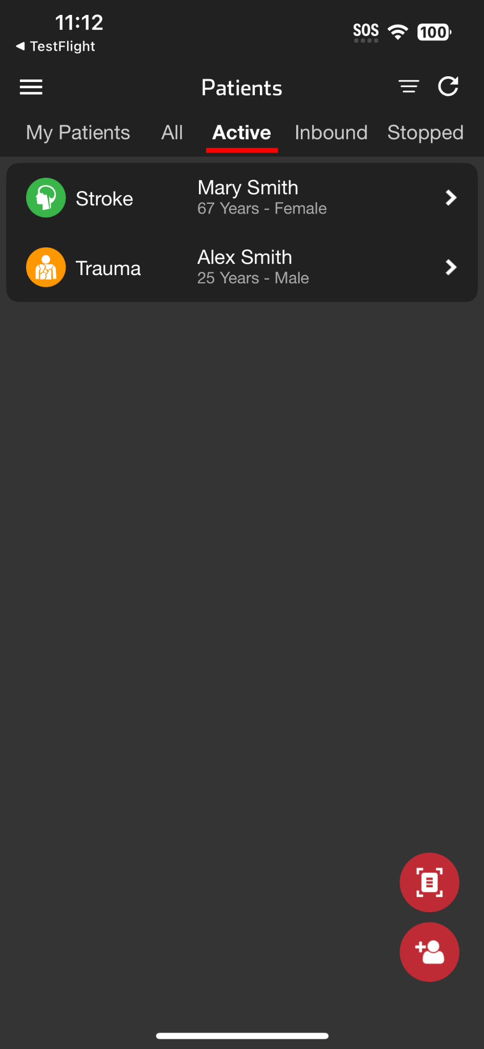
Join an Incident
Emergency Dept | Patient List - Mobile
Status Filters
My Patients
Patients assigned to you
Green = New Information
All
  All patients at your organization(s)
      If granted privileges
  Logs you have viewed
  Able to assign to yourself and receive future alerts
Active
Notes:
You can also filter to see only patients activated for downstream care teams

Slide 7
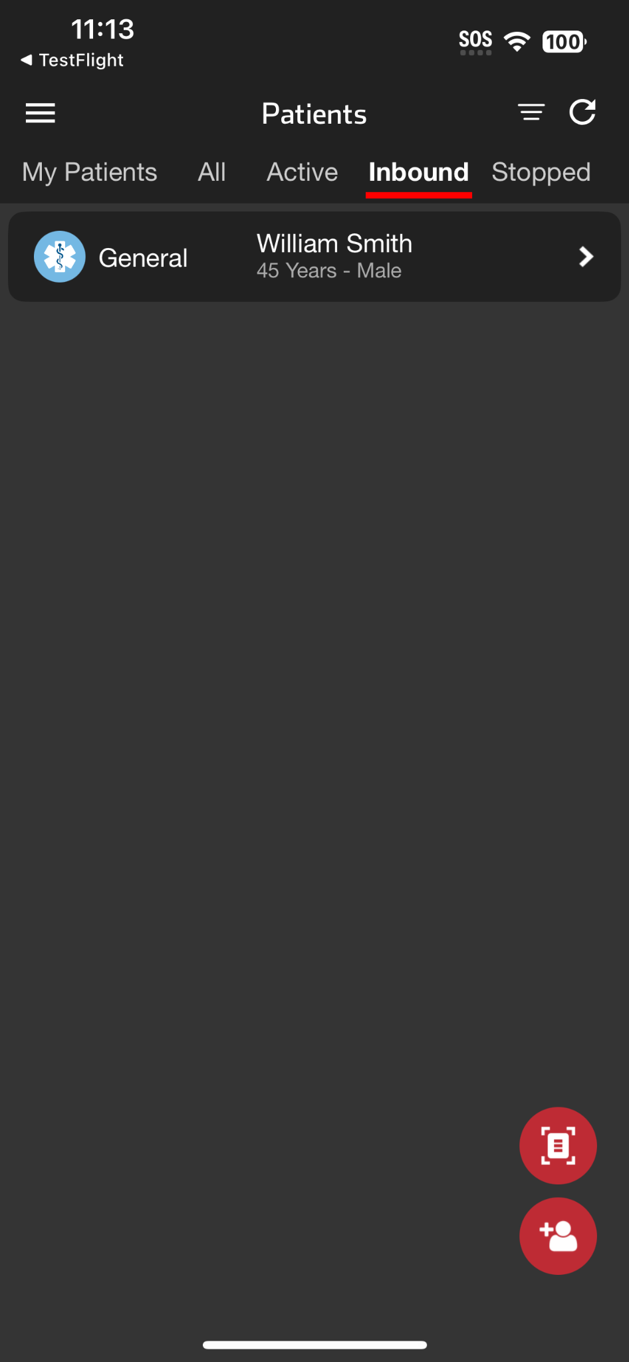
Emergency Dept | Patient List - Mobile
Status Filters
My Patients
Patients assigned to you
Green = New Information
All
  All patients at your organization(s)
      If granted privileges
  Logs you have viewed
  Able to assign to yourself and receive future alerts
Active
Inbound
Notes:
or those currently inbound to your facility.

Slide 8
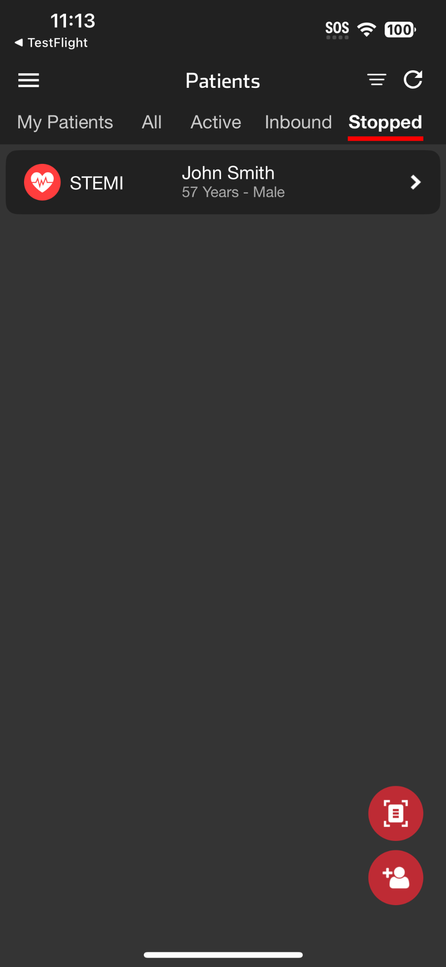
Emergency Dept | Patient List - Mobile
Status Filters
My Patients
Patients assigned to you
Green = New Information
All
  All patients at your organization(s)
      If granted privileges
  Logs you have viewed
  Able to assign to yourself and receive future alerts
Active
Inbound
Stopped
  Able to restart channel if needed
Notes:
If you need to review or restart a recently stopped channel, simply select the “Stopped” filter.

Slide 9
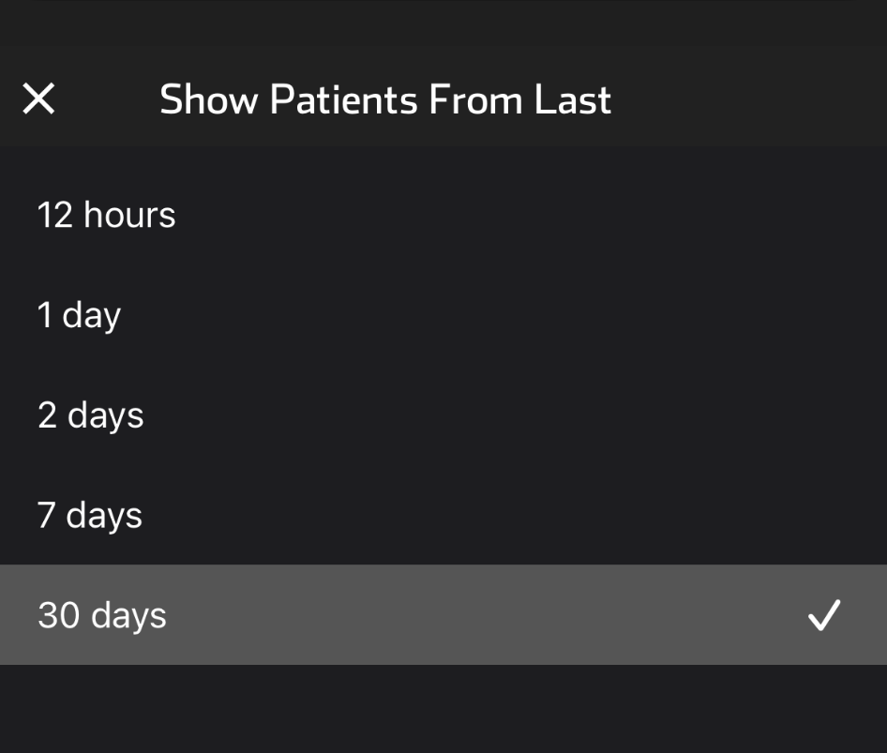
Emergency Dept | Patient List - Mobile
Status Filters
My Patients
Patients assigned to you
Green = New Information
All
  All patients at your organization(s)
      If granted privileges
  Logs you have viewed
  Able to assign to yourself and receive future alerts
Active
Inbound
Stopped
  Able to restart channel if needed
Time Filters (show patients from last)
  12 hours
  1 day
  2 days
  7 days
  30 days
Notes:
Lastly, you can use Time Filters to narrow the list to patients from the last 12 hours, or from 1, 2, 7, or 30 days.

