Slide 1
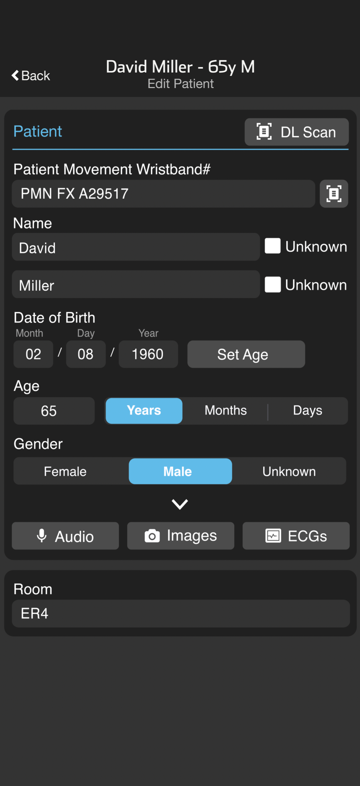
ED | Inbound Patient – Set Arrival Time/Close Channel
Open Patient Channel
From the Patients screen, tap the patient name or
Scan the wristband
Set ED Arrival Time
Scroll down to the Emergency Department card and tap on the ED Arrival time button.
Review or Assign Room (Optional)
Tap Edit on the Patient card to add or update the Room number.
STOP Patient Channel
When communication is no longer needed tap STOP to close the channel.
You can restart the channel, by scrolling to the bottom and tapping the Restart Case button.
Notes:
First, you’ll need to open the patient’s channel. You can either tap their name right from the patient screen, or if they've got a patient movement wristband on, just scan it. For this tutorial, we’ll go ahead and scan the wristband.
Once you’re in the channel, scroll down to the Emergency Department card — it’s at the bottom of the screen. Tap that to set the ED Arrival Time. This lets everyone in the channel know the patient has arrived.
If your team’s using Pulsara to track where the EMS patient is headed, you can update that info in the Patient Card right here in the channel.
And when you’re done — the patient’s arrived and everything’s been updated — just tap STOP to close the channel. Need to reopen it later? No problem. Just tap Restart at the bottom.

Slide 2
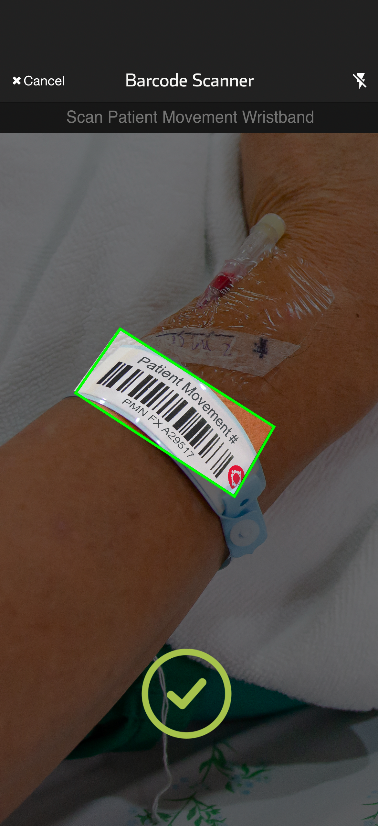
ED | Inbound Patient – Set Arrival Time/Close Channel
Open Patient Channel
From the Patients screen, tap the patient name or
Scan the wristband.
Notes:
First, you’ll need to open the patient’s channel. You can either tap their name right from the patient screen, or if they've got a patient movement wristband on, just scan it. For this tutorial, we’ll go ahead and scan the wristband.

Slide 3
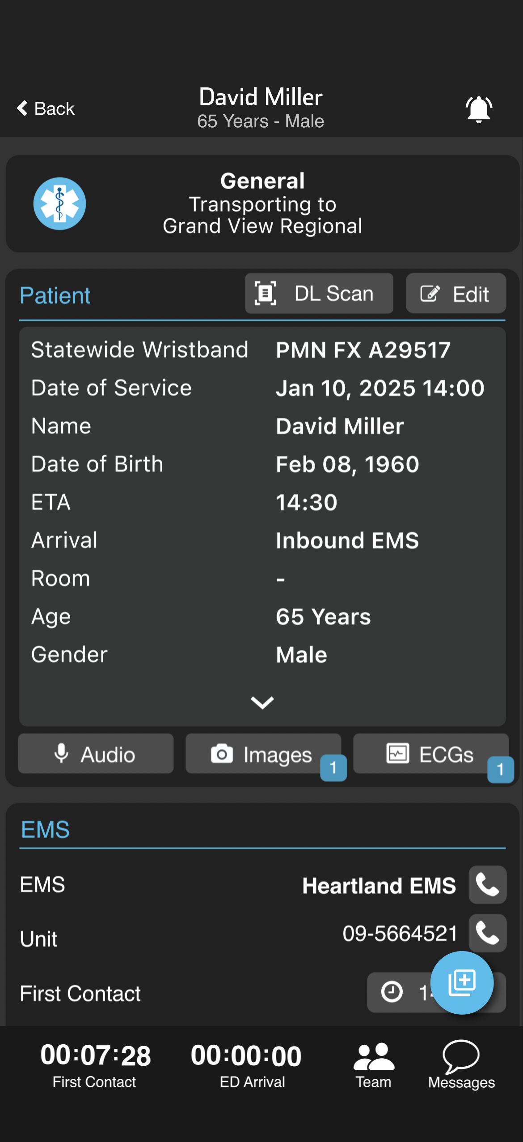
ED | Inbound Patient – Set Arrival Time/Close Channel
Open Patient Channel
From the Patients screen, tap the patient name or
Scan the wristband.
Set ED Arrival Time
Scroll down to the Emergency Department card and tap on the ED Arrival time button.
Notes:
Once you’re in the channel, scroll down to the Emergency Department card — it’s at the bottom of the screen. Tap that to set the ED Arrival Time. This lets everyone in the channel know the patient has arrived.

Slide 4
ED | Inbound Patient – Set Arrival Time/Close Channel
Open Patient Channel
From the Patients screen, tap the patient name or
Scan the wristband
Set ED Arrival Time
Scroll down to the Emergency Department card and tap on the ED Arrival time button.
Review or Assign Room (Optional)
Tap Edit on the Patient card to add or update the Room number.
Notes:
If your team’s using Pulsara to track where the EMS patient is headed, you can update that info in the Patient Card right here in the channel.

Slide 5
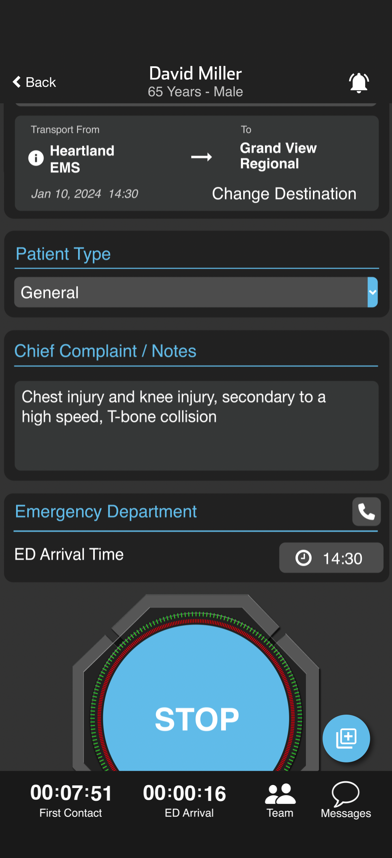
ED | Inbound Patient – Set Arrival Time/Close Channel
Open Patient Channel
From the Patients Screen, tap the patient name or
Scan the Wristband
Set ED Arrival Time
Scroll down to the Emergency Department card and tap on the ED Arrival Time button.
Review or Assign Room (Optional)
Tap Edit on the Patient card to add or update the Room number.
STOP Patient Channel
When communication is no longer needed, tap STOP to close the channel.
You can restart the channel by scrolling to the bottom and tapping the Restart Case button.
Notes:
And when you’re done — the patient’s arrived and everything’s been updated — just tap STOP to close the channel. Need to reopen it later? No problem. Just tap Restart at the bottom.

