Slide 1


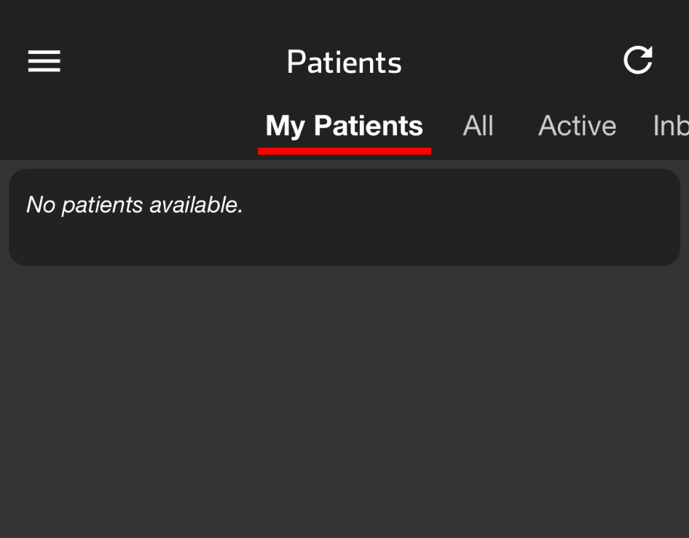
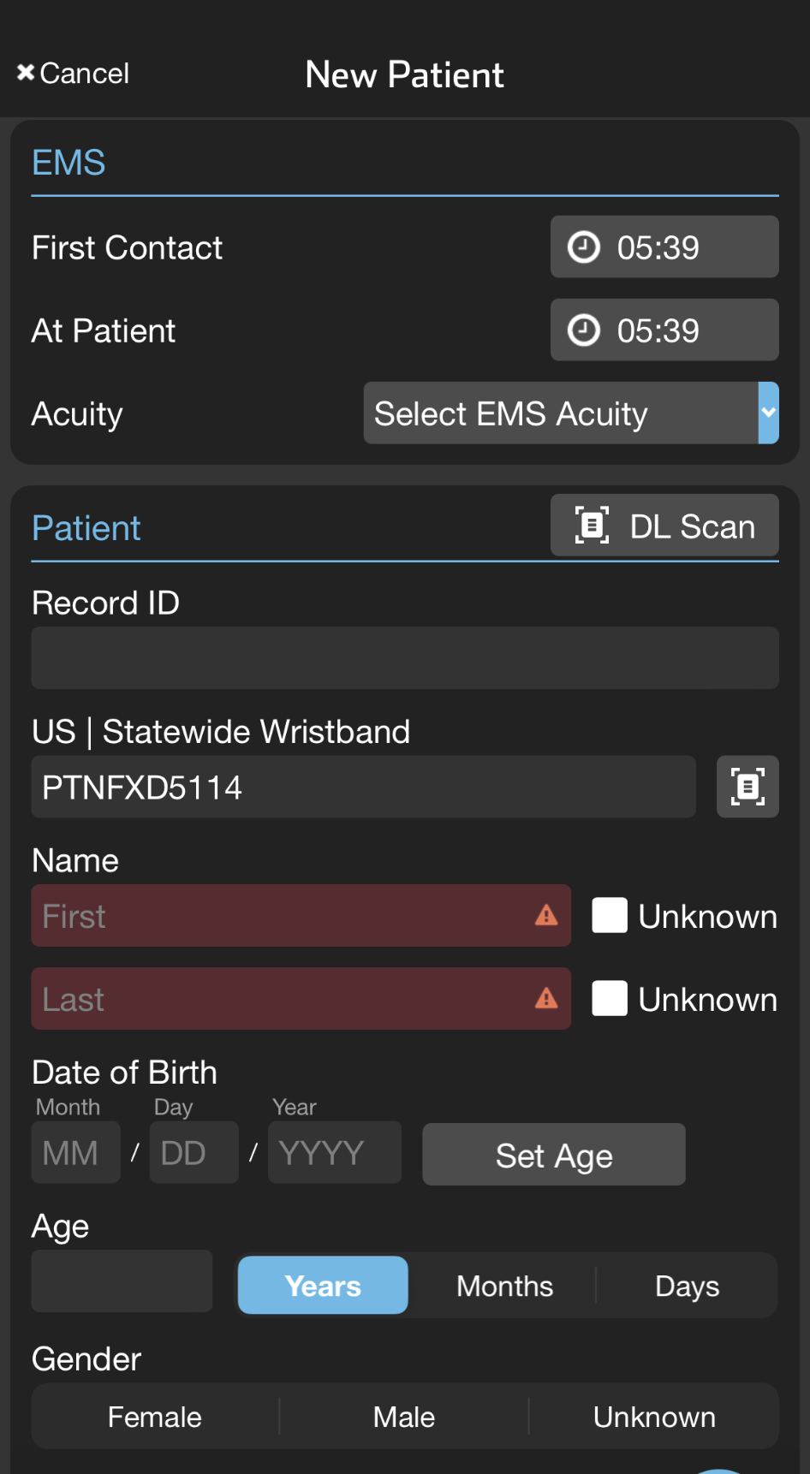
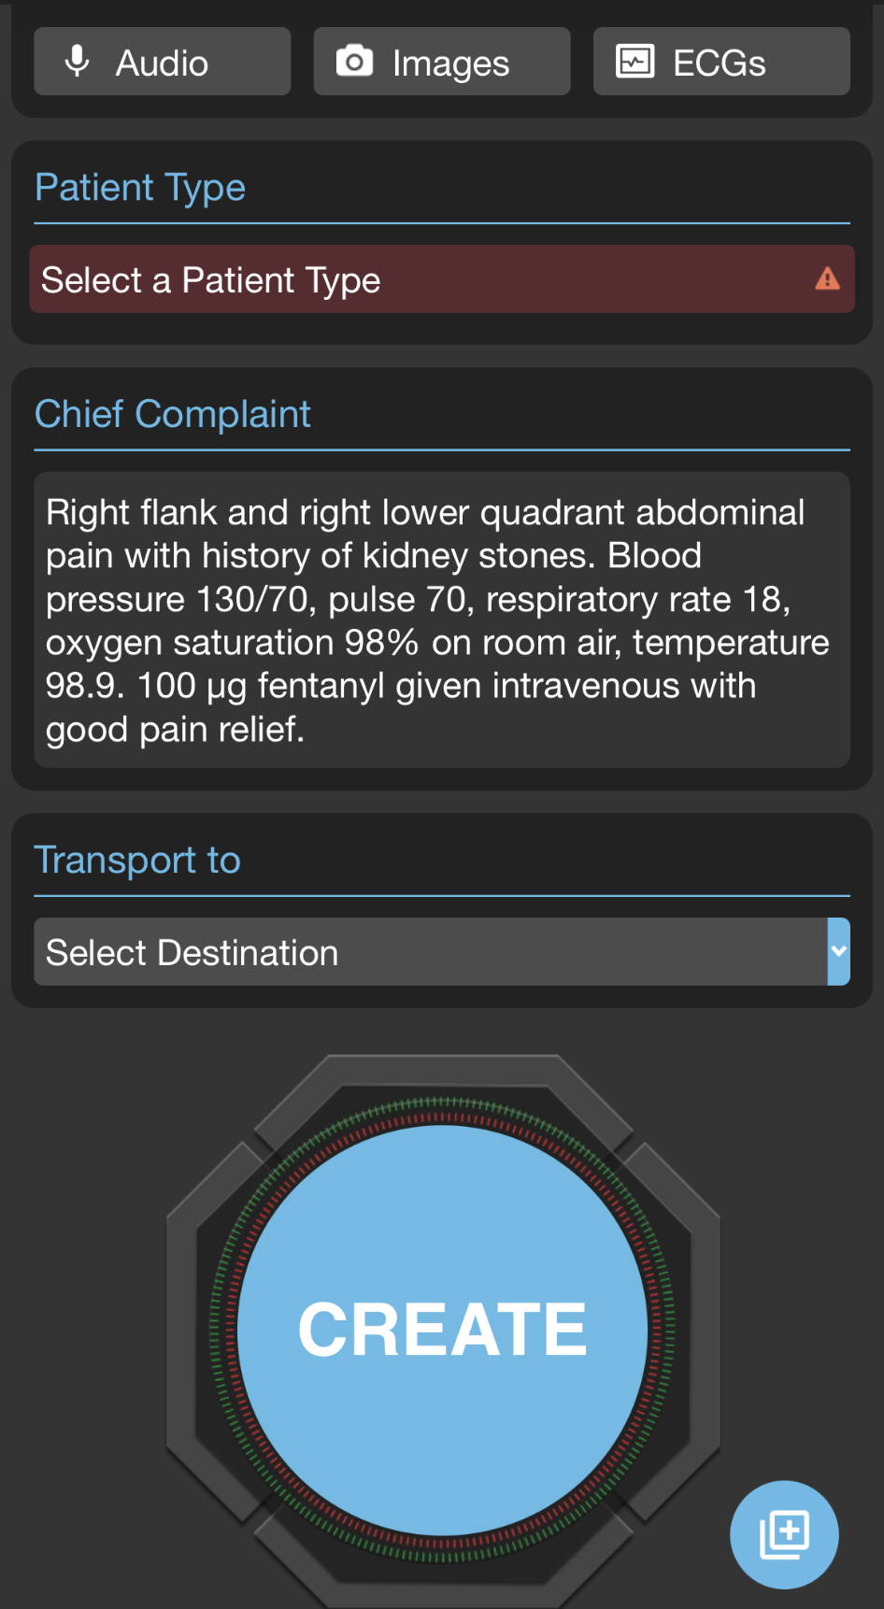



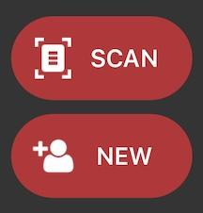


EMS | Create Patient - Prehospital Notification
Scan Wristband - Create Patient
Tap NEW if not using Patient Movement wristband
Scan Driver’s License - Demographics
Enter demographics manually if not available
Rapid: Unknown name, estimated Age, Gender
Photos
Images: Patient, scene, paperwork…
ECG: Photo or attach from monitor
Patient Type
Select General
Upgrade as needed anytime
Voice to Text additional details
Dictate your normal prehospital report
“Eat the mic” - Hold microphone close to mouth
Note: All patient information can be added at any time, before or after patient creation.
Include:
Chief Complaint and HPI
Key Findings
Vitals
Interventions
WATCH
VIDEO
Create Patient | Alert Hospital
Create: Tap Create to create channel now but alert hospital later
Alert Hospital Now: Tap Select Destination then Alert
  Create button is replaced with Alert after destination is set
Notes:
How to create a patient channel and notify the hospital.

Slide 2
EMS | Create Patient - Prehospital Notification
1. Scan the Wristband to Create Patient
2. Scan Driver’s License for Demographics
3. Take Photos
Images
ECG
4. Voice to Text Additional Details
Chief Complaint and HPI
Key Findings
Vitals
Interventions
Notes:
The key to this process is to remember the phrase: Scan, Photos, Voice to Text. This simple workflow will help you quickly build your prehospital report. First, scan the patient’s wristband and Driver’s License, add any necessary photos, and then use voice-to-text for the rest of the report. Now, let’s break it down step by step.

Slide 3
EMS | Create Patient - Prehospital Notification
Scan Wristband - Create Patient
Tap NEW if not using Patient Movement wristband
Notes:
If your region uses Patient Movement Wristbands, begin by applying a wristband to the patient and tapping Scan. If wristbands are not used, simply tap New to start the process.

Slide 4
EMS | Create Patient - Prehospital Notification
Scan Wristband - Create Patient
Tap NEW if not using Patient Movement wristband
Scan Driver’s License - Demographics
Enter demographics manually if not available
Rapid: Unknown name, estimated Age, Gender
Notes:
Next, scan the Driver’s License to automatically add the patient’s demographics.

Slide 5
EMS | Create Patient - Prehospital Notification
Scan Wristband - Create Patient
Tap NEW if not using Patient Movement wristband
Scan Driver’s License - Demographics
Enter demographics manually if not available
Rapid: Unknown name, estimated Age, Gender
Notes:
If the Driver’s License isn’t available, you can manually enter the information or select Unknown. While not required, entering an estimated age and gender can be helpful.

Slide 6
EMS | Create Patient - Prehospital Notification
Scan Wristband - Create Patient
Tap NEW if not using Patient Movement wristband
Scan Driver’s License - Demographics
Enter demographics manually if not available
Rapid: Unknown name, estimated Age, Gender
Photos
Images: Patient, scene, paperwork…
Notes:
Once that’s done, tap Images to add photos of anything relevant, like the patient’s injuries, the scene, a medication list, paperwork, or personal belongings.

Slide 7
EMS | Create Patient - Prehospital Notification
Scan Wristband - Create Patient
Tap NEW if not using Patient Movement wristband
Scan Driver’s License - Demographics
Enter demographics manually if not available
Rapid: Unknown name, estimated Age, Gender
Photos
Images: Patient, scene, paperwork…
ECG: Photo or attach from monitor
Notes:
If you need to add an ECG, tap ECG and either take a photo or attach it if your agency uses an integrated system.

Slide 8
EMS | Create Patient - Prehospital Notification
Scan Wristband - Create Patient
Tap NEW if not using Patient Movement wristband
Scan Driver’s License - Demographics
Enter demographics manually if not available
Rapid: Unknown name, estimated Age, Gender
Photos
Images: Patient, scene, paperwork…
ECG: Photo or attach from monitor
Patient Type
Select General
Upgrade as needed anytime
Notes:
When you select the patient type, most patients will fall under the General category. However, if it’s a time-sensitive emergency, you can upgrade the patient type now or at a later time, if appropriate.

Slide 9
EMS | Create Patient - Prehospital Notification
Scan Wristband - Create Patient
Tap NEW if not using Patient Movement wristband
Scan Driver’s License - Demographics
Enter demographics manually if not available
Rapid: Unknown name, estimated Age, Gender
Photos
Images: Patient, scene, paperwork…
ECG: Photo or attach from monitor
Patient Type
Select General
Upgrade as needed anytime
Voice to Text additional details
Dictate your normal prehospital report
Notes:
Now it’s time to focus on the Chief Complaint and Notes field. Use voice-to-text to dictate the remainder of your report. This is the same report you would typically give over the radio or phone, but now it’s enhanced with multimedia.

Slide 10
EMS | Create Patient - Prehospital Notification
Scan Wristband - Create Patient
Tap NEW if not using Patient Movement wristband
Scan Driver’s License - Demographics
Enter demographics manually if not available
Rapid: Unknown name, estimated Age, Gender
Photos
Images: Patient, scene, paperwork…
ECG: Photo or attach from monitor
Patient Type
Select General
Upgrade as needed anytime
Voice to Text additional details
Dictate your normal prehospital report
“Eat the mic” - Hold microphone close to mouth
Include:
Chief Complaint and HPI
Key Findings
Vitals
Interventions
Notes:
The field should include the chief complaint, the history of the present illness, key findings, vitals, and any interventions you’ve performed. Keep in mind that some components of the traditional radio report—like the patient’s age, gender, your unit, and the ETA—are already included, so there’s no need to repeat those. While you can type the information, most people prefer using voice-to-text. Just remember to hold the microphone close to your mouth to ensure it works effectively, even in noisy environments.

Slide 11
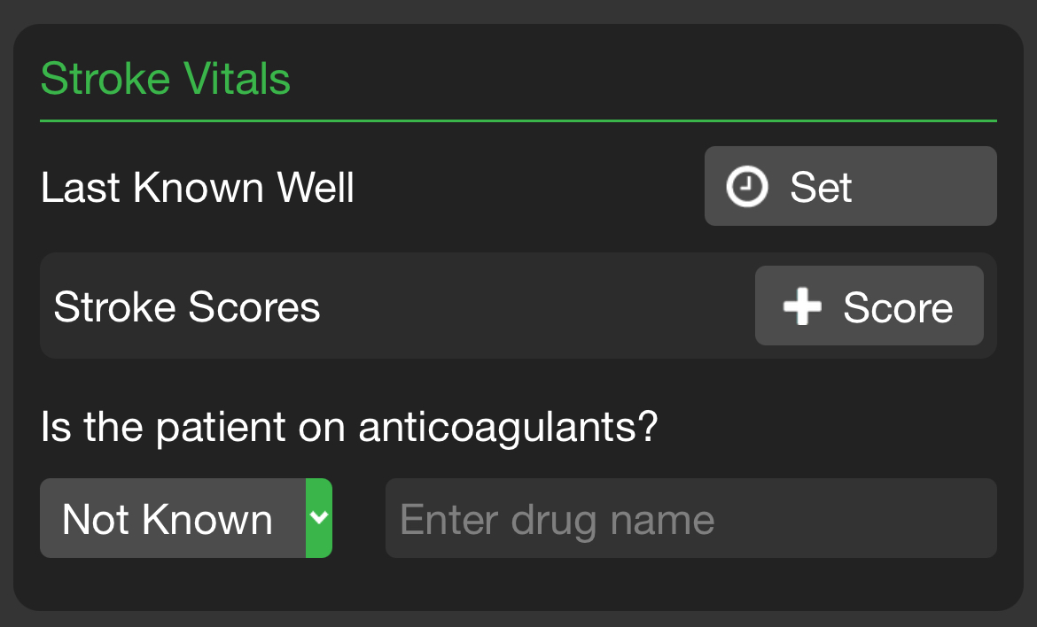
EMS | Create Patient - Prehospital Notification
Scan Wristband - Create Patient
Tap NEW if not using Patient Movement wristband
Scan Driver’s License - Demographics
Enter demographics manually if not available
Rapid: Unknown name, estimated Age, Gender
Photos
Images: Patient, scene, paperwork…
ECG: Photo or attach from monitor
Patient Type
Select General
Upgrade as needed anytime
Voice to Text additional details
Dictate your normal prehospital report
Include:
Chief Complaint and HPI
Key Findings
Vitals
Interventions
Notes:
For stroke cases, there are a few additional fields specifically designed for stroke-related information.

Slide 12
EMS | Create Patient - Prehospital Notification
Scan Wristband - Create Patient
Tap NEW if not using Patient Movement wristband
Scan Driver’s License - Demographics
Enter demographics manually if not available
Rapid: Unknown name, estimated Age, Gender
Photos
Images: Patient, scene, paperwork…
ECG: Photo or attach from monitor
Patient Type
Select General
Upgrade as needed anytime
Voice to Text additional details
Dictate your normal prehospital report
“Eat the mic” - Hold microphone close to mouth
Include:
Chief Complaint and HPI
Key Findings
Vitals
Interventions
Notes:
You can always add more details later using the universal add button in the lower right-hand corner, but we encourage you to stick to the simple Scan, Photo, Voice to Text workflow as much as possible.

Slide 13
EMS | Create Patient - Prehospital Notification
Scan Wristband - Create Patient
Tap NEW if not using Patient Movement wristband
Scan Driver’s License - Demographics
Enter demographics manually if not available
Rapid: Unknown name, estimated Age, Gender
Photos
Images: Patient, scene, paperwork…
ECG: Photo or attach from monitor
Patient Type
Select General
Upgrade as needed anytime
Voice to Text additional details
Dictate your normal prehospital report
“Eat the mic” - Hold microphone close to mouth
Include:
Chief Complaint and HPI
Key Findings
Vitals
Interventions
Create Patient | Alert Hospital
Create: Tap Create to create channel now but alert hospital later
Notes:
At this point, you have two options. You can either create the patient channel, which saves all the information to the cloud and allows you to alert the hospital later, or you can notify the hospital right away.

Slide 14
EMS | Create Patient - Prehospital Notification
Scan Wristband - Create Patient
Tap NEW if not using Patient Movement wristband
Scan Driver’s License - Demographics
Enter demographics manually if not available
Rapid: Unknown name, estimated Age, Gender
Photos
Images: Patient, scene, paperwork…
ECG: Photo or attach from monitor
Patient Type
Select General
Upgrade as needed anytime
Voice to Text additional details
Dictate your normal prehospital report
“Eat the mic” - Hold microphone close to mouth
Include:
Chief Complaint and HPI
Key Findings
Vitals
Interventions
Create Patient | Alert Hospital
Create: Tap Create to create channel now but alert hospital later
Alert Hospital Now: Tap Select Destination then Alert
  Create button is replaced with Alert after destination is set
Notes:
To do that, tap Select Destination.

Slide 15
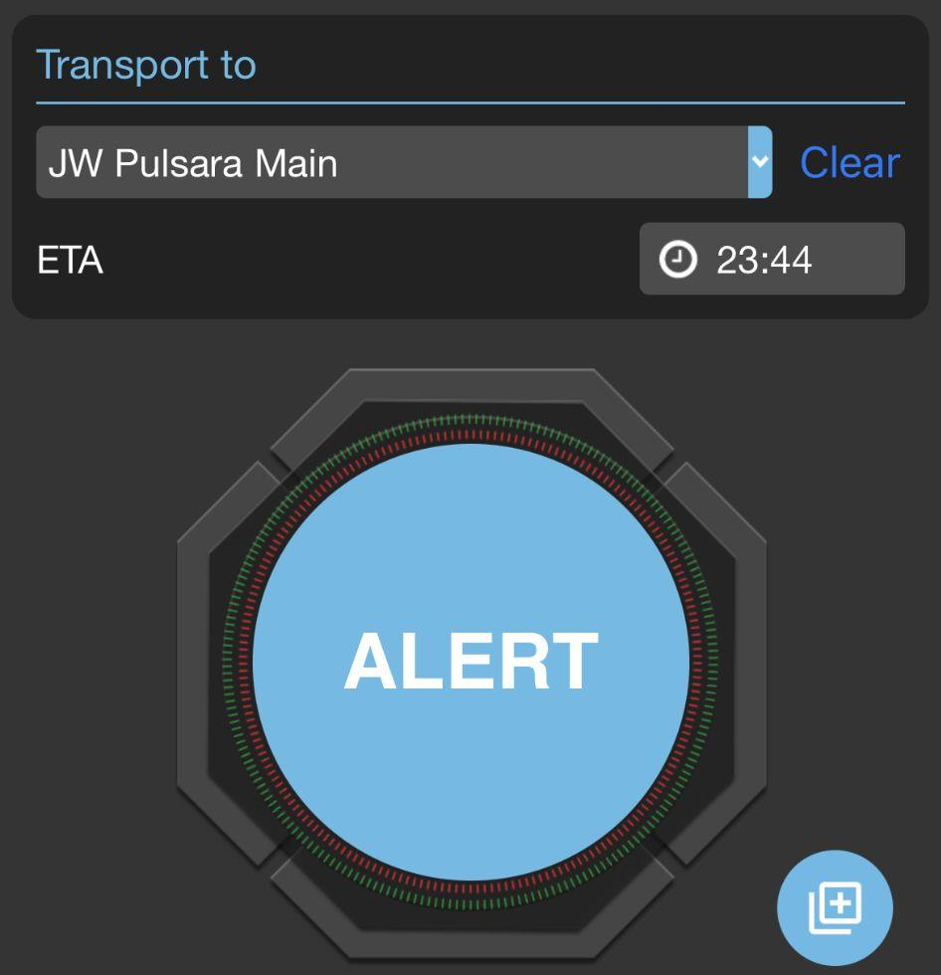
EMS | Create Patient - Prehospital Notification
Scan Wristband - Create Patient
Tap NEW if not using Patient Movement wristband
Scan Driver’s License - Demographics
Enter demographics manually if not available
Rapid: Unknown name, estimated Age, Gender
Photos
Images: Patient, scene, paperwork…
ECG: Photo or attach from monitor
Patient Type
Select General
Upgrade as needed anytime
Voice to Text additional details
Dictate your normal prehospital report
“Eat the mic” - Hold microphone close to mouth
Include:
Chief Complaint and HPI
Key Findings
Vitals
Interventions
Create Patient | Alert Hospital
Create: Tap Create to create channel now but alert hospital later
Alert Hospital Now: Tap Select Destination then Alert
  Create button is replaced with Alert after destination is set
Notes:
ETA is auto calculated but you can adjust if needed.

Slide 16
EMS | Create Patient - Prehospital Notification
Scan Wristband - Create Patient
Tap NEW if not using Patient Movement wristband
Scan Driver’s License - Demographics
Enter demographics manually if not available
Rapid: Unknown name, estimated Age, Gender
Photos
Images: Patient, scene, paperwork…
ECG: Photo or attach from monitor
Patient Type
Select General
Upgrade as needed anytime
Voice to Text additional details
Dictate your normal prehospital report
“Eat the mic” - Hold microphone close to mouth
Include:
Chief Complaint and HPI
Key Findings
Vitals
Interventions
Create Patient | Alert Hospital
Create: Tap Create to create channel now but alert hospital later
Alert Hospital Now: Tap Select Destination then Alert
  Create button is replaced with Alert after destination is set
Notes:
To alert the hospital, simply tap Alert.
Remember, you can always add or edit information at any time.

