Slide 1
SAME PATIENT MOVEMENT SYSTEM
EVERY DAY
EVERY EVENT
Notes:
Pulsara is The communication and logistics platform used in your region that unites distributed teams and fragmented technologies during dynamic events. The most common events are Patient Movement Events. This video will highlight how Pulsara is used in Transfer Operations.

Slide 2
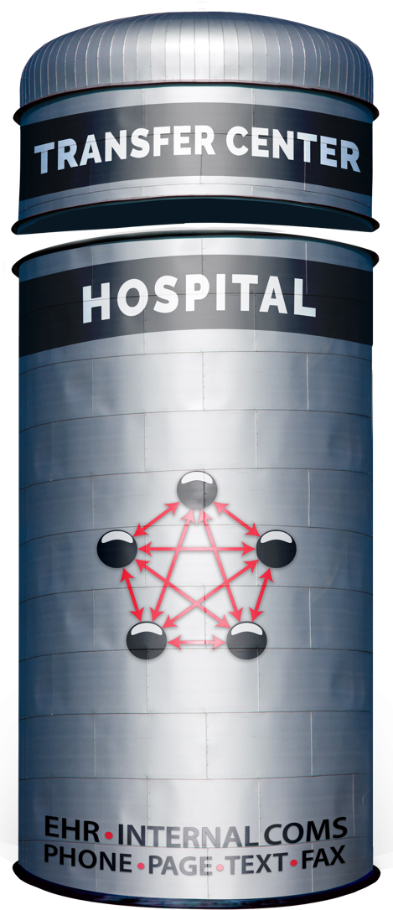


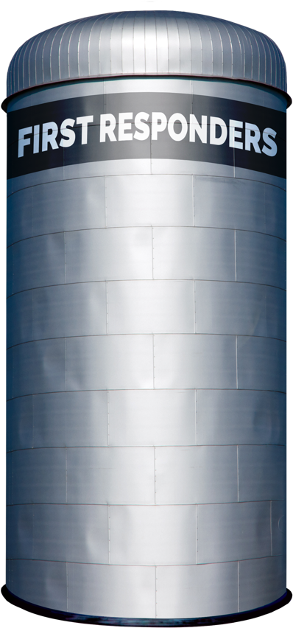
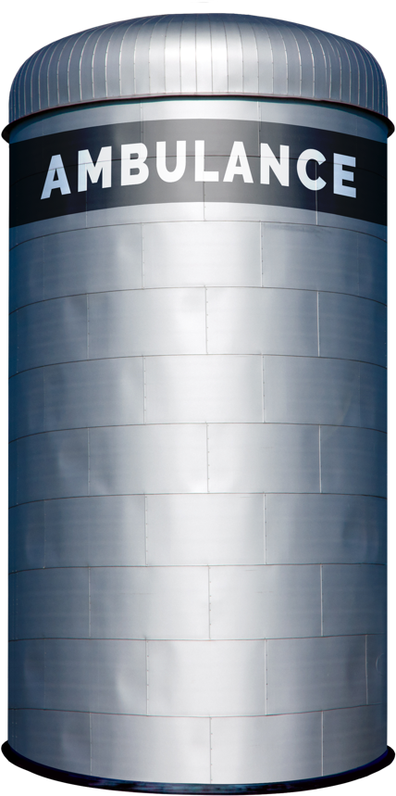

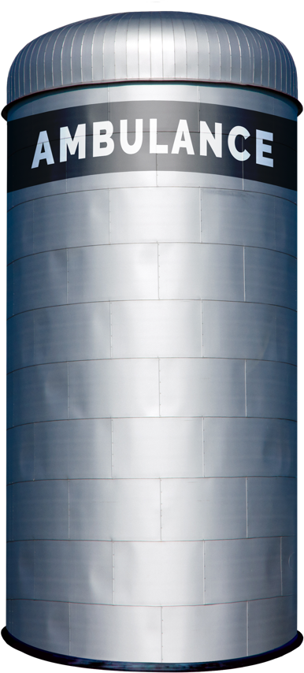


Traditional Patient Movement
Teleconsult
Phone
Secure
Msg
Page
Verbal
Handoff
Electronic
Notifications
Radio
Phone
ECG
ePCR or
Electronic
Notifications
Phone
Bedside
Handoff
Radio
Phone
Bedside
Handoff
Each Red Arrow Represents a Separate Communication Channel
COMMUNICATION CHANNELS: Numerous
Notes:
Coordinating patient movement across organizations involves managing multiple communication channels, including radio reports, phone calls, alerting tools, messaging systems, and intermediaries like transfer centers.
The red lines in the diagram illustrate these complex communication paths. Many Transfer Center Operations are integrated into larger Command or Access Centers, where they face highly inefficient workflows during time-sensitive emergencies like STEMI, stroke, and trauma. In these scenarios, care teams are often spread across multiple departments and organizations, adding to the challenge.
Even for routine inter-facility transfers, Transfer Center Agents primarily rely on multiple phone calls to coordinate communication among individuals at the referring hospital, the interfacility transport agency, and the receiving hospital.

Slide 3


Distributed Team Challenges
CALL LIST
Who’s on call today? Did they get their alert?
The call list is wrong. What do I do?
I can’t stop my alerts when I’m done.
PATIENT IDENTIFICATION
Why can’t my alert include the patient’s name so I can pull PMH or old studies / images?
I have 5 different “secure message” threads about 2 different patients and 4 ECGs with no names on them.
I can’t do anything until the patient is registered.
UNNECESSARY COMPLEXITY
Why is it so hard to de-escalate our system once it’s in motion?
Where is the patient now?
Why do we have different protocols for different methods of arrival and different times of day?
Why can’t we provide timely feedback to EMS and referral partners?
Traditional Patient Movement Challenges
Notes:
These are just a few of the common issues that arise, affecting patient safety, outcomes, treatment times, efficiency, and overall costs.

Slide 4

Transfer Agent Challenges
CALLS & CALL LISTS
Too many calls—I can handle multiple messages at once, but only one call. Why can’t I text instead?
Nobody calls back, and then everyone calls back at once.
What’s the callback number in case I get disconnected?!
I can’t listen to my voicemails because the phone keeps ringing!
Why is it so hard to find out who’s on call for each of the service lines?
Did they get their alert? Why aren’t they answering or calling back?
It’s impossible to call all the people that need this update.
OTHER CHALLENGES
I have too many people here with not enough volume. But 15 minutes later, I need more staff!
I wish the notification had enough information in it to cut down on all the follow-up questions!
It’s so hard to get transport and nobody knows when they will arrive.
Traditional Patient Movement Challenges
Notes:
Imagine trying to coordinate a group dinner with eight friends, relying primarily on phone calls. In today’s world, we wouldn’t even consider doing that in our personal lives. Yet, that’s exactly what we ask our Transfer Center Agents to do every day, which is why they can relate to the challenges and frustrations you see on this slide.

Slide 5

Transfer Care Team Challenges
RECEIVING FACILITY
Where are they? When will they get here? Wait… they haven’t even left yet?!…
What do you mean the patient is here?!
Who accepted the patient, and what’s the plan once they get here?
Why didn’t they give me that update?!?
I wish I would have asked ____
This patient should have been auto-accepted.
If I’d just seen a photo or done a quick video call, I could’ve treated this patient in the clinic instead of transferring them.
REFERRAL FACILITY
They don’t understand how sick the patient is.
I need to call three facilities at once to get someone to take this patient quickly.
If I’m on the phone, there is nobody with the patient.
How many times do I need to answer the same question?
Where is transport?
I’d feel comfortable sending them home if the specialist said it was okay after reviewing a photo or doing a video call.
Traditional Patient Movement Challenges
Notes:
The “telephone game” can be especially frustrating for frontline clinicians and staff at both the referring and receiving facilities.

Slide 6
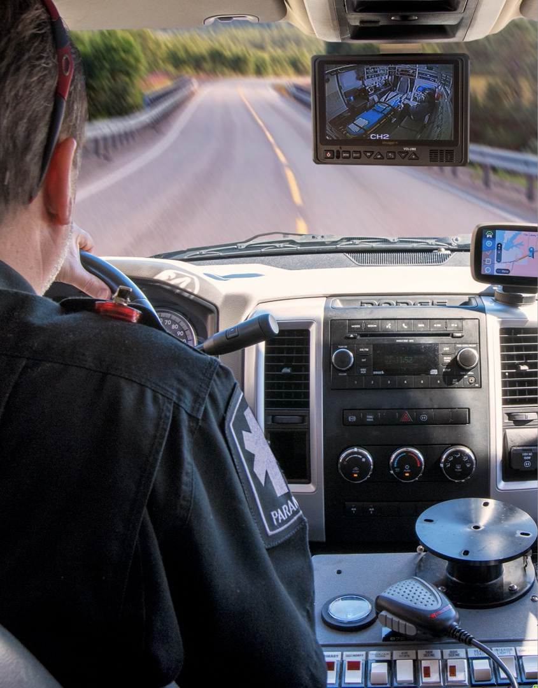
Interfacility Transport Crew Challenges
Where do I go at the referral AND receiving hospital?
It is difficult to get an updated ETA to the correct people at the referral AND receiving hospital.
It is difficult to provide an update on the patient's condition if there are significant changes en route, especially during long transports.
It is difficult to get communication back from the facility about room changes or other pertinent updates.
Traditional Patient Movement Challenges
Notes:
Even primary inter-facility transport agencies face challenges stemming from outdated communication technology.

Slide 7
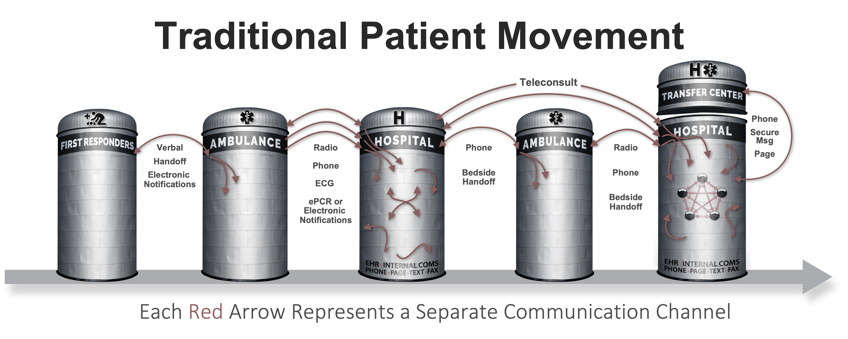






Patient Movement with
3
EHR
Radiology
Create Channel
Build Team
Communicate
ECG
Monitor
STEPS
ePCR
…
Pulsara
API
UNIFIED CARE TEAM
PATIENT MOVEMENT
Notes:
Pulsara’s Patient Movement System offers a HIPAA-compliant solution for streamlining communication and logistics across organizations. Think of it as a HIPAA Compliant secure group chat that integrates public safety and healthcare teams.
You simply create a dedicated communication channel for each patient encounter, build the care team, and begin communication.
The Pulsara API also allows you to move data into and out of the channel.
Regions use Pulsara daily for EMS-to-ED communications. Many regions and states also adopt the Patient Movement System for large-scale situations like mass casualty incidents, mass evacuations, load balancing initiatives, and more.
Hospitals can enhance their capabilities with Pulsara TRANSFER OPS or Pulsara UNITED, which allows Transfer Centers the ability to receive inter-facility consult and transfer requests and even add specialists or downstream care teams to the patient channel.

Slide 8
UPGRADES
UPGRADES
Transfer Functionality by Package
Transfer Functionality by Package
INFRASTRUCTURE
INFRASTRUCTURE
PACKAGE OPTIONS
All hospital bundles include either Pulsara ONE or Pulsara MED OPS. Hospitals can upgrade to Pulsara UNITED which includes all Transfer functionality OR they can add Pulsara TRANSFER OPS and/or Pulsara SELECT to meet their needs.
PACKAGE OPTIONS
All hospital bundles include either Pulsara ONE or Pulsara MED OPS. Hospitals can upgrade to Pulsara UNITED which includes all Transfer functionality OR they can add Pulsara TRANSFER OPS and/or Pulsara SELECT to meet their needs.
Pulsara
ONE
Pulsara
ONE
Pulsara
MED OPS
Pulsara
MED OPS
Pulsara
TRANSFER OPS
Pulsara
TRANSFER OPS
Pulsara
UNITED
Pulsara
UNITED
Pulsara
SELECT
Pulsara
SELECT
v
v
v
v
AND/OR
OR
AND/OR
OR
OR
OR
Send Request
Send Request
ALL
ALL
ALL
ALL
ALL
ALL
ALL
ALL
ALL
ALL
ALL
ALL
ALL
ALL
ALL
ALL
Receive Request
Receive Request
ALL
ALL
1-2
ALL
1-2
ALL
ALL
ALL
ALL
ALL
ALL
ALL
ALL
ALL
Add Physician Consultants for Consult &
Transfer Requests
Add Physician Consultants for Consult &
Transfer Requests
ALL
ALL
ALL
1-2
ALL
1-2
1-2
ALL
1-2
ALL
ALL
ALL
Add Downstream Teams (STEMI, Stroke, Trauma,
OB, Behavioral Health, Toxicology, Sepsis…)
Add Downstream Teams (STEMI, Stroke, Trauma,
OB, Behavioral Health, Toxicology, Sepsis…)
1-2
1-2
ALL
ALL
ALL
ALL
1-2
1-2
Adds 1-2
Patient Types
Adds 1-2
Patient Types
Always Free to Everyone
Includes ALL
Transfer Functionality
Includes ALL
Transfer Functionality
Always Free to Everyone
Free to Hospitals in MED OPS Regions
Free to Hospitals in MED OPS Regions
Adds
Consultants
Adds
Consultants
Notes:
All U.S. hospitals can join the Pulsara network for free with the Pulsara ONE package. This allows them to receive EMS traffic and create patient channels for consults or transfer requests. That means any referral hospital in your region can use Pulsara to refer patients to you, make live video calls, and access the platform—at no cost.
If your region uses Pulsara MED OPS, your Transfer Center can also receive inter-facility requests through Pulsara, fully integrated with your existing workflows, and again, at no additional cost.
For expanded capabilities, optional upgrades are available. Pulsara TRANSFER OPS lets you include physician consultants in inter-facility requests. With Pulsara SELECT, you can involve downstream care teams like STEMI, Stroke, or Trauma for one or two patient types. These can be bundled or purchased separately.
Or, upgrade to Pulsara UNITED for full transfer functionality across all patient types.

Slide 9

Alerting Basics (Who, How, When)
WHO
Driven by Teams
Identify your Teams
Place individuals on Teams
  Able to be on more than one Team
  HOW
Call Status
  ON Call = Alert
  OFF Call = No Alert
Workflow Triggered Alerts
  Method of Arrival / Status
  Pulsara MED OPS: Incident
  Pulsara UNITED: Other options
Manual: Team or Individual
Alerting | Who, How, & When
Notes:
Configuring Pulsara Alerting to fit specific workflows is straightforward. You simply decide WHO is alerted and WHEN they need to receive their alert.
Alerting is based on teams—like transfer center, trauma team, trauma surgeon, or House Supervisor teams—and can even be configured for different specialty groups.
If you’re on call, you receive alerts for new patients; if you’re off call, you don’t.
WHEN teams are alerted is automatically triggered by workflow, but you can also manually add teams or individuals as needed.

Slide 10
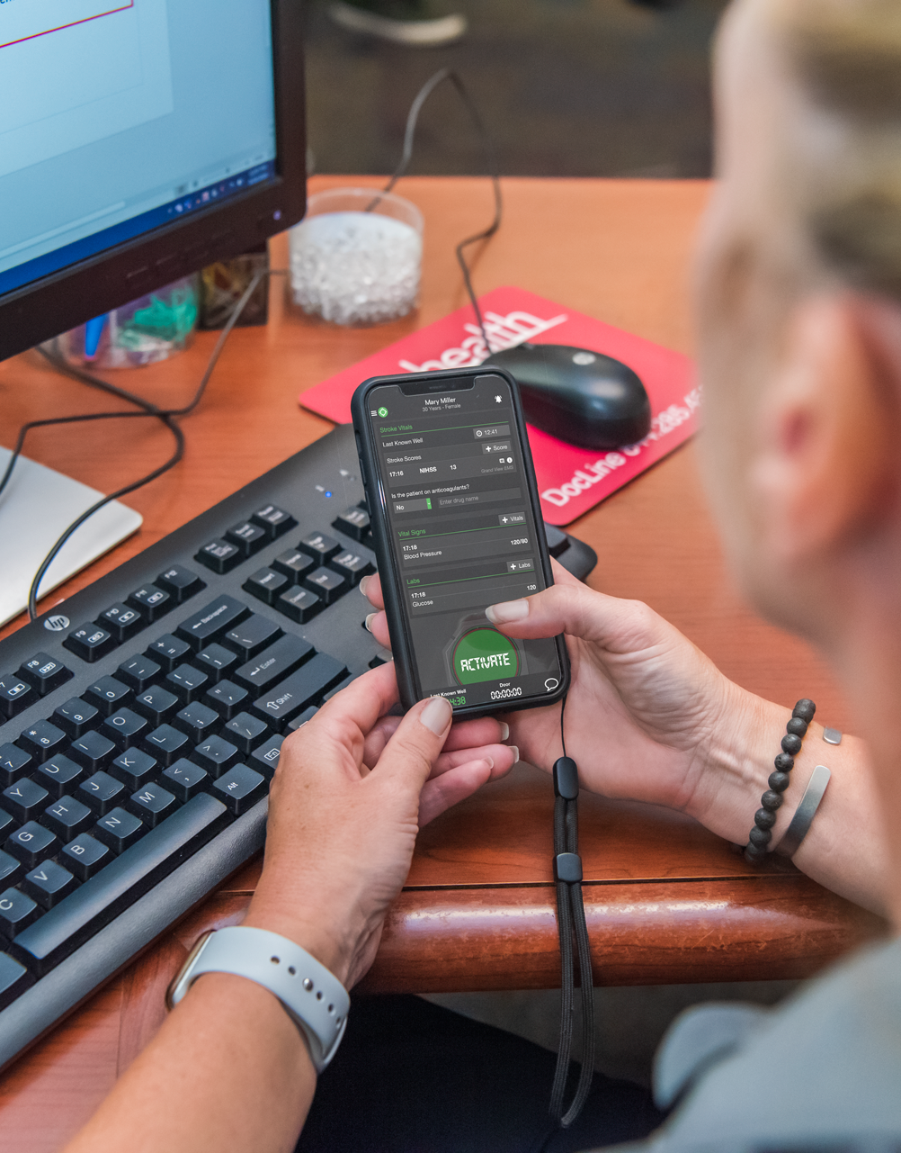
Alerting Basics (Who, How, When)
WHEN
Method of Arrival
Prehospital (EMS Alert) Options
  When prehospital sends initial notification
  When ED “Activates”
ED Activation
Inpatient Activation
Transfer Requested
Transfer Accepted
Consult Requested
Manual
Team or Individual
Time Sensitive Emergency Event Triggered
Stroke: Suspected LVO, CT Complete, CTA Complete
Trauma: Level
Alerting | Who, How, & When
Notes:
For instance, a hospital can alert both the Transfer Center and On-Call Cardiologist immediately when the request is made or only alert the Transfer Center who can add the On-Call Cardiologist if appropriate.

Slide 11
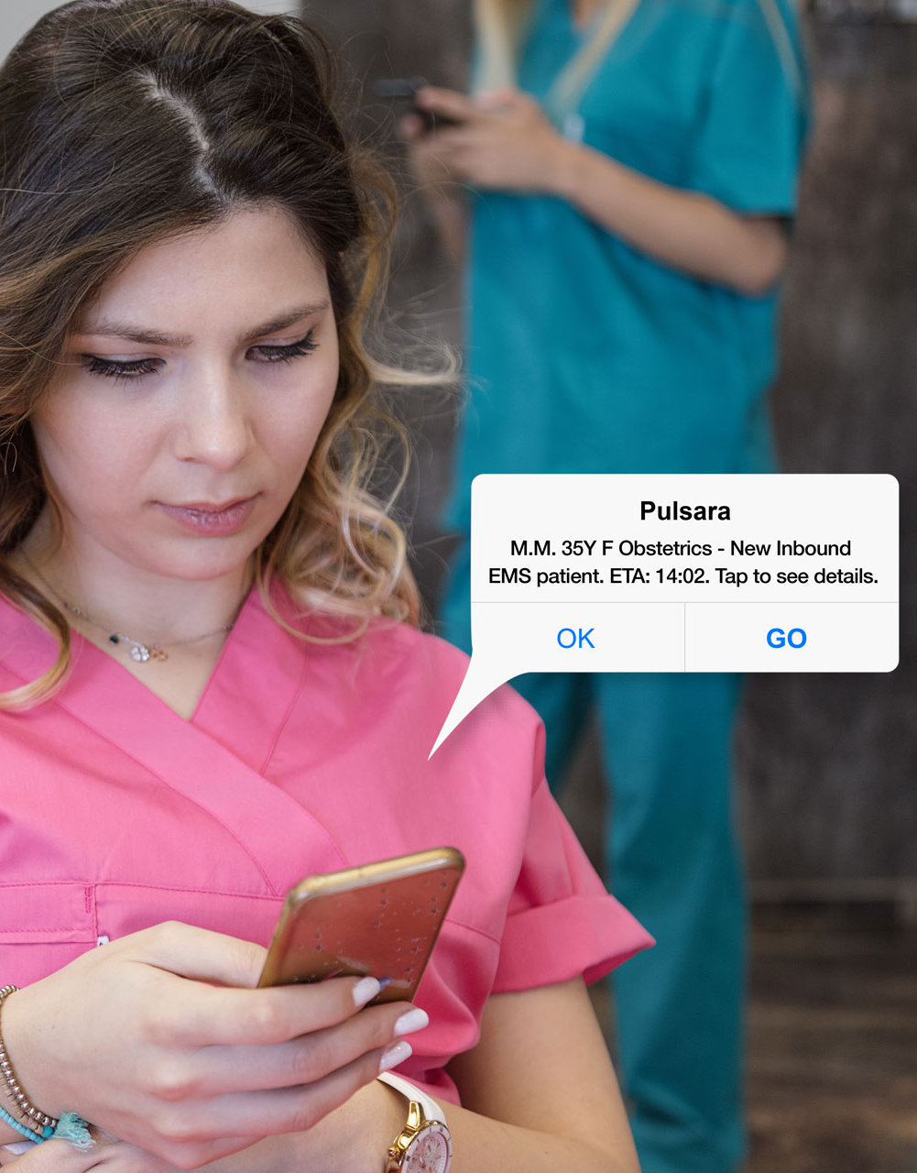
Hospital Call Status
MANAGE
Toggle ON/OFF
Set NEXT ON / OFF
Admin can Set Call Status
Integrate with Calendar
VISIBILITY ON TEAM SCREEN
Call Status of Individuals
Acknowledgement Status of Individuals
Silence Alerts Status of Individuals
MANUAL
Assign to individual in real time regardless of call status
How To’s
Notes:
Managing call status is straightforward for care team members. The easiest approach is to integrate call status with your calendar for automatic updates. Alternatively, individuals can manually toggle their status or schedule upcoming on-call or off-call times. Administrators also have the flexibility to adjust call statuses as needed.
Additionally, a Transfer Center Agent can reference another source for call status and manually add any individual to a patient channel, regardless of their current call status in Pulsara.
Each patient channel includes a Team Screen that displays all organizations involved, along with every individual and their role at each organization assigned to the case. Transfer Agents can also see when each individual has acknowledged their alerts, ensuring clear and efficient communication.

Slide 12
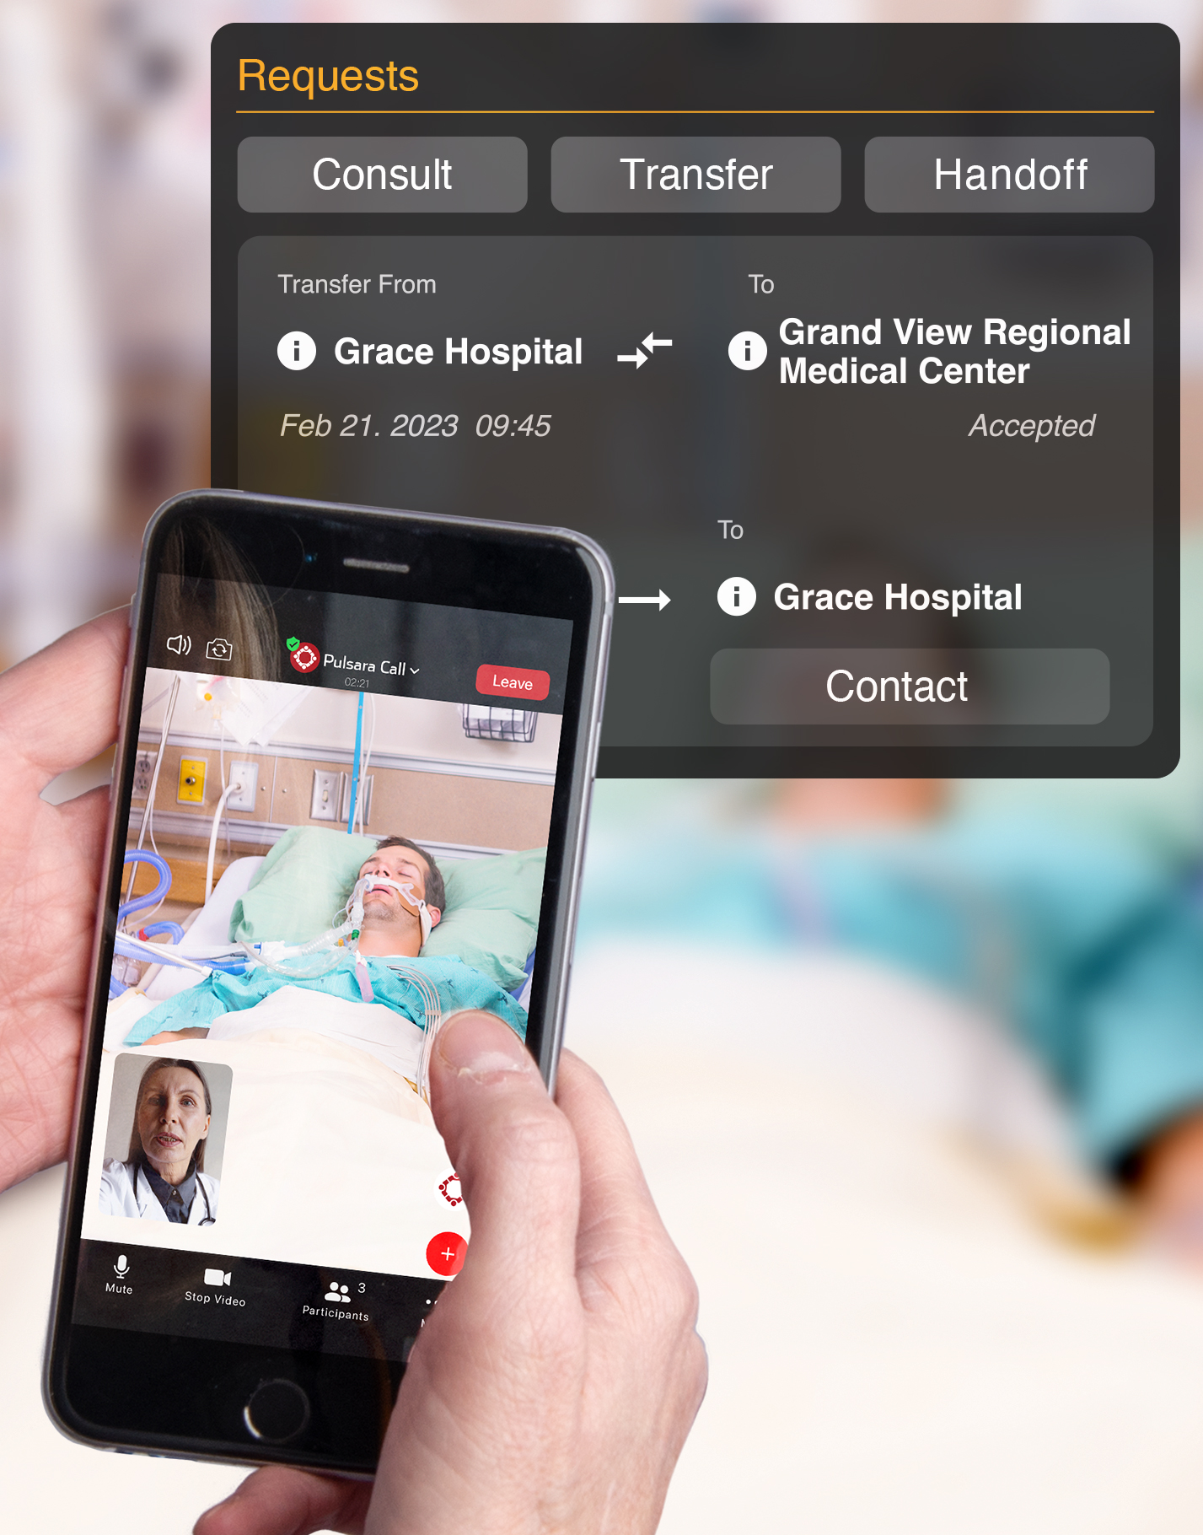
Transfer Operations Value
Streamline Communication
Swap endless calls for secure messaging, letting agents manage multiple messages while avoiding missed calls, voicemails, and communication gaps.
Boost Efficiency & Scalability
Help agents handle multiple patients simultaneously, avoid bottlenecks during peak demand, and reduce time spent chasing on-call providers or repeating the same information.
Enhance Situational Awareness
Give everyone real-time updates on transport ETAs, clinical status, and patient acceptance for clear coordination.
Reduce Delays & Improve Care
Speed up acceptance times by ensuring critical initial notifications include enough information to avoid repeated follow-ups, enabling faster decision-making and definitive care.
Strengthen Referral Networks
Foster collaboration across organizations with with free referral participation, solving ‘no callbacks’ and ‘who to contact’ issues with clear communication channels.
Research Confirms Improvements
Notes:
Uniting care teams on a dedicated communication channel has been studied for over a decade. Research shows that Pulsara improves treatment times, care team satisfaction, and hospital economics.

